Slide 1
openSUSE Tumbleweed
- how it does keep rolling!
Max Lin – Software Engineer
mlin@suse.com

Slide 2

What is Tumbleweed
A pure rolling release version of openSUSE
Tumbleweed contains the latest stable applications
Tumbleweed is based on Factory, openSUSE's main development codebase
The core system packages receive automated testing via openQA

Slide 3
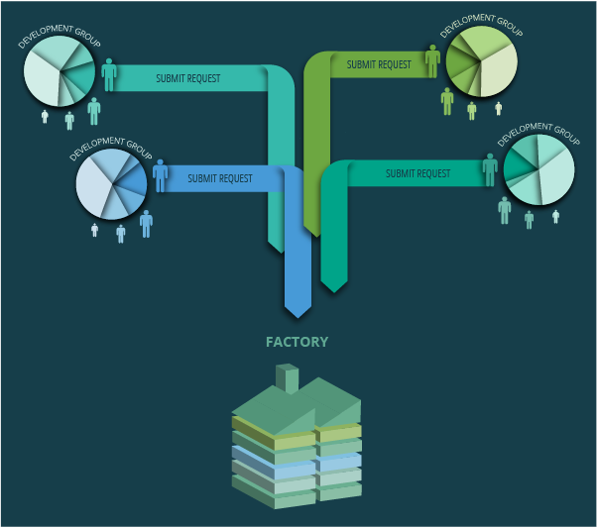
Development workflow

Slide 4
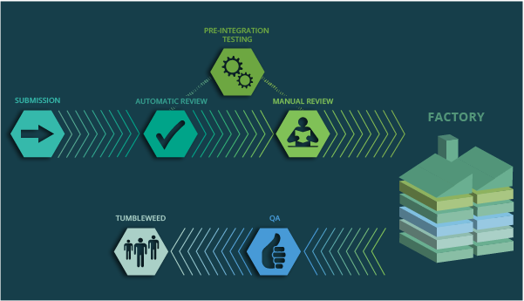
Process

Slide 5
Reviews
Creating
Devel Project
Submit Request
Factory-Auto
Legal-Auto
Repo-Checker
Staging Mgr
Manual Review
Security/Legal Check
openQA Testing
Staging Project
Release Mgr
Factory
download.o.o

Slide 6
Reviews(cont.)
Factory-Auto: checks basic rules and adds additional reviewers
Legal-Auto: checking if the license of the package is in the permitted license database
Review Team: human check of the request
Repo-Checker: a more deeper automatic check
Factory-Staging: review by Staging Manager (manual check and assisted by repochecker and openQA)

Slide 7
Repo Checker
Build result verification, including sub-package
The binary files is installable
Checks the conflicts with other packages
Checks the source was changed in the devel project but not in the submission
Detecting new build cycle
Checks the validation of delete request as far as possible
Commenting on the request if found the problem

Slide 8
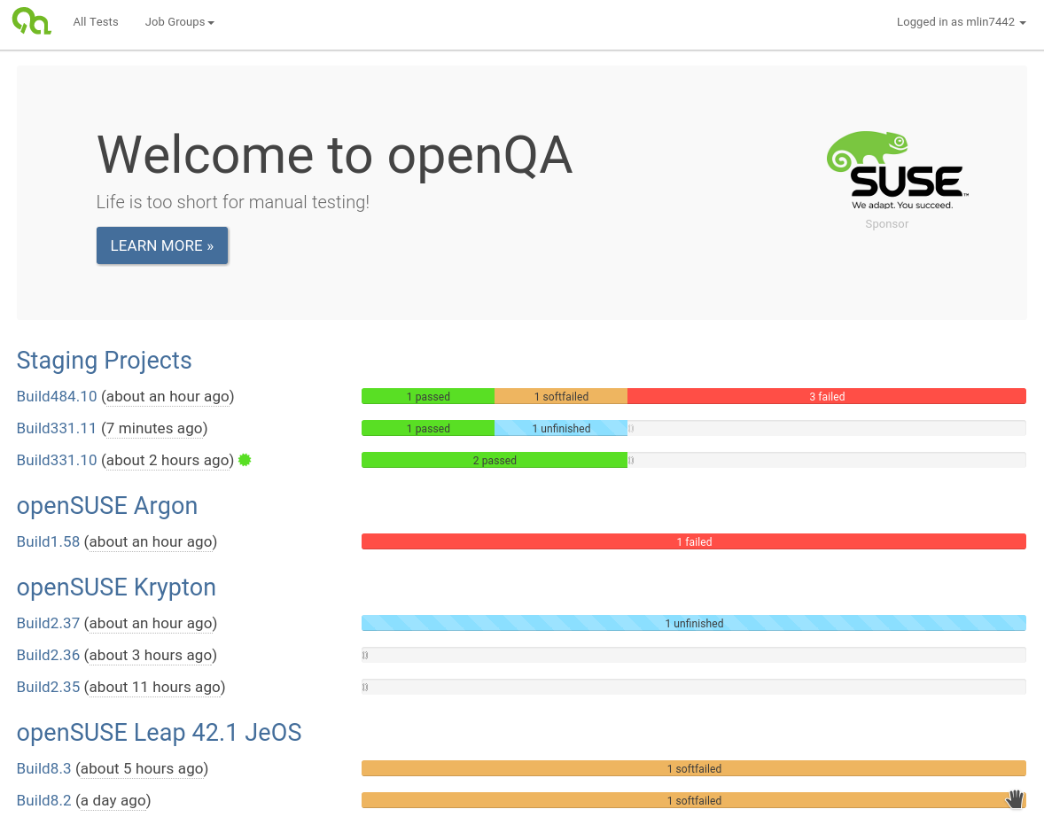
openQA

Slide 9
Rings and Staging Project
Rings:0-Bootstrap : bootstrap packages (108 packages)
Rings:1-MinimalX : everything for minimal X environment (1160 packages)
Rings:2-TestDVD : a pretty much complete DVD (1096 packages)
Staging:A-J : staging for ring 1 packages
Staging:A-J:DVD : staging for ring 2 packages
Staging:adi:* : staging for others packages not in the Rings

Slide 10
openQA Tests
Normal installation
Installation on RAID partition(software RAID)
Installation with cryptlvm enabled
Installation on UEFI environment
Boot into rescue system
Console tools test
Minimal-X/GNOME/KDE environment work
Update system to current staging from Leap 42.1 or old staging
Only test the stuff were in the staging DVD

Slide 11
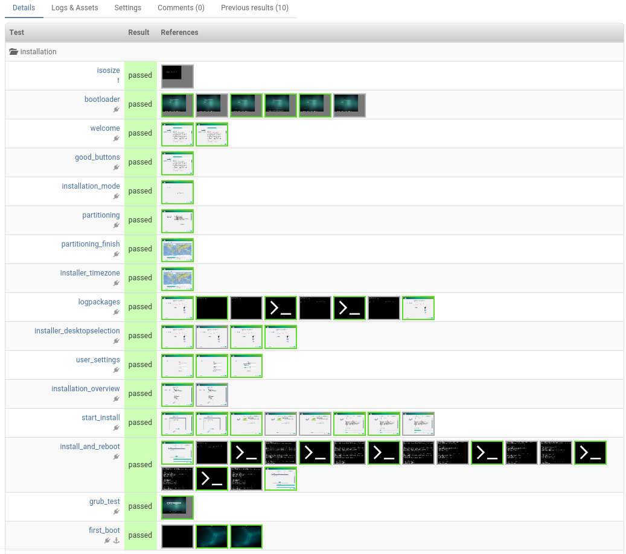
Test result on openQA

Slide 12
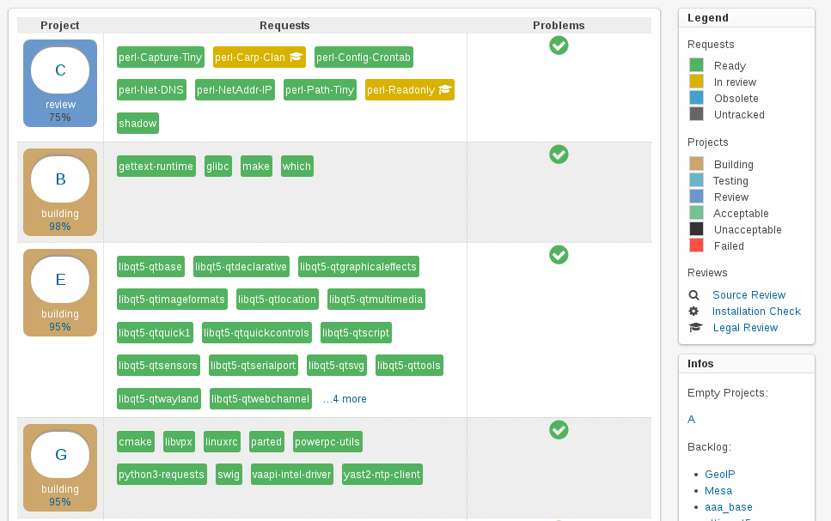
Staging Dashboard

Slide 13
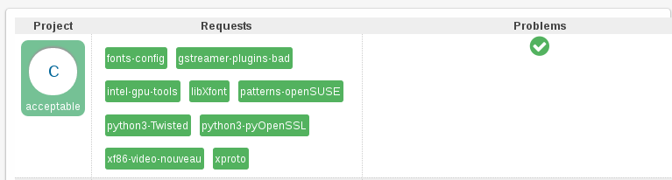
Acceptable
No build failures
All reviews were accepted
Passed openQA testing

Slide 14
After an check-in
Rebuilding the changes in openSUSE:Factory
Update package-lists if needed
Generate an new snapshot DVD
The online repository is in a consistent state
More openQA testing!
^ When everything is done – publish the new Tumbleweed and sync the repository to the download mirrors.

Slide 15
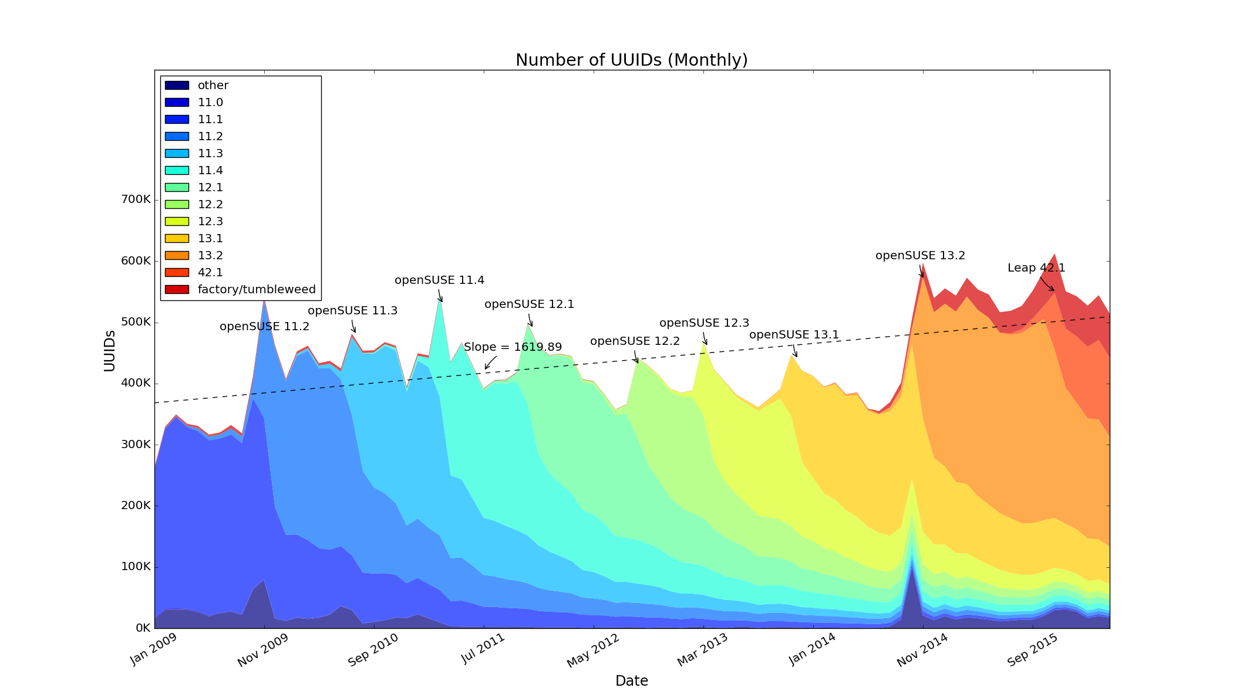
Numbers

Slide 16
Working together
opensuse-factory@opensuse.org mailing list
opensuse-packaging@opensuse.org mailing list
#opensuse-factory IRC channel
Dominique Leuenberger
Ludwig Nussel
Max Lin

Slide 17
Questions?

Slide 18
Join the conversation,
contribute & have a lot of fun!
www.opensuse.org

