Slide 1
KMS Dataset Knowledge Graph
Nilzelly Caroline Martins da Silva

Slide 2
Introduction
This presentation shows how I turned the GitHub CSV dataset into a small knowledge graph, checked the import and used Cypher queries to understand the study programmes.
My goal was to understand how the CSV files were connected and then build a graph that I could explore with Cypher queries.

Slide 3
objectives
Why is a knowledge graph important?
The dataset is about connections: programmes have courses, courses have topics and courses also have learning outcomes. Using Neo4j made it easier for me to see how programmes, courses, topics and learning outcomes are connected.
Explore the dataset from the GitHub repository.
Build a graph schema from the node and edge CSV files.
Import the graph into Neo4j AuraDB Free.
Run Cypher queries and explain what the results mean.

Slide 4
Dataset and maping idea
Node files
Relationship files
nodes_study_programs.csv
StudyProgram
program+course.csv
HAS_COURSE
nodes_study_courses.csv
Course
program+study_field.csv
HAS_STUDY_FIELD
nodes_course_topics.csv
Topic
course+topic.csv
HAS_TOPIC
nodes_learning_outcomes.csv
LearningOutcome
course+learning_outcome.csv
HAS_LEARNING_OUTCOME
StudyField
nodes_study_fields.csv

Slide 5
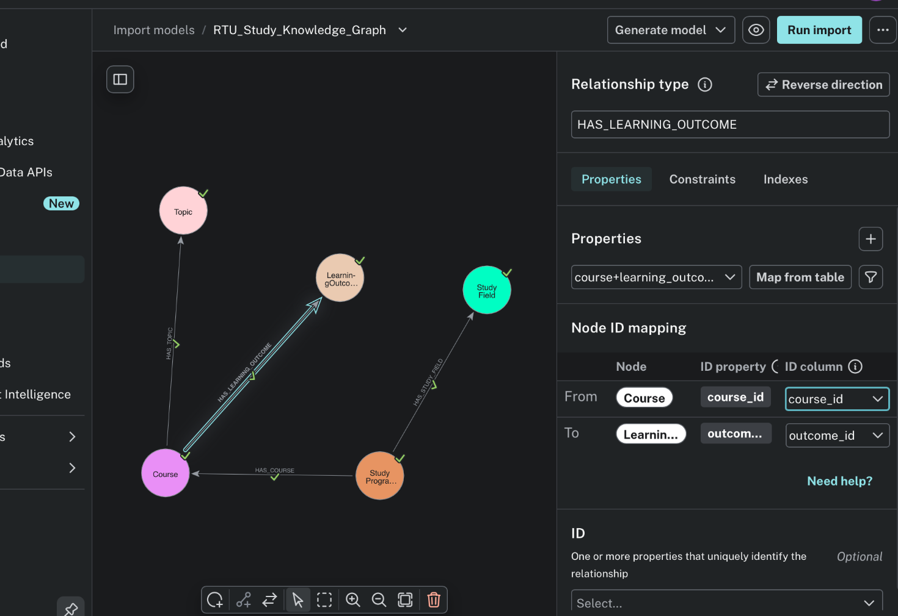
Graph schema
This is the schema I built before running the import.
StudyProgram connects to Course.
Course connects to Topic.
Course connects to LearningOutcome.
StudyProgram connects to StudyField.
How to read it
This screenshot proves that the schema was designed manually before importing.

Slide 6
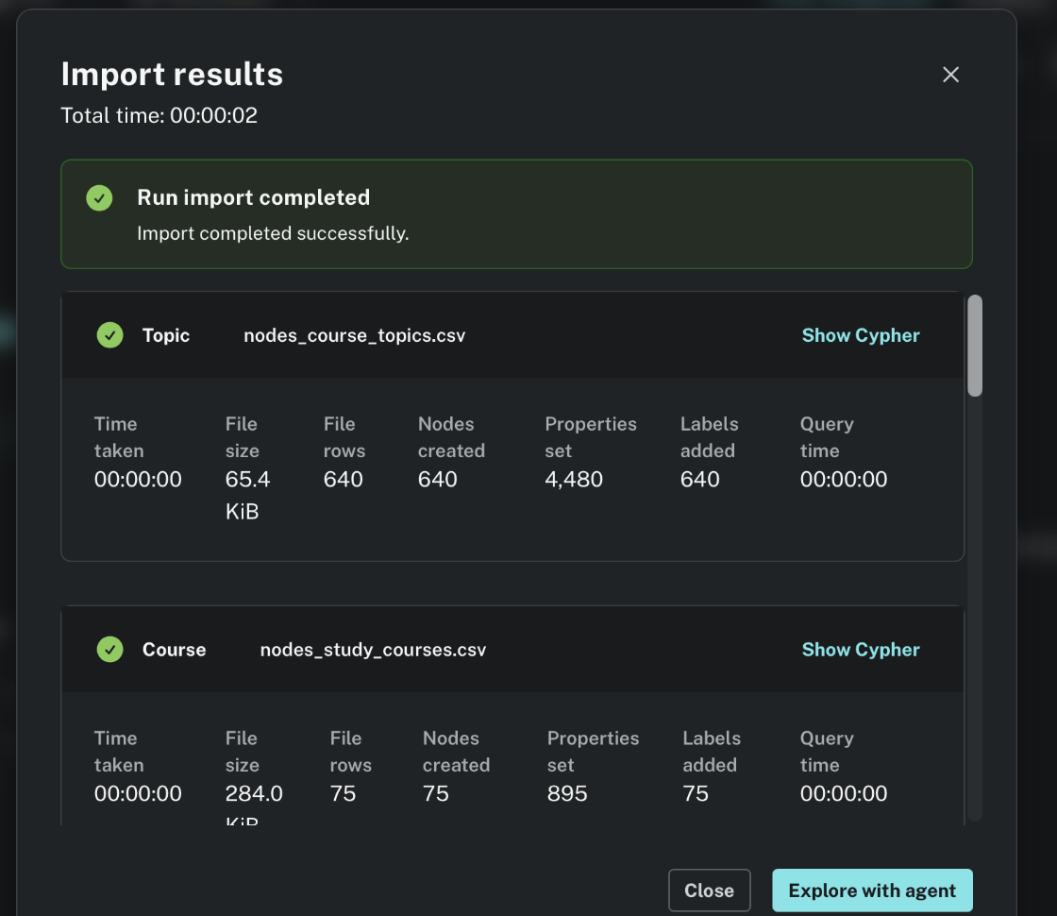
Import into auradb
After mapping the schema, I ran the import in my AuraDB Free instance
Import completed successfully
The import result confirms that the CSV files were processed and nodes were created in Neo4j. After the import was completed, I could finally see the dataset as a connected graph.
640
Topic nodes created
75
Course nodes created

Slide 7
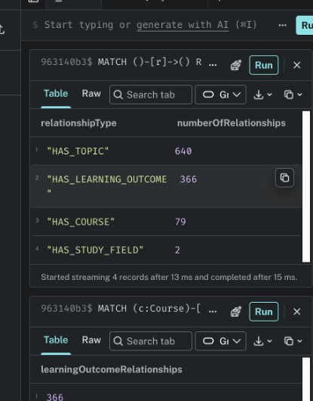
Quick validation check
Before I analyze the graph, I checked wether all relationships types were present.
Relationship count
640
HAS_TOPIC
366
HAS_LEARNING_OUTCOME
79
HAS_COURSE
2
HAS_STUDY_FIELD
I had to correct the Course → LearningOutcome mapping once. After fixing it, the 366 relationships appeared correctly.

Slide 8
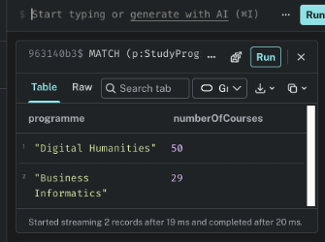
Query 1 – course per programme
This query answers a simple question: how many courses does each programme have?
Main result
50
Digital Humanities courses
29
Business Informatics courses
In this dataset, Digital Humanities has the larger course structure.
MATCH (p:StudyProgram)-[:HAS_COURSE]->(c:Course)
RETURN p.title AS programme, count(c) AS numberOfCourses
ORDER BY numberOfCourses DESC;

Slide 9
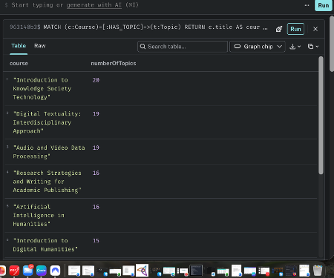
Query 2 – courses with the most topics
This helped me see which courses have more learning outcomes attached to them.
What stood out
•
Introduction to Knowledge Society Technology has 20 topics.
•
Digital Textuality: Interdisciplinary Approach has 19.
•
Audio and Video Data Processing also has 19.
For me, this suggests that these courses cover more topics or divide the content into smaller parts.

Slide 10
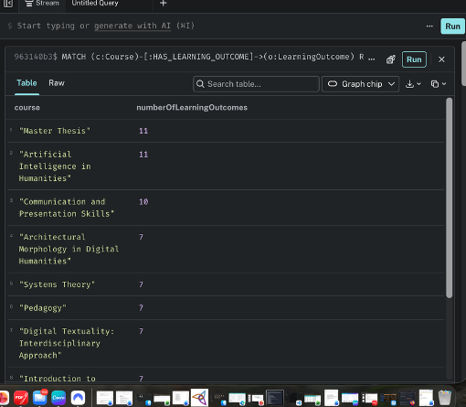
Query 3 – courses with the most learning outcomes
This query shows where the most learning outcomes are attached.
Top results
•
Master Thesis has 11 learning outcomes.
•
Artificial Intelligence in Humanities also has 11.
•
Communication and Presentation Skills has 10.
This makes it easy to spot courses with a larger number of explicitly described objectives.

Slide 11
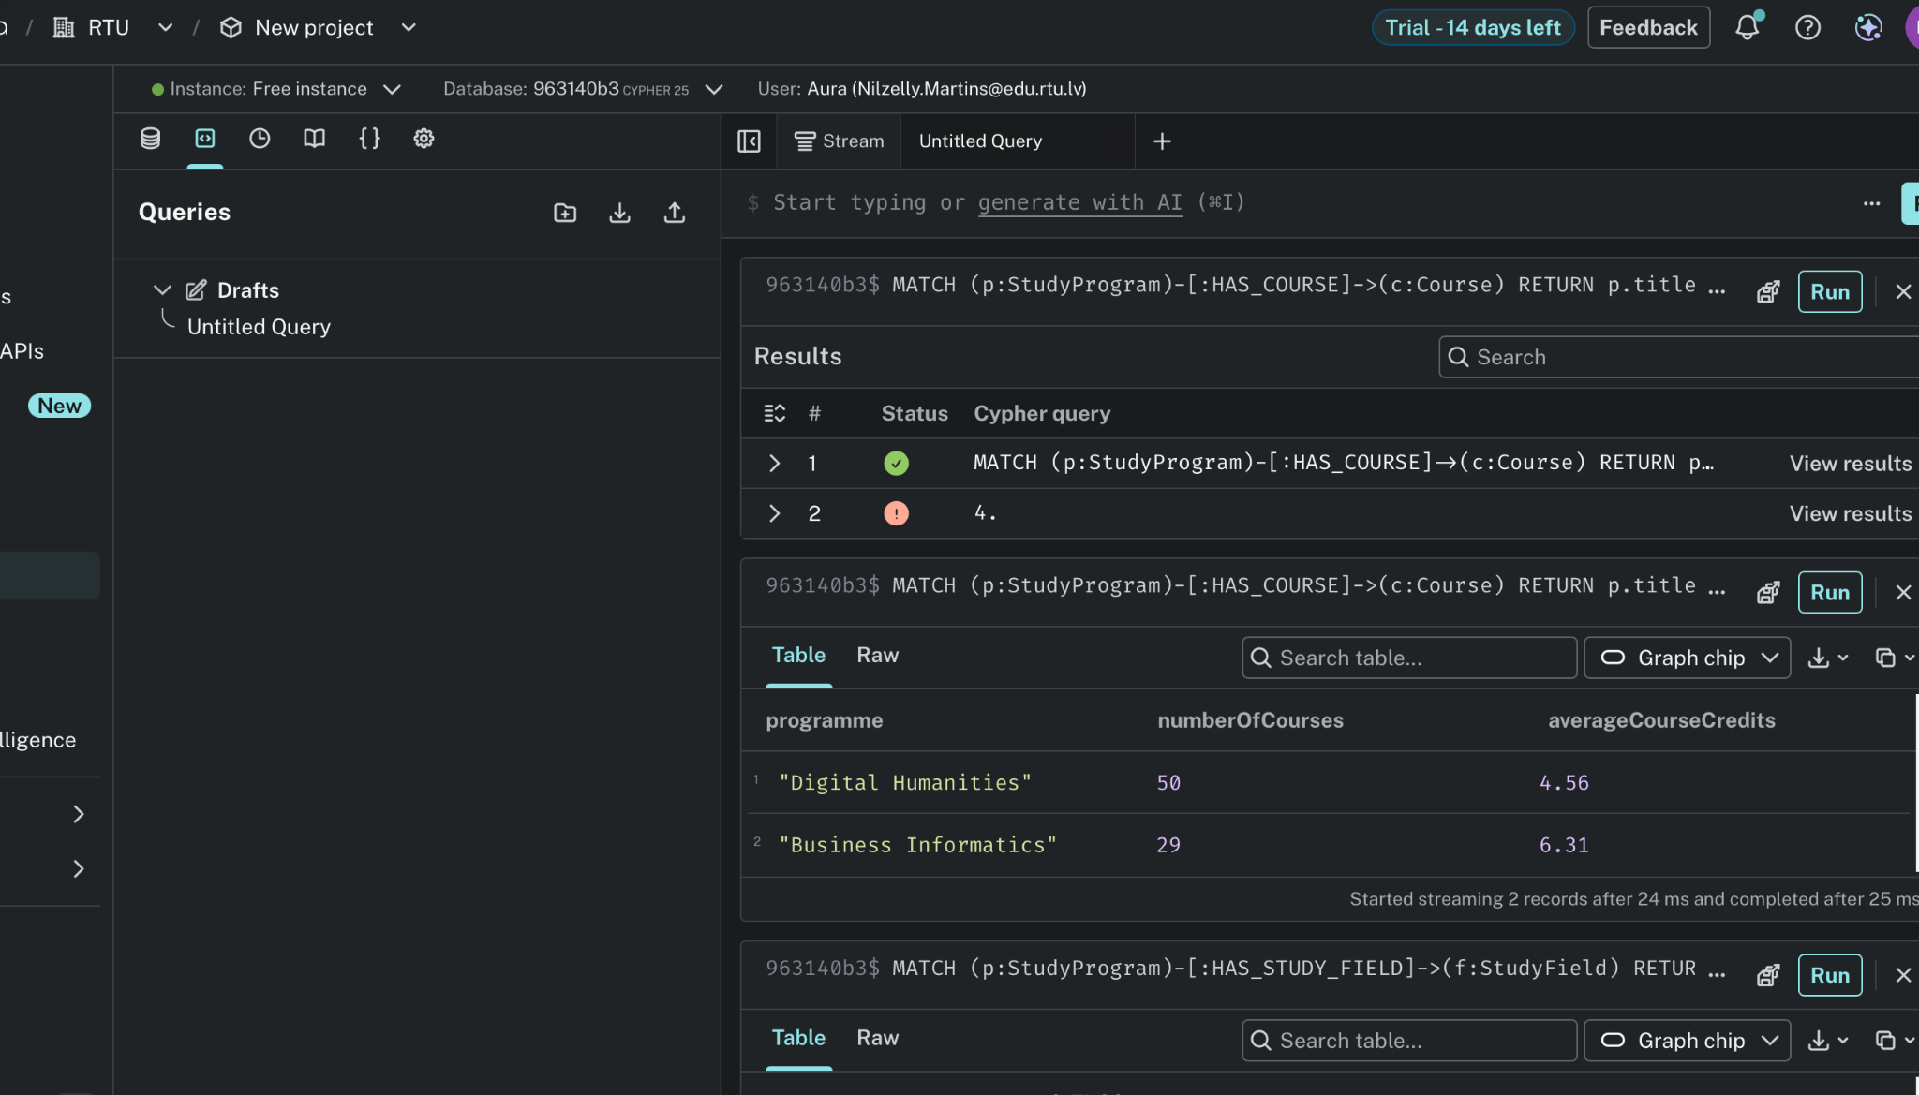
Query 4 – course load and average credits
This query compares programme size with average course credits.
A useful comparison
Digital Humanities has more courses, but the average credit value is lower.
Business Informatics has fewer courses, but the average credit value is higher.
Digital Humanities: 50 courses, 4.56 avg credits
Business Informatics: 29 courses, 6.31 avg credits

Slide 12
conclusion
This was my first time working with Neo4j, so at the beginning I found the nodes, relationships and ID mappings quite confusing. After building the graph and fixing some mapping mistakes, I understood much better how the different CSV files were connected.
The results also made the dataset easier for me to understand. I could see that Digital Humanities has more courses, while Business Informatics has a higher average number of credits per course. I was also able to see which courses had the most topics and learning outcomes.
For me, the most useful part of the assignment was seeing how separate CSV files could become one connected graph that I could explore with queries.

