Slide 1

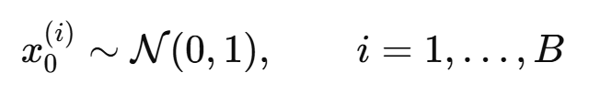
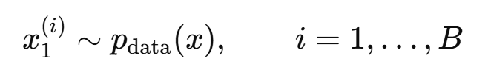


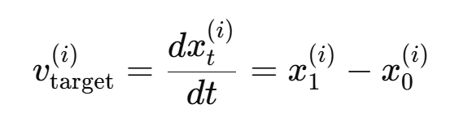
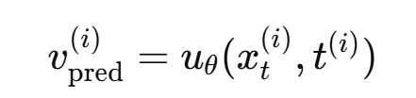
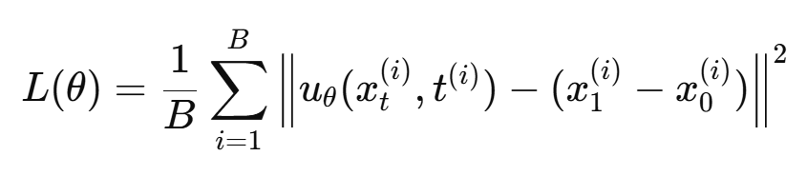
x₀: Gaussian noise → x_{t}: データ画像の学習
for step in range(n_iter):
x0 = torch.randn(batch_size, 1, device=device) # Gaussian noise
x1 = sample_target(batch_size) # data
t = torch.rand(batch_size, 1, device=device)
x_t = (1 - t) * x0 + t * x1
v_target = x1 - x0
v_pred = model(x_t, t)
loss = ((v_pred - v_target) ** 2).mean()
opt.zero_grad()
loss.backward()
opt.step()
losses.append(loss.item())
if step % 500 == 0:
print(step, loss.item())

Slide 2

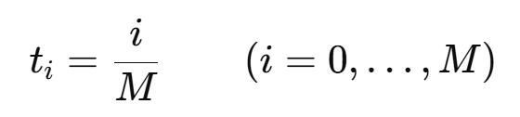

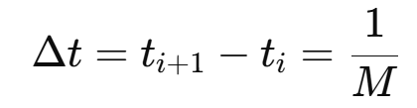
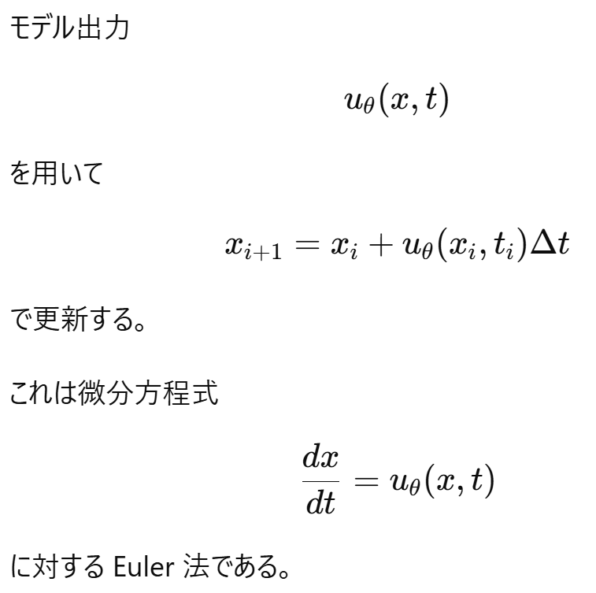
x₀: Gaussian noise からt=1の画像生成
@torch.no_grad()
def sample(model, n=10000, n_steps=100):
x = torch.randn(n, 1, device=device)
ts = torch.linspace(0, 1, n_steps + 1, device=device)
for i in range(n_steps):
t = ts[i].expand(n, 1)
dt = ts[i + 1] - ts[i]
x = x + model(x, t) * dt
return x.cpu().numpy().ravel()

