Slide 1
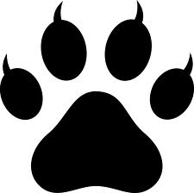
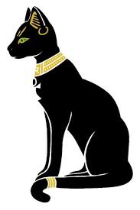

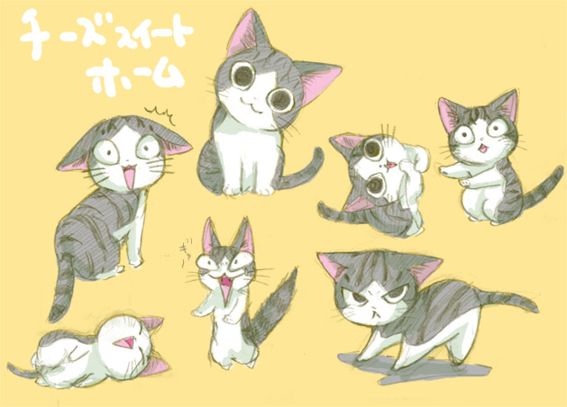
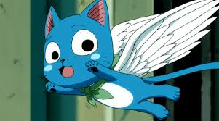
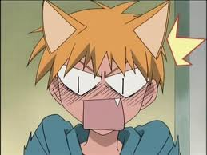
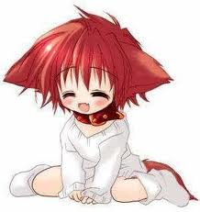
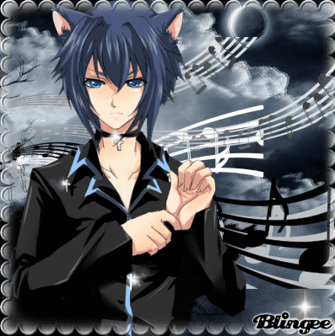
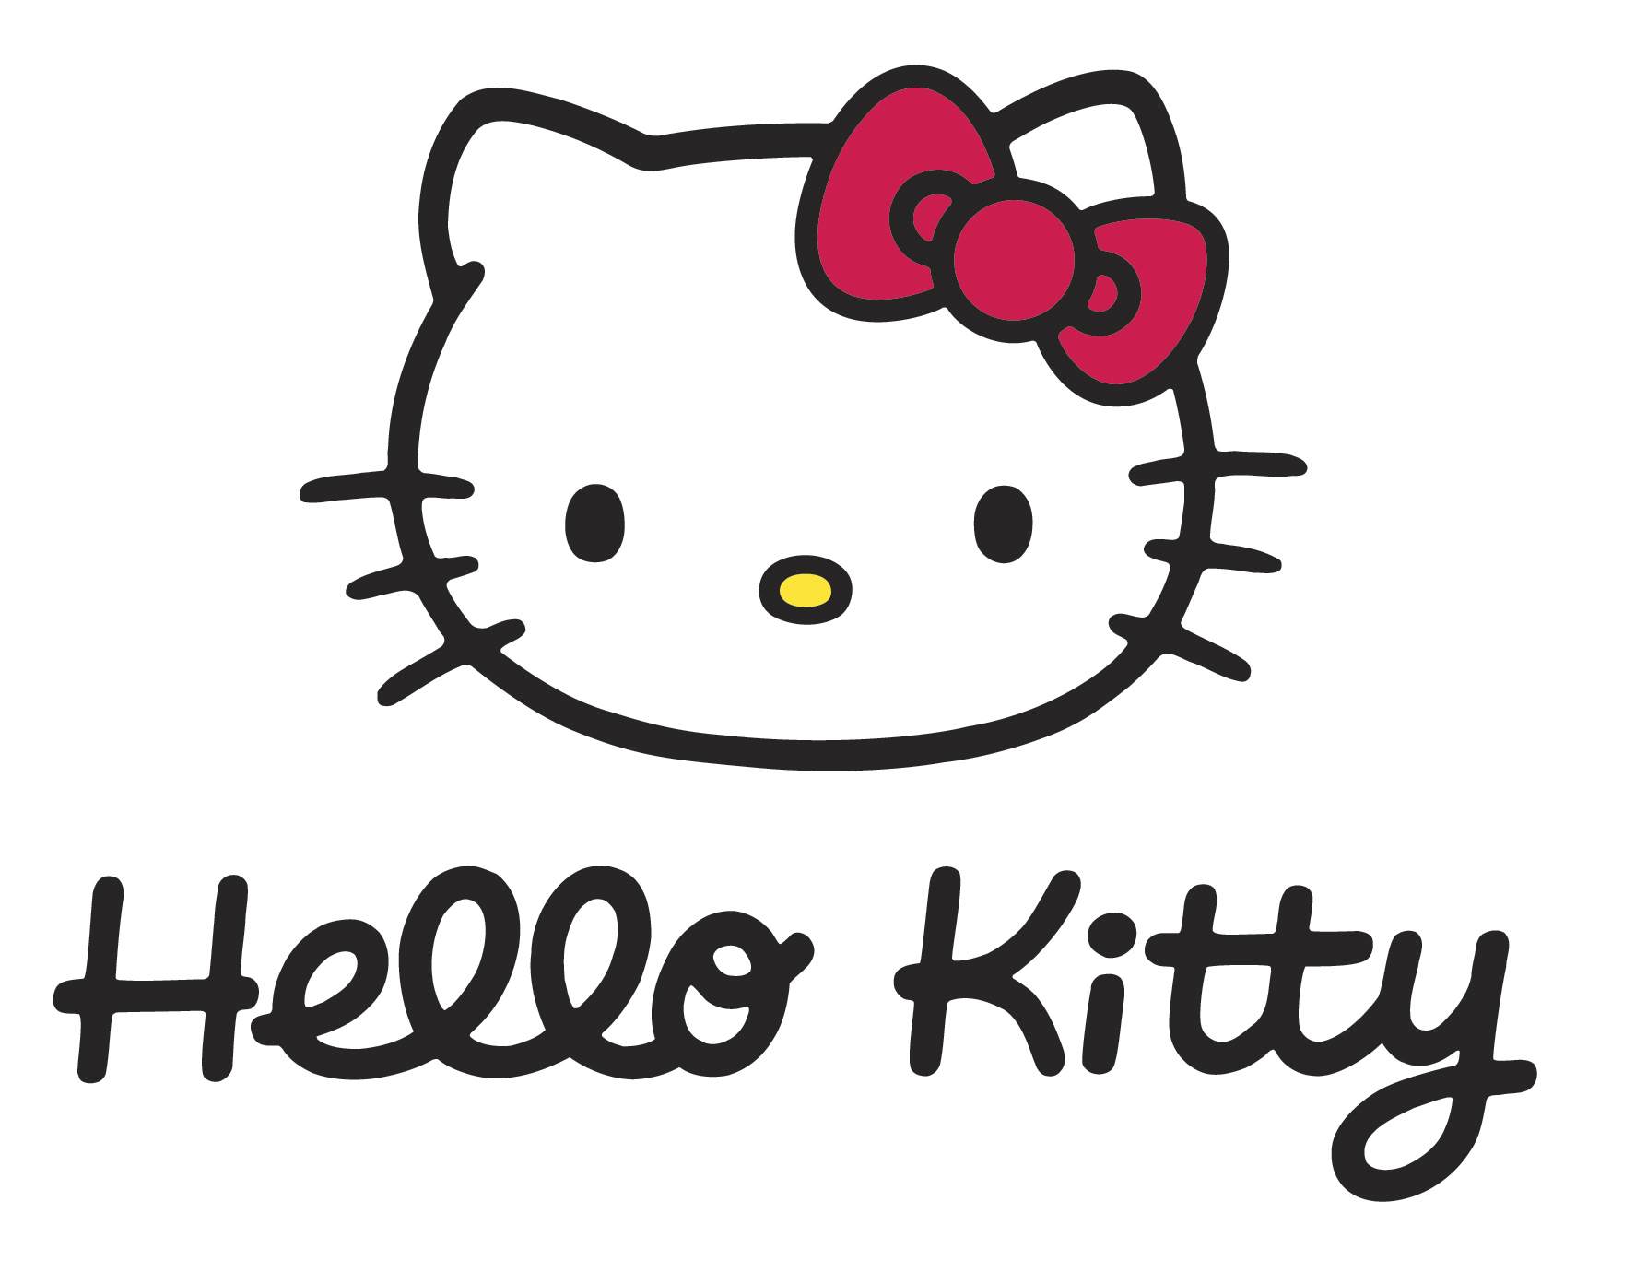

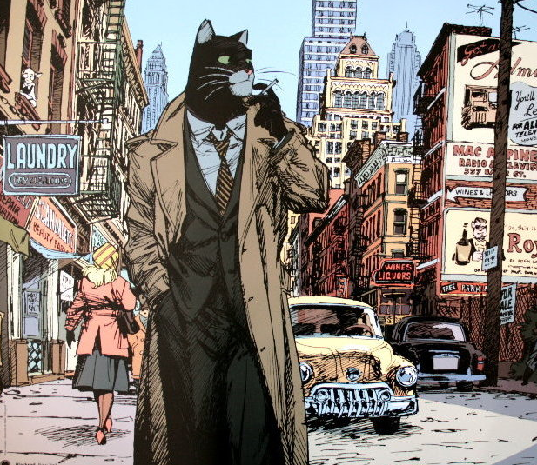
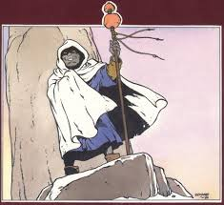
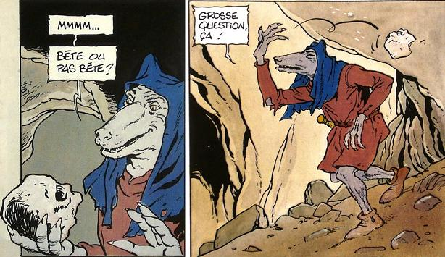
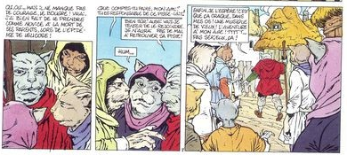
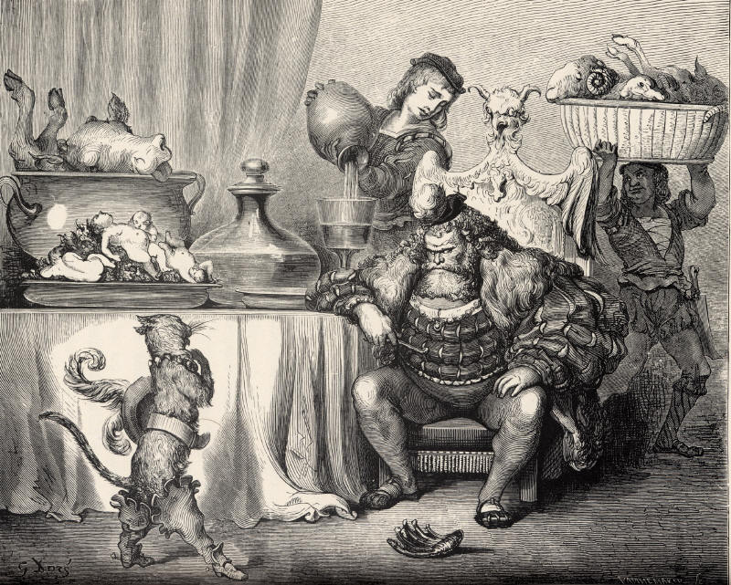
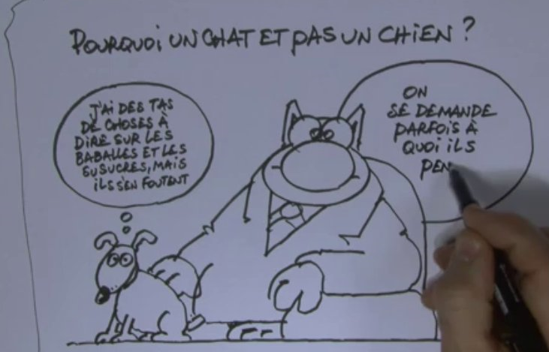
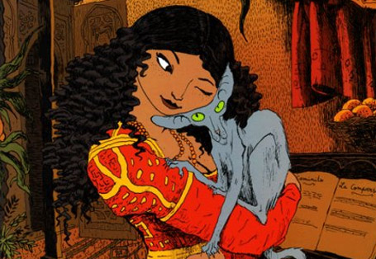

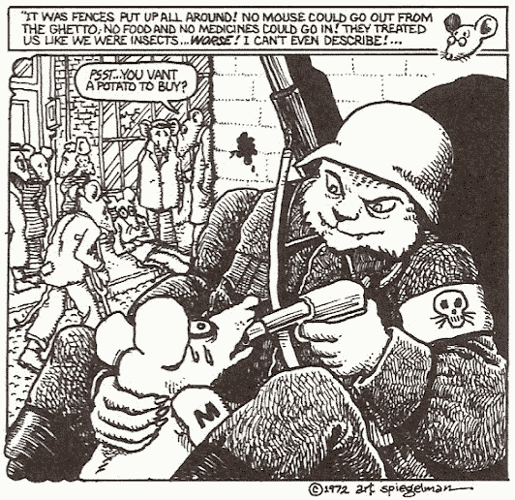
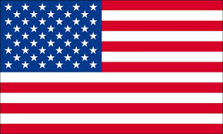
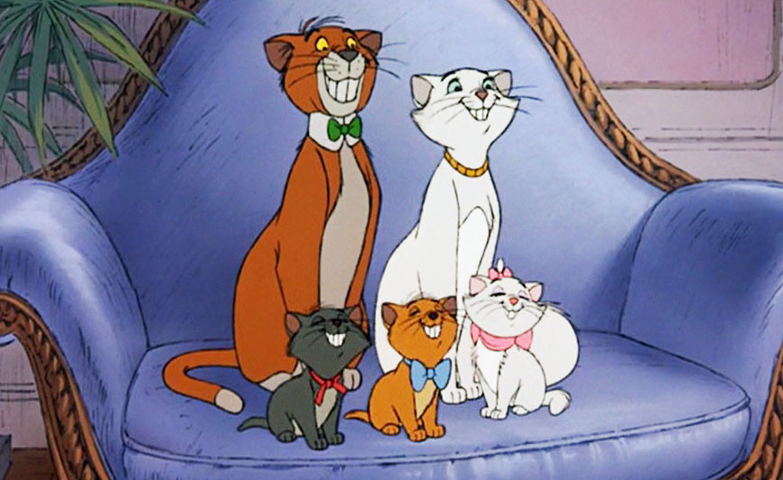
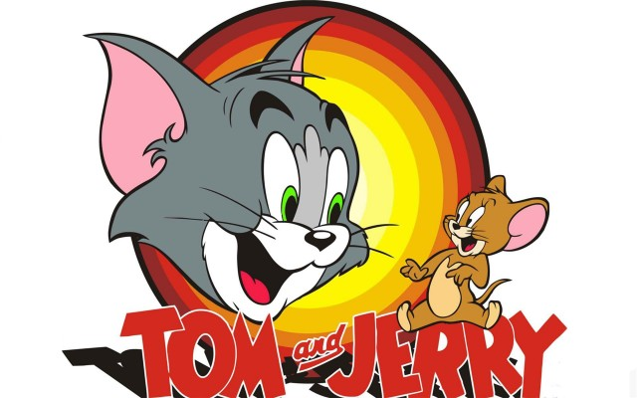
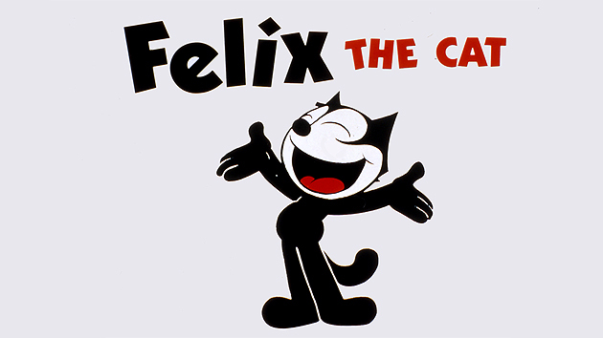
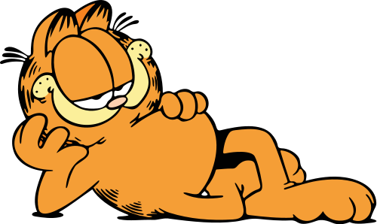
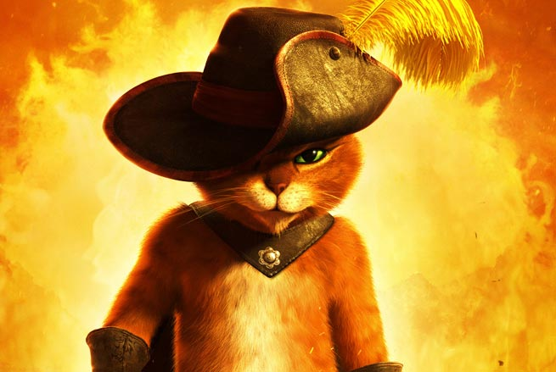


CATMANIA
A study of international fictional cats
Quitterie CAZENAVE, Ségolène TUBAU & Guilhem SAUREL
INP-ENM INP-ENSEEIHT
We can see them everywhere on the internet. They were venerated back in the ancient time as it was the case in Egypt. In the ancient time cats were domesticated because they could kill unwanted living beings such as rats or snakes. Thanks to this fact they were praised for controlling vermin and became a symbol of grace and poise. Since then they succeeded in becoming indispensable in our society. Nowadays cats are little ball of fur that are living with us as pets. Why are cats that popular?
Fictional cats in Asia
In Asia, people are so fond of cats that they became a large phenomenon. People consider cats as the cutest pet. Their demeanour, the way it moves silently, graciously and nimbly make also people consider cats as cool and stylish.
In some mangas, cats are used as mascots such as the Exceed in Fairy Tail, a race of cat-like beings using magic to fly.
There is even what we can call a cat type of character in manga. Characters with a cat-like behaviour that will be represented with cat ears.
Chi’s sweet home: in this manga, we can follow the adventures of Chi, a funny and clumsy kitten.
The popularity of cats is so considerable that we can say that there is currently a “cat phenomenon” in Japan. As an example, the matchless success of Hello Kitty.
Fictional cats in europe
The cleverness of the cat is also described in Blacksad, from Canales and Guranido where the main character is represented as a cat private detective. In this cartoon, all the characters are manlike animals.
In the devastated world created by Didier Convard in Chats, men are
In the european cartoon litterature cats are often represented as manlike characters. Describing the human world through a cat's eyes is also a way to criticize our way of life.
back to the animal state and cats and wolves evolved to become smarter.
Cat in boots, from Charles Perrault tells the story of a clever and cunning cat wearing boots and helping his poor young master to become rich.
Le Chat
Philippe
Geluck
Le chat du rabbin, from Joann Sfar is a mysterious cat who can talk but nobody knows why.
In Maus, cats represent the cruelty of the Nazi hunting and exterminating the Jews represented as mice.
Fictional cats in America
In the United States, the cats seems to appear everywhere in cartoons, comics, comic-strips and animated movies, where they can
have a very wide panel of different personalities, from the nasty cat, which tries to eat some cute animals, to the cute animal itself, which drinks milk and tries to catch the «red dot ».
The Aristocats
Tom
Felix the cat
Garfield
Puss in Boots
In 1910 lived a rich woman, without any heir. She decided to left her fortune to her cat Duchesse and its three kittens, Marie, Berlioz and Toulouse. Of course, the butler wants that fortune, and set up a plan to leave the cats into the countryside, and so the adventure begins.
Tom and Jerry has the simplest plot : the fight between a house cat and a mouse.
Most of the time, Jerry wins, making fun of Tom, but sometimes they have to cooperate for a common goal.
Felix the cat began as a very popular serie of shorts. 183 animated films have been made in 19 years, and some of them are in the public domain, and therefore freely available on the internet (http://archive.org).
Garfield is a house cat which is excessively lazy, eats obsessively and disdains work, mondays, exercise and diets. He is also pessimistic, sadistic, cynical, sarcastic, sardonic and a bit obnoxious.
In most of the strips, we can only see Garfield on a table, with Jon and/or Odie.
Based on Charles Perrault's fairy tale, this character first appeared in Shrek 2, and It now owns an eponym spin-off prequel.
Voiced by and based on Antonio Banderas, its catness stays representated by a lot of different feline gags.

