Slide 1
Geometry in 3D

Slide 2
Representation!
p
^{A}p
A
This is a point
This is not a point
This is the representation of a point

Slide 3

Rotation
Rotation matrices
$$R=\left(\begin{matrix}r00 & r01 & r02 \\ r10 & r11 & r12 \\ r20 & r21 & r22\end{matrix}\right)$$
Derivation of a matrix
$$\dot{R}=…$$

Slide 4
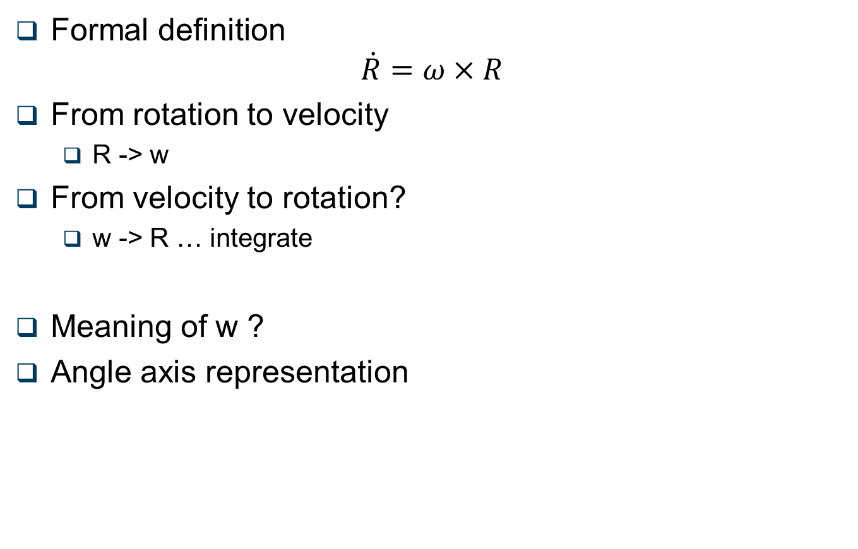
Angular velocity / Angle vector
Formal definition
$$\dot{R}=ω×R$$
From rotation to velocity
R -> w
From velocity to rotation?
w -> R … integrate
Meaning of w ?
Angle axis representation

Slide 5
Quaternions
Start from complex
1, i, -1, -i, 1 …
X, Y, -X, -Y, X …
Complexs can map the 2D plan , and the 2D rotation
Hamilton (again!) says: let’s do it more complex
j so that j² = -1 and ij = -ji
ij = k , jk = i …
x x y = z, y x z = x …
Unit quaternions map 3D rotations
q = [ w, x, y, z ] = cos(α/2), sinα/2)[a,b,c]

