Slide 1
Inverse kinematics
Chapter 3.
Pseudo inverse and redundancy

Slide 2
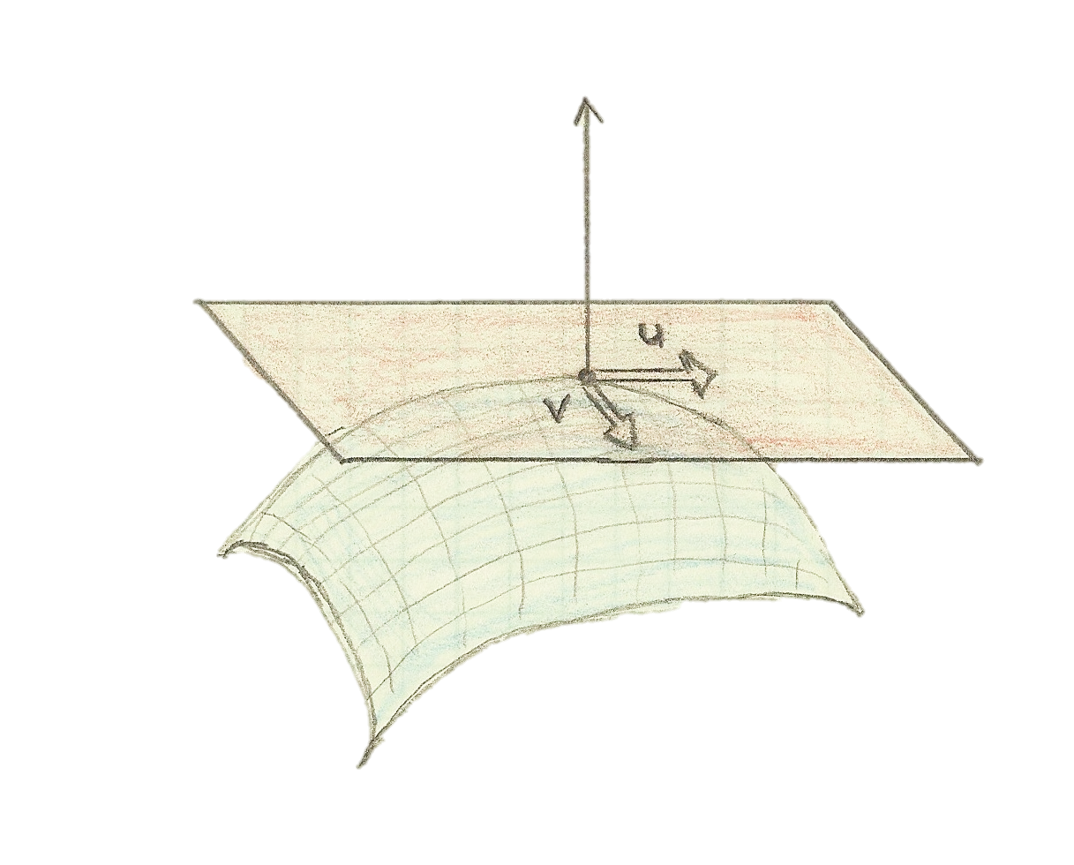

Direct and inverse functions
Direct geometry
h: q → h(q), C¹ continuous function
Direct kinematics
v: q,$\dot{q}$ → v (q,$\dot{q}$) = J(q) $\dot{q}$
Inverse geometry
Ill defined, singular points
Numerical inversion by Newton descent
Integration of the descent
Robot trajectory
Quadratic problem at each step
v₁
v₂

Slide 3
A linear minimization solution
Ax = b
If A is not invertible, two cases:
There is no way to reach b
x* = argmin ||Ax-b||
= { x, so that ||Ax-b|| = min ||Ax-b|| }
There is many optimal solutions for x
x* = min { x so that x = argmin ||Ax-b|| }
x* = min argmin ||Ax-b|| .
= A⁺ b

Slide 4
Pseudo inverse definition
The four conditions of Moore & Penrose
A A⁺ A = A
A⁺ A A⁺ = A⁺
A A⁺ is symmetrical
A⁺ A is symmetrical

Slide 5
Pseudo inverse definition
A A⁺ A = A
A⁺ A A⁺ = A⁺
A A⁺ is symmetrical
A⁺ A is symmetrical
A A⁺ A x = A x
b*: reachable point
Solution for b*
Projector
into A range

Slide 6
Pseudo inverse definition
A A⁺ A = A
A⁺ A A⁺ = A⁺
A A⁺ is symmetrical
A⁺ A is symmetrical
A⁺ A A⁺ b = A⁺ b
“twin” for b
Projector
into A kernel
Solution for b

Slide 7
A linear minimization solution
Ax=b
x* = min argmin ||Ax-b||= A⁺ b
Specific cases
If A is invertible
argmin ||Ax-b||=0
unique solution to reach the minimum
A
x
b
=

Slide 8
A linear minimization solution
Ax=b
x* = min argmin ||Ax-b||= A⁺ b
Specific cases
Few lines, many columns
It is not possible to reach ||Ax-b||=0
Unique solution to reach the minimum
A
x
b
A⁺ = (A^{T} A)⁻¹ A^{T}
=
x=a
x=b
x*
b
a
x
Notes:
Ax-b = A(x-z) + (Az –b) with z=Ap b // both being orthogonal since A’ A Ap b – b = 0

Slide 9
A linear minimization solution
Ax=b
x* = min argmin ||Ax-b||= A⁺ b
Specific cases
Few lines, many columns
argmin ||Ax-b||=0
Many solutions to reach the minimum
x₁=a
x
x₂
argmin
A
=
b
A⁺ = A^{T} (A A^{T})⁻¹
a
x₁
Notes:
Si Ax=b, A x = Ap b + x - Ap A x = Ap b + N x, both being orthogonal

Slide 10
Computing the pseudo inverse
Singular Value Decomposition (SVD)
Proof using the 4 Moore-Penrose conditions
(with UU^{T}=I and VV^{T}=I)
Might be seen as a constructive definition
A
U
σ₁
σ_{m}
V^{T}
0
0
=
…
0
0
A⁺
V
σ₁⁺
σ_{m}⁺
U^{T}
0
=
…
0
0
0

Slide 11






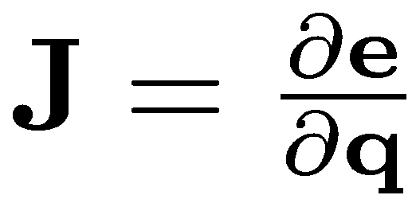
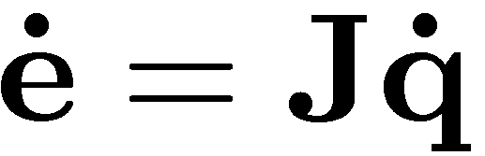



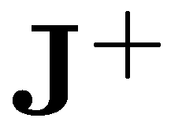

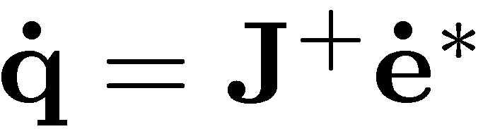
What is a task?
Robot position: Robot control input:
An error between current and desired sensor values
A reference behavior of the error
The associated Jacobian matrix
Classical control law
[Samson91],[Espiau91]
1
2
4
3
-
1
2
+
4
3
Sensor
Sensor

Slide 12
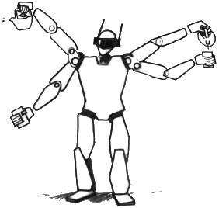
Control in the task space
position 6d
Configuration space VS task space
Easy motion specification
Reusability - versatility
Deformation of the motion
Sensor feedback
gaze
parallelism
relative
pose
position
joint
limits
center of
mass

Slide 13
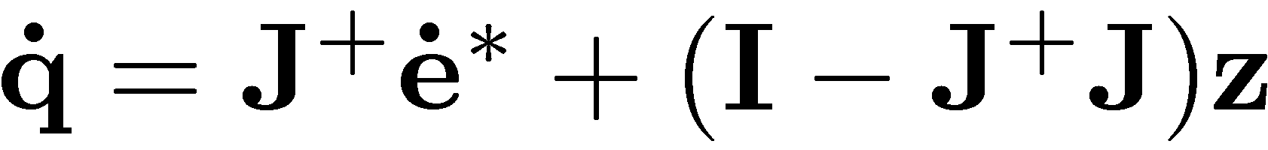



Task redundancy
z can be used to vary the trajectory (obstacle avoidance)
P
[Rosen60],[Liegeois77]
We will use z to realize at best the second elementary task
?

