Slide 1
MANE 4240 & CIVL 4240
Introduction to Finite Elements
Prof. Suvranu De
Shape functions in 1D

Slide 2
Reading assignment:
Lecture notes, Logan 2.2, 3.1
Summary:
Linear shape functions in 1D
Quadratic and higher order shape functions
Approximation of strains and stresses in an element

Slide 3
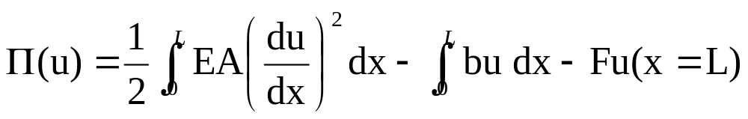
Axially loaded elastic bar
y
A(x) = cross section at x
b(x) = body force distribution (force per unit length)
E(x) = Young’s modulus
F
x
x
x=0
x=L
Potential energy of the axially loaded bar corresponding to the
exact solution u(x)

Slide 4
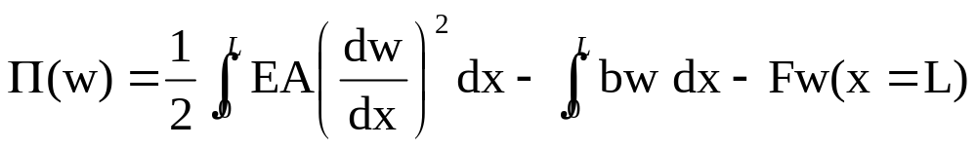
Finite element formulation, takes as its starting point, not the strong formulation, but the Principle of Minimum Potential Energy.
Task is to find the function ‘w’ that minimizes the potential energy of the system
From the Principle of Minimum Potential Energy, that function ‘w’ is the exact solution.

Slide 5
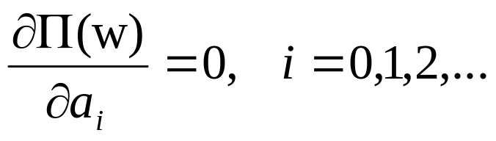
Rayleigh-Ritz Principle
Step 1. Assume a solution
Where ϕ_{o}(x), ϕ₁(x),… are “admissible” functions and a_{o}, a₁, etc are constants to be determined.
Step 2. Plug the approximate solution into the potential energy
Step 3. Obtain the coefficients a_{o}, a₁, etc by setting

Slide 6
The approximate solution is
Where the coefficients have been obtained from step 3

Slide 7


Need to find a systematic way of choosing the approximation functions.
One idea: Choose polynomials!
Is this good? (Is ‘1’ an “admissible” function?)
Is this good? (Is ‘x’ an “admissible” function?)

Slide 8
Finite element idea:
Step 1: Divide the truss into finite elements connected to each other through special points (“nodes”)
1
2
3
4
El #1
El #2
El #3
Total potential energy=sum of potential energies of the elements

Slide 9
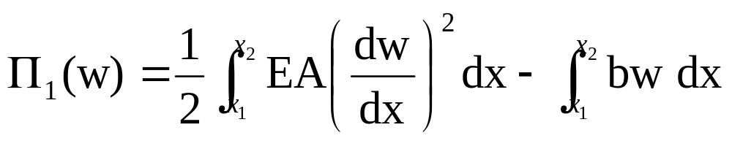
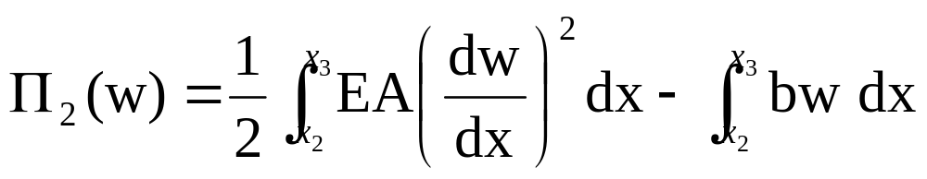
x₁=0
x₂
x₃
x₄=L
El #1
El #2
El #3
Total potential energy
Potential energy of element 1:
Potential energy of element 2:

Slide 10
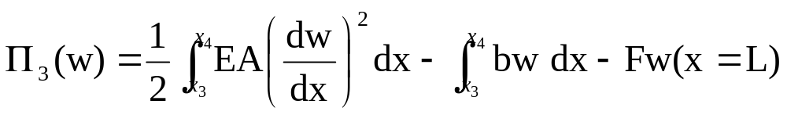
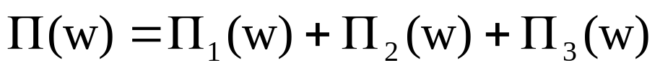
x₁=0
x₂
x₃
x₄
El #1
El #2
El #3
Potential energy of element 3:
Total potential energy=sum of potential energies of the elements

Slide 11
Step 2: Describe the behavior of each element
Recall that in the “direct stiffness” approach for a bar element, we derived the stiffness matrix of each element directly (See lecture on Trusses) using the following steps:
TASK 1: Approximate the displacement within each bar as a straight line
TASK 2: Approximate the strains and stresses and realize that a bar (with the approximation stated in Task 1) is exactly like a spring with k=EA/L
TASK 3: Use the principle of force equilibrium to generate the stiffness matrix

Slide 12
Now, we will show you a systematic way of deriving the stiffness matrix (sections 2.2 and 3.1 of Logan).
TASK 1: APPROXIMATE THE DISPLACEMENT WITHIN EACH ELEMENT
TASK 2: APPROXIMATE THE STRAIN and STRESS WITHIN EACH ELEMENT
TASK 3: DERIVE THE STIFFNESS MATRIX OF EACH ELEMENT (next class) USING THE PRINCIPLE OF MIN. POT ENERGY
Notice that the first two tasks are similar in the two methods. The only difference is that now we are going to use the principle of minimum potential energy, rather than force equilibrium, to derive the stiffness matrix.

Slide 13
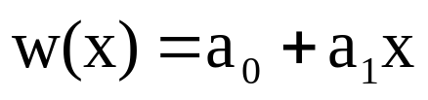



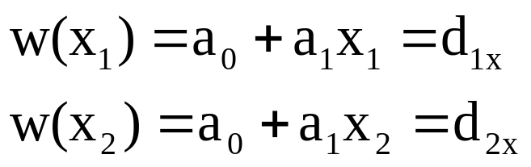
TASK 1: APPROXIMATE THE DISPLACEMENT WITHIN EACH ELEMENT
Simplest assumption: displacement varying linearly inside each bar
El #1
x₁
x₂
How to obtain a₀ and a₁?

Slide 14
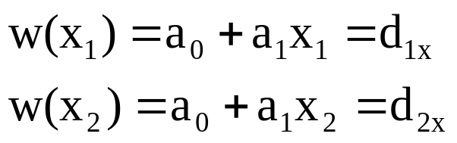
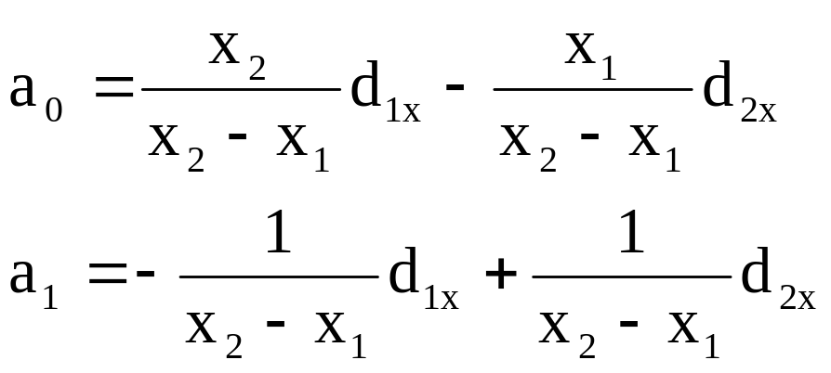
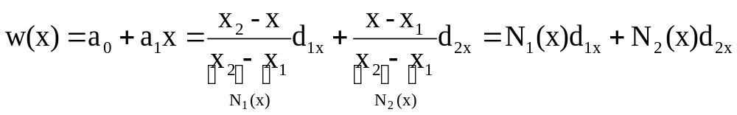
Solve simultaneously
Hence
“Shape functions” N₁(x) and N₂(x)

Slide 15

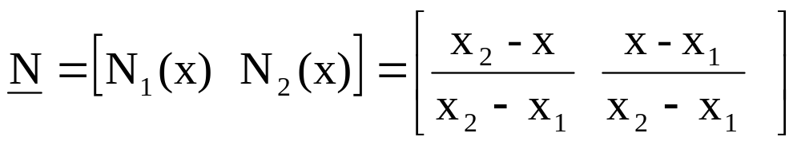
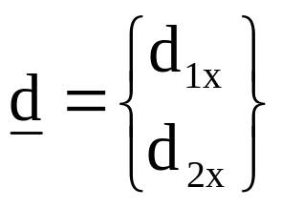
In matrix notation, we write
(1)
Vector of nodal shape functions
Vector of nodal displacements

Slide 16
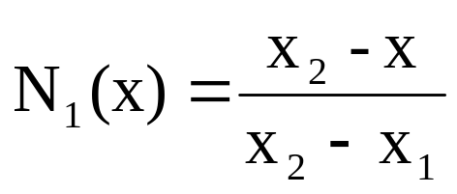
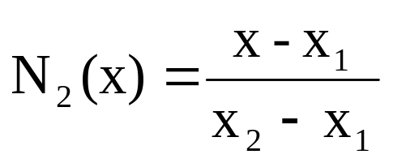
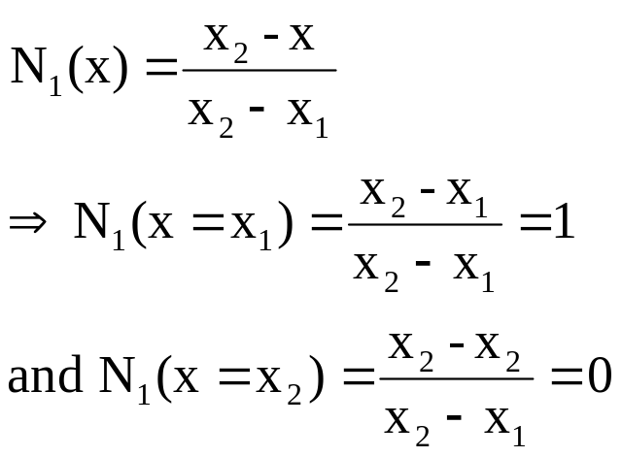
NOTES: PROPERTIES OF THE SHAPE FUNCTIONS
1. Kronecker delta property: The shape function at any node has a value of 1 at that node and a value of zero at ALL other nodes.
1
1
x₁
x₂
El #1
Check

Slide 17
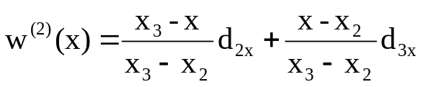
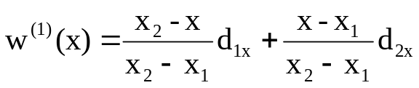
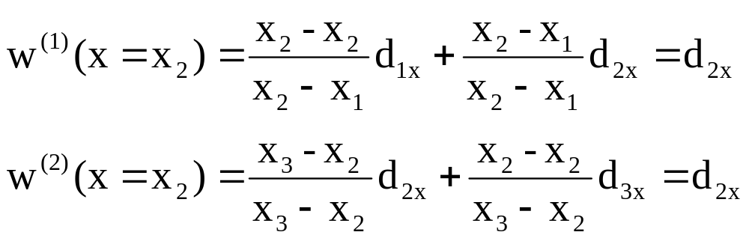
2. Compatibility: The displacement approximation is continuous across element boundaries
x₁
x₂
El #1
El #2
x₃
At x=x₂
Hence the displacement approximation is continuous across elements

Slide 18
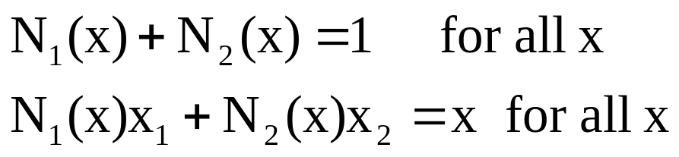
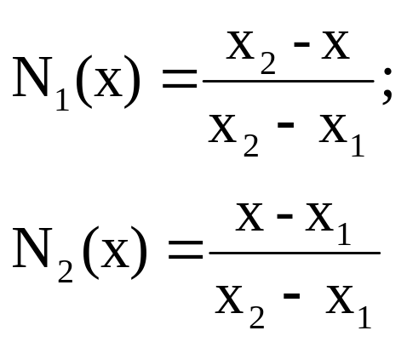
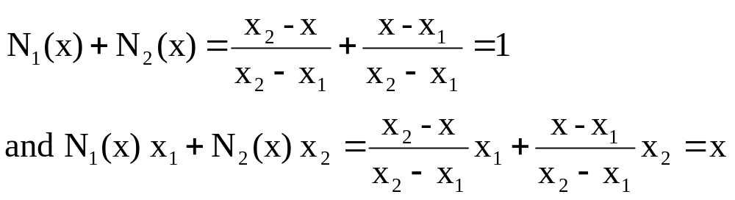
3. Completeness
Use the expressions
And check

Slide 19
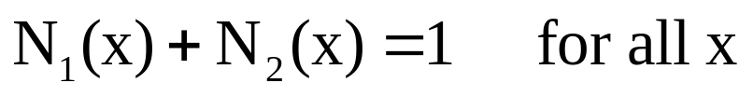
Rigid body mode
What do we mean by “rigid body modes”?
Assume that d_{1x}=d_{2x}=1, this means that the element should translate in the positive x direction by 1. Hence ANY point (x) on the bar should have unit displacement. Let us see whether the displacement approximation allows this.
YES!

Slide 20
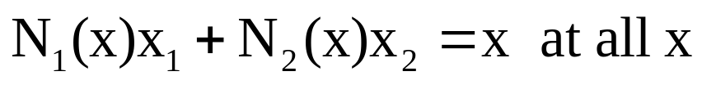
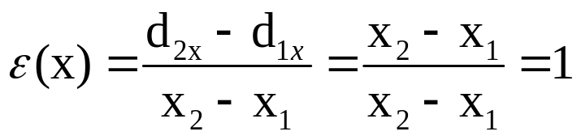
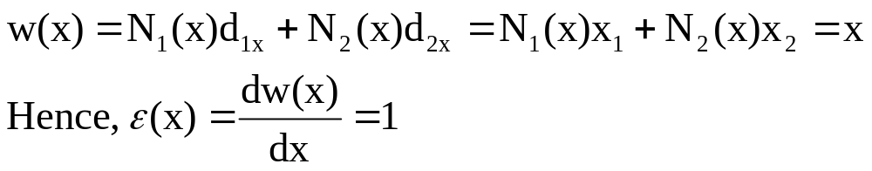
Constant strain states
What do we mean by “constant strain states”?
Assume that d_{1x}=x₁ and d_{2x}=x₂. The strain at ANY point (x) within the bar is
Let us see whether the displacement approximation allows this.
YES!

Slide 21
Completeness = Rigid body modes + Constant Strain states
Compatibility + Completeness ⇒ Convergence
Ensure that the solution gets better as more elements are introduced
and, in the limit, approaches the exact answer.

Slide 22
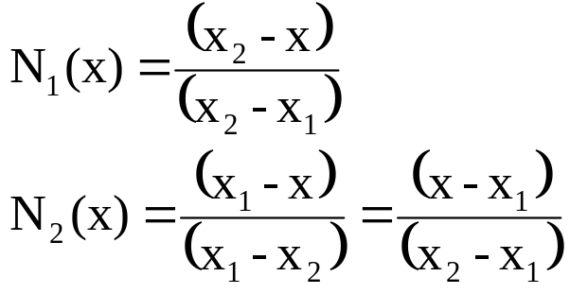
4. How to write the expressions for the shape functions easily (without having to derive them each time):
Start with the Kronecker delta property (the shape function at any node has value of 1 at that node and a value of zero at all other nodes)
1
1
x₁
x₂
El #1
Node at which N₁ is 0
Notice that the length of the element = x₂-x₁
The denominator is
the numerator evaluated at
the node itself

Slide 23



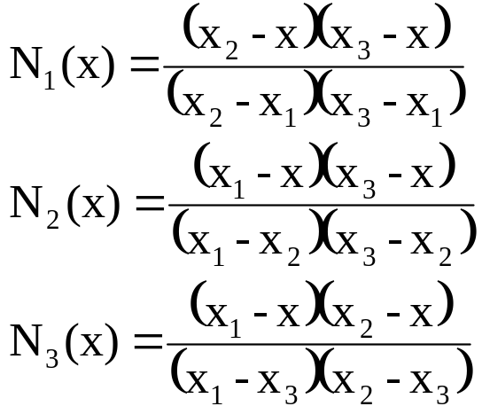
A slightly fancier assumption:
displacement varying quadratically inside each bar
1
x₁
x₂
x₃
El #1
This is a quadratic finite element in 1D and it has three nodes and three associated shape functions per element.

Slide 24
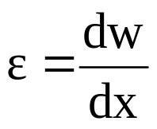
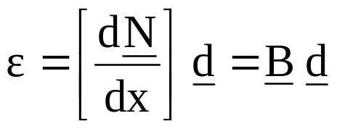
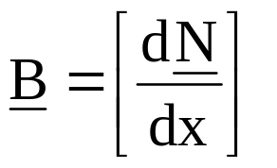
TASK 2: APPROXIMATE THE STRAIN and STRESS WITHIN EACH ELEMENT
From equation (1), the displacement within each element
Recall that the strain in the bar
Hence
(2)
The matrix B is known as the “strain-displacement matrix”

Slide 25
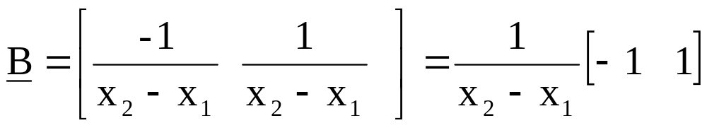
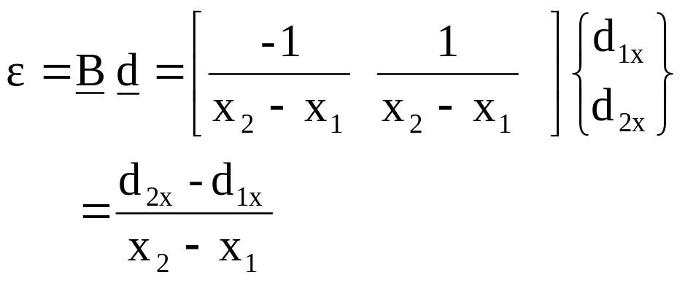
For a linear finite element
Hence
Hence, strain is a constant within each element (only for a linear element)!

Slide 26
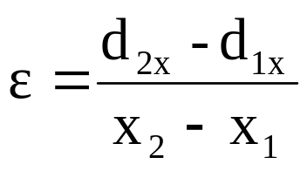
Displacement is linear
El #1
x₁
x₂
Strain is constant
El #1
x₁
x₂

Slide 27
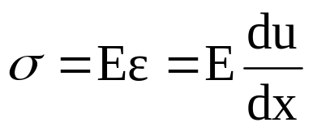

Recall that the stress in the bar
Hence, inside the element, the approximate stress is
(3)
For a linear element the stress is also constant inside each element. This has the implication that the stress (and strain) is discontinuous across element boundaries in general.

Slide 28


Summary
Inside an element, the three most important approximations in terms of the nodal displacements (d) are:
Displacement approximation in terms of shape functions
(1)
Strain approximation in terms of strain-displacement matrix
(2)
Stress approximation in terms of strain-displacement matrix and Young’s modulus
(3)

Slide 29
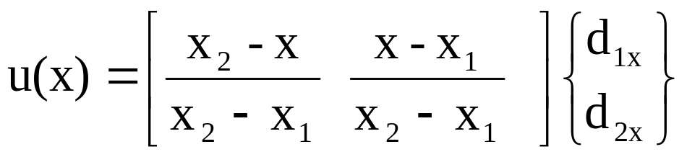
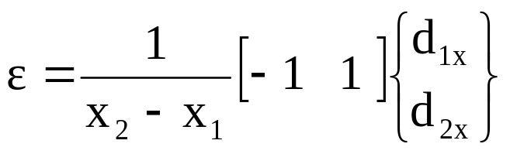
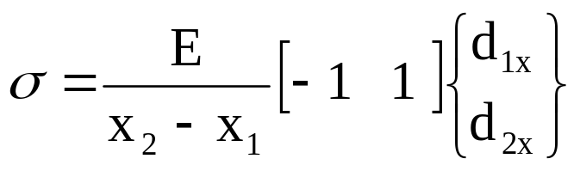
Summary
For a linear element
Displacement approximation in terms of shape functions
Strain approximation
Stress approximation

