Slide 1


Twisted-Tea Robot
Anthony Popa, Corey Meyer, Sean Nima, Garrett Gularson

Slide 2
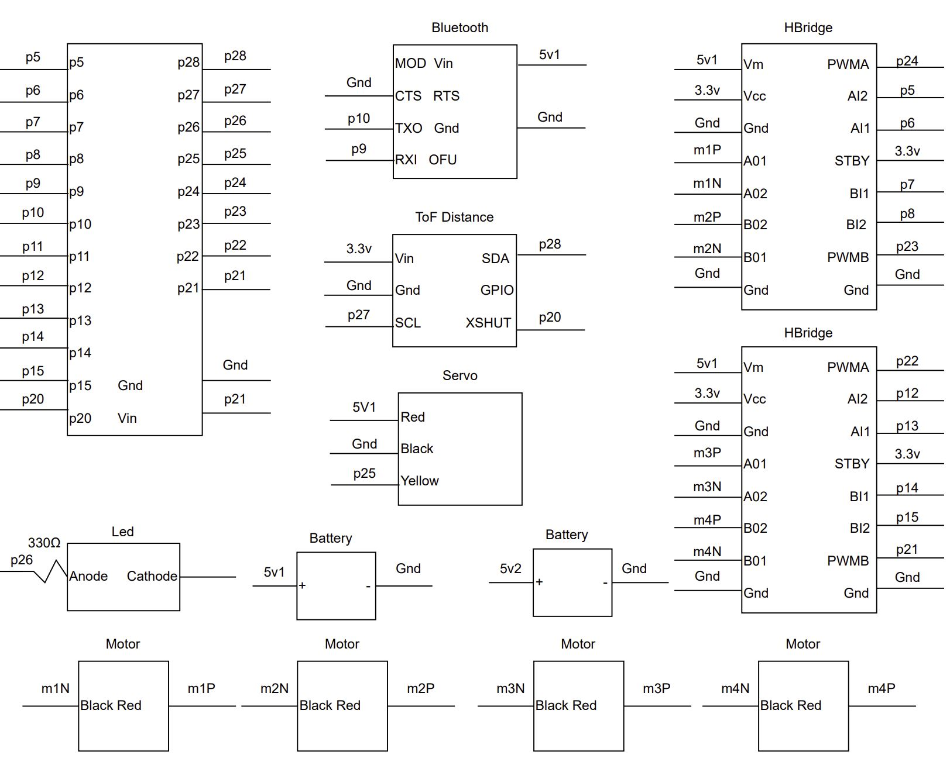
An RC Car with a Twisty Twist
Features:
Touchscreen-controlled driving via Bluetooth
Time of Flight distance sensor for safety
Car will automatically stop when headed towards an obstacle
LED with adjustable brightness and collision-warning lights
Built on a Twisted Tea box

Slide 3
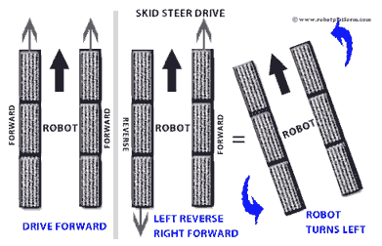
Steering
Wheels spin in same direction to go forwards and backwards;
left and right wheels spin in opposite directions to turn.

Slide 4
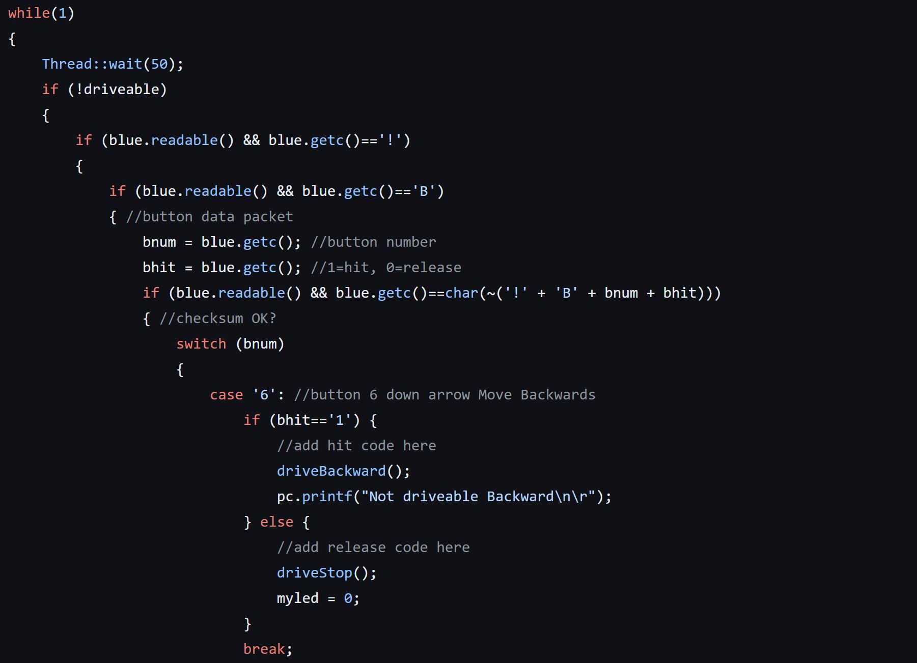
Software Snippet

Slide 5
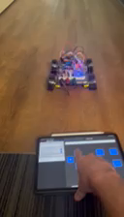
Demo in HD

Slide 6
Conclusion/Reflections
Overall, we are satisfied with the outcome of this project. We achieved what we set out to do, with one exception:
The original idea included a servo-controlled “sprinkler” made out of empty Twea cans. This feature was abandoned because the servo drew too much power from our battery packs.
If we had more time, perhaps we would have found a work-around to this issue.

