Slide 1
WiFi CSI
Presence Detection
Using Channel State Information from ESP32-C6 & ESP32-C3
Nima Chaharbaghi · Saif Meftah · Florian Milbradt
github.com/nimachaharbaghi/presencedetection
IoT · WiFi Sensing · Real-Time Detection

Slide 2
CSI describes how a WiFi signal travels from transmitter to receiver — capturing the amplitude and phase shift of each subcarrier frequency.
What is
CSI?
~
Beyond RSSI
RSSI gives one number. CSI gives 52–256 complex values per packet — a full fingerprint of the signal path.
⊕
Physics in action
Channel State
Information
Human bodies absorb 2.4 GHz WiFi at ~60%. Any person in the path measurably distorts the signal.
◎
No extra hardware
Standard 802.11 packets carry CSI. No cameras, no PIR sensors — just the WiFi radio already on the chip.

Slide 3
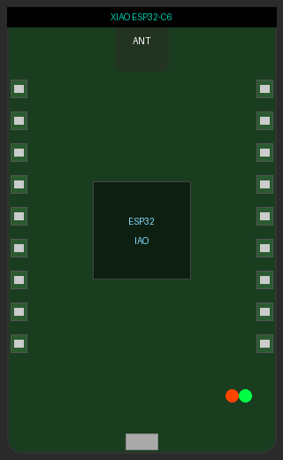
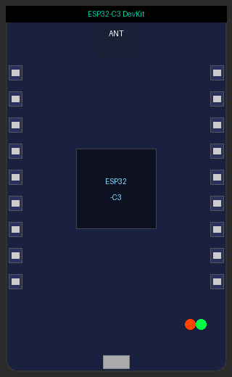
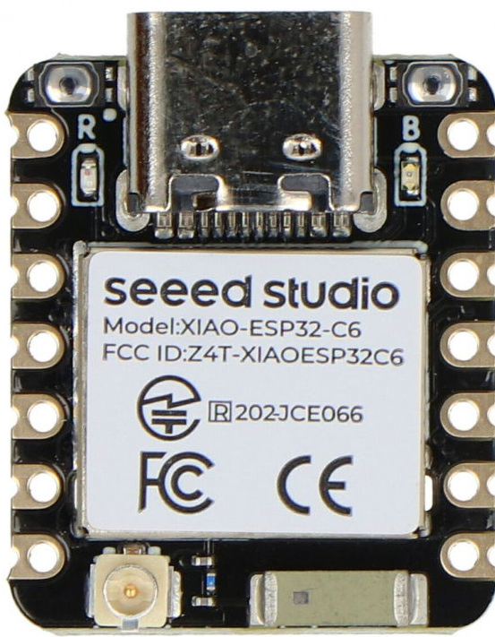
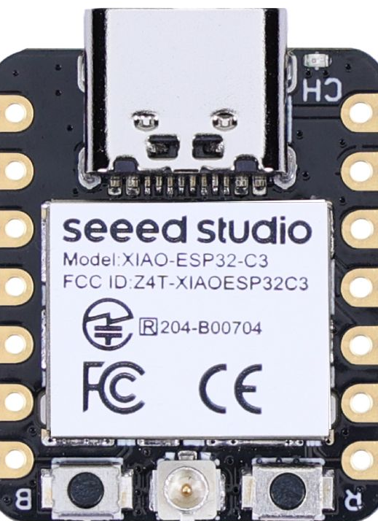
Hardware
Both boards under $5 — total hardware cost ~$10
Seeed XIAO ESP32-C6
ESP32-C3 DevKit
CSI Receiver
CSI Transmitter
— WiFi 6 (802.11ax)
— WiFi 802.11n
— RISC-V 160 MHz
— RISC-V 160 MHz
— 128 CSI samples/pkt
— 10 packets/sec
— ESP-IDF v5.3
— Runs on powerbank
~$5
Seeed Studio
XIAO Series
~$4
Generic devkit
AliExpress/Amazon
Total project hardware cost: ~$9 · No soldering required · Plug-and-play USB

Slide 4
System Architecture
Phone
Hotspot
ESP32-C3
ESP32-C6
Python
Server
Browser
Dashboard
WiFi AP
Channel 6
Transmitter
active_sta
Receiver
passive sniffer
WebSocket
csi_server.py
presence_dashboard
.html
WiFi connection
CSI packets
(raw data)
Serial /dev/
ttyACM0
WebSocket
localhost:8765
1. Transmission
2. CSI Collection
3. Presence Detection
C3 connects to hotspot and fires packets at 10/sec. Each packet triggers a CSI measurement on the receiver.
C6 runs in promiscuous mode on ch.6. For every C3 packet, the WiFi driver captures 128 CSI samples and prints to serial.
Python reads serial, extracts RSSI, computes rolling variance over 50 samples, and compares against a calibrated threshold.

Slide 5
The Physics
of Detection
Multipath propagation
C3
TX
WiFi signals travel multiple paths. A human body changes those paths.
direct
60%
of 2.4 GHz absorbed by water in human tissue
person
52+
subcarriers measured per packet on ESP32-C6
C6
RX
10×
packets per second from the C3 transmitter
<1s
detection latency after calibration

Slide 6
Detection Algorithm
01
Filter by MAC
04
Calibration
Only packets from the C3's known MAC address are processed. All ambient WiFi traffic is ignored.
On startup, 30 seconds of empty-room variance is recorded. Threshold = median + 2 × std deviation + 0.5.
02
Rolling window
05
Decision
The last 50 RSSI values are stored in a circular buffer. Smooths noise while staying responsive to real changes.
If variance > threshold → person detected. Change in state triggers a WebSocket broadcast and alert sound.
03
Variance metric
Variance = average squared deviation from the mean. Empty room: low. Person present: higher and fluctuating.
threshold = median(σ²) + 2 × std(σ²) + 0.5

Slide 7
Hardware & Software Stack
Seeed XIAO ESP32-C6
ESP32-C3 DevKit
CSI Receiver · ~$5
CSI Transmitter · ~$4
— RISC-V 160 MHz
— RISC-V 160 MHz
— WiFi 6 (802.11ax)
— WiFi 802.11n
— USB-Serial/JTAG
— 10 packets/sec
— ESP-IDF v5.3
— ESP-IDF v5.3
Software Stack
ESP-IDF v5.3
ESP32-CSI-Tool
Python + websockets
HTML + Web Audio
Single SDK for both C3 and C6. Provides WiFi driver, CSI API, FreeRTOS.
Open-source base firmware (StevenMHernandez). Modified for C6 API.
Reads serial, variance-based detection, broadcasts via WebSocket :8765.
Single-file dashboard. Live charts, pulsing indicator, beep on detection.

Slide 8
Live Dashboard
Dashboard Features
●
Room Empty
Live RSSI and variance charts
Pulsing green / red status indicator
Calibration progress bar on startup
Beep sound on detection change
RSSI
Variance
Threshold
-57 dBm
1.8
4.2
Event log with timestamps
Auto-reconnects on disconnect
RSSI signal
Single HTML file — no install needed

Slide 9
Results & Limitations
What Works Well
Current Limitations
✓
Detects entry and exit reliably when someone crosses the signal path
×
Stationary people are hard to detect — body must move
✓
Adaptive calibration adjusts to any room without manual tuning
×
Sensitive to environmental changes (doors, fans)
✓
Dedicated C3 transmitter gives clean, regular 10 Hz signal
×
Single threshold may need re-tuning across rooms
✓
Fully passive — no cameras, no PIR, no additional hardware
×
RSSI only — full complex CSI values not yet used
✓
Sub-second detection latency once calibrated
×
One detection zone — no localization or counting
Next steps: Use full CSI buffer (128 complex values) instead of RSSI · Apply ML classifier for person counting · Fuse multiple receivers for localization

Slide 10
Thank You
Questions?
Nima Chaharbaghi · Saif Meftah · Florian Milbradt
github.com/nimachaharbaghi/presencedetection
ESP32-CSI-Tool — github.com/StevenMHernandez/ESP32-CSI-Tool
ESP-IDF v5.3 — github.com/espressif/esp-idf

