Slide 1

wander
John Crescenzi • Darya Dragun • Nima Eskandary • Pranjal Singi • Morgan Wallace

Slide 2
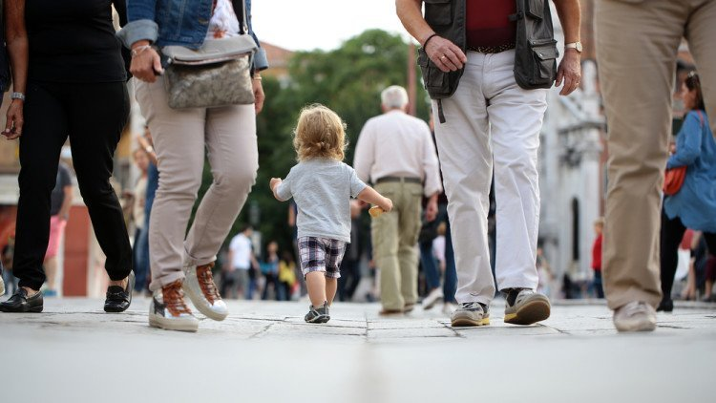
“Billy has wandered off from the group!”
Photo source: http://tiphero.com/lost-kid-tip/

Slide 3
Introducing the App: wander

Slide 4
How it works:

Slide 5






How we built it:

Slide 6
Encryption

Slide 7
Market Data

Slide 8
Market Data

Slide 9
Potential Issues
Random code generator - no two codes at once!

