Slide 1
Scale, Scope, and modern Antitrust
Competitive Strategy
Nima Haghpanah
Notes:
Uber good because (1) good review of things we have seen (chicken and egg, ratings and review, platform v pipeline) (2) new things (scale and scope and regulation)

Slide 2
Announcements
Final exam Thursday May 7, 9am-10:20.
Practice problem set (with solutions) posted
Explain your answers!
Review session recording on Canvas
Drinks tonight!
Sign up on Canvas

Slide 3
How did Uber disrupt taxi industry?
Innovations compared to taxis:
Drivers unleashed from artificial supply constraints (medallions)
Replaced dispatch system with algorithm on phones
Customers no longer needed to stand on the street
Subsidized rides
Notes:
Taxi company with hired employees cannot respond to demand shocks well.

Slide 4
Business model innovation
Platform instead of pipeline
Use algorithm to
match supply and demand efficiently
adjust supply and demand (surge pricing)
Creative use of GPS technology

Slide 5
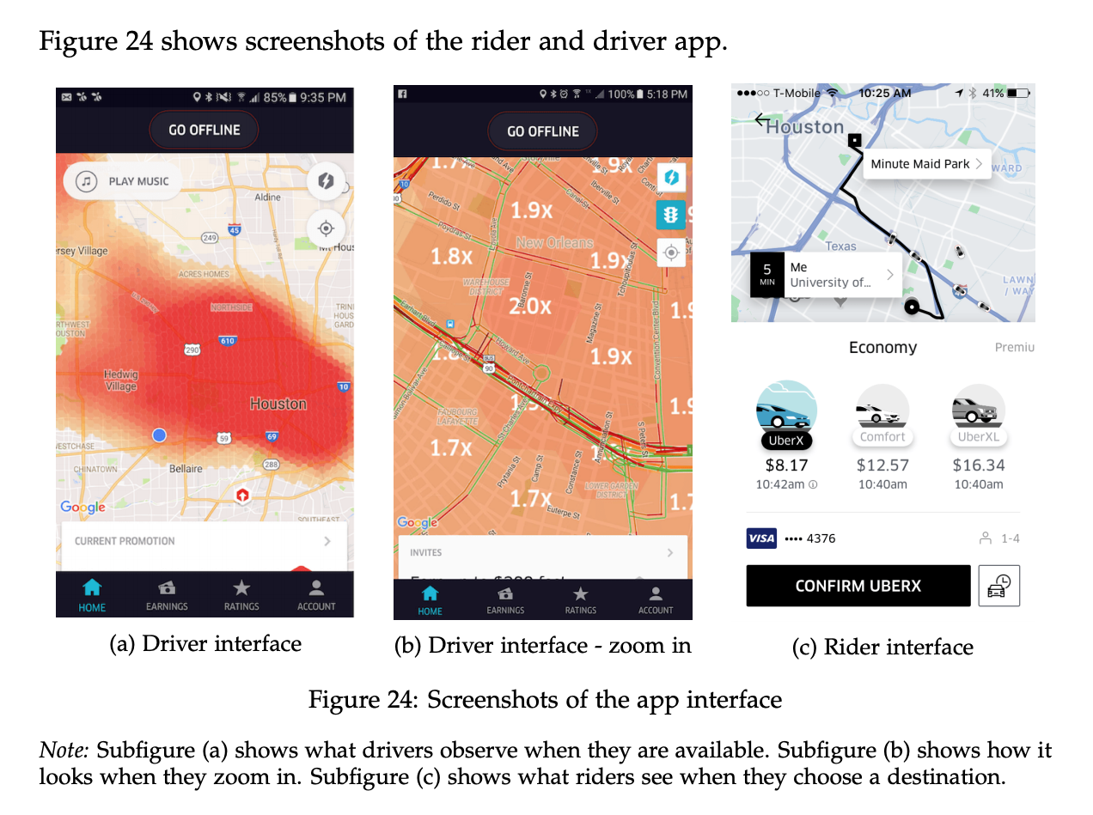
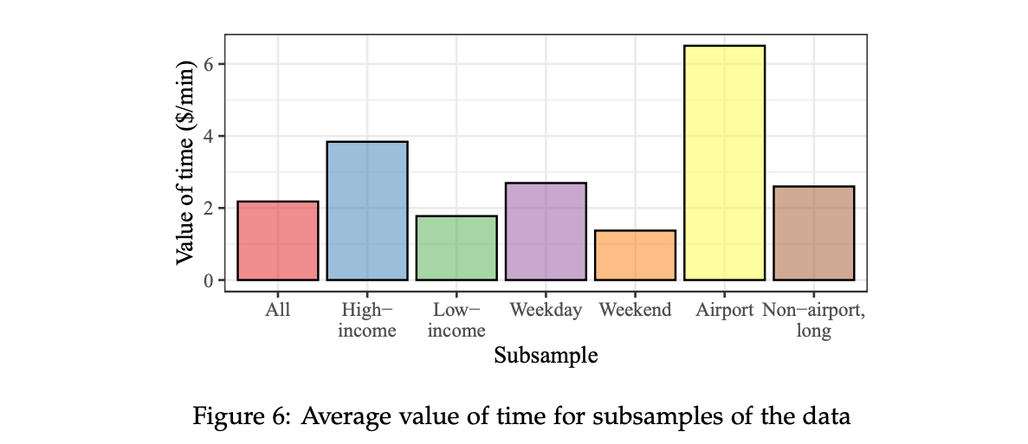
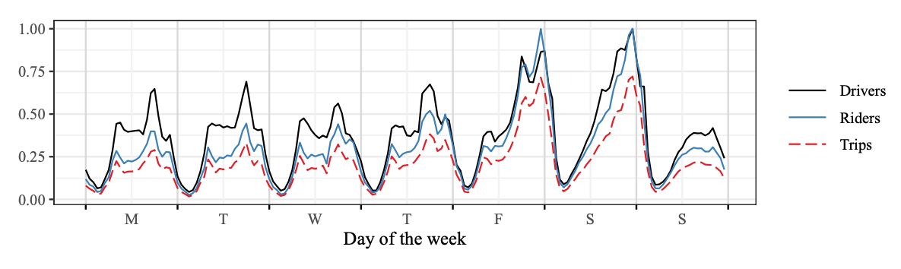
Ride Platform Pricing
Here, uncertainty in rides and drivers causes price fluctuations
Notes:
An example of dynamic pricing. Uber’s problem a bit easier because it is a spot market. But harder because of space. More interesting because it is two-sided (airline has fixed supply)
Uber is estimating what rides have higher demand. Top right bottom right.
We can price discriminate pretty well based on destination

Slide 6
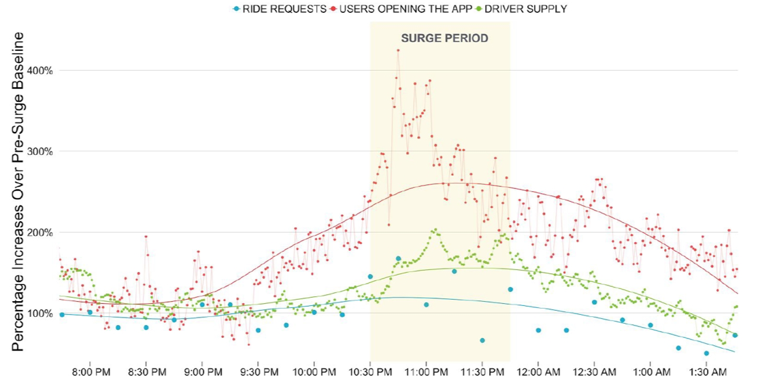
Ride Platform Pricing
Notes:
This is the picture that shows why surge pricing is such a good idea.
Ariana Grande concert getting out.
Demand shock. Uncertainty + Scarcity. Price goes up because of scarcity. But then more drivers show up (this was not present in Airbnb example). Uber’s idea: surge pricing to match supply and demand. Pretty impressive.

Slide 7
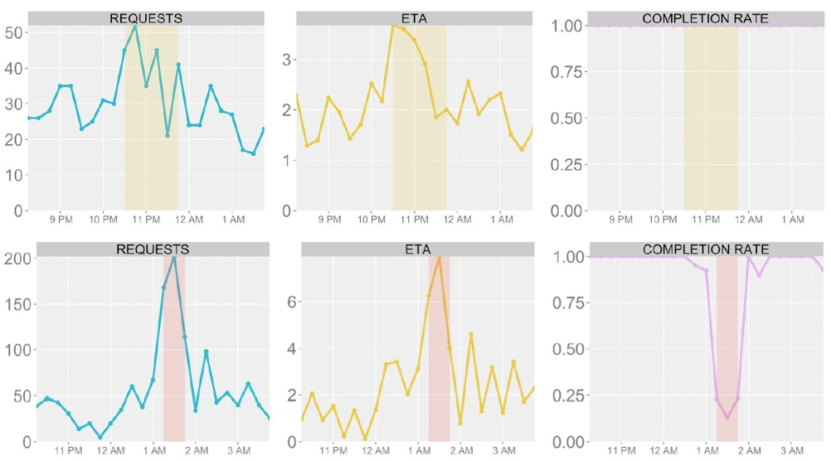
What happens when surge is turned off?
Notes:
Bottom. NYC new years. Demand shock. Surge malfunctioned! Why did ETA (waiting times) go down? People left the app!
Uber cares about completion rates (not just revenue). They stay at 100%. Speaking of Uber’s objective, let’s see next slide.

Slide 8
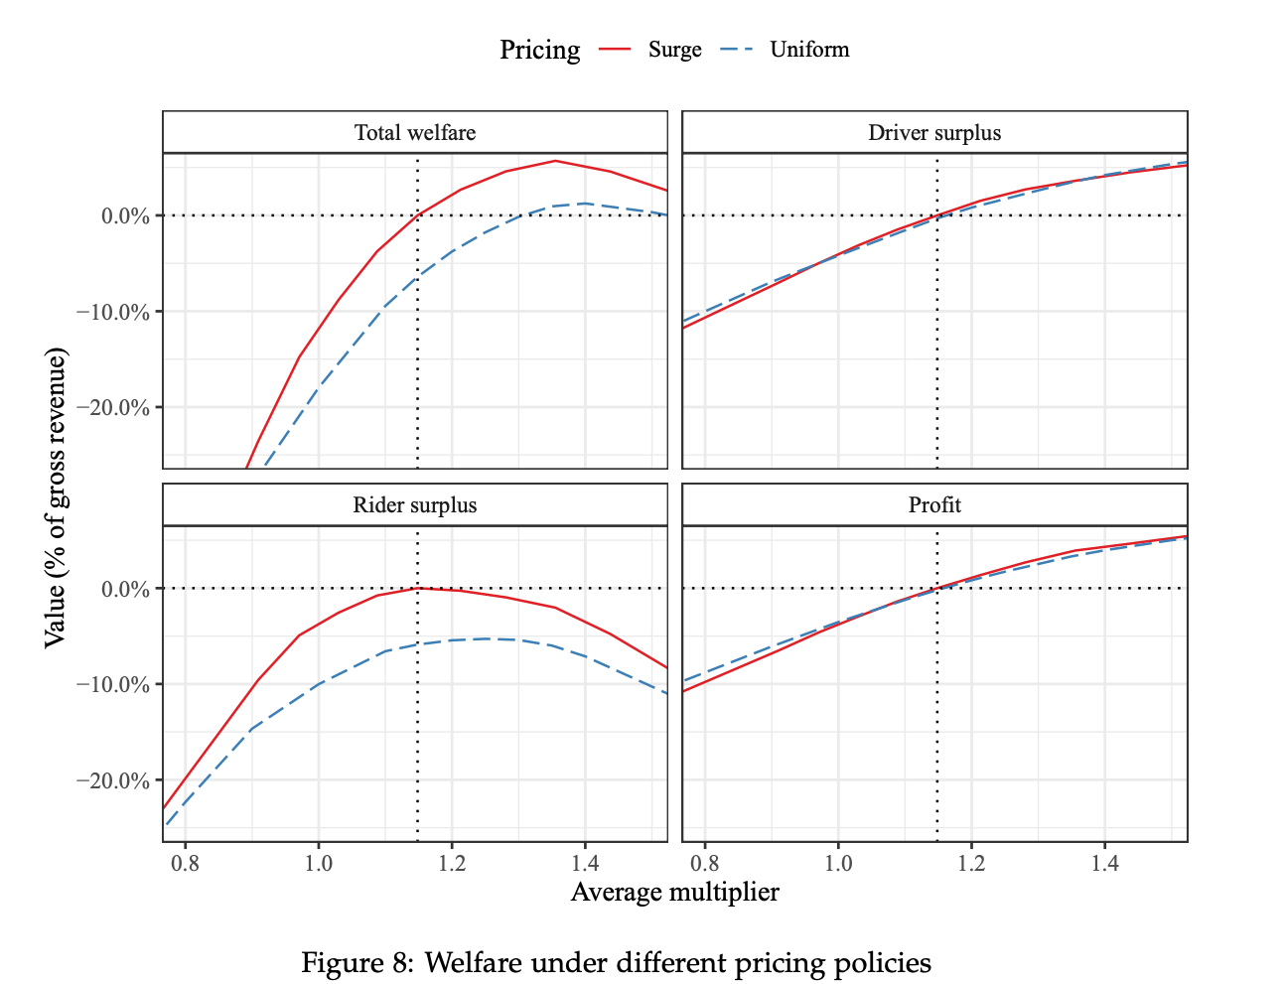
What are the welfare effects of dynamic pricing?
Surge pricing results in higher welfare than uniform pricing
Uber is “leaving money on the table” – dynamic considerations of the firm?
Note that rider surplus is being maximized, not driver surplus.
Grow the market? … more difficult in two-sided market where drivers want higher prices
Notes:
Looks like a Pareto improvement.
Explanation (not necessary to give): Multiplier: surge (price) multiplier. What happens if we change the average multiplier. It also applies to uniform pricing because it shifts prices by a constant multiplier. Dotted lines are the status quo.
Very interesting: their multiplier maximizes rider surplus.
This is not taking into account long-term effects.

Slide 9
Strengths and weaknesses of Uber’s platform strategy
Strengths
Scale more efficiently than pipeline
Value created by algorithm via efficient matching and management of supply and demand
Community feedback via ratings and reviews
Weakness
Chicken and egg problem
High driver turnover
Multi-homing with Lyft
Notes:
Scale: not own resrouces (drivers, dispatchers)
Ratings help refine platforms and incentivize good behavior

Slide 10
Scale and Scope effects
Scope:
Uber rides
Uber eats
Uber freight
Scale:
What are scale benefits of having service in Seattle, Stockholm, and Seoul?
Notes:
Helps with the network effects and chicken and egg problem: user who uses ride might also choose eats. Drivers may work for multiple services.
Scale: operates in 10000 cities
Scale: of course fixed costs, but also startup costs and variable costs for each location
Scale: regulations, customs, culture, different competitiors

Slide 11
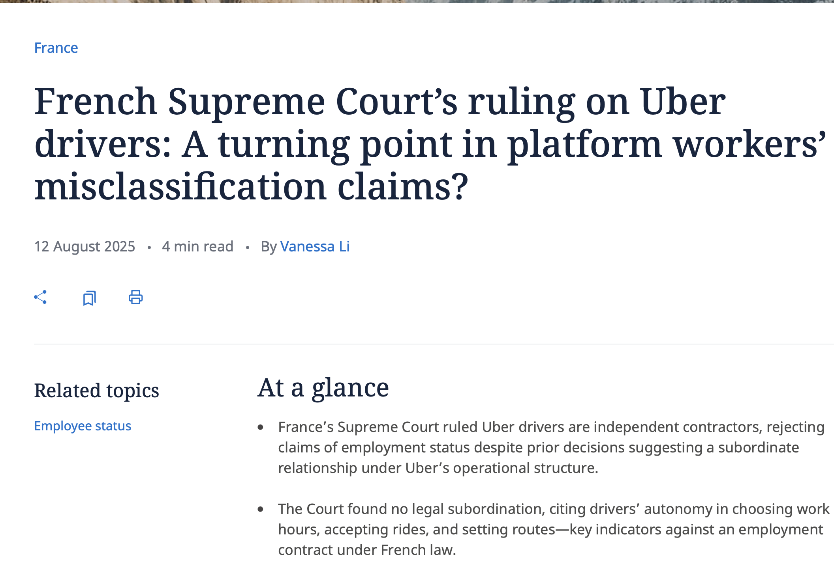
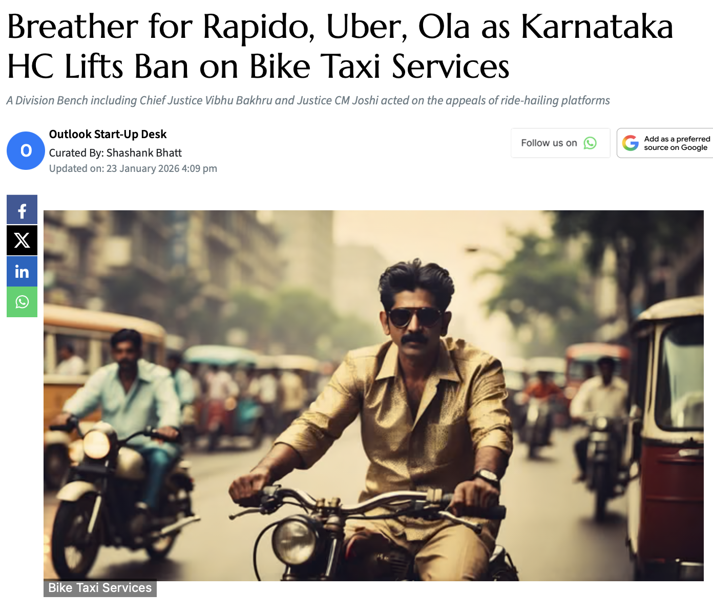
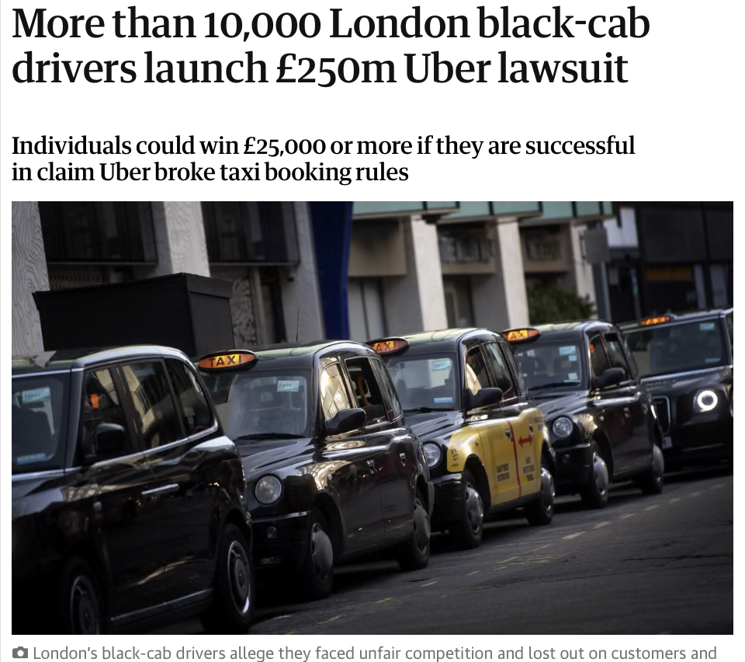
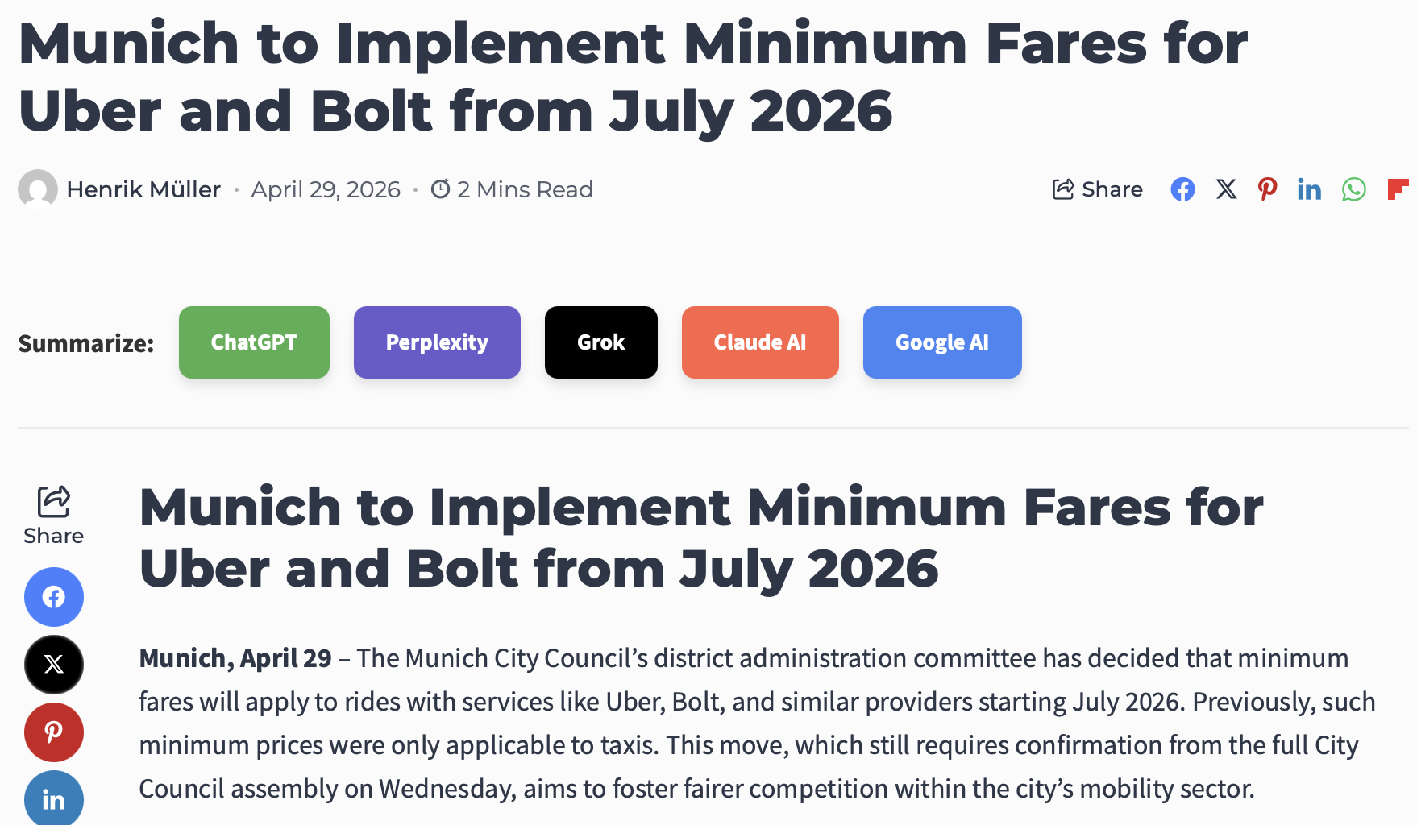
Notes:
Karnataka state in India
These are examples of different regulatory challenges that Uber faces in different locations. Workers welfare. How they get around regulations and harm copmetitiors.

Slide 12


Feedback please!
Difficulty: Too hard, too easy, just right?
Pace: Too fast, too slow, just right?
What topic did you like or dislike the most?
What topic do you wish we had discussed (or discussed more)?
Guest lectures, cases, lectures, simulation (and games)?
The types of lectures:
Conceptual ones (e.g., pros and cons of platforms v pipelines)
Econ analysis (e.g., what are the prices to the two sides)
Understanding the CS-tech (blockchains, AI pricing and collusion)
Logistics and classroom tech?
Notes:
CS-tech: I intentionally went into details. This is what I think a main point of this class.
Beyond that you can say anything. You can talk about my handwriting, complain that I don’t wear a tie, how much you appreciate the yummy cupcakes I just gave you.

Slide 13
Sherman Act Section 2 prohibits “monopolization”
Example: Microsoft (1997),
Very hard to for government to win s2 cases in the US
Must distinguish success due to a good product from exercise of market power
Courts are hostile to antitrust enforcement so agencies are afraid
Notes:
So far we have been looking at things from the perspective of the firm. But what about the social good?
Later supreme court said (1) possession of monopoly power and (2) attempting to maintain it in ways distinguished from having a superior product.
Case 2: Tying (Browser)
Microsoft tied Internet Explorer to Microsoft Windows. Goal: weaken Netscape Navigator. District court: anticompetitive tying. Appeals court: rejected per se tying. Still relevant as exclusionary conduct under §2.
Case 3: Monopolization (OS Market)
Microsoft had monopoly in PC operating systems. Threat: middleware like Java. Middleware could reduce application entry barriers. Microsoft acted to block these threats. Used contracts and technical restrictions.
Court: unlawful maintenance of monopoly under Section 2 of the Sherman Act.

Slide 14
US v Apple 2024
Notes:
Argument: extend monopoly in OS to complements.
Degrading interoperability. Raises switching costs.
Super app. WeChat. (friends, shopping, favorite restaurants). You switch from IOS to Android, all that stuff are there. Makes consumers platform agnostic.
Cloud gaming. Lessen need for good hardward. Dumbphone.
Messaging. De-grade non-iOS messaging (you can’t give thumbs up). Multi-homing for messaging is easy and common.
Apple says we can design our product however we want.
If we do all of our shopping on one devide. Concern: What if apple tells a car company they have to pay 1000 to get their app on our phones (maybe they don’t have that incentives, but they can)

Slide 15
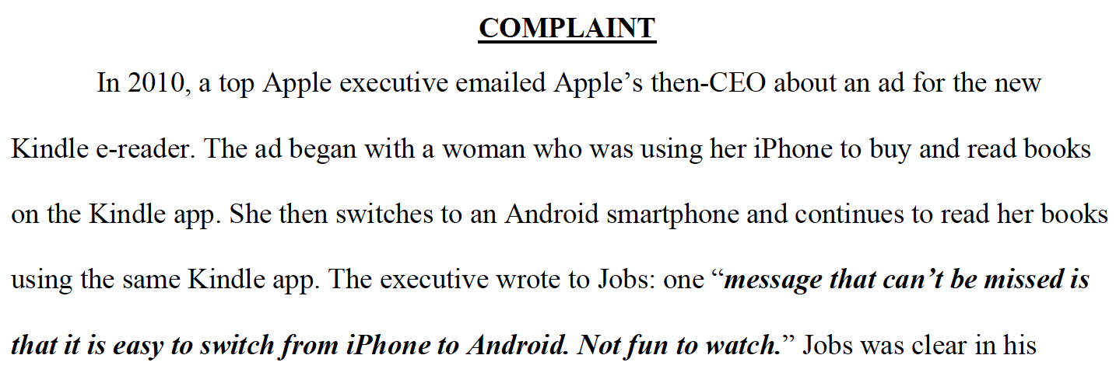
Notes:
DOJ’s complaint
Still ongoing.

Slide 16
US v Apple
Government’s argument:
Create market power by degrading interoperability and raising switching costs
Super apps, cloud gaming, messaging, …
Apple’s argument:
These are our design choices, I’m creating a better product
Also so what? Are we really worried about the price of iphones?
Concern:
Apple has power over businesses who want their apps on Apple devices
Consider both incentive and ability to foreclose
Notes:
Argument: extend monopoly in OS to complements.
Degrading interoperability. Raises switching costs.
Super app. WeChat. (friends, shopping, favorite restaurants). You switch from IOS to Android, all that stuff are there. Makes consumers platform agnostic.
Cloud gaming. Lessen need for good hardware. Dumbphone.
Messaging. De-grade non-iOS messaging (you can’t give thumbs up).
Apple says we can design our product however we want. (Remember second argument: how do you maintain power other than better product?)
But are we really only worrying about the price of iphones? Maybe could have charged $600 instead of $800?
If we do all of our shopping on one device. Concern: What if apple tells a car company they have to pay 1000 to get their app on our phones (maybe they don’t have that incentives, but they can)
The concern is NOT just that the price of smartphones goes up

Slide 17
But for world
What would have happened if Apple didn’t engage in those practices?
What would search look like if Google wasn’t so dominant?
How would we restore the lost competition?
Notes:
It’s hard to imagine what the world would look like if Google hadn’t done its search thing. Would we have subscription search? Ads more clear?
Maybe Amazon Fire would have succeeded.
Google search is hard because we don’t know what would happen without these forces.

Slide 18
Epic v Apple
Has Apple monopolized distribution of apps on IOS?
Court said no. However,
Court ruled that developers should be able to talk to their own consumers
“buy this app for cheaper by directly going to our website”
Apple not complying, knowingly
Notes:
Much more specific question: monopolized distribution of apps.
Epic Games makes Fortnite.
Apple Inc. requires iOS apps to:
Be distributed through the App Store, and
Use Apple’s in-app payment system (IAP) for digital goods, taking a ~30% commission.
In 2020, Epic added its own payment option inside Fortnite to bypass Apple’s commission. Apple removed the app; Epic sued.
Could there have been multiple app stores?
We could have curated app stores. Green app store. Children app store. Rich people app store. Go to US open, buy Champain.
Why did judge reject: Apple has not monopolied distribution of apps. Android, console, PC. Second was how to maintain. Didn’t show any exclusive contracts.
So neither condition holds (1) no monopoly (2) no contract to limit competition (just design)

Slide 19
Epic v Google
Google did set up Android to allow for multiple app stores.
The case against Google:
Paid developers to stay out of rival app stores
Paid OEM’s put rival app stores on back pages
Epic won largely
Notes:
Google did monopolize by *disadvantaging other stores*. Apple didn’t have them to start with!
OEM = Original Equipment Manufacturer.

Slide 20
Google search
2017 in EU
Harm competition by not showing them in search results prominently
Foundem
Froogle
Cases for and against?
Notes:
Case for Google:
- Google is just better. Isn't it how competition works? In fact OK under US and EU law. But should it be?
But maybe people use Google because Google Search is good, but Foundem is better than Google.
Foundem is there an consumers can use it.If they choose to use Google, then they are benefiting
What’s even the harm? Google is free!
Case against:
Comparison shopping websites increase competition
Google is reducing competition
- If consumers don't know all prices, then sellers have market power
- So prices go up
Verdict:
-Google found guilty of anticompetitive behavior in Europe
- They have to treat their own results and comparison shopping equally (not clear)

Slide 21
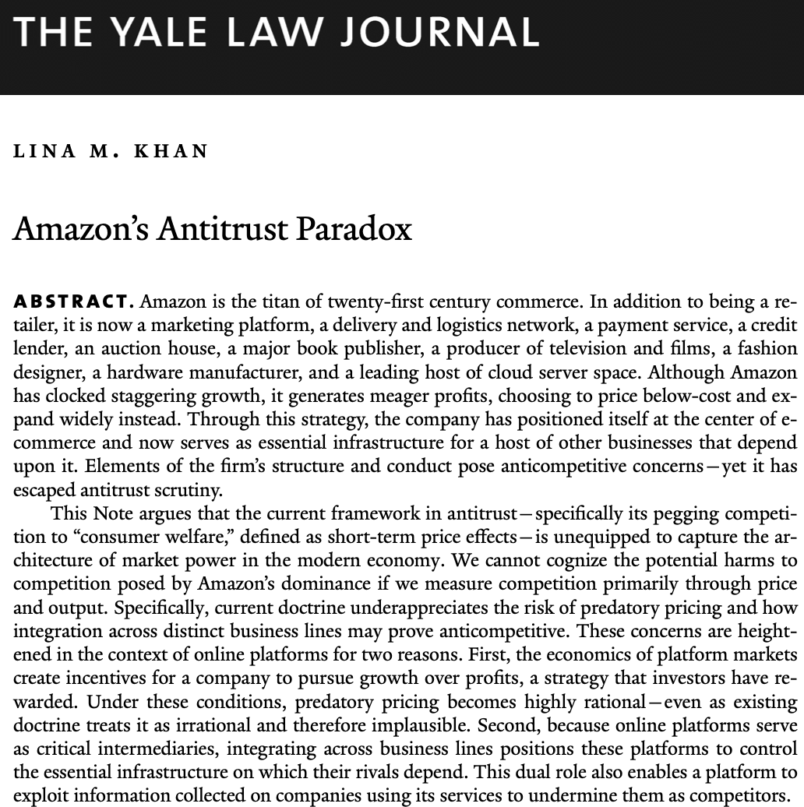
Notes:
29 yo Yale law student

Slide 22
Neo-Brandeisian Antitrust (Lina Khan)
If prices are zero, where is the harm?
Power, not prices
Market power can harm consumers through choice, quality, innovation, and dependency—even when prices are zero. And they do pay high prices indirectly.
Gatekeeping & exclusion
Dominant platforms can shape who reaches users, who survives, and which rivals never emerge.
Dynamic harms
The real cost shows up later: less innovation, weaker competition, fewer alternatives.
Enforcement posture
Willing to intervene earlier, accept litigation risk

Slide 23
Amazon resembles the all-powerful railroads of the Progressive Era:
“The thousands of retailers and independent businesses that must ride Amazon’s rails to reach market are increasingly dependent on their biggest competitor.”
Notes:
Amazon resembles the all-powerful railroads of the Progressive Era, Ms. Khan wrote: “The thousands of retailers and independent businesses that must ride Amazon’s rails to reach market are increasingly dependent on their biggest competitor.”

Slide 24
Thank you!

