Slide 1
Predicting expiry of Kiva’s loans
Jiamin Lim

Slide 2
Outline
Introduction (What is Kiva)
Project aim
Project plan
Findings
Future work

Slide 3
Introduction
Add Kiva webpage

Slide 4
Project aim
Predict which fundraising loans were going to expire (not get fully funded)
Understand which factors were important in determining whether a loan expired

Slide 5
Project plan
Data cleaning and exploration
Models
Logistic regression
Decision trees
Random Forests
Evaluate models
Which features were important?
Predictive power: Accuracy scores & ROC

Slide 6
Data
Source: Kivatools.com
y variable: Binary variable, expired = 1, fully funded = 0
Possible X variables:
Numerical: Loan amount, Total borrowers, Total female borrowers, Total male borrowers, Posted year, Loan term in months
Categorical: Country, Sector, Activity
Text: Loan use description
Notes:
X-variables are the ones that

Slide 7
Data
y variable: Binary variable for if the loan expires (expired = 1, fully funded = 0)
X variables:
Numerical: Loan amount, Total borrowers, Total female borrowers, Total male borrowers, Posted year, Loan term in months
Categorical: Continent Country, Sector, Activity
Text: Loan use description

Slide 8
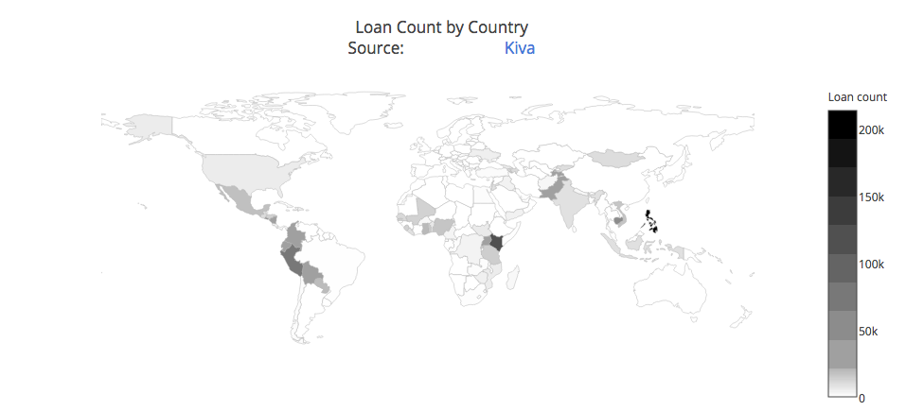
Loan Count by Country

Slide 9
 | Loan amount | No. of total borrowers | No. of male borrowers | No. of female borrowers
Loan amount | 1
No. of total borrowers | 0.533203 | 1
No. of male borrowers | 0.262862 | 0.440664 | 1
No. of female borrowers | 0.499284 | 0.953883 | 0.150881 | 1

Slide 10
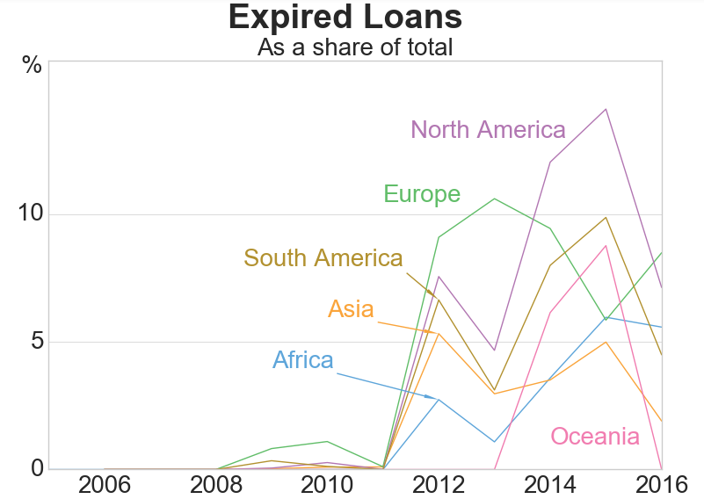

Slide 11
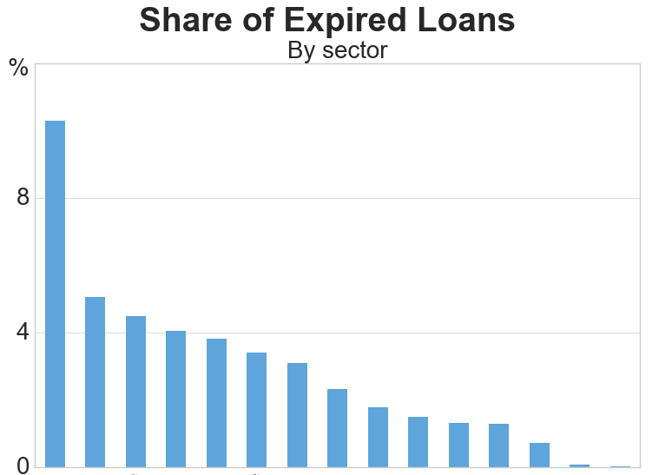
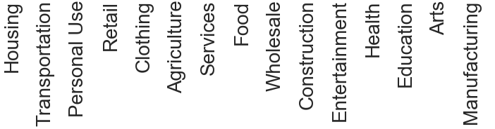

Slide 15
ROC curve

Slide 16
Conclusion
Random forest had the best predictive power - highest ROC and accuracy score
Based on random forest
Higher loan amount – more likely for your loan to get expired
Longer loan term – more likely for your loan to expire
Female borrowers
Continent and sector does not really matter

Slide 17
Logistic Regression

Slide 18
Future work
more x-variables: merge with partner dataset
Use other y-variables
Recommendation engine (merge with lender data set)

Slide 19
Spares
Distribution of expired loans

