Slide 1
Energy awareness
Lesson 1 – Energy around us

Slide 2
Learning objectives:
Understand what UN Global Goal 13 (climate action) is and why it’s relevant to us
Understand how our energy use can have an impact on climate change
To consider and plan how we might monitor our energy use at home or at school and how awareness can drive changes in behaviour

Slide 3
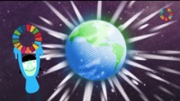
Introducing the Global Goals https://microbit.org/projects/do-your-bit/global-goals/introducing-the-global-goals/

Slide 4


https://microbit.org/projects/do-your-bit/global-goals/climate-action/

Slide 5
‘Learning is the first step to doing’
Climate change includes the global warming driven by human emissions of greenhouse gases and the resulting shifts in weather patterns.
Although the climate has changed at other times in the Earth’s history, this is the first time humans have caused it to change.Many sources of energy have an impact on climate change by putting CO2 into the atmosphere.
How can we make a contribution to combating climate change by becoming more aware about our energy use?
How might we be able to use data to drive changes in behaviour?

Slide 6
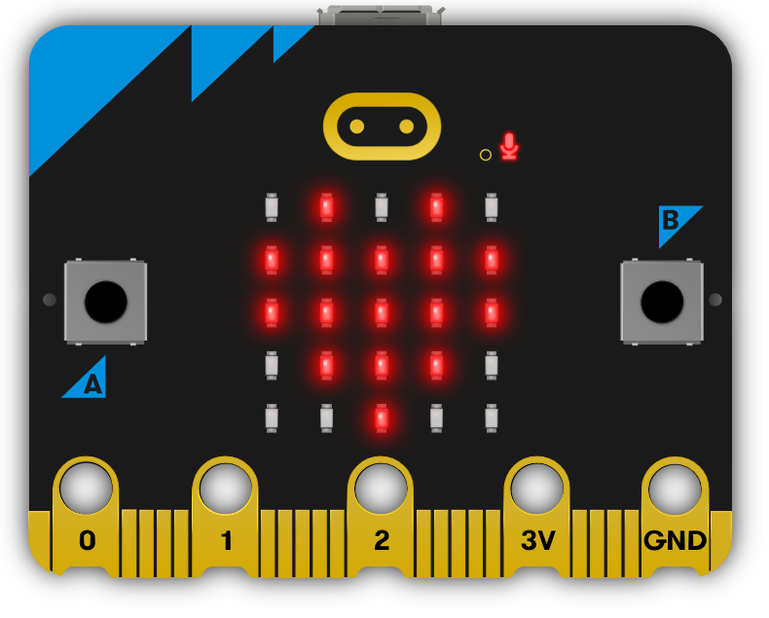
Energy use around us
The micro:bit has sensors for temperature, light and magnetism which could be used to monitor energy use.
In the following lessons we’ll be using its light sensor.

Slide 7
Planning to monitor energy usage for lighting
Which places use the most energy?
When is energy used most? Are there patterns of behaviour you could discover, for example is lighting left on at night or at weekends?
Does it make a difference what kind of lighting is used?
Light bulbs are rated in Watts - the more Watts, the more energy they use.
More efficient kinds of lighting generate more light and less heat. LED lighting uses less electricity than fluorescent lighting, which uses less energy than incandescent lighting. What kinds of lighting are in use around you?

Slide 8
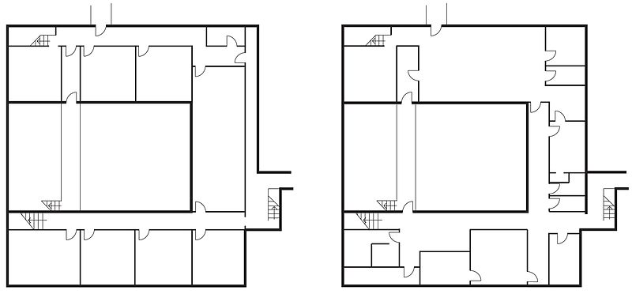
Planning micro:bit placement
Draw a plan of where you might collect good data and be able to measure a clear difference when lights are on and off.
Away from daylight / windows / people getting between the sensor and the light source.
Notes:
https://commons.wikimedia.org/wiki/File:Floor_plans_of_Sacred_Heart_School.jpg This file is licensed under the Creative Commons Attribution-Share Alike 3.0 Unported license.

Slide 9
Re-cap learning objectives:
Understand what UN Global Goal 13 (climate action) is and why it’s relevant to us
Understand how our energy use can have an impact on climate change
To consider and plan how we might monitor our energy use at home or at school and how awareness can drive changes in behaviour

Slide 10
Licensing information
Published by the Micro:bit Educational Foundation microbit.org
Licence: Attribution-ShareAlike 4.0 International (CC BY-SA 4.0)

