Slide 1
Energy awareness
Lesson 3 – data collecting

Slide 2
Learning objectives
To calibrate and deploy a data logger (micro:bit light timer)
To collect environmental data (light usage) over time

Slide 3
Recap
Review the calibration readings gathered in the last lesson for each area you’re going to monitor.
What did you decide about which locations might allow reliable collection of data, and why?

Slide 4
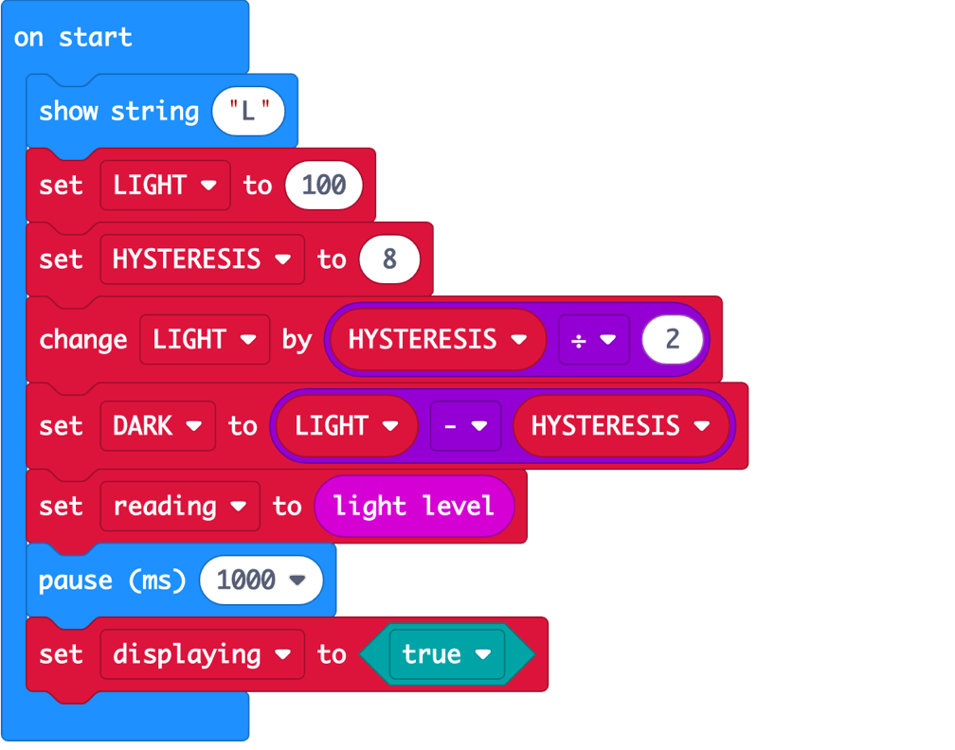
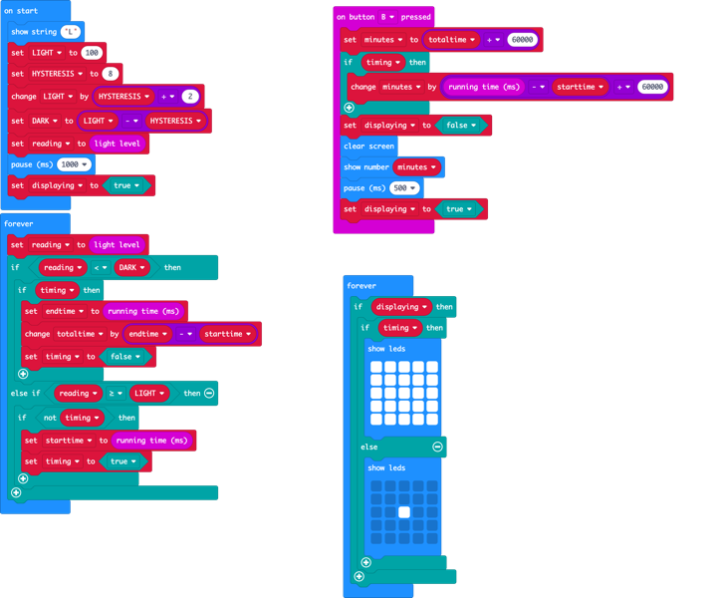
Make an energy timer
Open the project in MakeCode or Python

Slide 5
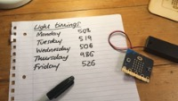
Optional video
https://microbit.org/projects/make-it-code-it/energy-light-timer/

Slide 6
Collect data
Place micro:bit(s) attached to battery packs in your chosen locations.
Test with lights on and off.
Press reset button on back to clear the time recorded.
Leave for a period of time, then collect and press button B to read time.
Record time.

Slide 7
Recap learning objectives
To calibrate and deploy a data logger (micro:bit light timer)
To collect environmental data (light usage) over time
What do you expect to discover?

Slide 8
Licensing information
Published by the Micro:bit Educational Foundation microbit.org
Licence: Attribution-ShareAlike 4.0 International (CC BY-SA 4.0)

