Slide 1
Energy awareness
Lesson 2 – data planning

Slide 2
Learning objectives
Understand the importance of planning when collecting data to ensure it is reliable
Program a micro:bit to take measurements of environmental data (a light meter to measure light levels)
Understand the importance of baseline measurements and calibration when collecting data

Slide 3
Review and introduction
What locations did we suggest for gathering light usage data last time?
Which might the best locations be?
Today we will make a light meter to see which locations give the best (most reliable) data.
We’ll use this to calibrate a light timer which we’ll use next lesson.

Slide 4
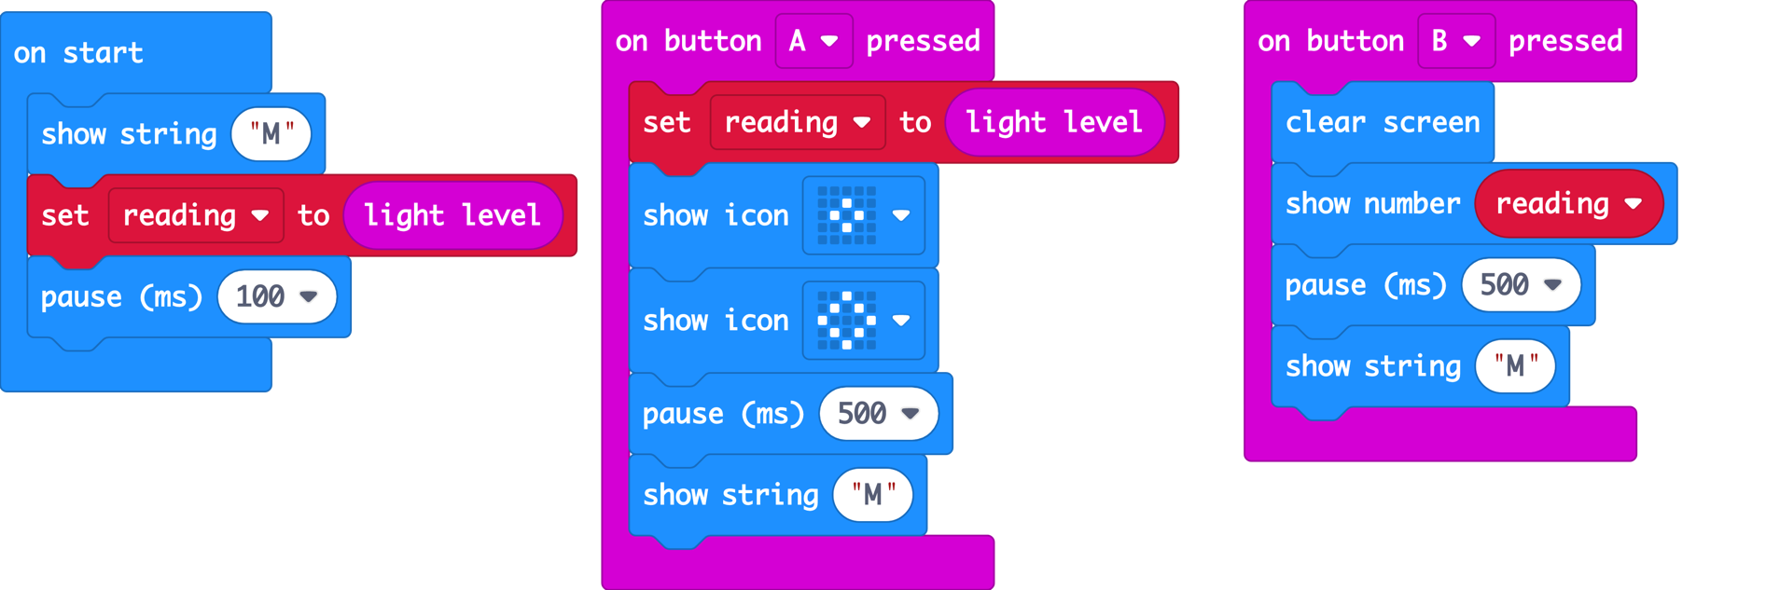
Make a light meter
Open this program in MakeCode or Python.
What does the code do?

Slide 5
Key concepts
it uses a variable called reading to store the light level recorded by the micro:bit’s built-in light sensor input, which is in the LED display
it takes a new light level reading when you press button A and stores it in the reading variable
the light level reading is shown on the micro:bit’s LED display output when you press button B

Slide 6
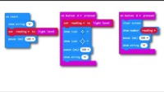
Optional video
https://microbit.org/projects/make-it-code-it/energy-light-meter/

Slide 7
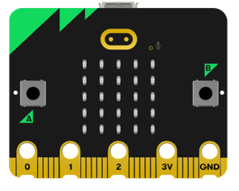
Test the light meter
Flash the program on to a micro:bit
Place your micro:bit where you want to take the light reading, cover it over or turn the lights off and press button A.
Uncover it and button B to see the light reading. This will be a number between 0 and 255.
You can press B again if you're not sure of the reading.
To record another reading with the lights on (or with it uncovered) press button A again and then press button B to see the number.
You should see a consistent difference between the values - lower numbers when the lights are off or micro:bit is covered and higher values when the lights are on and the micro:bit is uncovered.

Slide 8
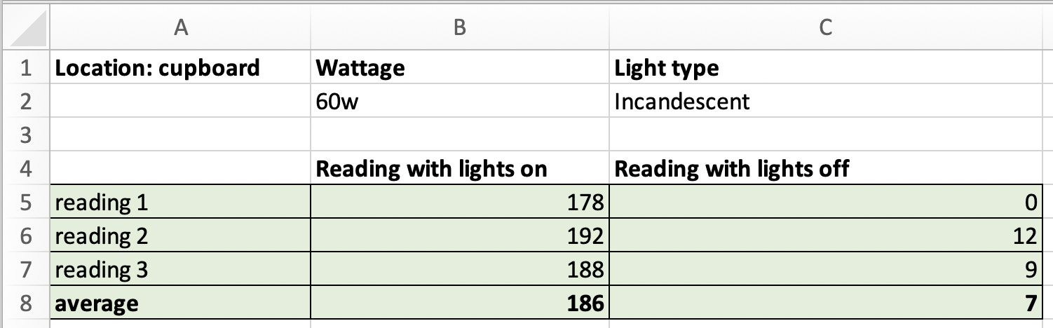
Use the light meter
Record at least 3 readings in different areas chosen in the previous lesson and at the start of this lesson. We need as large a difference as possible when the lights are on and off.
If possible, also gather information about the wattage and type of lighting used in each location.
Work out the average for each location.

Slide 9
Re-cap learning objectives
Understand the importance of planning when collecting data to ensure it is reliable
Program a micro:bit to take measurements of environmental data (a light meter to measure light levels)
Understand the importance of baseline measurements and calibration when collecting data

Slide 10
Discuss…
What are the best locations for recording light usage data?
Did we encounter any problems?
How might we overcome them or take account of them when we record light usage data next time?

Slide 11
Licensing information
Published by the Micro:bit Educational Foundation microbit.org
Licence: Attribution-ShareAlike 4.0 International (CC BY-SA 4.0)

