Slide 1
Energy awareness
Lesson 4 – data processing

Slide 2
Learning objectives
Collate and process numerical data
Present numerical data in visual form
Analyse data and make inferences from it about energy use
Use these inferences to make proposals to modify behaviour to save energy

Slide 3
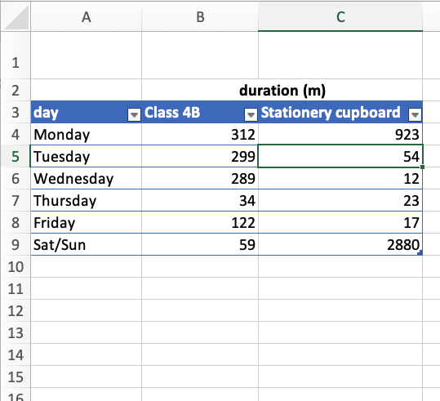
Collate data
Share what data we have
Record it in a table
Make charts to make it easier to visualise the data

Slide 4
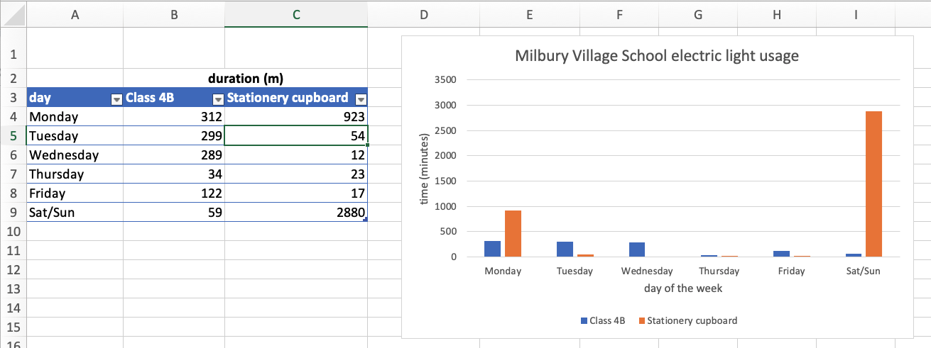

Slide 5
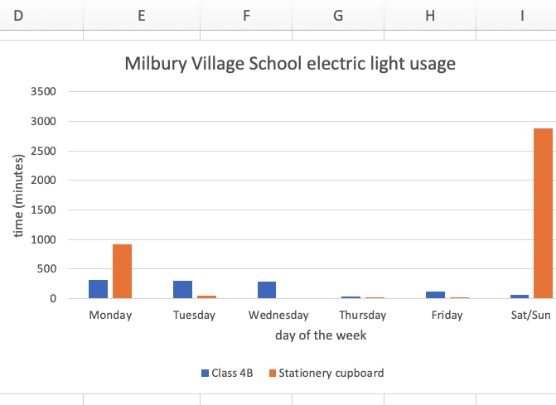
Analyse data
Do some locations use more electric light that others?
Can you spot any patterns?
Any unusual behaviour?

Slide 6
Propose solutions
Using the data we have gathered, and the ways you have visualized and analysed it, can you suggest solutions to reduce energy use?
How can we modify people’s behaviour?
How can data help us do this?

Slide 7
Recap learning objectives
Collate and process numerical data
Present numerical data in visual form
Analyse data and make inferences from it about energy use
Use these inferences to make proposals to modify behaviour to save energy

Slide 8
Licensing information
Published by the Micro:bit Educational Foundation microbit.org
Licence: Attribution-ShareAlike 4.0 International (CC BY-SA 4.0)

