Slide 1
Energy awareness
Lesson 5 – energy use calculations

Slide 2
Learning objectives
Calculate the amount of energy used in kWh given the time and power consumed by electric lighting
Calculate the cost of energy used from previously recorded data

Slide 3
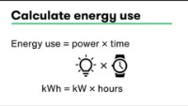
Optional video
https://microbit.org/projects/make-it-code-it/energy-cost-calculator/

Slide 4
What do we need to calculate energy use?
How long lights were left on (minutes or hours)
Power rating of lights (Watts)
Use these numbers to calculate energy used in kilowatt hours (kWh)
kWh = watts ÷ 1000 × minutes ÷ 60

Slide 5
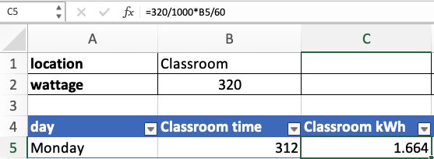
Calculate energy used in kWh
Formula =320/1000*B5/60
The wattage of the lights divided by 1000 to convert Watts to kilowatts
The time in cell B5 is divided by 60 to convert minutes to hours
The power is multiplied by time to give energy used in kWh

Slide 6
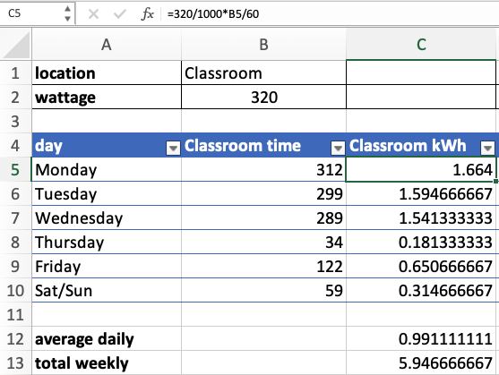

Slide 7
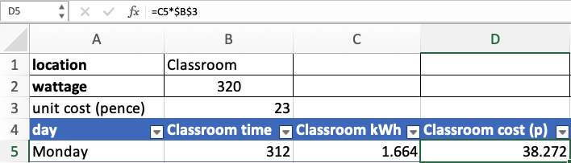
Calculate energy cost
Find out the unit cost of electricity and put it in cell B3
Multiply this by the energy used in kWh to find the cost in cell D5
Use absolute cell references to cell $B$3 to prevent errors when copying formula to other rows

Slide 8
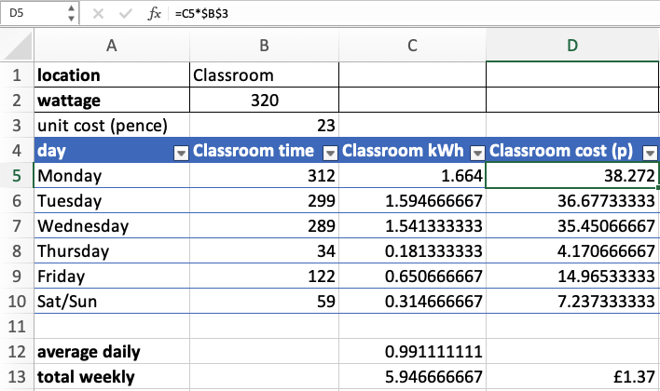

Slide 9
Analysing costs
If the cost seems small, what is the cost over a year?
Across a whole school?
Will more energy be used in winter or summer?
How much energy or money could we save by changing behaviours?
How could we calculate how this might improve our carbon footprint?

Slide 10
Recap learning objectives
Calculate the amount of energy used in kWh given the time and power consumed by electric lighting
Calculate the cost of energy used from previously recorded data

Slide 11
Licensing information
Published by the Micro:bit Educational Foundation microbit.org
Licence: Attribution-ShareAlike 4.0 International (CC BY-SA 4.0)

