Slide 1

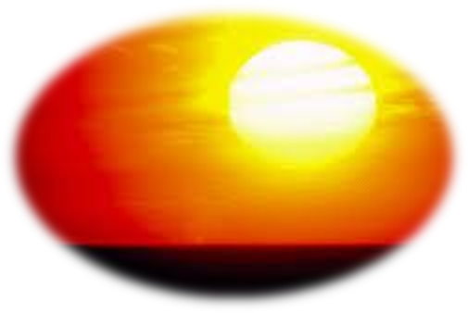
ORIENTAL COLLEGE OF EDUCATION
SANPADA
PRESENTATION ON SUBJECT- SCIENCE
TOPIC- ‘LIGHT’
BY
MEGHA SAO

Slide 2
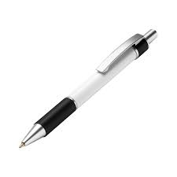

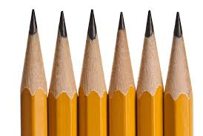

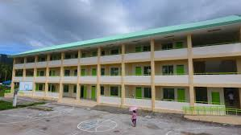
How do we see things around us ?

Slide 3
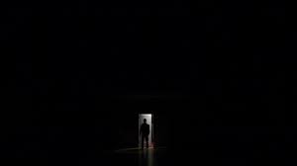
We can’t see anything in dark room

Slide 4
We see things because they reflect light into our eyes
SUN
Text Book

Slide 5
TOPICS TO BE COVERED:
Reflection of light.
Classify different types spherical mirror and lens.
Compare and contrast convex and concave mirror.
Value convex and concave lens in daily life.
Students will be able to examine dispersion of light.
Students will be able to construct Newton’s disc.

Slide 6
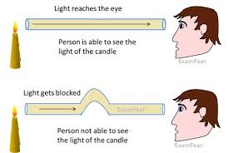
1. Light travels along a straight line
Activity:- Light a candle and fix it on a table. Take a piece of rubber tube. Look at the candle through the pipe. You can see the candle flame. If the pipe is bent, you can’t see the flame. This shows that light travels along a straight line.

Slide 7
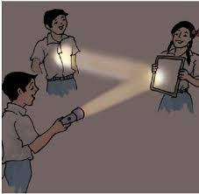
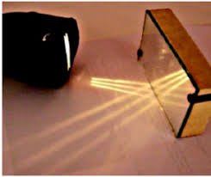
2.Reflection of Light :-
When the light falls on a mirror, the direction of light changes, this change in the direction of light is called reflecton of light.

Slide 8
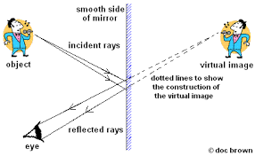
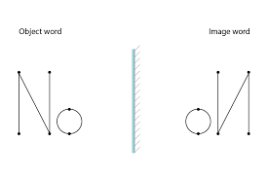
3. Image formed by a plane mirror:-
The image is erect.
The image is same size of the object.
The image is at the same distance from the mirror as the object is in front of it.
The image is virtual (Cannot not be obtained on a screen).
In the image, the right side appears left and the left side appears right

Slide 9
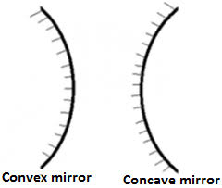
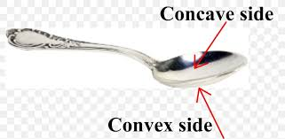
4a) Spherical mirrors :-
Spherical mirrors are curved mirrors
If the reflection surface is inside, the spherical mirror is a concave mirror.
If the reflecting surface is outside, the spherical mirror is a convex mirror.

Slide 10
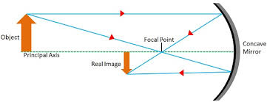
4b) Image formed by Concave mirror :-
Depending upon the distance of object get from the mirror.
The image may be-
Larger or smaller than the object.
Real (can be obtained on a screen) or virtual (can not be obtained on a screen) .
Inverted of erect.

Slide 11
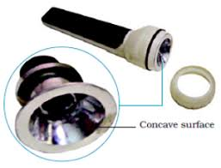

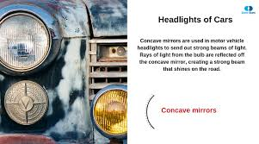
4c) Uses of Concave mirror :-
These are used as reflector of light, Headlights of cars and scooters etc.
These are used by dentists to see enlarged image of teeth.
These are used by doctors to examining eyes, ears, nose and throat.

Slide 12
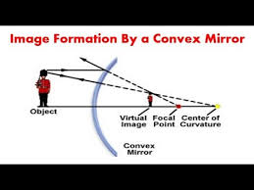
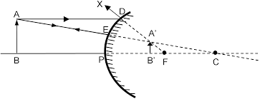
4d) Image formed by Convex mirror :-
The image formed by Convex mirror is virtual (can not be obtained on screen)
The image is smaller in size than the object.

Slide 13
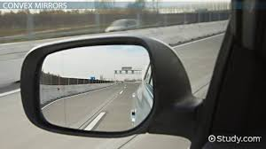
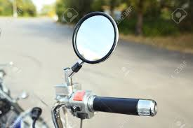
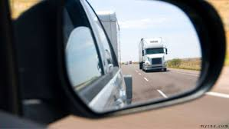
4e) Uses of Convex mirrors:-
These are used as side mirrors cars, scooters etc.
Convex mirror has wider view to help drivers to see the traffic behind them.

Slide 14
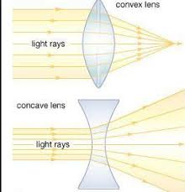
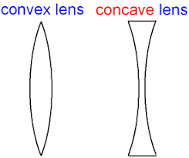
5a) Lenses :-
Lenses are of main two types. They are of convex lenses and concave lenses.
Convex lens is thick in the middle and thin at the edges. A convex lens bends light inwards so it is called converging lens.
Concave lens is thin in the middle and thick at the edges. A concave lens bends light outwards. So it is called diverging lens.

Slide 15
5b) Image formed by convex lens:-
Depending upon the distance of object get from the convex lens.
The image formed by convex lens may be smaller or Larger than the object.
The image may also real (can be obtained on a screen) or virtual (can not be obtained of screen).
The image may inverted of erect.
5c) Image formed by concave lens:-
The image formed by concave lens is virtual (can not be obtained of screen).
The image is smaller in size than the object.

Slide 16
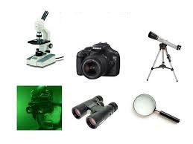
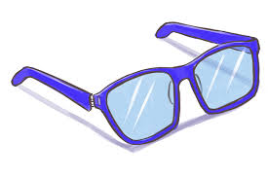
5d) Uses of Lenses:-
Lenses are used spectacles, microscopes, telescopes, cameras etc.

Slide 17
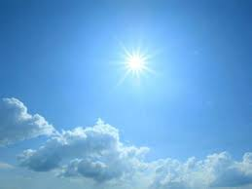

6a) Sunlight white of coloured ?
A rainbow is seen usually seen in the sky after a rain, when the sun is low in the sky. A rainbow has seven colours. They are red, orange, yellow, green blue indigo and violet.

Slide 18
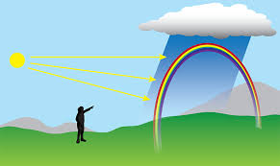
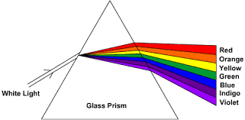
Activity :-
Take a glass prism and allow a narrow beam of a sun light to fall on one slide of the prism. Keep the screen on the other side of the prism. We can see that seven rainbow colours on the screen. This sows that sun light and white light is a mixture of seven colours.

Slide 19
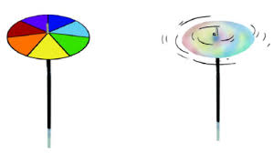
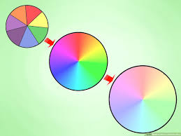
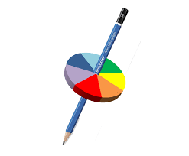
6b) Mixing the rainbow colours produces white light :-
If the seven rainbow colours are mixed together, it produces white light.
Activity :- Take a circular card board and devide into seven segments. Paint the seven rainbow colours on it. Make a small hole in the centre of the disc. Fix the disc on the tip of a reffil of a ball pen or pencil. When the disc is rotated fast, the colours get mixed and appears white in colour. This disc is known as Newton’s colour disc.

Slide 20


