Slide 1

SMART INDIA HACKATHON 2026
TITLE PAGE
Problem Statement ID - SIH26001
Problem Statement Title- AI-Based Early Warning and Landslide Risk Monitoring System in NER
Theme- Disaster Management
PS Category- Software
Team ID- SIH26-A0H-T184
Team Name (Registered on portal)- Aura
Lum Khasi for 'hill'. Two clocks on every slope in the North East.
A slow clock reads ground movement from radar that images every slope in the region every six days. A fast clock reads rainfall against a threshold fitted to the North East. A slope already creeping and about to be rained on is an evacuation; rain alone on stable ground is only a watch.
Every alert carries its reasons, and reaches the village by broadcast, by voice, or by a siren that needs no mobile network.
Notes:
Problem statement SIH26001 from the Ministry of Development of North Eastern Region. Team Aura. Our solution is called Lum, Khasi for hill. One line: radar tells us which slope is already moving, rainfall tells us which night it will fail, and the alert reaches the village even where there is no phone signal.

Slide 2
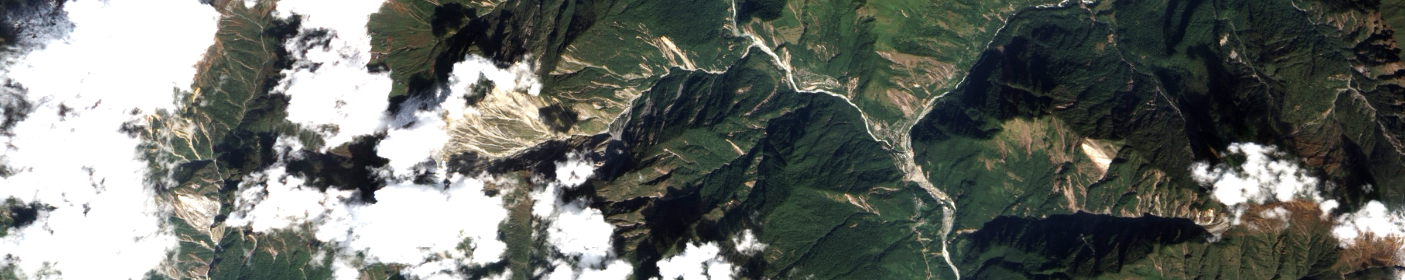
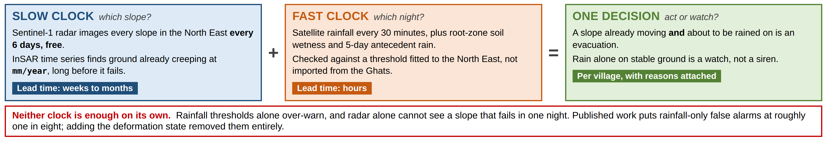
Aura
Lum: Watching the Slope Before the Rain Arrives
◆ Proposed Solution (Describe your Idea/Solution/Prototype)
◆ How it addresses the problem
1 Radar images every slope, every six days, free.
2 Interferometry finds slopes already creeping, months ahead.
3 Rain and soil wetness meet a North East threshold.
4 Both fuse into one risk state per village, with reasons.
5 Alerts go by broadcast, SMS, voice and LoRa siren.
6 Field reports and nodes return, and retrain both clocks.
Forecast skill is not the bottleneck. A correct bulletin went out hours before the Darjeeling landslides of 4 October 2025. Twenty-four people still died.
We narrow the warning from a district to a slope, say why it fired, and reach villages no SMS can.
◆ Innovation and uniqueness of the solution
Rainfall alone over-warns, radar alone is too slow. Fusing them is what removes the false alarms.
Radar triages for free, so sensors go only on slopes already moving, not on all 87,000.
Every alert carries a reason a District Magistrate can record when ordering an evacuation.
Every confirmed event is dated and located, building the record the region has never had.
Landslide scars in the Eastern Himalaya, seen from orbit. Radar covers this ground every six days, free.
@SIH Idea submission- Template
2
Notes:
Two clocks. The slow clock is radar interferometry: it tells us which slope is already moving. The fast clock is rainfall against a North East threshold: it tells us which night. Neither alone is enough, and the fusion is what removes false alarms.

Slide 3
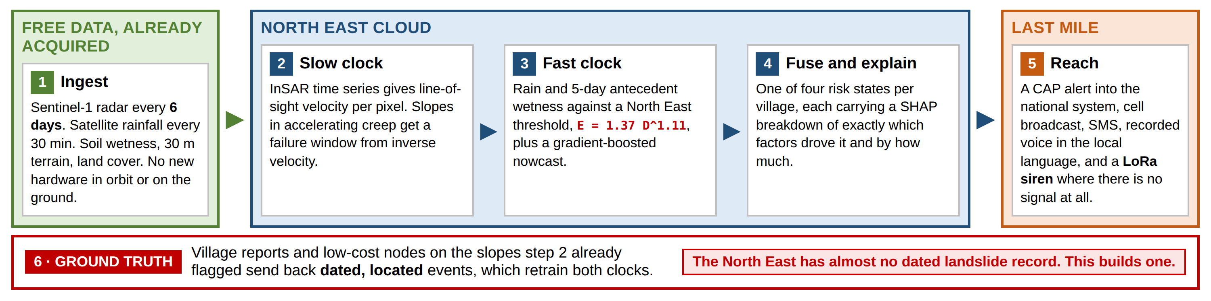















Aura
TECHNICAL APPROACH
◆ Technologies to be used
◆ Methodology and process for implementation
Data and processing
AI models
Platform
Apps, maps and test
Phase 1 Terrain and history: susceptibility layer for one pilot district.
Phase 2 Slow clock: InSAR time series, velocity map, creep detection.
Phase 3 Fast clock: thresholds, nowcast, spatial validation.
Phase 4 Fusion, SHAP reasons, and the control-room dashboard.
Phase 5 Last mile: CAP alerts, voice, LoRa siren and the field app.
Data and processing Sentinel-1 via ASF HyP3, IMERG rainfall, SMAP wetness, CartoDEM, Bhuvan land cover. Airflow schedules each pass; PostGIS holds slopes and villages.
AI models Gradient-boosted trees, spatially cross-validated, exported to ONNX so edge and cloud run the same weights.
Platform FastAPI and Redis, containerised for one state data-centre node or NIC cloud.
Apps, maps and test React and Leaflet control room, offline Flutter field app, tested on replayed monsoon data.
@SIH Idea submission- Template
3
Notes:
Six stages. Free data in, two independent clocks, a fused and explained risk state, then dissemination that survives no signal. Stage six closes the loop and builds the dated inventory the region does not have.

Slide 4
Aura
FEASIBILITY AND VIABILITY
◆ Analysis of the feasibility of the idea
◆ Potential challenges and risks
◆ Strategies for overcoming these challenges
Technical Every input is already in orbit and already free. No new satellite, no new gauges, nothing trained from scratch.
Operational The national alert system reaches all 36 states and union territories in over nineteen languages. It has no landslide generator. We become one.
Economic Free interferometry quotas cover hundreds of district-scale pairs a month. Watching one more slope costs nothing.
Institutional Amrita built India's first landslide sensor network, and Kerala acted on its alerts at Munnar in 2009. We extend our own field experience.
Radar cannot see a shallow slope that fails in a single night.
Exactly why the fast clock exists. Radar says where, rainfall says when.
Monsoon cloud blinds optical satellites when landslides happen.
Radar sees through cloud. The design is radar-first by necessity.
Landslide data is severely imbalanced; naive models score no better than chance.
Informed undersampling, physics-constrained negatives, spatial cross-validation.
Why a new approach is needed
India's landslide maps say where, never when. Forecasting is operational in three districts nationwide and none in the North East. The published roadmap reaches only eighteen districts here by 2030, against eighty-seven that are landslide-prone.
Waiting is not a plan. Everything Lum needs is already overhead.
False alarms get a warning system switched off in one season.
Rainfall-only false alarms run near one in eight. Adding deformation removed them.
1,841 villages cannot receive a phone alert at all.
LoRa sirens on the gateways already carrying sensor data, satellite messaging beyond.
@SIH Idea submission- Template
4
Notes:
The honest weakness is that radar cannot catch a shallow rain-triggered failure. We say so first, because it is the reason the second clock exists.

Slide 5
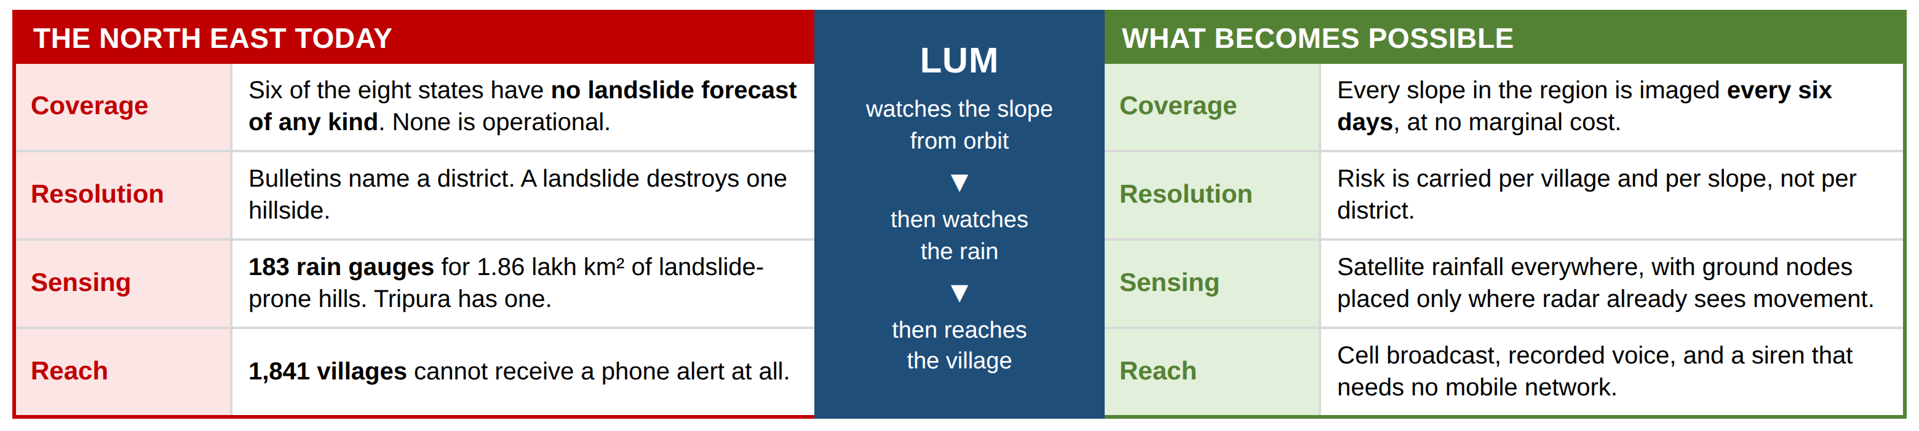
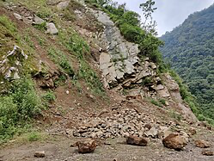
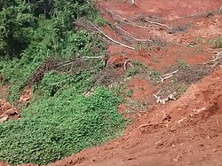
Aura
IMPACT AND BENEFITS
◆ Potential impact on the target audience
◆ Benefits of the solution (social, economic, environmental, etc.)
Social Warning reaches hill villages, quarry settlements and highway camps, in the local language and without a phone.
Economic Radar and rainfall data are free and already acquired, so coverage grows with terrain rather than with budget.
Environmental Slopes destabilised by cutting and quarrying show up as movement long before they fail, turning warning into planning evidence.
Guwahati–Shillong road, Meghalaya, and a failed slope in Nagaland.
3 districts in India have operational landslide warning, none in the North East
1 / 1,015 km² rain gauge density across the region's landslide-prone hills
6 days radar revisit on every slope in the North East, at no cost
₹0 marginal cost to bring one more slope under watch
@SIH Idea submission- Template
5
Notes:
Left of the table is the North East today, right is what changes. The two photographs are what a landslide does at ground level. The four numbers close it: three operational districts nationwide and none here, one gauge per thousand square kilometres, six-day radar revisit, zero marginal cost per extra slope.

Slide 6
Aura
RESEARCH AND REFERENCES
◆ Details / Links of the reference and research work
The problem statement and national policy
SIH 2026 problem statement SIH26001, Ministry of Development of North Eastern Region
Ministry of Earth Sciences, mapping of landslide prone areas, Parliament reply, 2025
NDMA, National Landslide Risk Management Strategy, 2019
Geological Survey of India, landslide and forecasting scenario in the North Eastern Region
Where warning falls short today
Bhusanket, the GSI landslide forecast portal
Down To Earth, why localised landslide warnings remain an uphill battle, 2024
Down To Earth, nearly 600 landslides in Mizoram in ten days, June 2025
Sangi et al., Cyclone Remal-induced landslides in Aizawl, Landslides, 2025
The Sentinel, 1,841 North East villages without mobile coverage, February 2026
Rainfall thresholds for the North East
Roul et al., rainfall thresholds for landslide prediction in India, 2025
Harilal et al., rainfall thresholds for real-time landslide warning in Sikkim, 2019
Guzzetti et al., rainfall thresholds for the initiation of landslides, Landslides, 2008
Reading ground movement from orbit
Carla et al., predicting catastrophic slope failures from satellite InSAR, 2019
ASF HyP3, free on-demand Sentinel-1 interferometry
ESA, Sentinel-1 mission and the six-day repeat cycle
COMET LiCSAR, pre-processed Sentinel-1 interferograms
Learning and explaining the risk
Stanley et al., data-driven landslide nowcasting at the global scale, 2021
He et al., radar rainfall thresholds and false alarm rates, 2025
Gupta and Shukla, handling data imbalance in landslide susceptibility, Landslides, 2023
Mihu et al., machine-learning susceptibility in the Dibang Valley, North East India, 2026
Al-Najjar et al., SHAP for landslide susceptibility models, ISPRS Annals, 2025
Data sources and the last mile
NASA GPM IMERG Early Run precipitation
NASA SMAP root-zone soil moisture products
NRSC Bhoonidhi, CartoDEM and Indian earth observation data
ISRO Landslide Atlas of India
SACHET, NDMA's CAP-based integrated alert system
SACHET CAP feed integration guide for agencies
Ramesh et al., wireless sensor networks for landslide early warning, a decade of deployment
Pires and Veiga, low-cost LoRa system for landslide monitoring, Designs, 2025
Copernicus GLO-30 global digital elevation model
Photographs: Landslide on the Guwahati to Shillong road, Wikimedia Commons
Photographs: Landslide in Nagaland, Wikimedia Commons
@SIH Idea submission- Template
6
Notes:
Every link is live. The three that matter most are the Parliament reply for the coverage figures, the GSI North East presentation for the gauge density, and Roul et al. for the North East rainfall threshold we use.

