Slide 1



Strain Engineering Valleytronics for State Coherence
Exploring novel quantum degrees of freedom for next-generation computation!
Nima Leclerc[1,2], Jonah Haber [2], Jeffrey B. Neaton [2]
[1] Department of Materials Science and Engineering, Cornell University
[2] Molecular Foundry, Lawrence Berkeley National Laboratory

Slide 2

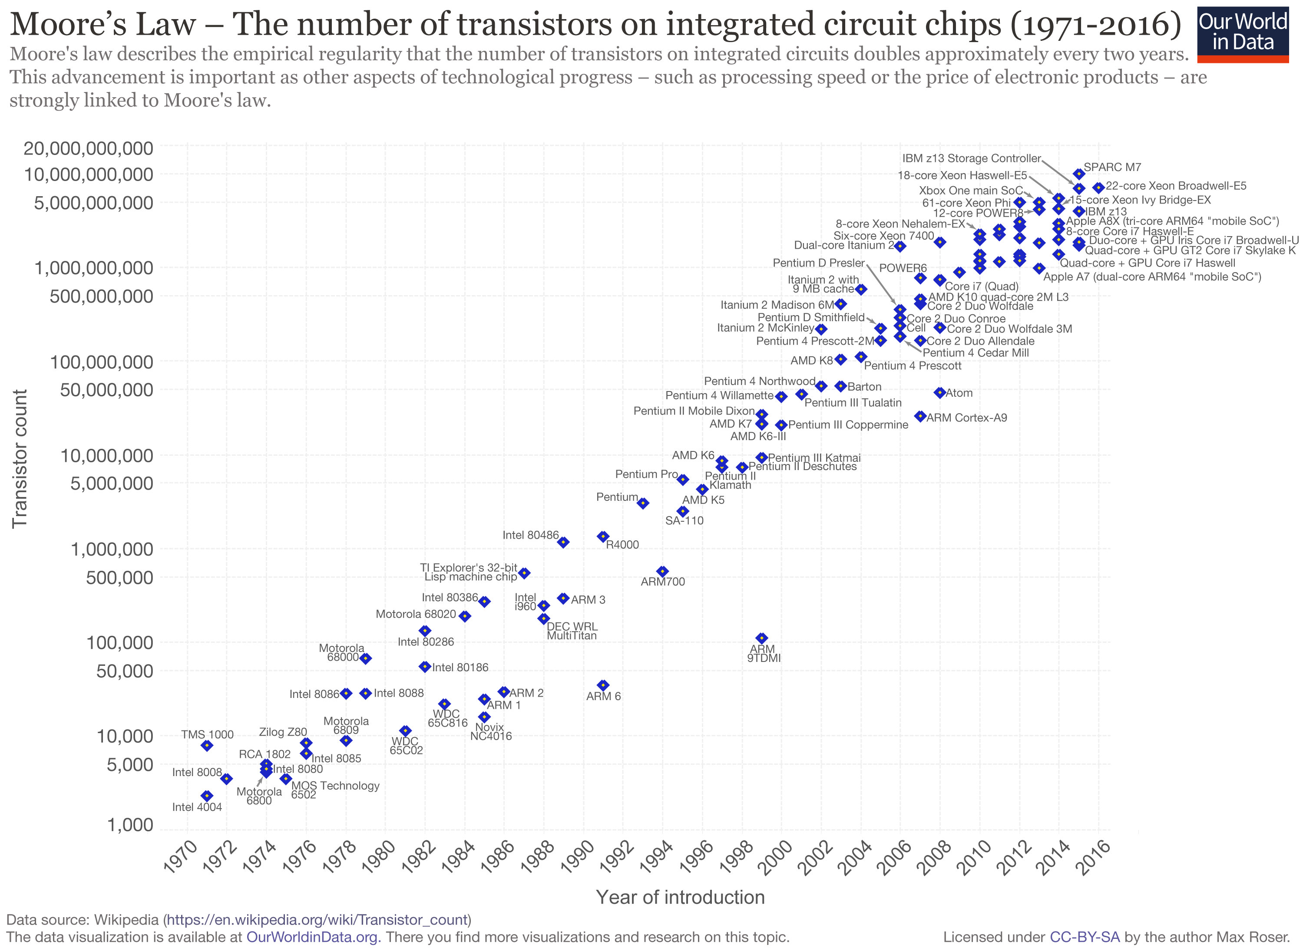




Coming to the End of Moore’s Law?
-IC transistor density scales linear with time
-Power loss scaling quadratic
-Major effort to reduced subthreshold voltage swing ➔ 60 mV/Dec
$$Low V_{s}$$
$\sim {10}^{11}$ Devices!
$$Heat Loss$$
III-V CMOS Design Concepts Dominant (HEMT)
[Cornell Group Proposal]
Let’s forget voltage? Think light.
Think valleys.

Slide 3
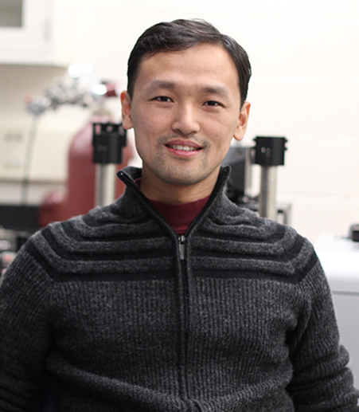

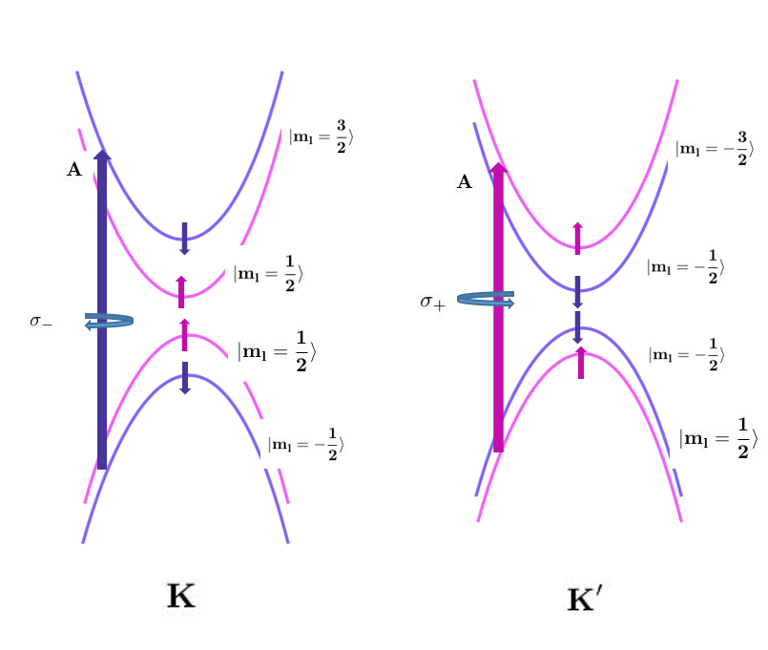


Valleytronics: Moving Electrons with Light for Computation
Time-reversal symmetry ➔ Valley index corresponding to K/K’ points in momentum space couple to right and left polarized light ➔ NO GATE VOLTAGE = NO HEATING
Energy
Kin Fai Mak (Cornell)
Tony Heinz (Columbia )
The grand physical challenge: Maintain state coherence to be robust to lattice vibrations. So heat doesn't matter?

Slide 4


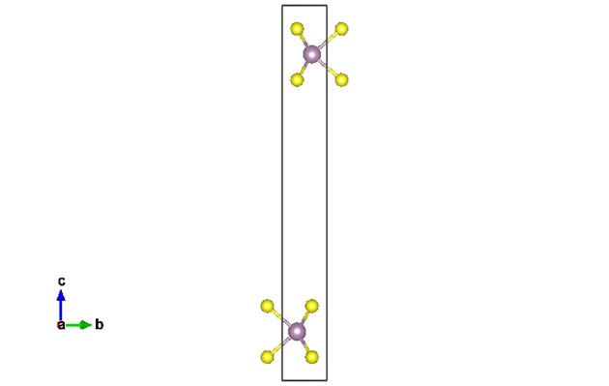
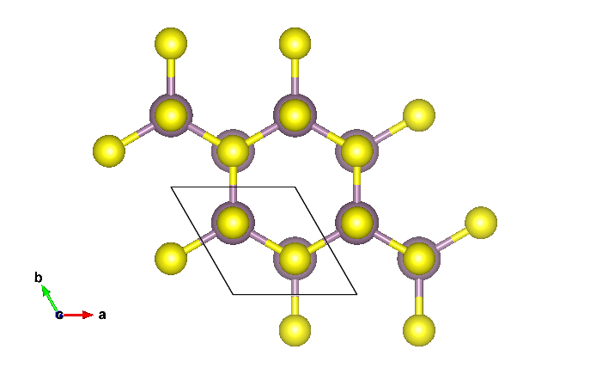


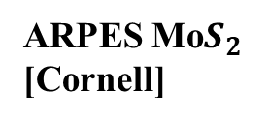

A Brief Introduction to 2D Transition Metal Dichacolgenides
2D Confinement of Mo$S_{2}$ with Uniaxial Strain
Direct Band Gap Transition
Bulk
2D Confinement
TMDs
Mo/W + S/Se
-Earth abundant
-Used in lubricants
Mono
Break Inversion Symmetry
ARPES Mo$S_{2}$ [Cornell]

Slide 5
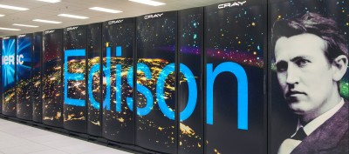
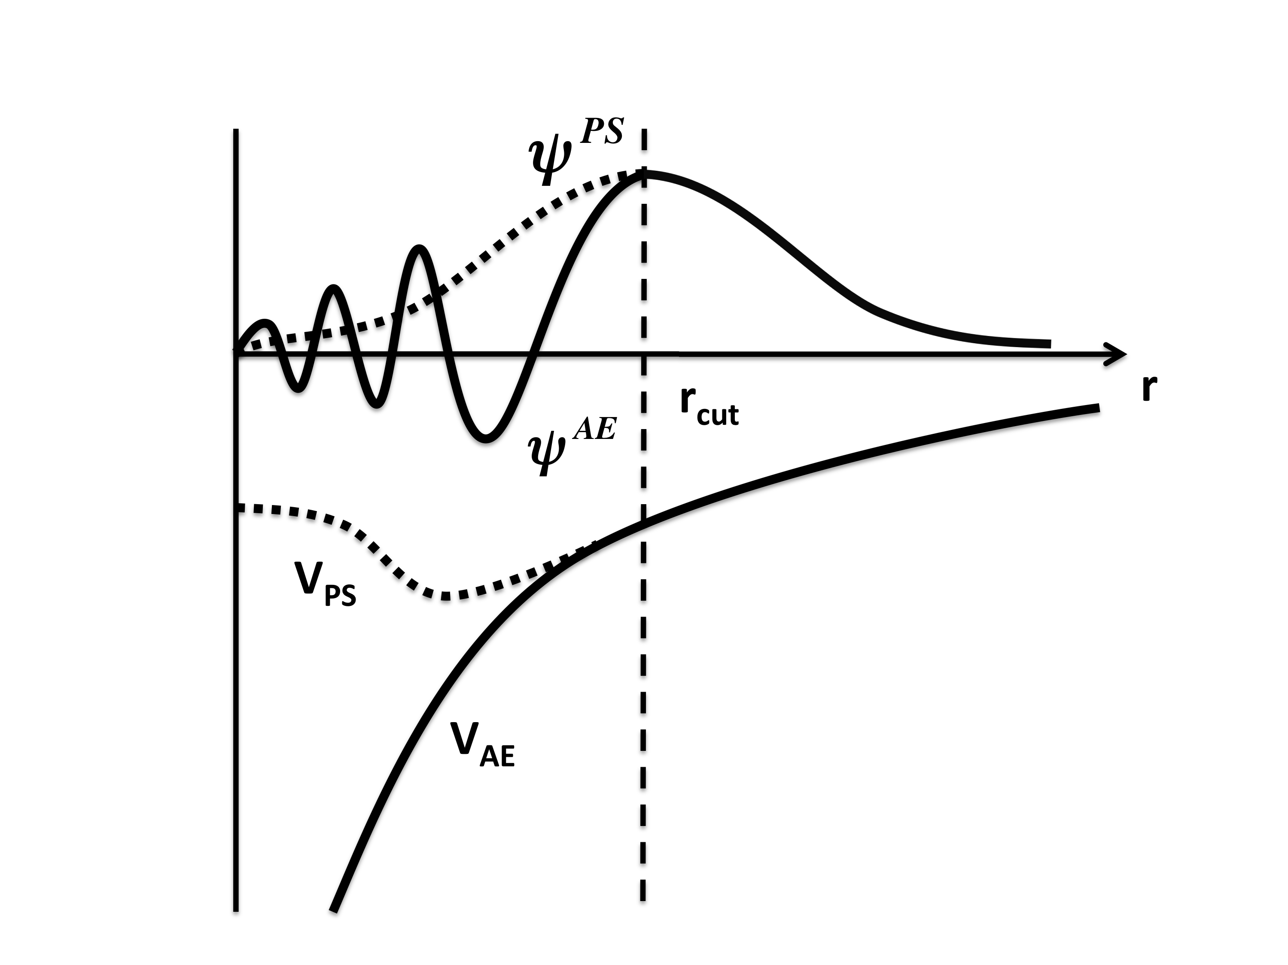
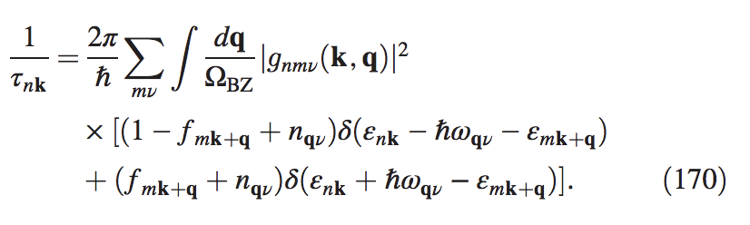

Engineering Electronic Materials with Quantum Mechanics
Solve SE for material in super computer ➔ use DFT ➔ obtain wavefucntions
Predict electronic properties ➔ device behavior, carrier lifetimes
Hypothesize/tune structure and pseudo-interactions

Slide 6
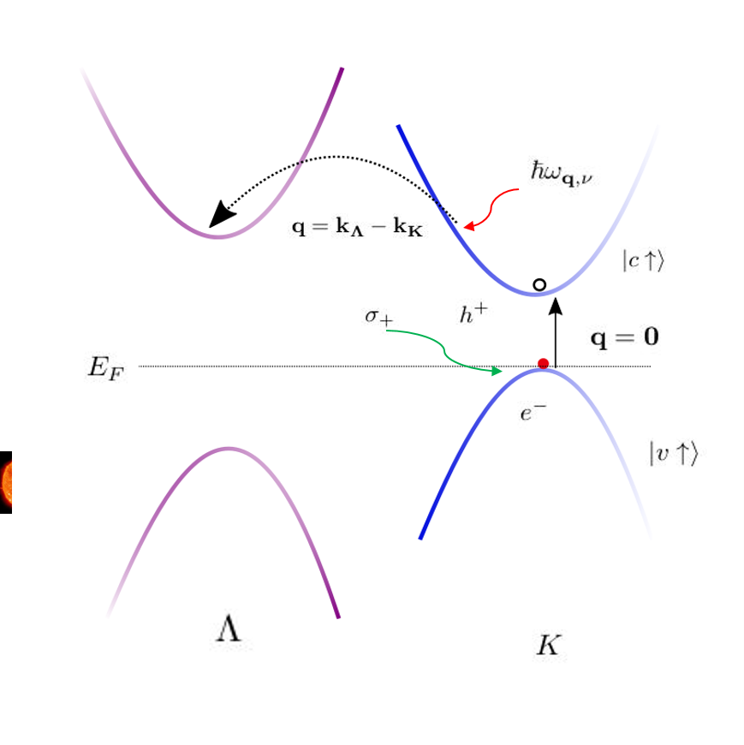
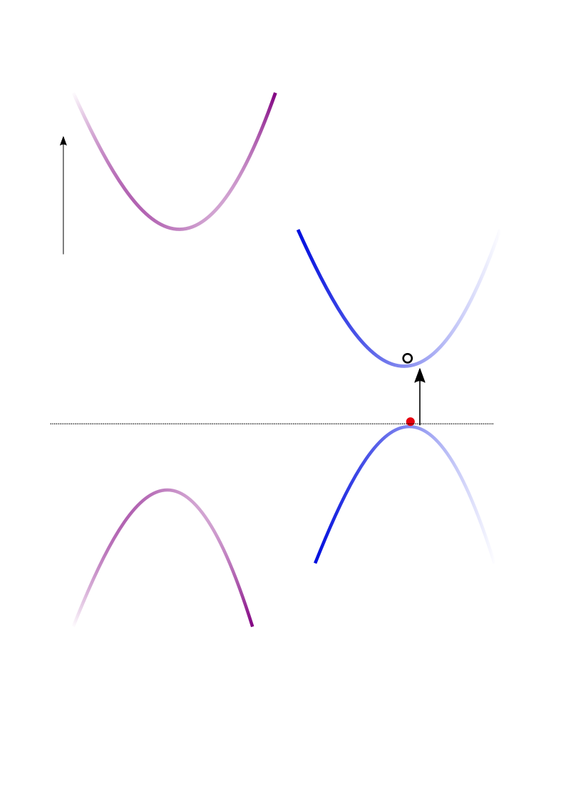
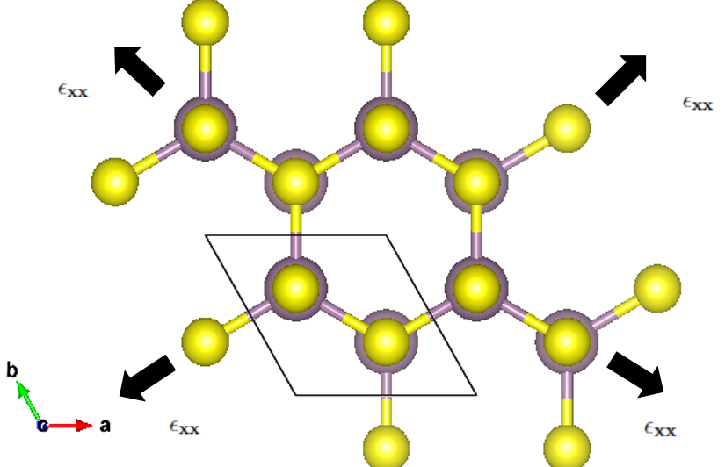











Engineering Coherence by Stretching Atomic Layers
Proposal= Apply biaxial strain to 2D TMD material
-Spatially separate K-Λ valleys == > fewer intervalley scattering events ➔ thermal vibrations don’t interfere coherence ➔ longer exciton lifetime
-Energetically separate K-Λ valleys ➔ only desire direct transitions for valley logic coherence

Slide 7
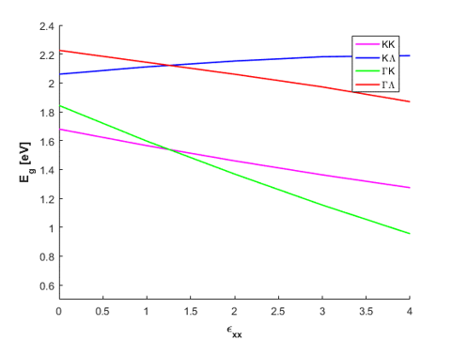
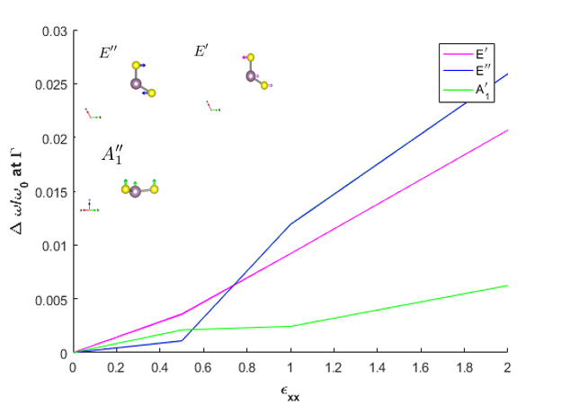
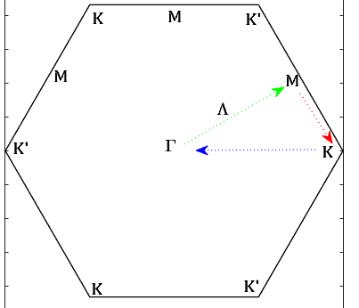
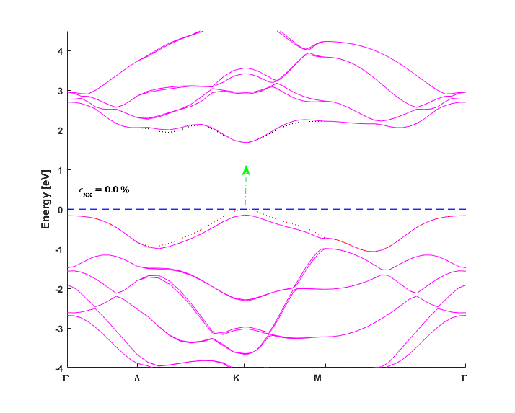
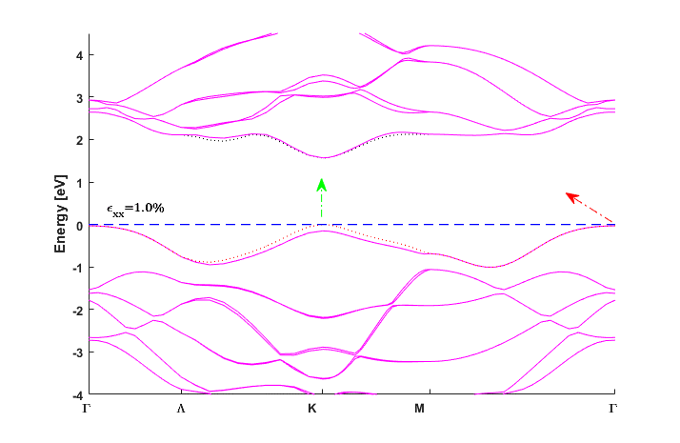
Theoretical Results of Strain Engineering Valleytronics
Energetics ➔ energetic contribution to coherence improves with strain
K-space transition ➔ energetic contribution to coherence improves with strain
0.0%
1.0%
Take away ➔ we can now engineer valley coherence of deviceswith application of biaxial strain on 2D materials
Upper bound on strain = 1.0 % ➔ stay between 0-1.0%
KK remains direct transition
KK remains direct transition,
ΓK transition emerges

Slide 8
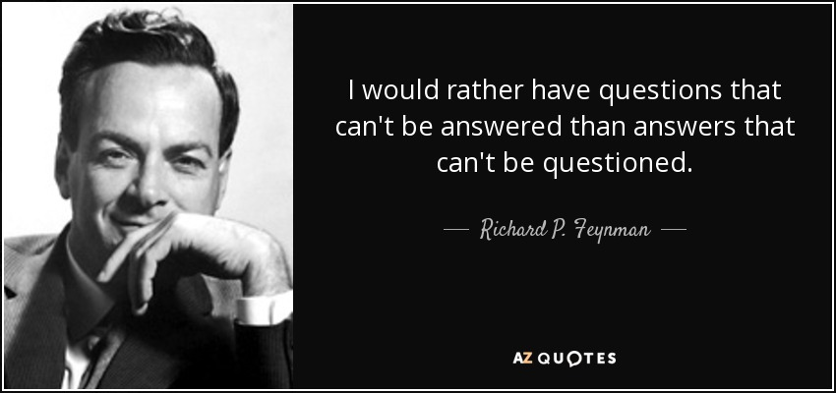
So just ask the right questions and think valleys…
Nima Leclerc, nl475@cornell.edu

