Slide 1
CURSOR MOVEMENT BY HAND GESTURE
Members:
Purti Lalan
Purvi Lalan
Nimali Keny

Slide 2
Our algorithm works as follows:
Webcam video is captures using c# OR Python video capture libraries
It is broken up into continuous image frames
Each frame is converted to grayscale
Each frame is now scanned to check five finger design pattern
Once detected it is flagged as an object
System now tracks its movement within particular frame
This is tracked in terms of x,y coordinates
These x, coordinates are now mapped onto mouse cursor positioning

Slide 3
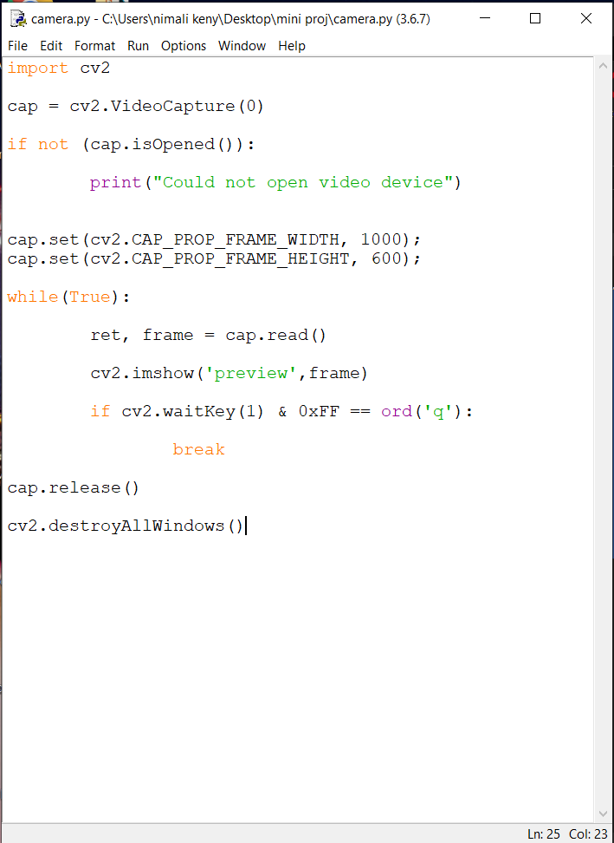
Program

Slide 4
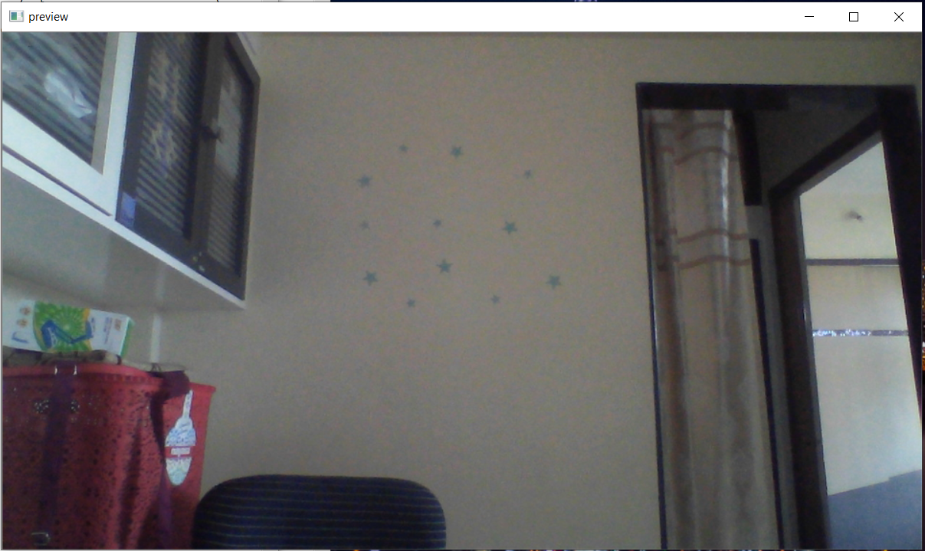
Output

Slide 5
The main objectives of the project are as follows: -
a. Obtain input video feed
b. Retrieve useful data from the image to be used as input
c. Filter the image and identify different colors.
d. Track the movement of colors in the video frame.
e. Implement it to the mouse interface of the computer according to predefined notions for mouse pointer control.

Slide 6
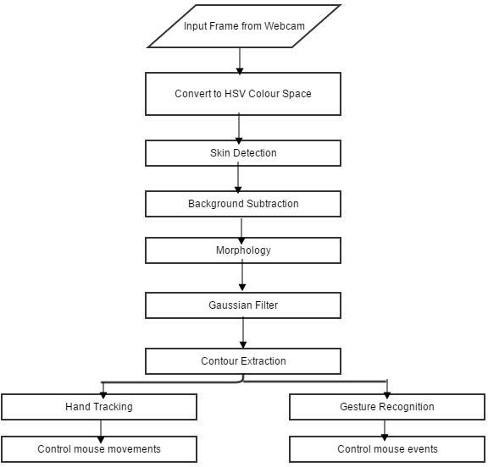

Slide 7
The HSV color space was chosen since it was found by to be the best color space for skin detection.
The next step would be to use a method that would differentiate selected color pixels from non-color pixels in the image (color detection).
The system can be broken down in four main components, which are:
Color detection
Color Contour Extraction
Hand Tracking
Gesture Recognition
Cursor Control

Slide 8
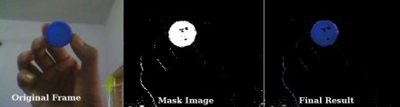
calibrate the color ranges for three of his fingers individually. This is done by calling the calibrateColor() function thrice right at the beginning of the program
Depending on the calibrations, only the three fingertips are extracted from the video, one by one, using the cv2.inRange() function
In order to remove noise in the video feed, we apply a two-step morphism i.e. erosion and dilation
Depending upon its output, the performAction() function carries out either of the following using the PyAutoGUI library:
free cursor movement
left click
right click
drag/select
scroll up
scroll down

Slide 9
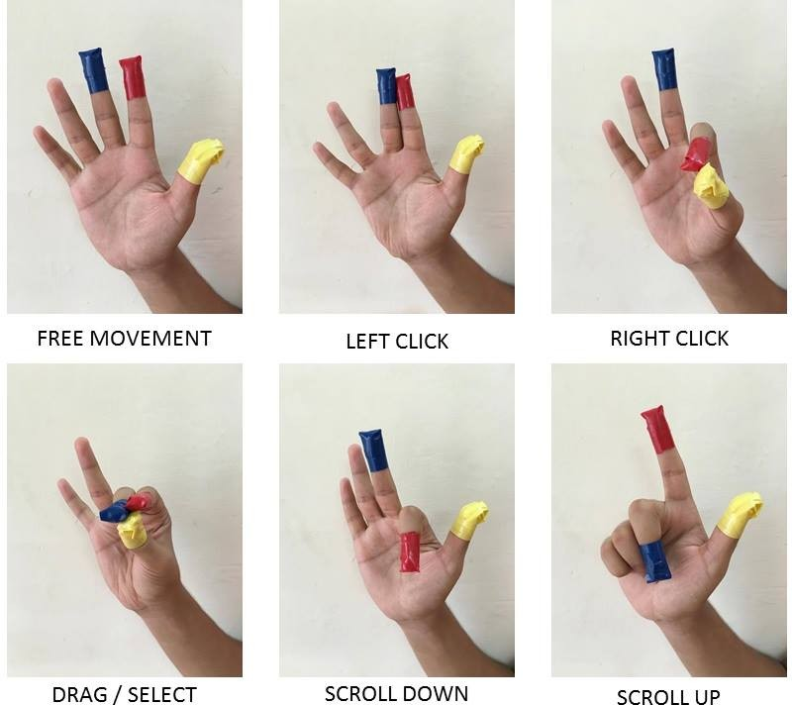

Slide 10
Project Specifications
Software Specifications:
64-bit Operating System: Windows 8 or Higher
OpenCV 2.4.9 needs to be installed prior to running.
Windows Administrator permissions are needed for some parts of the program to function properly.
Hardware Specifications: A Webcam
Other Specifications:
A clear white background
There should be no other objects (especially red, blue, yellow colored) in front of the webcam other than on the fingers.

Slide 11
Advantages:
The system is easy to install.
It can be used as easy mouse control for users.
It is not an electronic based system so one can easily make use of laptops to install this system.
It is cost-effective.
It maximizes accuracy and reduces energy usage.
Disadvantages:
It requires a lot of memory.
The alarm it has limited accuracy.
Applications:
The project can be used for home, office, school, shops etc for easy usage purposes.

