Slide 1


, , , , , , ,
, , , , , , ,
Digital Evidence Management System
(DEMS)
A Cloud-Native Forensic Evidence Platform Built on Microsoft Azure
Presented By: Nima Mehranfar
Course: Cloud Computing
Date: Feb 20, 2026
Notes:
Good morning, everyone! My name is Nima, and today I'll be presenting on "DEMS“. This project is a full-stack cloud application built entirely on Microsoft Azure services.

Slide 2

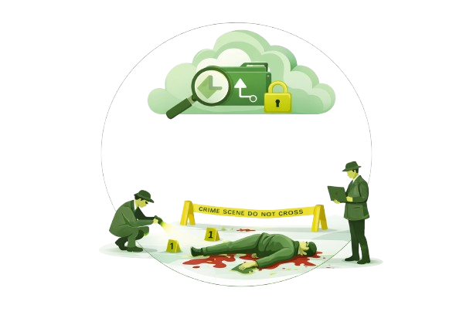
, , , , , , ,
, , , , , , ,
AGENDA
Introduction & Goal
System Architecture
Role-based Access Control
Order Workflow
Demo
Notes:
Here's a quick look at the agenda. I’ll briefly cover the goal , System Architecture, deep dive to important services , the end-to-end order workflow, and then show a live demo.

Slide 3
PROBLEM STATEMENT & PROJECT GOALS
What Problem Does DEMS Solve?
Problem:
01
02
Digital evidence is fragmented, unsearchable, and lacks audit control.
Investigations are slowed by manual handling of files and media.
Goal:
01
02
Provide a unified cloud-based platform to securely manage evidence under structured cases.
Enable Cloud-powered full-text search across documents, images, and audio.
Notes:
So what problem we are trying to solve?
The sheer volume and size of evidences in criminal cases can makes manual search practically impossible without specialized software
A detective being able to search for the word "knife" across all evidences while some evidences maybe is a 40-minute audio interview or interrogation is a good example for that..
The goal is to use cloud platform without any upfront investment and automate information extraction process of collected evidence.

Slide 4
System Architecture
Architecture Overview — All Azure, No On-Premise
•
•
Microsoft Entra ID (Workforce): Authenticates users and provides app roles for RBAC.
Azure Blob Storage: Stores raw uploads and derived outputs
•
•
Azure Static Web Apps: Hosts the React SPA and deploys via GitHub Actions.
Azure Cosmos DB: Stores metadata + relationships (departments, cases, evidence, users/roles mapping).
•
•
Azure API Management (APIM): Single public API entry point with JWT validation + CORS + stable base URL.
Azure Computer Vision: Extracts text via OCR from images and PDFs.
•
•
Azure Functions (Node.js/TypeScript): Implements HTTP APIs and processes evidence via blob-trigger pipeline.
Azure Speech: Transcribes audio evidence into searchable text.
•
•
Azure Key Vault: Holds secrets (AI/Search keys etc.) resolved at runtime without hardcoding.
Azure AI Search: Indexes extracted text + tags for full-text search, filtering, and relevance ranking.
Notes:
This application uses some cloud services that you can see. So couple of important notes that I have to mention is
browser uploads files DIRECTLY to Blob Storage using a SAS(Shared Access Signature) URL — the backend never touches the file bytes.
key Vault + Managed Identity means there are zero plaintext credentials and secrets exposed anywhere.
I Wanted to deploy object detection in computer vision service but it required custom model and increased complexity so I just have ocr from computer vision service.

Slide 5
Identity & RBAC Model
Authentication and Access Control — How Users Sign In and What They Can Do
Sign-In Flow:
01
User visits DEMS (unauthenticated) → redirected to Microsoft Entra ID
02
Entra handles login/2fa → redirected to DEMS (authenticated)
Roles (defined as App Roles in Entra, carried in the JWT):
01
Admin : Manage users & departments only - Zero access to cases, evidence, or search
02
Detective : Full CRUD — create, edit, delete cases and evidence
03
Prosecutor : Read-only access — view cases, evidence, search results
Notes:
For auth and access control, basically Azure entra id handles everything about sign in sign out and website just receives the user access token.
APIM service AND Functions validate JWT independently and also fronted manages role based access to components and routes and functionalities.
We have 3 roles for now.

Slide 6
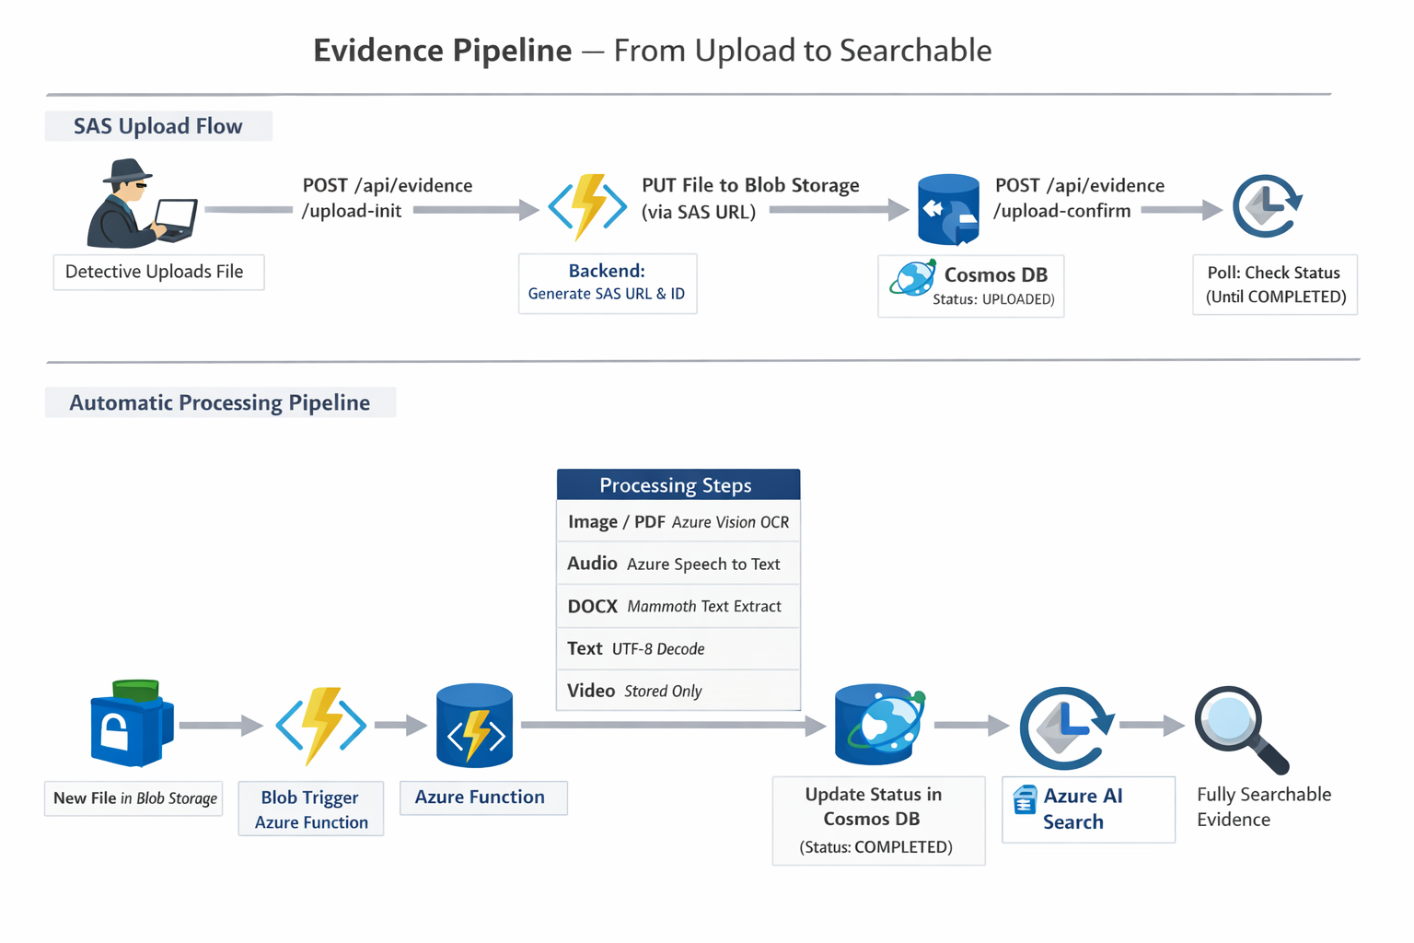
EVIDENCE UPLOAD & PROCESSING PIPELINE
rqt_graph of nodes and topics
Notes:
Step 1: upload-initializes → returns SAS URL and evidenceId
Step 2: browser uploads directly to Blob Storage (PUT SAS(Shared Access Signature) URL)
Step 3: upload-confirm → metadata stored (description, tags)
Step 4: status endpoint used for polling (processing progress)
what happens in the backend: file lands on blob storage and triggers a function which processes the files based on it’s type and saves extracted data on cosmos db. Then we search it.

Slide 7

Search Experience
•
Azure AI Search index stores:
- Extracted Text
- Status
- Case
- Department
- Tags
- Timestamps
•
Search API supports:
- Full-text query
- Filters (case, department, status, tag)
Notes:
Search is cross-case and cross-department by default, meaning investigators are not limited to one case folder view. The Azure AI Search index contains extracted text from OCR and audio transcription, so queries match not only file names but actual spoken words and document content.

Slide 8
CI/CD and Operations
Automated Deployment with GitHub Actions
Frontend:
Backend:
01
05
Checkout repository
Checkout repository
02
06
Inject secrets from GitHub Secrets into build environment
npm install + npm run build (TypeScript → dist/)
03
07
npm install + npm run build inside ./frontend
Login to Azure via OIDC (Federated Credential — no client secret in GitHub)
04
08
Deploy build/ output to Azure Static Web Apps
Deploy to func-dems1 Production slot via Azure Functions Action
Notes:
Both frontend and backend deploy automatically on push to main, with GitHub Actions building and securely deploying to Azure in minutes.
No secrets in code, and runtime secrets resolved from Key Vault via Managed Identity.

Slide 9



Thank You — Demo Time
Fun fact: Before searchable transcripts, investigators sometimes had to listen to recordings at 2× speed for hours — now AI does it in seconds, and it doesn’t even need coffee.
Notes:
Thank you for your attention. any questions?

