Slide 1

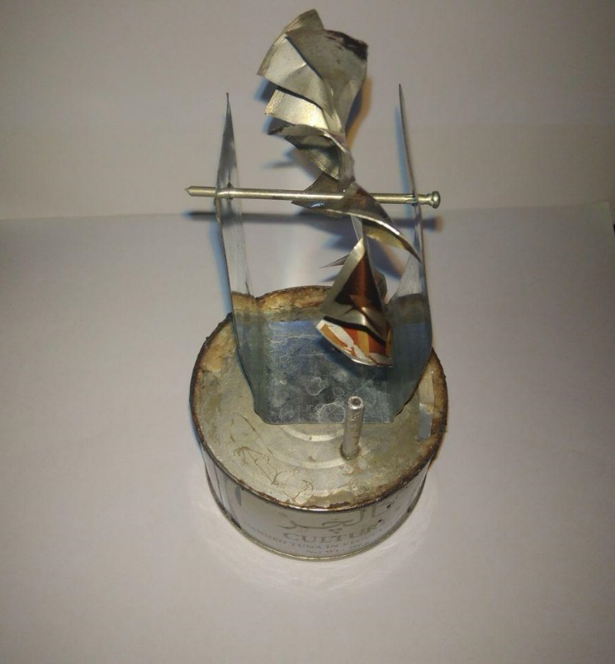
2 Jan 2019
IR,TEH
In The Name Of GOD
1st Exhibition Of Mechanical Engineering Science Projects
Steam Power Generator
A Cool Science Project With Easy Way
Morteza Kalvani, Alireza Moshrefi
Using the steam power has a 2000 years history & until 300 years ago steam engine hasn’t much effect on industry. First steam engine invented by Denis Papin in 1690.
History
Tuna can (Boiler) , Thin Aluminum sheet , Wing (soda can) , Glue , Perforated Iron Shaft , Water
Material
First we boil the water in the can and the steam comes out from the tiny shaft and makes the wings move
How to do
There is so many uses in industry from the wings that moving because of steam, such as producing electricity or mechanical uses in Trains & etc.
Result

