Slide 1
A Systematic Literature Review on AI-Driven DevOps: Enhancing CI/CD, Monitoring, and Error Prediction
کد مقاله: csc-1110
Ali Shahnazi, Bachelor's Student in Computer Engineering, Faculty of Technology and Engineering, University of Guilan, Guilan, Iran; alishahnazi83@gmail.com
Nima Nikrouz, Bachelor's Student in Computer Engineering, Faculty of Technology and Engineering, University of Guilan, Guilan, Iran; nimanikrouz@gmail.com
Amir Seyed Danesh, Faculty of Engineering and Technology and Engineering, East of Guilan, University of Guilan, Rudsar - Vajargah, Iran; seyeddanesh@guilan.ac.ir

Slide 2
Agenda
- Introduction
- Background on CI/CD
- Methodology of article
- Case study on GitLab
- Conclusion

Slide 3
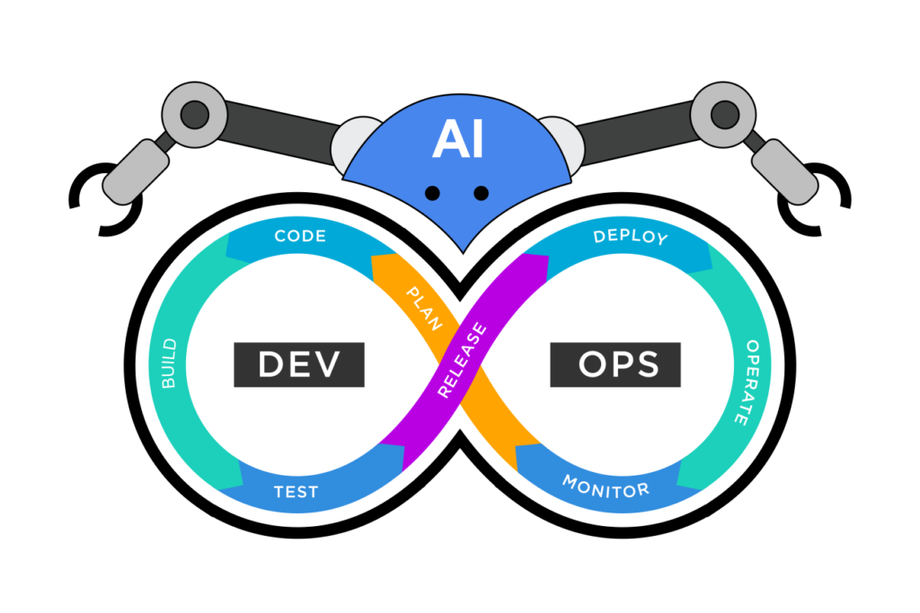
Introduction & Research Goal
This paper presents a systematic literature review (SLR) from 2020–2025 to explore how AI (ML, DL, LLMs) enhances DevOps in three key areas:
1. CI/CD Automation
2. Monitoring & Anomaly Detection
3. Fault Prediction & Remediation
Research Questions:
What AI algorithms are used in DevOps workflows?
How has AI improved CI/CD processes?
What methods exist for error prediction in DevOps?

Slide 4
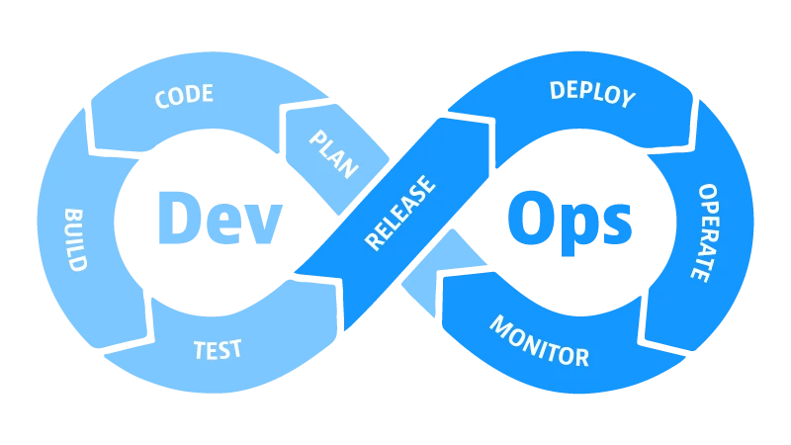
Key Topics Covered
Four quadrants or timeline layout:
1.DevOps is a widely embraced framework…
1.1 Importance of AI in Improving DevOps Processes
1.2 Problems in CI/CD and Monitoring that AI Can Address
1.3 Research Goals and Questions

Slide 5
Overview of DevOps & Core Components
Key points:
DevOps = Cultural + Technical bridge
between Dev and Ops
Core pillars:
CI/CD pipelines, Automated monitoring,
Feedback loops
Challenges at scale:
Frequent build failures, high costs, complex testing, limited visibility

Slide 6
History of AI in DevOps
Timeline:
Early 2010s → Basic ML for log analysis & anomaly detection
Late 2010s → Deep Learning on commit histories
~2020 → Rise of LLMs for log analysis & MTTR reduction
Now (2025) → AIOps widely adopted (GitLab, Dynatrace, Splunk)

Slide 7
What Makes This Review Different?
Previous reviews →
Narrow focus (only monitoring or only prediction)
This paper →
Systematic (2020–2025)
Covers all 3 pillars
Analytical comparison + Real-world GitLab CI/CD case study

Slide 8
Methodology – Simplified Systematic Literature Review (SLR)
Step | Description
Overview | Simplified SLR to explore AI in DevOps (AIOps) from 2020–2025 Focus: CI/CD automation, monitoring, fault prediction
Search Method | Sources: Google Scholar + accessible databases Keywords: “AI in DevOps”, “AIOps”, “CI/CD automation”, “anomaly detection”, “failure prediction” Added: GitLab, Dynatrace, Splunk industrial reports & blogs
Data Extraction & Analysis | Extracted: Title, Year, AI method, DevOps area, Key findingsQualitative & descriptive analysis Compared approaches, identified patterns
Limitations | Not exhaustive; limited to major databases + selected reports Still provides clear, balanced overview of AIOps trends

Slide 9
AI in DevOps – Key Areas Explored
Area | AI Techniques | Strengths | Limitations
AI in CI/CD Automation | • ML: Predict build failures from commits • LLMs: Log analysis, error classification, fix suggestions | • Prevents up to 30% of failed builds • Reduces MTTR by 40 – 60% • GitLab: +20 – 25% success rate | • Needs projectspecific data • High integration cost • Labeled data scarce
AI in Monitoring | • DL: Time-series anomaly detection • Clustering, Multi-agent (e.g., CoE-Ops) | • Real-time detection • Proactive RCA • Enables selfhealing | • Requires large, clean data • Privacy & heterogeneity issues • “Black box” → low trust
AI in Error Prediction / Fault Detection | • Supervised ML: Classify risky commits • LLMs: Correlate logs, recommend fixes | • 50% MTTR cut in some cases • Prevents downtime | • Noisy logs reduce accuracy • Automation risks in critical systems • Low explainability

Slide 10
Comparison of AI Techniques Across AIOps Categories (Table1)
Category | AI Technique/Algorithm | Strengths | Limitations | References
CI/CD Automation | ML (e.g., predictive models), LLMs (log analysis) | Improved failure prediction, reduced MTTR | Projectspecific data dependency, integration overhead | [4], [5], [8], [13]
Monitoring | DL (time-series), Multiagent (CoE-Ops) | Accurate anomaly detection, self-healing | Data scarcity, explainability gaps | [3], [6], [9], [14]
Error Prediction / Fault Detection | Supervised ML, LLMs (error classification) | Proactive remediation, 50% MTTR cut | Noisy data impact, automation risks | [4], [5], [6], [11]

Slide 11

Case Study – GitLab CI/CD with AIOps (Part 1)
GitLab Duo (2023 → GitLab 18, May 2025)
Key AI Features:
ML predicts build failures from commits (prevents ~30%)
LLMs power “Troubleshoot” – parses logs & suggests fixes
Dynamic runner scaling Auto DevOps with smart retries/rollbacks
Duo Agent Platform (beta 2025) – Multi-agent collaboration

Slide 12
Case Study – Real-World Impact (Part 2)
Metric | Pre-AI Baseline | With GitLab Duo AI | Improvement | Source
Pipeline Success Rate | 75% | 93–100% | +20 –25% | [8], [11]
MTTR for Failures | 45 – 60 min | 15 – 25 min | −50 –60% | [5], [8]
Deployment Frequency | 5 – 10/week | 15–20/week | +30% | [11]
Resource Costs | 100% baseline | 65–75% | −25 –35% | [9], [11]

Slide 13
Case Study – Limitations & Key Takeaways (Part 3)
Limitations:
Accuracy drops 20–30% with noisy/legacy logs
Integration overhead with non-GitLab tools
Black-box concerns in regulated industries
Advanced features require Duo Enterprise ($39/user/mo)

Slide 14
Discussion – Advantages, Challenges & Future
Advantages:
Predictive, automated, self-healing, massive MTTR/cost reduction
Key Challenges:
Data dependency, Explainability, Integration cost, Security
Future Directions:
Generative AI for diagnostics & log synthesis
Explainable AI (XAI)
Multi-agent systems (e.g., CoE-Ops)
Secure DevSecOps-native AIOps

Slide 15
Conclusion
Key Summary:
AI (ML, DL, LLMs) significantly enhances all three pillars of modern DevOps
GitLab case study proves real-world impact: +20 – 25% success rate, −50% MTTR
Answers to Research Questions:
1. Dominant algorithms: ML, DL, LLMs
2. AI improves CI/CD via prediction, log analysis, optimization
3. Error prediction: Supervised ML + LLMs → up to 50% MTTR reduction
Final line:
“AIOps is not the future — it is the present of intelligent software delivery.”

Slide 16
Thank you!
Questions?
Contact:
alishahnazi83@gmail.com
nimanikrouz@gmail.com
seyeddanesh@guilan.ac.ir

