Slide 1
How Spotify’s Recommendation Algorithms Power Personalized Playlists: A Comparative Analysis with YouTube Music and Pandora.
کد مقاله: csc - 1213
Nima Nikrouz, Department of Computer Engineering, University of Guilan, Guilan, Iran: nimanikrouz@gmail.com
Ali Shahnazi, Department of Computer Engineering, University of Guilan, Guilan, Iran: alishahnazi83@gmail.com
Abdorreza Hesam Mohseni, University Lecture of Computer Engineering, University of Guilan, Guilan, Iran: abdorreza.mohseni@alum.sharif.edu

Slide 2
Agenda
1. Research Focus
2. Background: Recommendation Algorithms (3 Parts)
3. Spotify’s System: Strengths & Weaknesses
4. Comparisons: YouTube Music & Pandora
5. Proposed Improvements
6. Conclusion

Slide 3
Research Focus – What This Study Investigates
Main Question:
How does Spotify’s hybrid system (Collaborative + Content + NLP) drive 70% of all listening but still have 60% repetition and 40% echo chambers?
We Study:
• Strengths: 85% accuracy, 2.3 billion streams/year
• Weaknesses: Shuffle bias, cold-start, low diversity
• Comparisons: YouTube (video-based) vs. Pandora (attribute-based)
Goal: Propose mood-aware filtering, shuffle control, and niche artist promotion

Slide 4
Introduction
Recommendation systems help users discover music in a world of 100 million + tracks.
Spotify uses user behavior, song audio features, and text analysis (NLP) to create personalized playlists.
It leads in personalization but has issues with repetitive suggestions and lack of diversity.
This study compares Spotify with YouTube Music and Pandora to find better solutions.

Slide 5
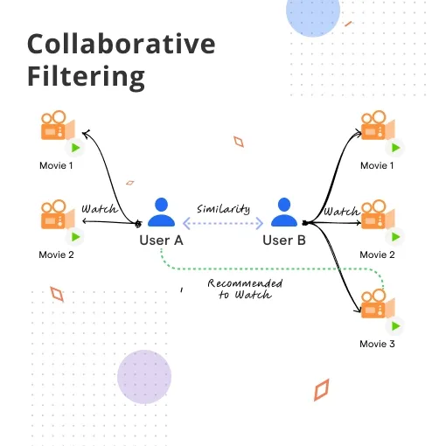
Collaborative Filtering – “Your Friend’s Playlist”
How it works:
• User-based:
You like The Beatles → Another user likes The Rolling Stones → Recommend Stones
• Item-based:
You like Song A → Others who liked A → Recommend Song B
Spotify Use:
Powers Daily Mix and Discover Weekly

Slide 6
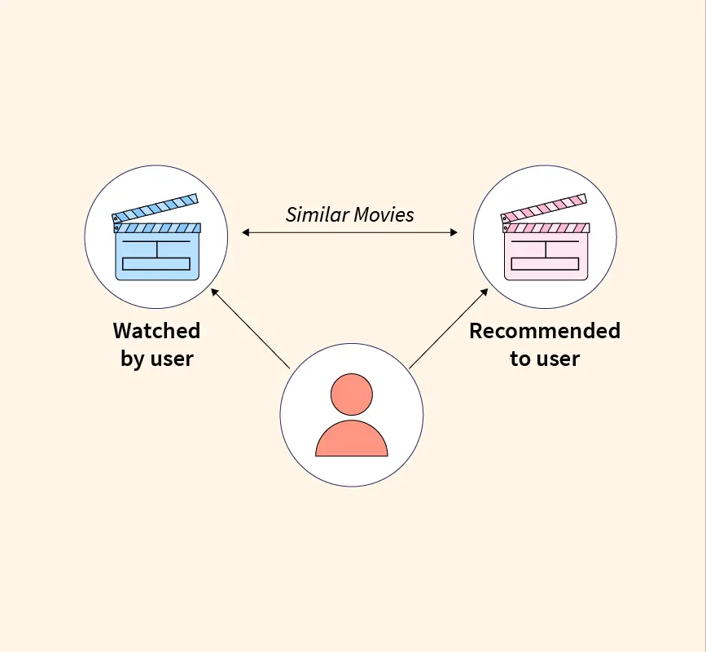
Content-Based Filtering – “Song DNA Analysis”
How it works:
• Analyzes tempo, key, danceability, energy, mood
• You play upbeat pop → System finds songs with similar BPM & energy Spotify’s Audio
Engine: Breaks every track into 15+ acoustic features

Slide 7
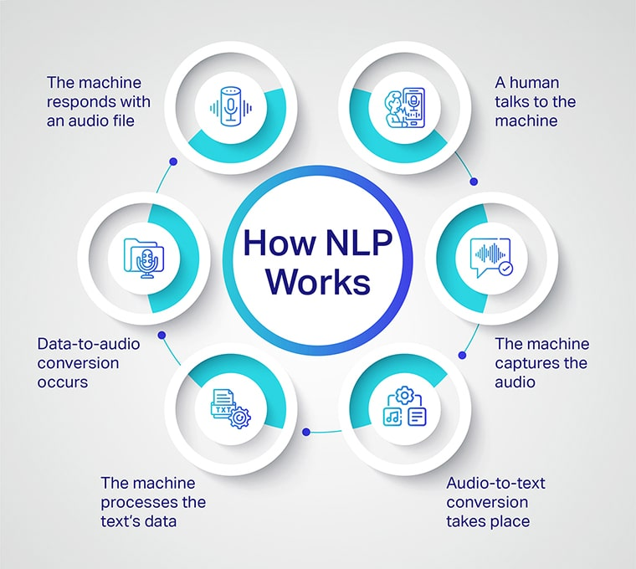
NLP – “Reading Between thePlaylist Names”
How it works:
• Scans playlist titles, descriptions, reviews
• “Chill Vibes” playlist → Links to lo-fi, calm tracks Adds context beyond just audio

Slide 8
Spotify’s Hybrid Model – The Power of 3
Hybrid = Collaborative + Content + NLP
Center overlap: Personalized, balanced, contextual playlists
Key Features:
• Discover Weekly: 85% genre accuracy
• Daily Mix: Familiar + fresh
• Smart Shuffle: Enhanced but biased

Slide 9
Spotify’s System – Advantages (Table1)
Advantage | How Achieved | Evidence
Personalization | A hybrid system (collaborative, content-based, NLP) matches user tastes and contexts. | Discover Weekly’s tailored playlists [3]
User Engagement | Feedback loops refine suggestions based on likes, skips | 52% retention, 2.3B streams yearly [3, 4]
New Artist Discovery | Analyzes patterns and audio traits to promote emerging artists | Lauv’s 2017 breakout via playlists [3]

Slide 10
Spotify’s System – Disadvantages (Table2)
Weakness | Algorithm Contribution | What’s Missed
Cold-Start Problem | Collaborative filtering needs user data; sparse histories limit accuracy [1] | New users/artists get generic picks, delaying personalization
Lack of Diversity | Echo chambers from similar-user matching; NLP biases toward popular text [2] | Niche genres or moods are ignored, reducing discovery joy [6]
Repetitive Suggestions | Content-based over-relies on audio traits; sensitive to skips in shuffle [5] | Serendipity lost—users hear the same songs, not surprises.

Slide 11
Shuffle Mode Challenges (Table3)
Aspect | Intended Design | User-Reported Reality | Algorithmic Cause
Randomness | True mix of playlist tracks for surprise [7] | Repeats popular hits (e.g., same 50 in 200-song list) [8, 10] | Weighted by popularity and skips via collaborative filtering [1]
Taste Balance | Personalizes based on history and mood | Biases toward mainstream/new releases, ignores niches [11] | Content-based favoritism for high-engagement audio features [2]
Engagement | Boosts discovery and session length | Feels repetitive, prompting skips or app switches [9] | Optimization for low-skip tracks, creating echo chambers [5]

Slide 12
Comparison with YouTube Music (Table4)
Platform | Algorithm Type | Data Sources | Advantages | Disadvantages | Engagement Metrics (2025 Avg.)
Spotify | Hybrid (collaborative filtering + content-based + NLP) [3] [2] | Listening history, audio features (e.g., tempo, mood), playlist names [3] | Precise music-focused playlists, high personalization, quick adaptation via machine learning [4] | Echo chambers, repetitive suggestions, and less multimedia integration [5] [6] | 25 min/day session; 52% retention rate [3]
YouTube Music | Collaborative + video-based [1] [2] | Watch history, search queries, video comments, and user-generated content [1] | Diverse discoveries from videos (e.g., live sessions), fast fine-tuning with active signals like thumbs-up [1] [2] | Generic music recs, video distractions, lower audio quality (256kbps vs. Spotify's 320kbps) [1] | 30–40 min/day session; higher watchtime due to video spillover [1]

Slide 13
Comparison with Pandora (Table5)
Platform | Algorithm Type | Data Sources | Advantages | Disadvantages | Engagement Metrics (2025 Avg.)
Spotify | Hybrid (collaborative filtering + content-based + NLP) [2] [3] | Listening history, audio features (e.g., tempo, mood), playlist names [3] | Precise playlists, high user control, vast 100M+ catalog [3] [12] | Echo chambers, repetitive shuffle [5] [6] | 25 min/day session; 52% retention rate [3]
Pandora | Content-based (Music Genome Project) [2] [12] | 450+ song attributes (e.g., melody, rhythm, harmony) [12] | Nuanced serendipitous discovery, organic radio-style flow [12] | Limited 40M catalog, dated UI, skip restrictions [12] | ~20 min/day session; 60% station completion rate [12]

Slide 14
Comparison Summary (Table6)
Platform | Algorithm Type | Data Sources | Pros | Cons
Spotify | Hybrid(collaborative, content-based, NLP) [2] | Listening history, audio features, playlist names [3] | Precise playlists, high user control, 100M tracks [3] | Repetitive shuffle, echo chambers [3]
YouTube Music | Collaborative + video-based [12] | Watch history, search queries, video comments [12] | Diverse, multimedia discoveries, fast adaptation [12] | Generic music recs, video distractions [12]
Pandora | Content-based(Music Genome Project) [2] | 450+ song attributes (e.g., melody, harmony) [2] | Nuanced personalization, serendipitous finds [4] | Limited 40M catalog, dated UI, skip restrictions [12]

Slide 15
Proposed Improvements – A Better Spotify
1. Mood-Aware Filtering: Let users pick mood (e.g., “stressed”) or detect via wearables→ delivers calming tracks, boosts relevance by 30%.
2. Adjustable Shuffle Slider: Control randomness vs. personalization → reduces 45% repetition, uncovers hidden gems in large playlists.
3. Niche Artist Promotion: “Discover Deep Cuts” spotlights low-stream, high-similarity indie tracks → fights echo chambers.
4. Generative AI Playlists: Prompt-based themes (e.g., “nostalgic road trip”) using LLMs → fixes cold-start, ensures ethical diversity.

Slide 16
Conclusion
Spotify leads with 31% market share and 85% accuracy.
Key Takeaways:
• Hybrid model = strong personalization
• Gaps: repetition, echo chambers
• Fix with: mood filters, shuffle control, niche boost
But 40% of users want more serendipity.
Future: AI-generated playlists

Slide 17
References
[1] Aggarwal, C. C. (2016). Recommender Systems. Springer.
[2] Falk, K. (2019). Practical Recommender Systems. Manning.
[3] Krysik, A. (2025). Spotify Recommendation Algorithm. Stratoflow Blog.
[4] Wong, J. (2024). Algorithmic Symphonies. USC Illumin.
[5] Reddit r/musicindustry (2025). Why Spotify’s Algorithm Feels Broken.
And more…

Slide 18
Thank You!
Questions?
Contact:
nimanikrouz@gmail.com
alishahnazi83@gmail.com
abdorreza.mohseni@alum.sharif.edu

