Slide 1





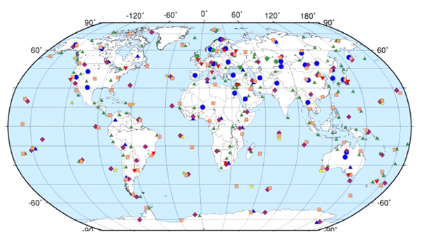
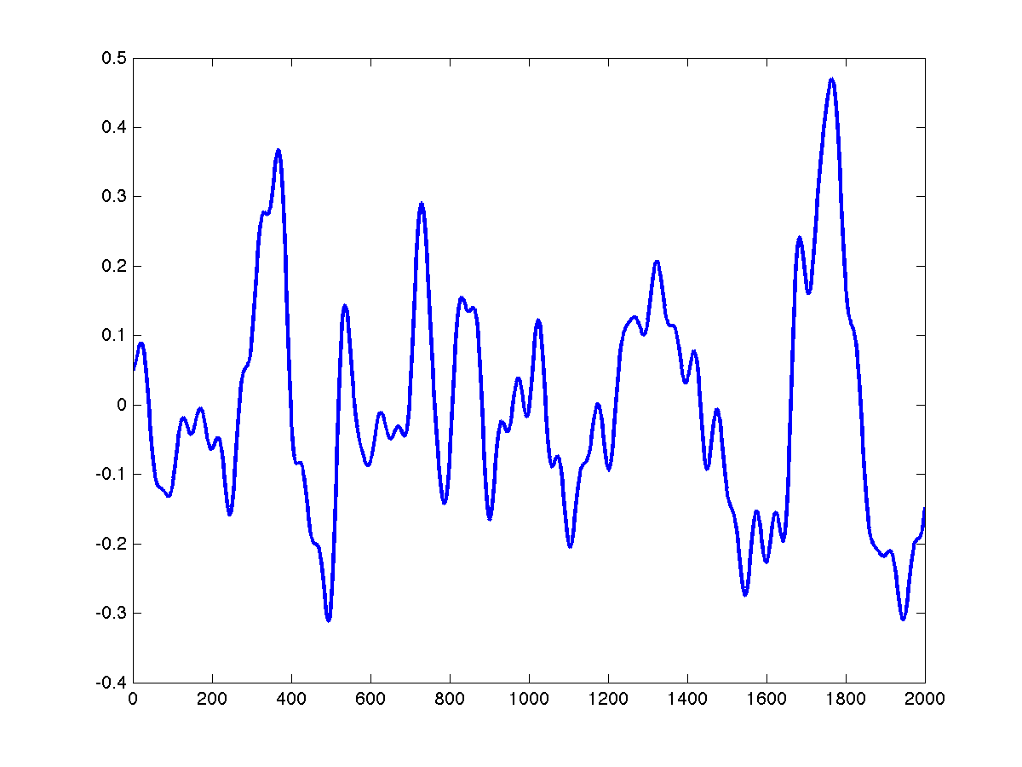
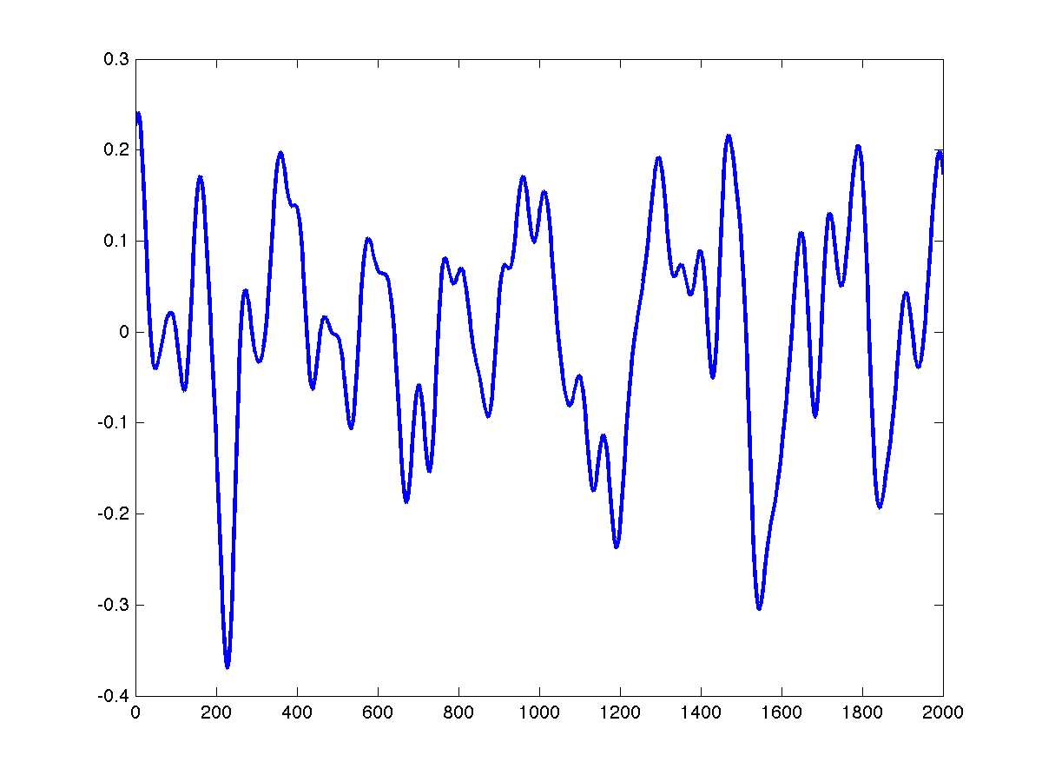
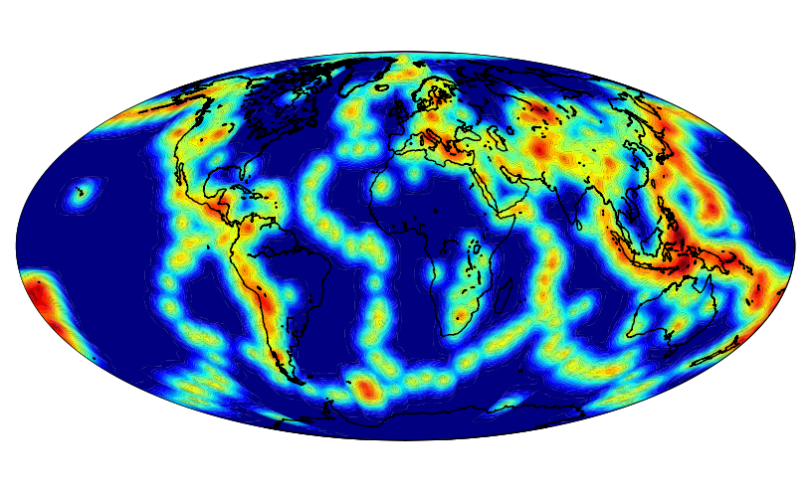
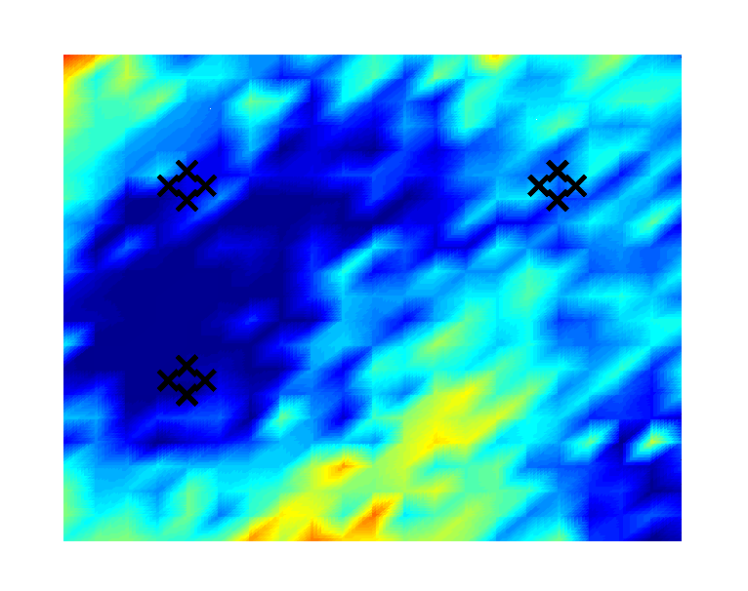
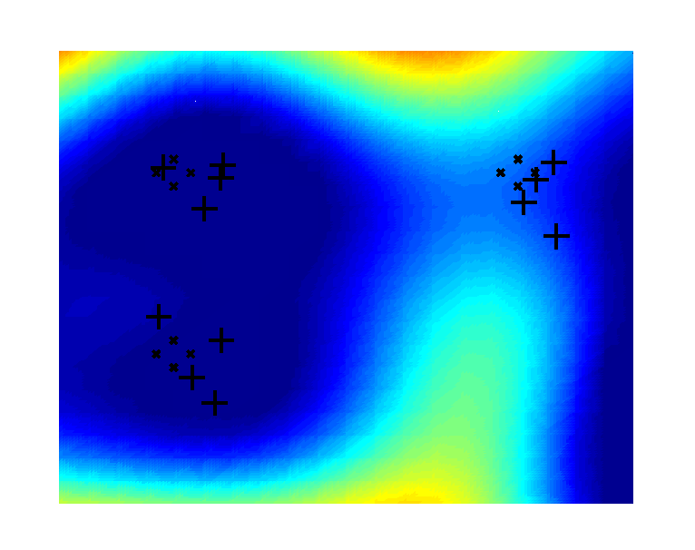
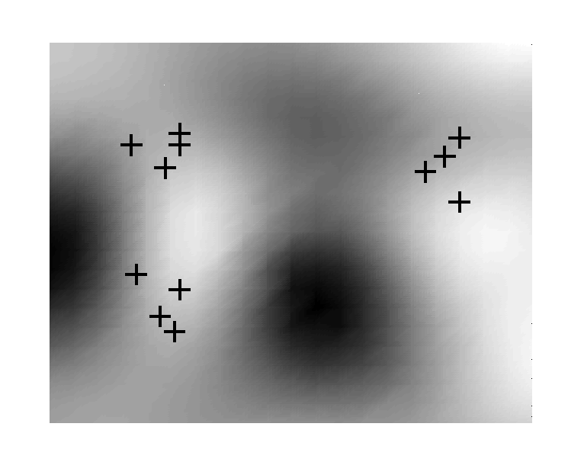
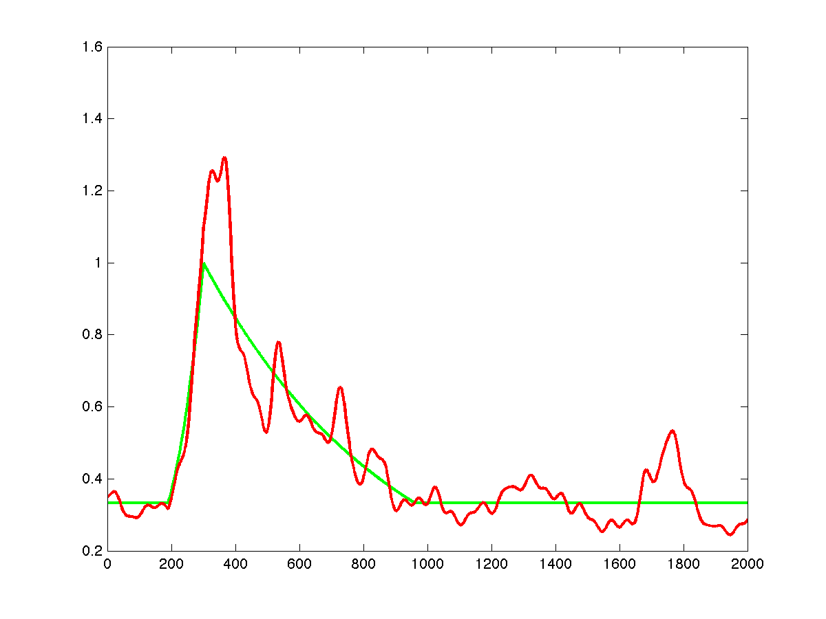
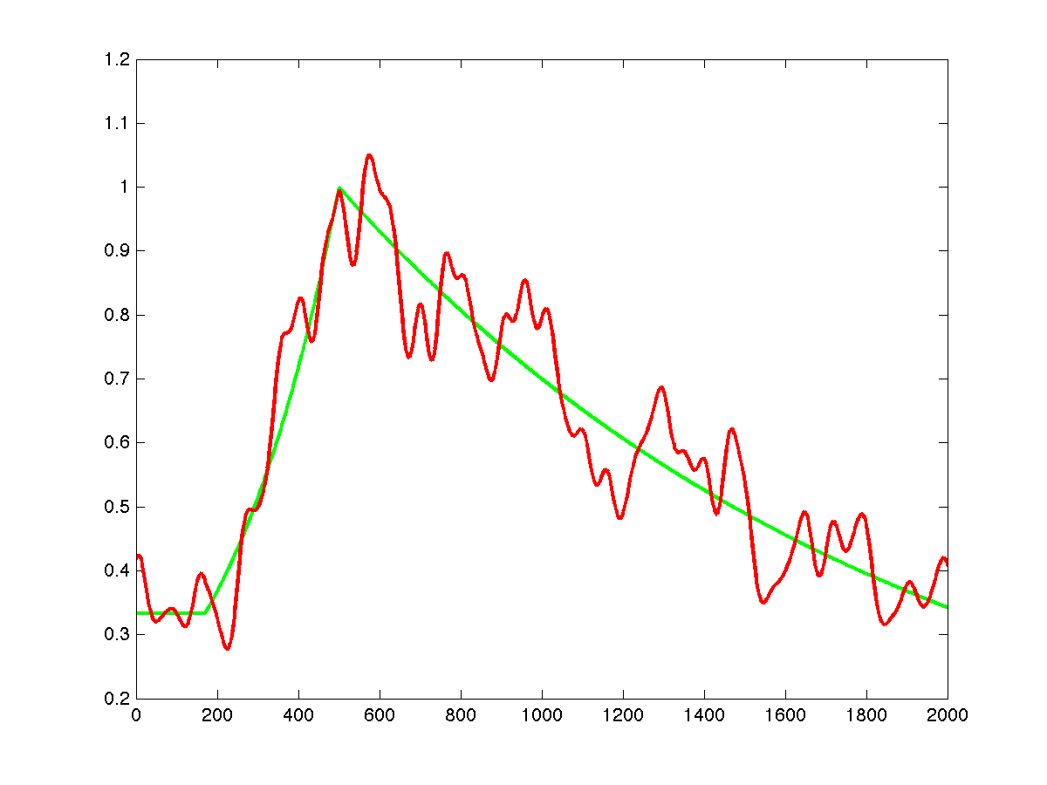
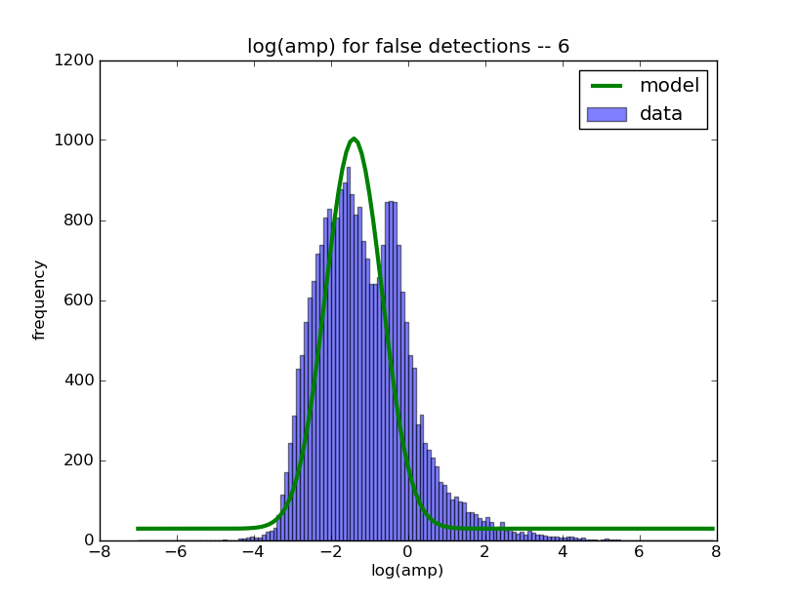
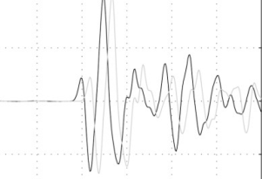
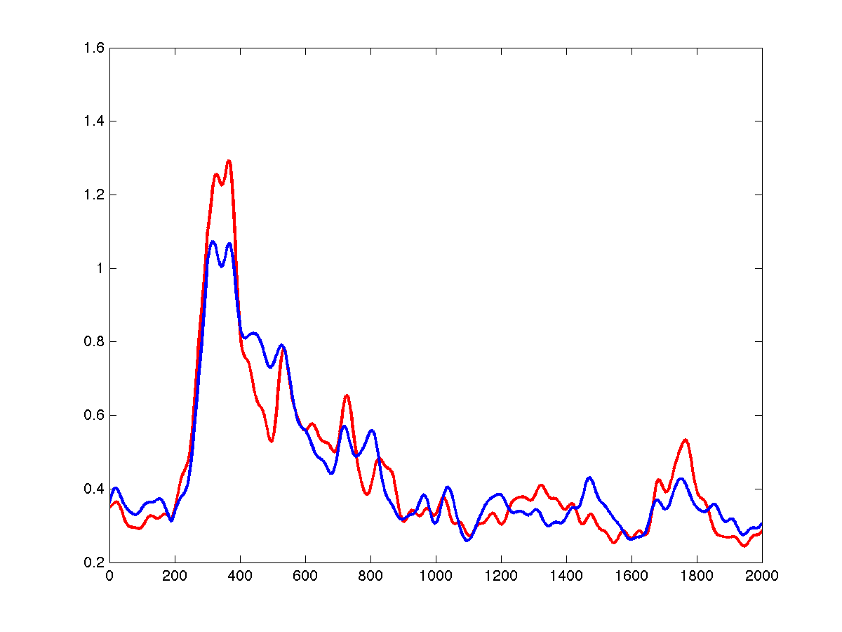
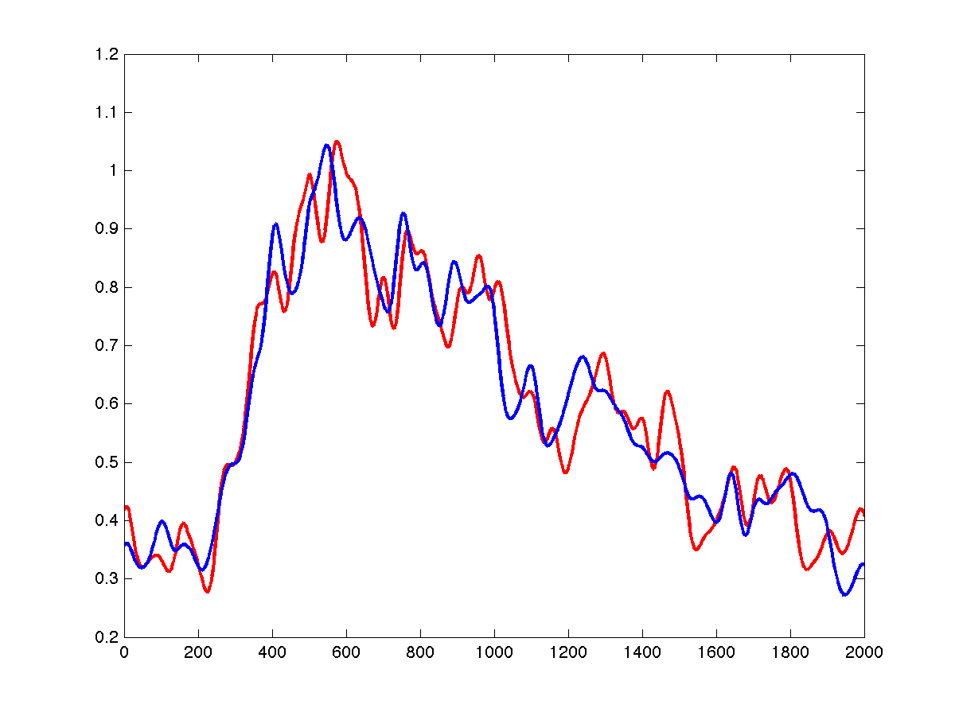
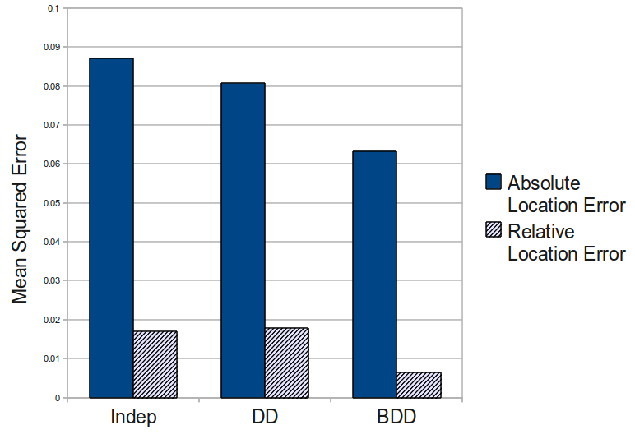
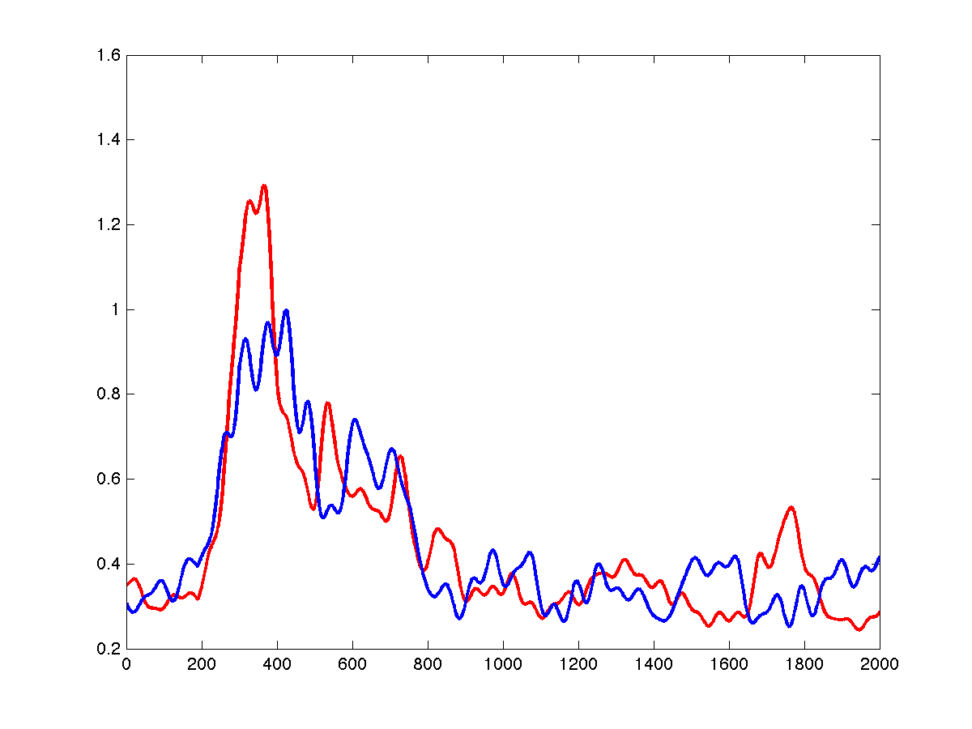
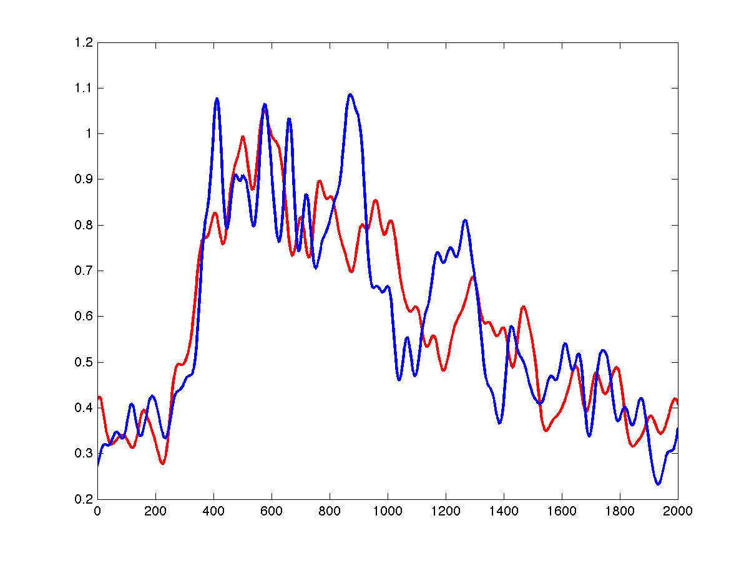
BAYESIAN TREATY MONITORING: PRELIMINARY REPORT
Stuart J. Russell,¹ Stephen C. Myers,² Nimar S. Arora,¹ David A. Moore,¹ and Erik Sudderth³
University of California, Berkeley,¹ Lawrence Livermore National Laboratory,² and Brown University³
Introduction
Background: Detection-based Bayesian monitoring
Signal-based Bayesian monitoring
Bayesian Double-Differencing
CONCLUSIONS
Global seismic monitoring for the Comprehensive Nuclear-Test-Ban Treaty (CTBT) aims to recover the time, location, depth, and magnitude for all seismic events in the magnitude range of interest.
Data from the International Monitoring System (IMS) are processed in real time at the International Data Centre (IDC) in Vienna. Our goal is to improve the sensitivity and accuracy of automated processing at IDC.
NET-VISA is a probabilistic generative model of seismic events, their propagation and detection. Also, a model of noise detections.
A signal-based model encodes the joint distribution of the waveform traces at each station given the event parameters for all hypothesized events.
We overlay background noise models, independent for each station, with event-generated waveforms of the contributions of each phase type.
A simple approach involves a low-dimensional parametric envelope descriptor (e.g., triangular or paired-exponential, cf. Huseby et al., 1998) whose arrival time, amplitude, and spread depend on event distance & magnitude:
The method of Double-differencing (Waldhauser & Ellsworth, 2000) relocates events using precise arrival-time difference information obtained through waveform matching, while considering correlated travel-time residuals.
We formulate a Bayesian model with similar properties: our model integrates information from picked arrival times as well as arrival-time differences, and explicitly models correlated residuals as a function of variation in the underlying slowness field (Rodi and Meyers, 2007):
The slowness field is modeled as a Gaussian process, which induces an equivalent Gaussian process on the travel-time residuals. This connection allows inference to recover a posterior distribution over event locations as well as the slowness field:
Inference is through Markov Chain Monte Carlo (Metropolis-Hastings w/ Gaussian proposals).
Prior results suggest that Bayesian monitoring is a promising technique for analyzing streams of parametric detections from multiple stations to form a global event bulletin and may be preferable to existing deployed methods for global association.
Our current work, in its very early stages, is aimed at extending Bayesian monitoring with generative models of waveform envelopes to improve detection and association and performing joint inference of event locations and slowness fields to improve localization accuracy.
Seismic Event
Seismic Event
Travel times
Travel times
Detected at
Station 1?
Detected at
Station 2?
REFERENCES
Blue dots and triangles are primary seismic stations.
Station 1
noise
Actual envelopes are not well-modeled by template + iid noise. We model large-scale variation in envelope shape as the product of a mean envelope (magnitude and distance dependent), and a stochastic modulation signal:
Arrival-Time Picks
Bayesian Inference (MCMC)
Event Locations
Arora, Nimar S., Stuart J. Russell, Paul Kidwell, and Erik Sudderth, “Global seismic monitoring as probabilistic inference.”, In Advances in Neural Information Processing Systems 23, MIT Press, 2011.
Milch, B., Marthi, M., Sontag, D. Russell, S., Ong, D. L., and Kolobov., A. (2005). BLOG: Probabilistic Models with Unknown Objects. In Proc. IJCAI-05, Edinburgh, Scotland.
Myers, S.C., G. Johannesson, and W. Hanley (2007). A Bayesian hierarchical method for multiple-event seismic location. Geophys. J. Int., 171, 1049-1063.
Oh, S., Russell, S., and Sastry, S. S. (2009). Markov Chain Monte Carlo Data Association for Multi-Target Tracking. IEEE Transactions on Automatic Control, 54(3), 481-497.
Rodi, W. L., and S. C. Myers (2007), Modeling travel-time correlations based on seismicity kernels and correlated velocity anomalies, Paper presented at 29th Monitoring Research Review: Ground-Based Nuclear Explosion Monitoring Technologies, Denver, Colorado.
Schaff, D. P., Bokelmann, G. H. R., Ellsworth, W. L., Zanzerkia, E., Waldhauser, F., & Beroza, G. C. (2004). Optimizing Correlation Techniques for Improved Earthquake Location. Bull. Seism. Soc. Amer, 94(2), 705-721.
Schultz , C.A., S.C. Myers, J. Hipp, and C. Young (1998). Nonstationary Bayesian kriging: a predictive technique to generate corrections for detection, location, and discrimination, Bull. Seismol. Soc. Am., 88, 1275-1288.
Waldhauser, F. and Ellsworth, W. L. (2000). A Double-Difference Earthquake Location Algorithm: Method and Application to the Northern Hayward Fault, California. Bull. Seism. Soc. Amer., 90(6), 1353-1368.
Zhang, H., & Thurber, C. H. (2003). Double-difference tomography: The method and its application to the Hayward fault, California. Bulletin of the Seismological Society of America, 93(5), 1875.
Station 1
detections
Station 2
detections
Station 2
noise
observedEventEnvelope = meanEnvelope x exp(eventSpecificModulation)
Arrival-time Differences
(waveform matching)
Slowness Field Tomography
A simple modulation model, which we will ultimately learn from historical data, is based on a random linear combination of Fourier basis functions:
NET-VISA is a detection-based Bayesian monitoring system whose performance is limited by the classical, bottom-up, threshold-based detections algorithms used in station processing.
SIG-VISA, a signal-based system, will use generative models that span the range from events to waveform traces. It will have several qualitative advantages over NET-VISA, potentially yielding a significant improvement in detection performance
The model consists of various probability distributions, which include:
A distribution for seismic event locations, which includes natural seismicity and manmade seismicity (assumed uniform).
Sampled Log Envelope Modulation Signal
Signal-Based vs. Detection-Based Monitoring
Mean Envelope and Observed Envelope
events
True event locations and slowness field
(simulated data)
inference
model
The detection probability of an event depends only on event magnitude, depth, and distance to station.
The residual distribution for the travel time, azimuth, and slowness are mostly modeled as Laplacian distributions.
Expected event locations and
slowness field , recovered from arrival time picks observed at stations in the four corners.
Variance/uncertainty in slowness field posterior (darker is higher)
SEL3
inference
model
A basic model of envelope variation would assign each event an independent sampled log-modulation signal, using a Gaussian prior on the basis coefficients
Envelope (or waveform) shape is highly repeatable across events with the same location and type. A nonparametric extension, based on Gaussian processes, captures correlations among event envelopes that decay with distance (analogous to correlation matching).
NET-VISA
detections
Bayesian/probabilistic formulation makes it easy to include additional inputs, such as arrival-time differences from waveform matching / cross-correlation techniques.
station
processing
SIG-VISA
waveform signals
Results on one week of data (trained on 2.5 months)
Historical Envelope and Sample at Close Distance
Image from Schaff et. al. (2004)
Bayesian monitoring with a generative approach
P_{θ}(world) describes prior probability for what is (events)
Pφ(signal | world) describes forward model
(propagation, measurement, etc.)
Results on simulated data show decreased error in both absolute and relative event locations, as compared to double-differencing and to a baseline inversion which assumes independent residuals.
m_{b} range | Number of Events | SEL3 |  | NET-VISA
 |  | Recall (%) | Error (km) | Recall (%) | Error (km)
0-2 | 74 | 64.9 | 101 | 86.5 | 101
2-3 | 36 | 50.0 | 186 | 77.8 | 159
3-4 | 558 | 66.5 | 104 | 86.4 | 115
>4 | 164 | 86.6 | 70 | 93.3 | 78
ACKNOWLEDGEMENTS
Detection-based Bayesian monitoring:
P(world | f (signal)) ~ P_{φ}(f (signal) | world) P_{θ}(world)
where f (signal) = set of all detections
Signal-based Bayesian monitoring:
P(world | signal) ~ P_{φ}(signal | world) P_{θ}(world)
Historical Envelope and Sample at Larger Distance
We gratefully acknowledge the support of DTRA for this work; also the support of CTBTO for the work on NET-VISA and the technical cooperation of CTBTO personnel including Ronan Le Bras and Jeff Given. We thank Sheila Vaidya of LLNL and Ola Dahlman, former Chair of CTBTO Working Group B, for their moral support and encouragement in this project.
The rates at which correlations decay with distance will also be calibrated from historical training data.

