Slide 1
Global seismic monitoring: A Bayesian approach
Nimar Arora
Computer Science, UC Berkeley
Joint work with Stuart Russell, Erik Sudderth, and Paul Kidwell
Notes:
The word “monitoring” in the title refers to nuclear explosion monitoring. The dangers of nuclear weapons can’t be overstated…

Slide 2
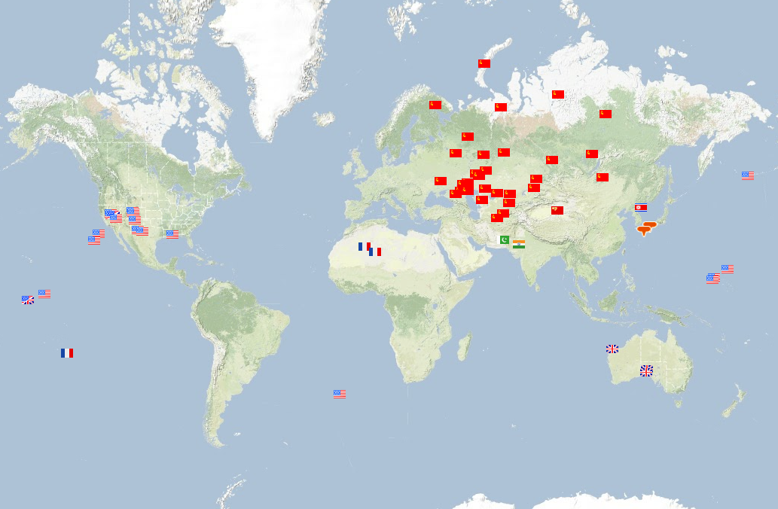
2053 Nuclear Explosions (1945 - 2009)
Notes:
Nuclear explosion testing is an integral part of waging nuclear war.

Slide 3
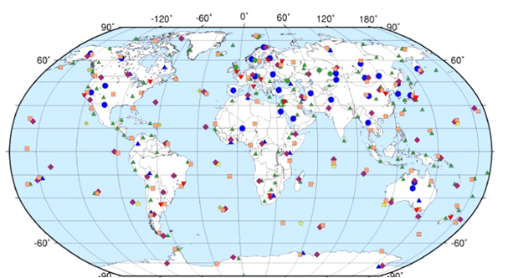
CTBT & IMS
seismic stations
other stations
Bans all testing of nuclear weapons on earth
Allows for outside inspection of 1000km²
~ 110 seismic stations in IMS (International Monitoring System)
Need 9 more ratifications including US, China
US Senate refused to ratify in 1998
“too hard to monitor”
Notes:
To understand why it is too hard to monitor let’s understand a bit about seismology.

Slide 4
Overview
Seismology
Generative Model
Inference
Results
Notes:
I’ll briefly talk about seismology – or as much as I understand of it ! Before going into our model and inference.

Slide 5
Notes:
Given a global network of stations.

Slide 7
Notes:
Seismic energy from these events propagates outwards

Slide 10
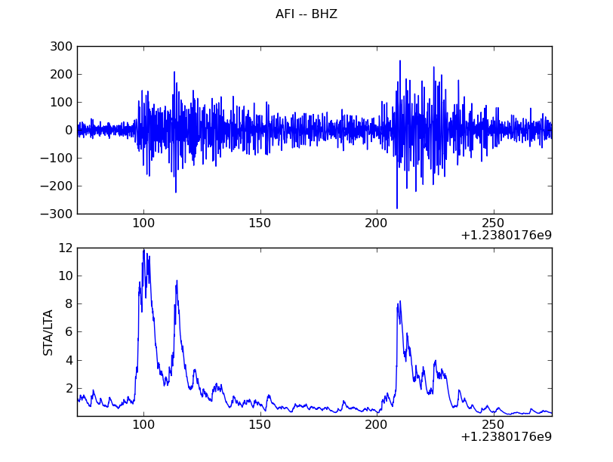
Waveforms → Detections
Filtered Waveform
(1-4 Hz)
Short-term (1.5s)
divided by
long-term (60s)
average
P phase
noise
S phase
noise
noise
Notes:
When the energy hits a station, it looks like the top panel.
Seismic waveform processing looks for sharp changes in the seismic energy and marks these as detections.

Slide 11
Notes:
But other noise detections are also noted, due to small local events.

Slide 13
Notes:
Wave types vary from 12 minutes to 40 minutes to traverse the earth

Slide 14
Notes:
What we see though are just a bunch of detections at each stations which we need to associate together.

Slide 15
Why is the problem hard?
~10000 “detections” per day, 90% from noise (less than magnitude 2 events)
CTBT needs to find all seismic events
CTBT automated system (SEL3) finds 69% of significant events and half the predicted events are spurious (nonexistent)
16 human analysts are required to fix these errors, and generate LEB (“ground truth”)
Unreliable below magnitude 4 (1kT)

Slide 16
Overview
Seismology
Generative Model
Inference
Results

Slide 17
Vertically Integrated Seismic Analysis (VISA)
Events
Seismic Wave Propagation
Inference
Station Noise
Waveforms at seismometers
Notes:
Our overall approach is to build a probabilistic model of events which lead to seismic waves in the earth and these in turn are observed at the IMS stations as waveforms. From the waveforms and using our model we aim to infer the events which took place.

Slide 18
Network Processing (NET-VISA)
Events
Inference
Seismic Wave Propagation
Station Noise
Detections
Waveforms at seismometers
Station Processing
Notes:
Currently, our model extends down only to detections,

Slide 19
Expressed in BLOG (Bayesian Logic)
# SeismicEvents ~ Poisson[TIME_DURATION*EVENT_RATE];
IsEarthQuake(e) ~ Bernoulli(.999);
EventLocation(e) ~ If IsEarthQuake(e) then EarthQuakeDistribution()
Else UniformEarthDistribution();
Magnitude(e) ~ Exponential(log(10)) + MIN_MAG;
Distance(e,s) = GeographicalDistance(EventLocation(e), SiteLocation(s));
IsDetected(e,p,s) ~ Logistic[SITE_COEFFS(s,p)](Magnitude(e), Distance(e,s));
#Arrivals(site = s) ~ Poisson[TIME_DURATION*FALSE_RATE(s)];
#Arrivals(event=e, site=s) = If IsDetected(e,s) then 1 else 0;
Time(a) ~ If (event(a) = null) then Uniform(0,TIME_DURATION)
else IASPEI(EventLocation(event(a)),SiteLocation(site(a)),Phase(a)) + TimeRes(a);
TimeRes(a) ~ Laplace(TIMLOC(site(a)), TIMSCALE(site(a)));
Azimuth(a) ~ If (event(a) = null) then Uniform(0, 360)
else = GeoAzimuth(EventLocation(event(a)),SiteLocation(site(a)) + AzRes(a);
AzRes(a) ~ Laplace(AZLOC(site(a)) AZSCALE(site(a)));
Slow(a) ~ If (event(a) = null) then Uniform(0,20)
else = IASPEI-SLOW(EventLocation(event(a)),SiteLocation(site(a)) + SlowRes(site(a));
SloRes(a) ~ Laplace(SLOLOC(site(a)), SLOSCALE(site(a)));
Notes:
It is interesting to note that this entire model can be written in one page of the BLOG or Bayesian Logic language, I don’t expect you to digest this page..
Our objective is to use this problem as a showcase for expressive modeling languages and to demonstrate that generic inference in such languages can solve really useful problems.

Slide 20
Generative Model
Event
Is Detected
Transmission
Detection
Is Detected = True
Detection
#phases
# false
#stations
#stations
#stations
# events
Notes:
But pictorially, this is what the model looks like.
The double arrow to transmission represents the deterministic dependencies.

Slide 21
Generative Model
Event
Is Detected
Transmission
Detection
Is Detected = True
Detection
#phases
# false
#stations
#stations
#stations
# events
Notes:
We’ll briefly see a few of the components of the model.

Slide 22
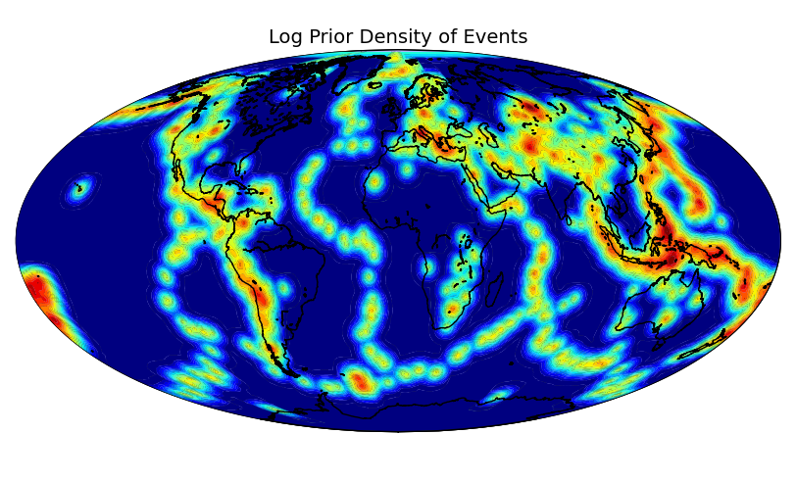
Generative Model – Event Location
Notes:
Learned with historical data and mixed with a uniform distribution to allow for explosions.

Slide 23
Generative Model
Event
Is Detected
Transmission
Detection
Is Detected = True
Detection
#phases
# false
#stations
#stations
#stations
# events

Slide 24
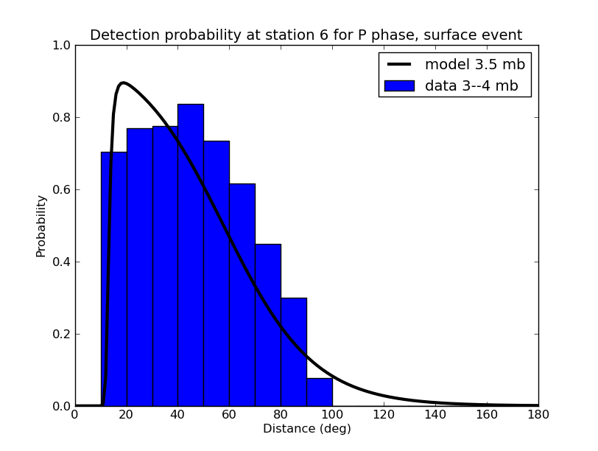
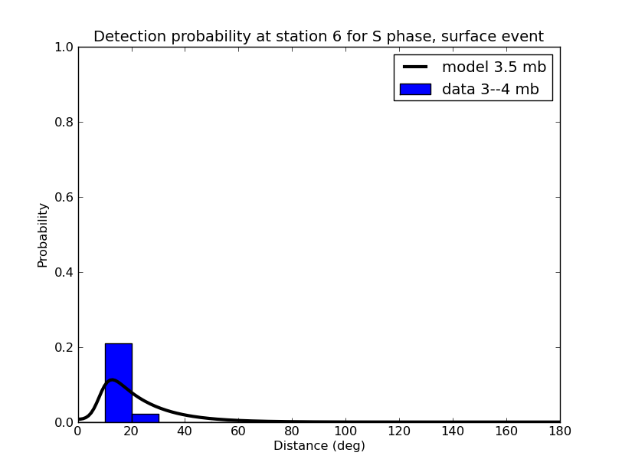
Generative Model – Detection Probability
Event
Location
Event
Magnitude
Station Location
Distance
Is Detected
(phase, station)
P phase, station 6
S phase, station 6
Notes:
The detection probability depends on the distance and magnitude (also depth, not shown for simpicity).
In contrast, seismologists build a detection model based on histograms of detections at every point on the earth – clear tendency to overfit where there is no prior history!

Slide 25
Generative Model
Event
Is Detected
Transmission
Detection
Is Detected = True
Detection
#phases
# false
#stations
#stations
#stations
# events

Slide 26
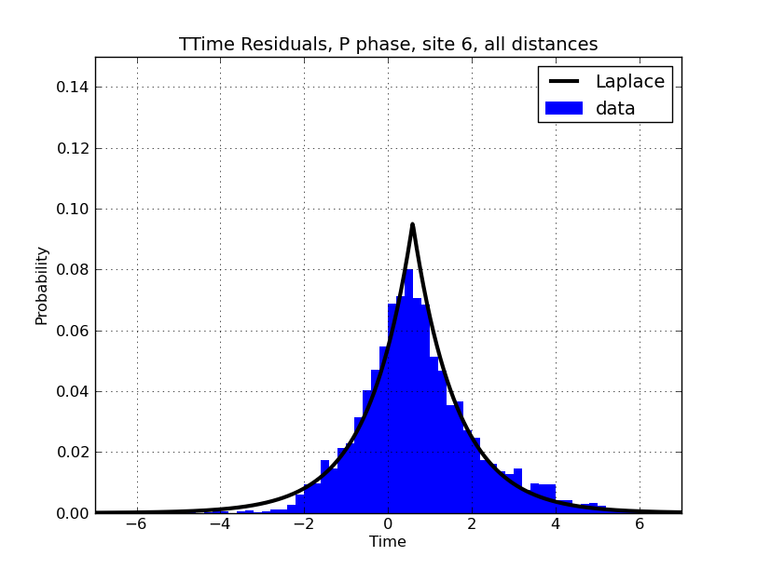
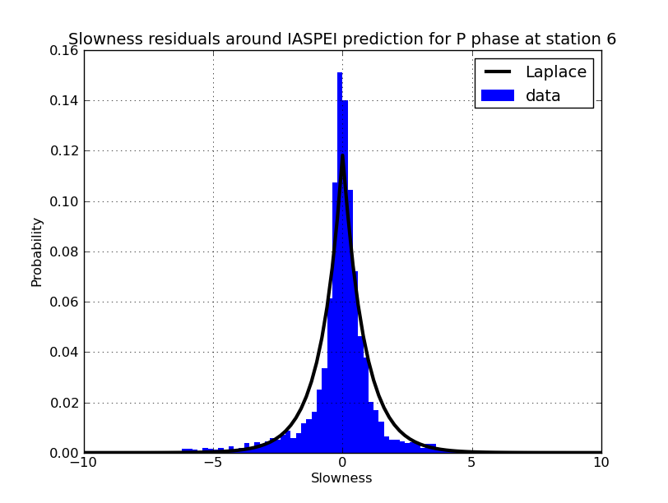
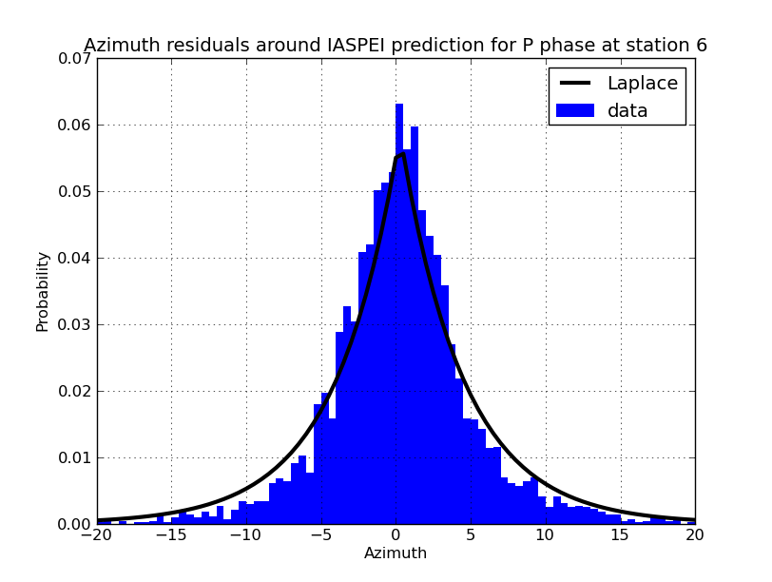
Generative Model – Arrival Time, Azimuth, Slowness
Event
Location
Event
Time
Station Location
Distance
Station-to-Event Azimuth
IASPEI Time
IASPEI Slowness
Arrival Time
Arrival Slowness
Arrival Azimuth
Notes:
Talk about arrival time in more detail than azimuth/slowness.

Slide 27
Generative Model
Event
Is Detected
Transmission
Detection
Is Detected = True
Detection
#phases
# false
#stations
#stations
#stations
# events
Notes:
But pictorially, this is what the model looks like.
The double arrow to transmission represents the deterministic dependencies.

Slide 28
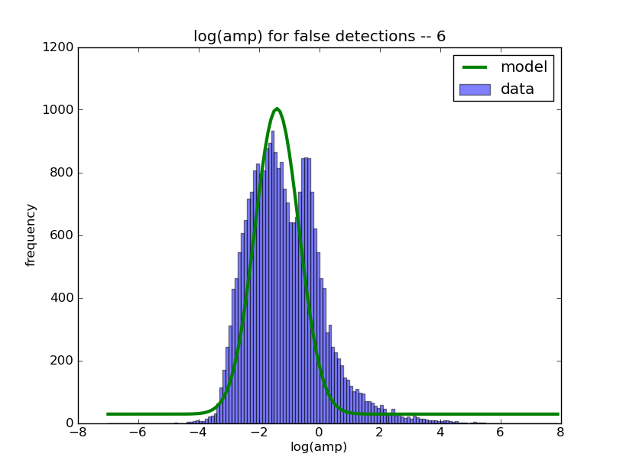
Noise Amplitude & Rate

Slide 29
Overview
Seismology
Generative Model
Inference
Results

Slide 30
Inference Overview
Max a-posteriori (MAP) seismic event bulletin
Easier to compare to SEL3
Continuously incorporate new detections in the hypothesis
Heuristic search moves improve the probability
Birth
Reassociate
Relocate
Death
Notes:
We are trying to find the MAP bulletin, because this is what seismologists expect to see.
The basic approach is a heuristic search which moves forward in time.

Slide 31
Inference Example
Events
e1
e2
e3
time
d1
d2
d3
d4
d5
d5
d6
d7
d8
d9
d10
d11
d12
d13
Detections
window
Notes:
We will explain the algorithm by this example.

Slide 32
Inference : Birth Move
Events
e4
e1
e2
e3
e5
time
d1
d2
d3
d4
d5
d5
d6
d7
d8
d9
d10
d11
d12
d13
Detections
window
Notes:
The dotted lines are detections which were used during proposing the event. The birth move proposes the best possible subset of events using the detections.

Slide 33
Inference : Birth Move
Events
e4
e1
e2
e3
e5
time
d1
d2
d3
d4
d5
d5
d6
d7
d8
d9
d10
d11
d12
d13
Detections
window
Notes:
The detections used as part of the birth move are removed from the hypothesis

Slide 34
Inference : Reassociate Detections
Events
e4
e1
e2
e3
e5
time
d1
d2
d3
d4
d5
d5
d6
d7
d8
d9
d10
d11
d12
d13
Detections
window
Notes:
Detection d8 finds a better event to explain it. But d5 and d10 stick to their event

Slide 35
Inference : Reassociate Detections
Events
e4
e1
e2
e3
e5
time
d1
d2
d3
d4
d5
d5
d6
d7
d8
d9
d10
d11
d12
d13
Detections
window
Notes:
e2-d8 is deleted

Slide 36
Inference : Relocate Events
Events
e4
e1
e2
e3
e5
e5
time
d1
d2
d3
d4
d5
d5
d6
d7
d8
d9
d10
d11
d12
d13
Detections
window
Notes:
E5 finds a better location

Slide 37
Inference : Death Move
Events
e4
e1
e2
e3
e5
time
d1
d2
d3
d4
d5
d5
d6
d7
d8
d9
d10
d11
d12
d13
Detections
window
Notes:
E2, e4 have –ve score

Slide 38
Inference : Death Move
Events
e1
e3
e5
time
d1
d2
d3
d4
d5
d5
d6
d7
d8
d9
d10
d11
d12
d13
Detections
window
Notes:
E2, e4 are killed

Slide 39
Inference : Move Window Forward
Events
e1
e3
e5
time
d1
d2
d3
d4
d5
d5
d6
d7
d8
d9
d10
d11
d12
d13
d14
d15
Detections
New detections
window

Slide 40
Inference : Output stable events
Events
e1
e3
e5
time
d1
d2
d3
d4
d5
d5
d6
d7
d8
d9
d10
d11
d12
d13
d14
d15
Detections
window
Notes:
e1 can’t affect any detection in the window. The inference proceeds on with newer detections…

Slide 41
Overview
Seismology
Generative Model
Inference
Results

Slide 42
Percentage of Missed Events by Event Magnitude
Percentage Missed
magnitude
Notes:
NET-VISA cuts down the percentage of missed events by more than a factor of 2 overall and by a factor of 3
TODO fix
(run 352)

Slide 43
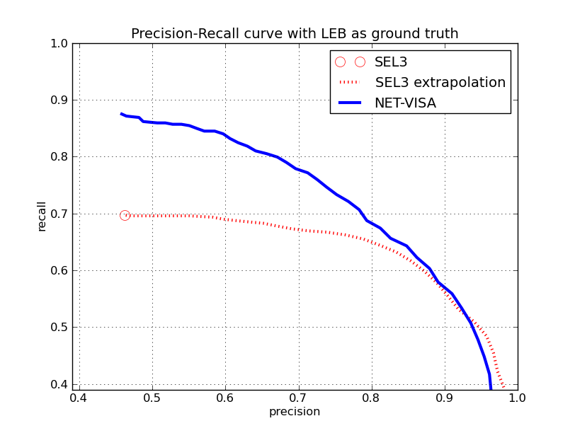
Precision & Recall
SEL3 extrapolation courtesy Mackey, Kleiner, and Jordan
Recall = fraction of true events that are reported
Precision = fraction of reported events that are true
Notes:
In terms of precision and recall NET-VISA does much better than SEL3 the red circle.
(run 352)

Slide 44
Precision & Recall
Real events missed
by human analysts
Notes:
In terms of precision and recall NET-VISA does much better than SEL3 the red circle.
(run 352)

Slide 45
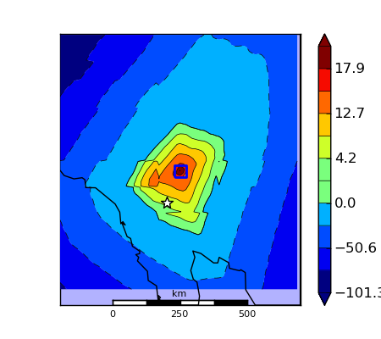
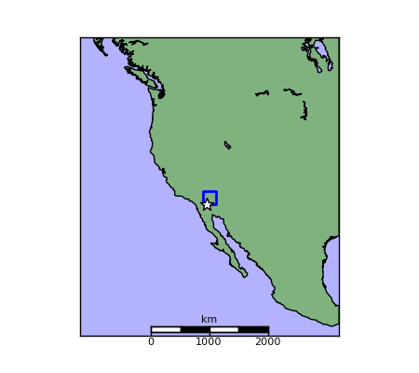
NEIC Event missed by LEB
Log posterior density
NEIC – white, and NET-VISA – blue.
Notes:
However, the analysts are not perfect, because they miss many events, like this one.
>python debug.py 15 visa 2069 -w 4 -r .1

Slide 46
Recall on Regional Networks

Slide 47
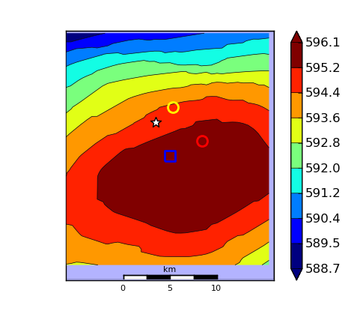
North Korean Explosion - 5/25/09
Log posterior density
SEL3 – 39 stations
NET-VISA – 53 stations
NEIC – white, LEB – yellow, SEL3 – red, and NET-VISA – blue.

Slide 48
Conclusion
Vertically integrated probability model of a complex, real-world process
Combines domain knowledge with learning
2.5 x reduction in missed events compared to current UN system
Currently installed for testing on CTBTO research platform
Anticipated deployment in 2012
Next steps:
Implement within general-purpose BLOG engine
Extend generative model to waveform level (SIG-VISA)
Notes:
Vertical integration + domain knowledge + learning = big win!

