Slide 1



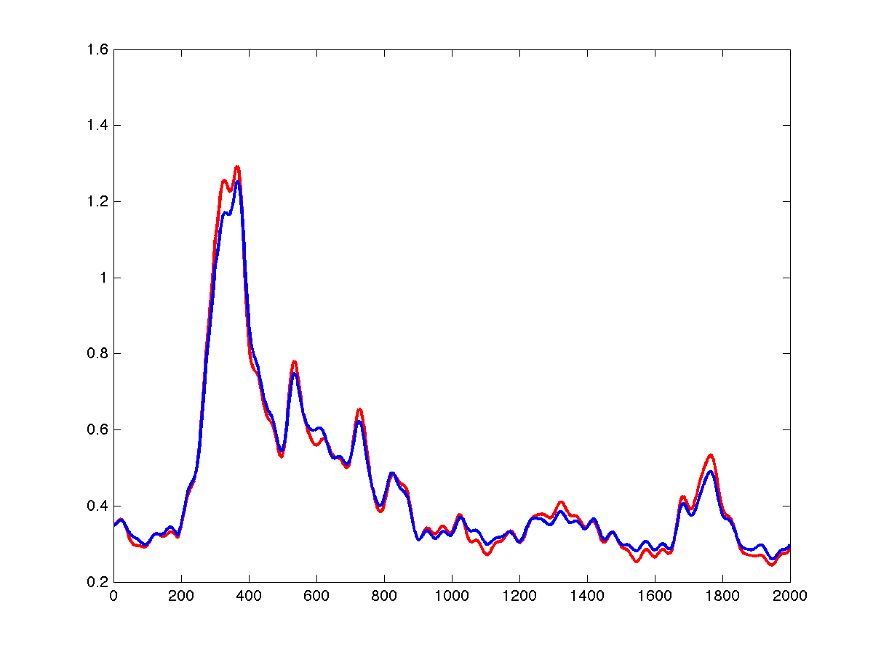
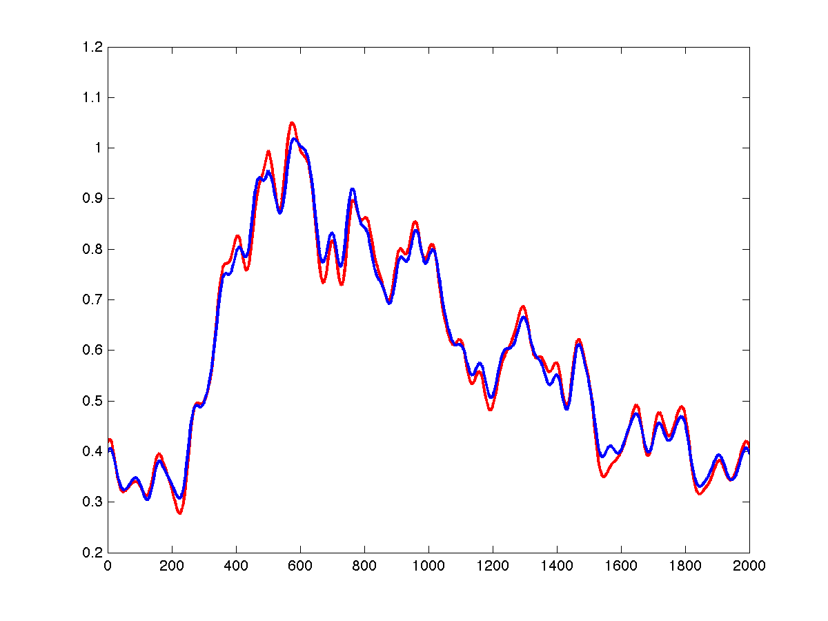
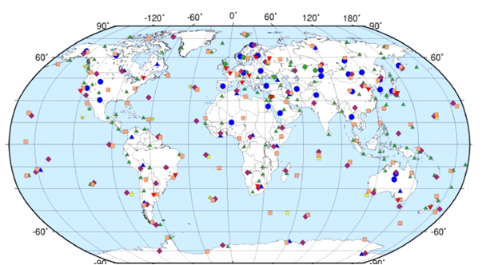
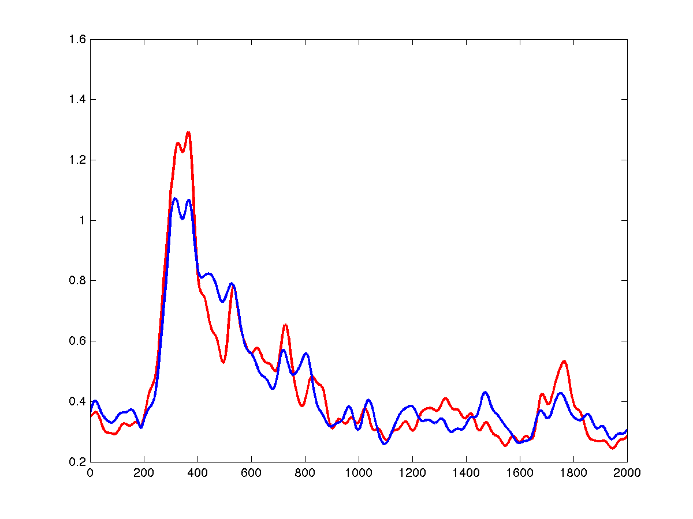
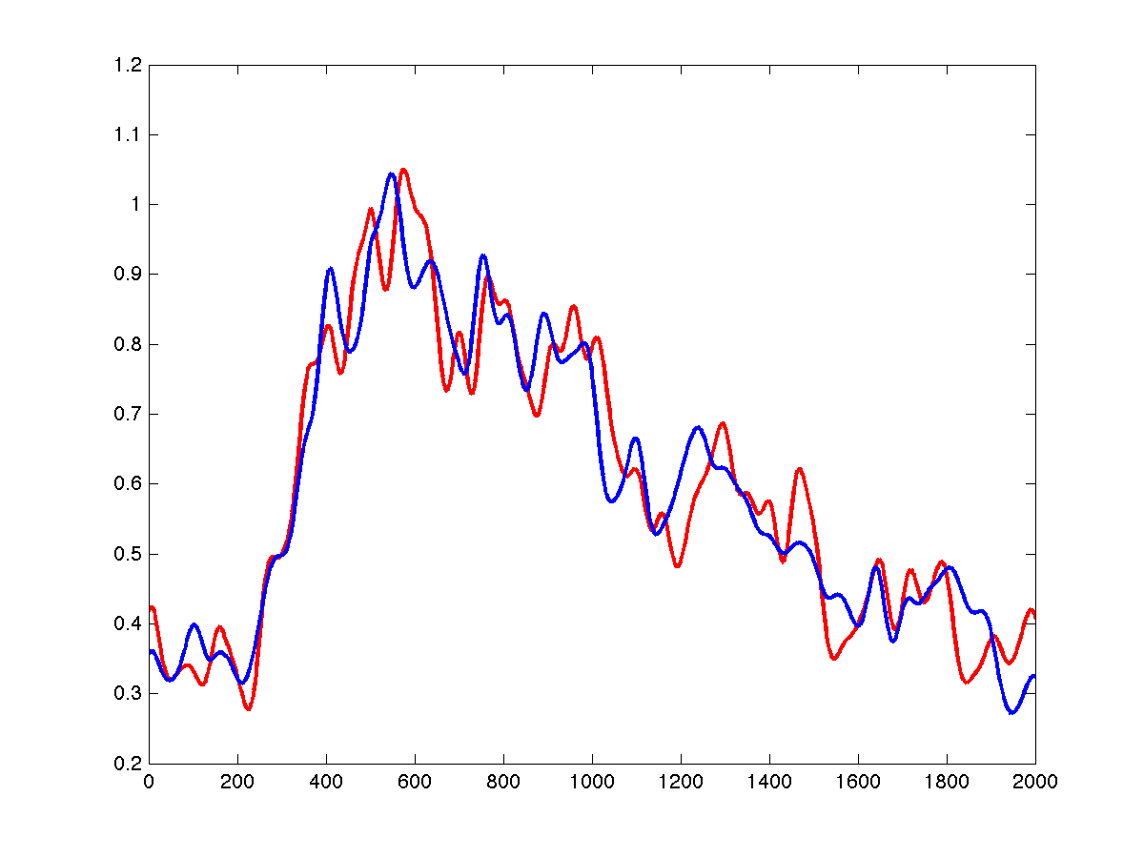
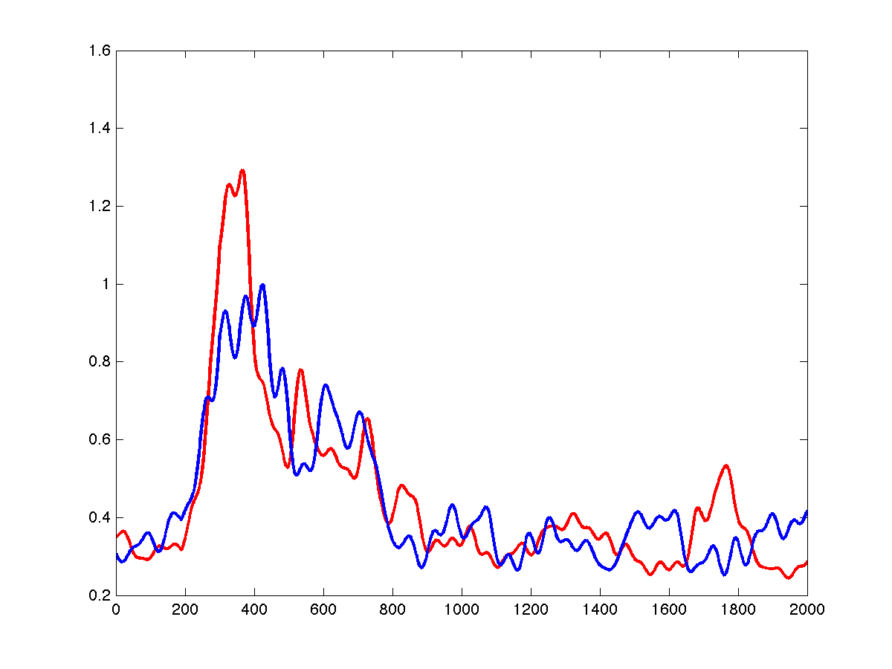
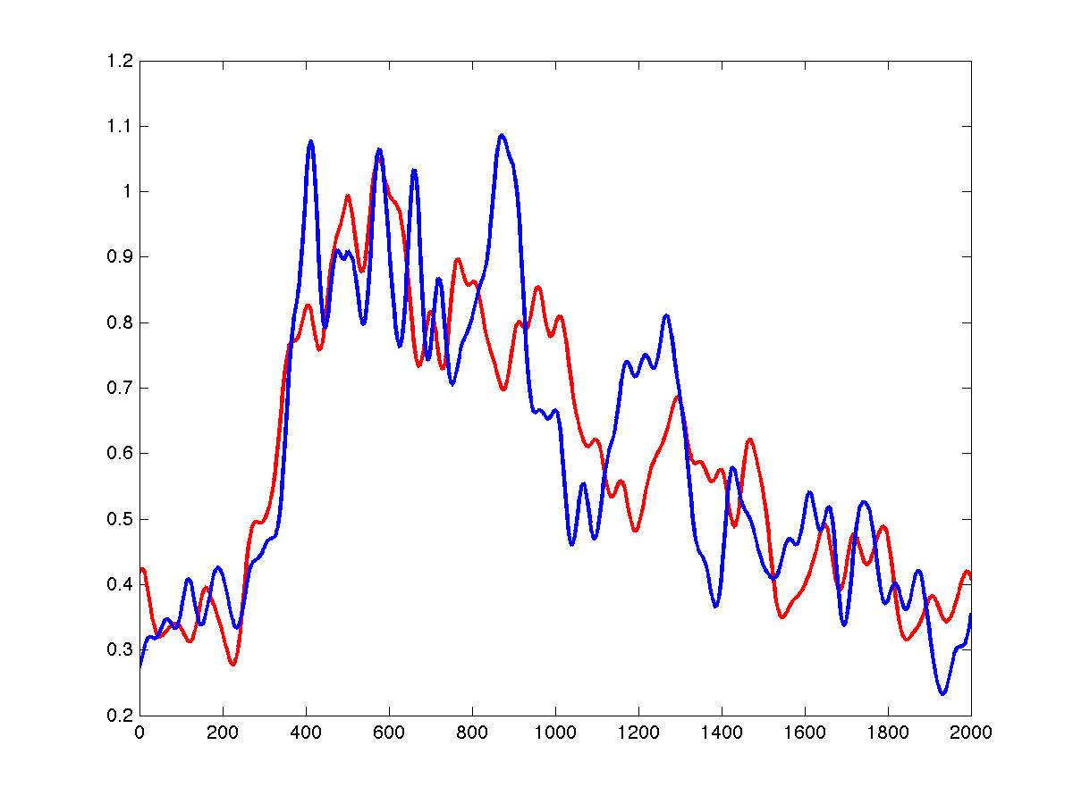
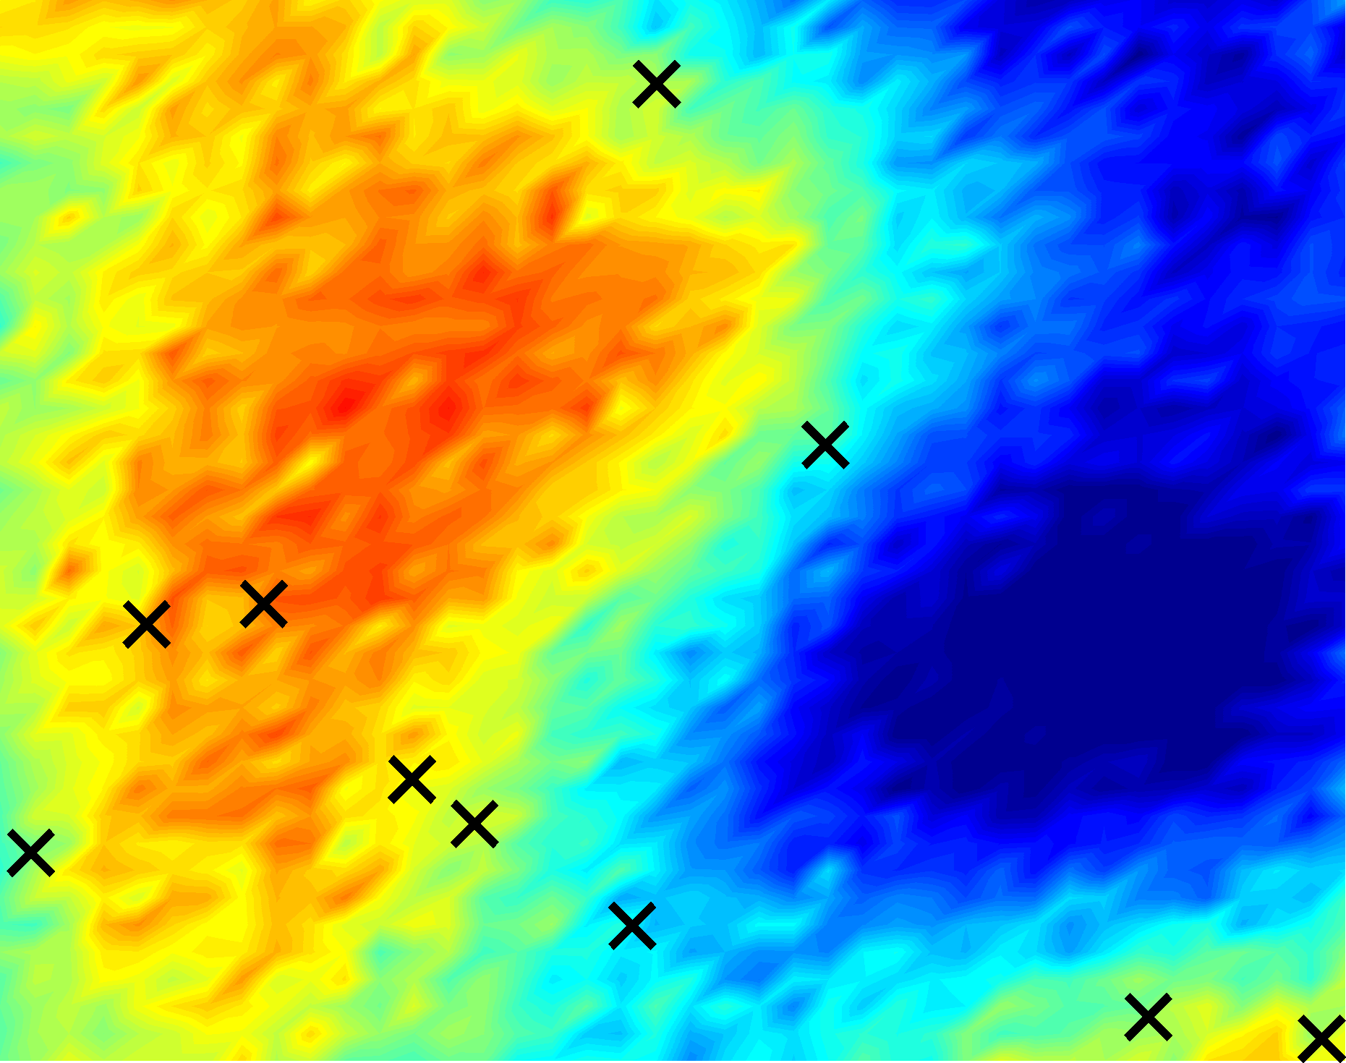
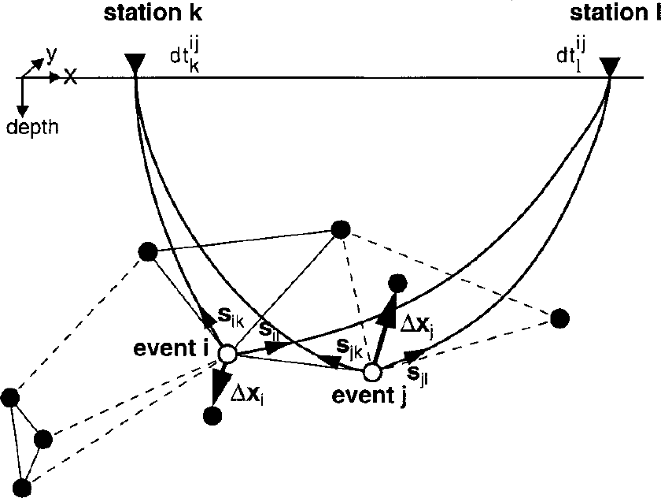
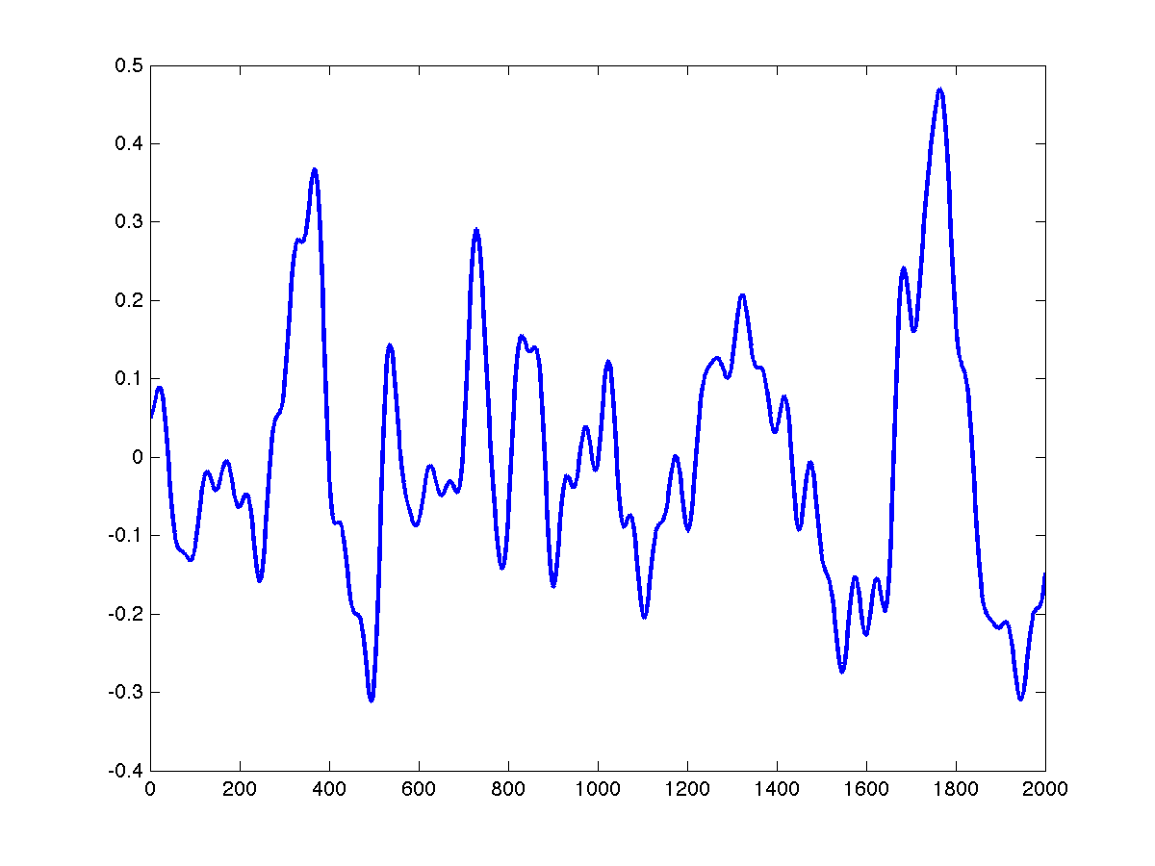
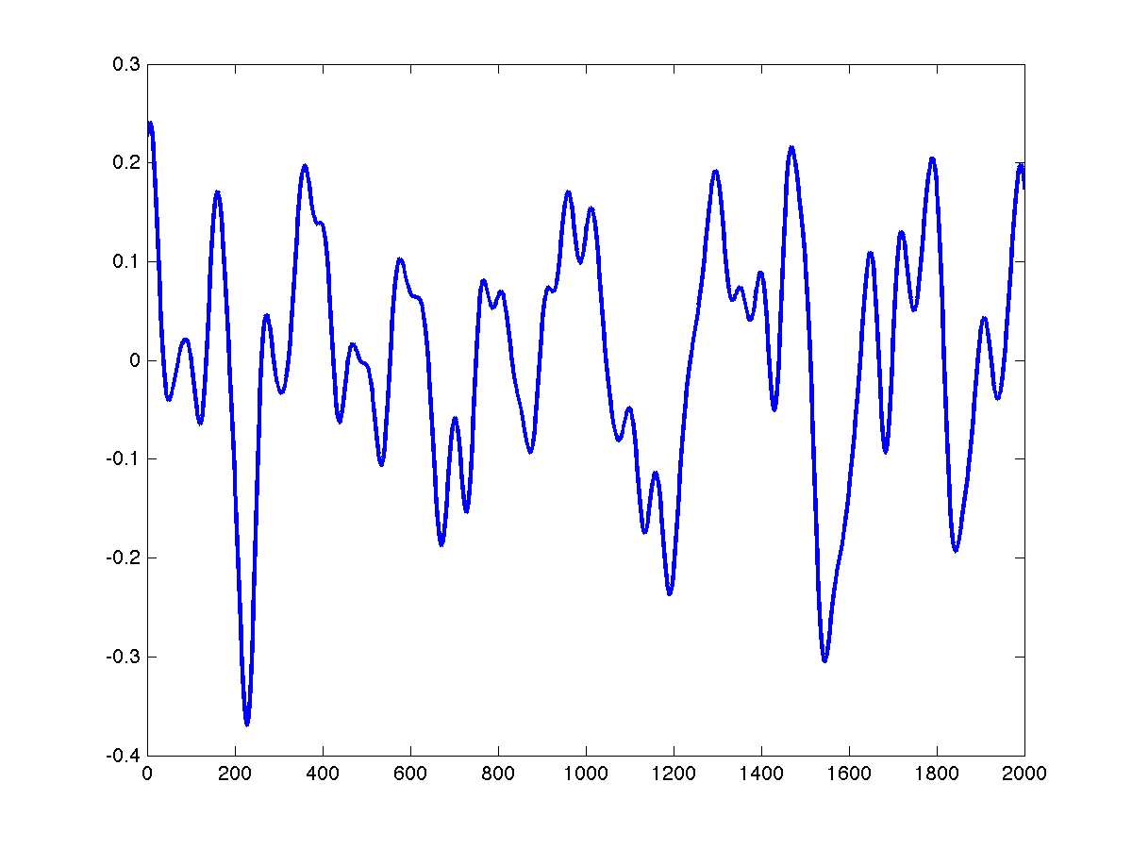
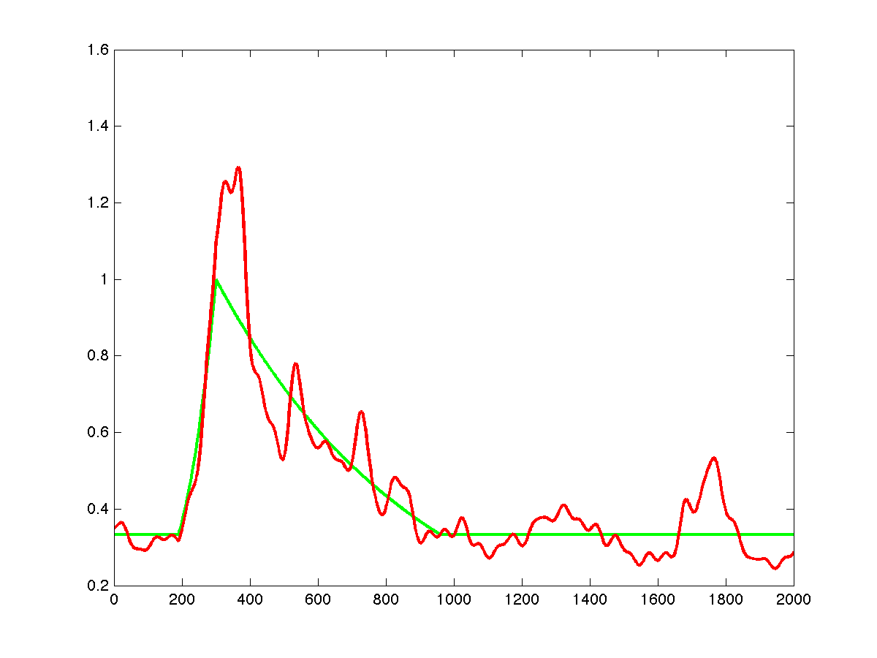
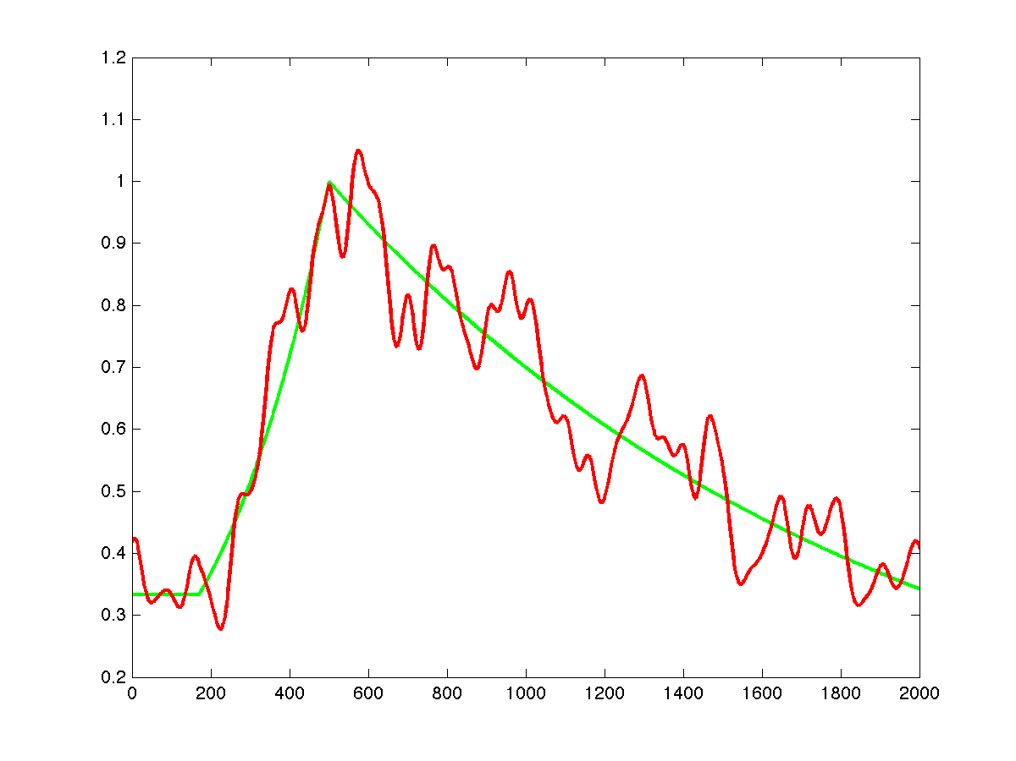
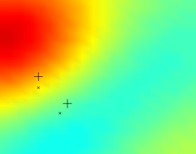
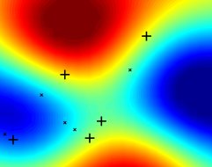
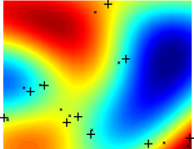
T4-P19: Signal-Based Bayesian Monitoring
Stuart Russell, Nimar Arora, Stephen Myers, Erik Sudderth, David Moore University of California Berkeley, Lawrence Livermore National Lab, Brown University.
Introduction
Generative Models of Waveform Data: Basic Parametric Forms
Combining Parametric Forms and Waveforms from Previous Nearby Events
Comparison to Double-Differencing: Results on Simulated Data
Global seismic monitoring for the Comprehensive Nuclear-Test-Ban Treaty (CTBT) aims to recover the time, location, depth, and magnitude for all seismic events in the magnitude range of interest.
Data from the International Monitoring System (IMS) are processed in real time at the International Data Centre (IDC) in Vienna. Our goal is to improve the sensitivity and accuracy of automated processing at IDC.
The key to signal-based modeling is to provide a reasonable model for the joint distribution of the waveform traces at each station given the event parameters for all hypothesized events.
We assume background noise models, independent for each station, with event-generated waveforms overlaid.
The simplest approach involves a low-dimensional parametric envelope descriptor (cf. Huseby et al., 1998) (e.g., triangular or paired-exponential) whose arrival time,
amplitude, and spread depend on the distance and magnitude of the event:
A basic model of envelope variation would assign each event an independently sampled log-modulation signal, using a Gaussian prior on the basis coefficients
A nonparametric extension, based on Gaussian processes, captures correlations among event envelopes that decay with distance (analogous to correlation matching)
Evaluated on simulated data against double-differencing and a naïve approach (using an independent, linear travel time model for each event).
Travel times sampled from the Gaussian field prior, event locations and origin times sampled uniformly for 5 events per trial (44 trials).
Location inference: Metropolis-Hastings with coordinate-wise Gaussian proposals.
Improvement over double-differencing: 44% in absolute location error, 63% in relative location error.
Historical Envelope and Sample at Small Distance
Blue dots and triangles are primary seismic stations.
Historical Envelope and Sample at Moderate Distance
NET-VISA (see poster T4-O6) is a detection-based Bayesian monitoring system whose performance is limited by the classical, bottom-up, threshold-based detections algorithms used in station processing.
SIG-VISA, a signal-based system, will use generative models that span the range from events to waveform traces. It will have several qualitative advantages over NET-VISA, potentially yielding a significant improvement in detection performance
Actual envelopes are not well-modeled by template + iid noise; below, we describe one simple way to allow for “macro” variation in envelope shape.
Envelope (or waveform) shape is highly repeatable across events with the same location and type. This is the basis for waveform cross-correlation; in our model it falls out naturally from a hybrid parametric/nonparametric generative model (next column).
Historical Envelope and Sample at Large Distance
Signal-Based vs. Detection-Based Monitoring
Discussion
events
Comparison to Double Differencing
A Possible Model of Envelope Variation
Double-differencing (Waldhauser & Ellsworth, 2000) relocates hypocenters jointly to account for correlated travel time errors, caused by local variations in the underlying slowness field.
Signal-based Bayesian monitoring potentially offers reliable event detection and
localization at substantially lower thresholds
Key technical problems:
Devising an envelope model allowing just the right amount of variability;
possibly will need to separate source and Green’s functions
- Tuning quantitative tradeoffs between envelope-model data likelihood and
(a) travel-time residual probability (b) noise-model data likelihood
- Keeping the whole process computationally tractable
inference
model
We can model the realized envelope for a given event as the product of a mean envelope (magnitude and distance dependent), and a stochastic modulation signal:
A simple modulation model is based on a random linear combination of Fourier basis functions (below). Ultimately we will learn a model from historical data.
SEL3
inference
model
NET-VISA
observedEventEnvelope = meanEnvelope x exp(eventSpecificModulation)
detections
station
processing
SIG-VISA
waveform signals
Sampled Log Envelope Modulation Signal
We model the slowness field explicitly as a Gaussian process.
Travel times are random variables given by integrals over the field.
Bayesian inference simultaneously recovers both event hypocenters and the underlying slowness field, given picked arrival times. (see left)
Location recovery accounts for correlated errors in a principled probabilistic manner.
References
Bayesian monitoring with a generative approach
P_{θ}(world) describes prior probability for what is (events)
Pφ(signal | world) describes forward model (propagation, measurement, etc.)
Huseby, E. S., Ruud, B. O, and Dainty, A. M., Robust and Reliable Epicenter
Determinations: Envelope Processing of Local Network Data. Bulletin of the
the Seismological Society of America (February 1998), 88(1): 284-290.
Waldhauser, F. and Ellsworth, W. A double-difference earthquake location algorithm; method and application to the northern Hayward Fault, California. Bulletin of the Seismological Society of America (December 2000), 90(6):1353-1368.
Detection-based Bayesian monitoring:
P(world | f (signal)) ~ Pφ(f (signal) | world) P_{θ}(world)
where f (signal) = set of all detections
Signal-based Bayesian monitoring:
P(world | signal) ~ Pφ(signal | world) P_{θ}(world)
Mean Envelope and Observed Envelope
Top: Example slowness field and event locations (stations are at the four corners).
Bottom: Recovered slowness and event locations (+) from 2, 5, and 10 events.
The authors were supported by contracts from the Preparatory Commission for the CTBT and the U.S. Defense Threat Reduction Agency.
Notes:
Introduction: We are trying to save mankind by saving the CTBT!
Prior Approach: The current approach has been to look at the predicted arrival time of seismic waves and the observed arrival time – then use least squares of the differences to find the best location. This doesn’t take mis-detections into account
Model:

