Slide 1
Automatic Inference in PyBLOG
Nimar Arora
Rodrigo de Salvo Braz
Erik Sudderth
Stuart Russell

Slide 2
Outline
Motivation
Syntax
Semantics
Distribution Properties
Example – LDA
Results
Inverting Deterministic Relations and Automatic Blocking
Example – Simplified Citation Matching
Conclusions

Slide 3
Motivation
BLOG has three kinds of inference:
  Likelihood weighted sampling
  Sample each variable separately by proposing using its distribution (i.e. independent of likelihood)
  User provided proposers for all the variables in the model
Need automatic efficient inference for:
  Variables with conjugate priors and likelihoods, or discrete variables with finite support, etc.
  Groups of variables with deterministic relations
Need finer grained user specified proposers:
  For individual variables
  For small blocks of variables

Slide 4
Syntax
Regular python code interspersed with special functions marked with “decorators”:
  @var_dist : declares a random variable and the return value of the function is the distribution of that random variable
  @var : declares a random variable whose value is the return value of the function
Can query the posterior distribution of a random variable given observations on other random variable which have a distribution (except for special cases, c.f. blocking)
Example:
  @var_dist
  def c(i): return Bernoulli(.5)
  @var_dist
  def mu(k):
  if k==1: return Normal(100,1)
  else: return Normal(250,1)
  @var_dist
  def y(i): return Normal(mu(c(i)))
  @var
  def z(n): return sum(c(i)==0 for i in range(n))
  query([z(4)], [y(0)==200, y(1)==20, y(2)==150, y(3)==1000])
z(4)
c(0)
c(1)
c(2)
c(3)
y(0)
y(1)
y(2)
y(3)
mu(0)
mu(1)
Observed variables
Queried variables

Slide 5
Semantics
Similar to BLOG
Each invocation of a function marked with @var or @var_dist is a random variable. Example: c(0), c(1), c(2), …
A world is an assignment of a fixed value to every possible random variable
A PyBLOG program defines a distribution over these possible worlds
In practice we only care about partial worlds

Slide 6
Distribution Properties
A distribution must provide the following properties:
  Evaluate the density (or mass) at a point
  Sample a random value
To enable Gibbs sampling the following properties are required
  Likelihood for distribution parameters. For example: Normal(10, x) has likelihood ScaledGamma(.5, 50)
  The support of finite, discrete variables, e.g. Bernoulli has support on [0,1]
In addition, likelihoods should be “multipliable” and “normalizable”

Slide 7
Smoothed LDA
(Blei, Ng and Jordan, 2003)

¯
k
®
µ
z
w
N
M

Slide 8
Smoothed LDA
@var_dist
def theta(d):
return Dirichlet([alpha0/k for i in range(k)])
@var_dist
def z(d, i): return Categorical(theta(d))
@var_dist
def w(d, i): return Categorical(beta(z(d,i)))
@var_dist
def beta(t):
return Dirichlet ([eta0/V for i in range(V)])
k = 100
V = 11000
Conjugate prior-likelihoods
Finite support
Conjugate prior-likelihoods

Slide 9
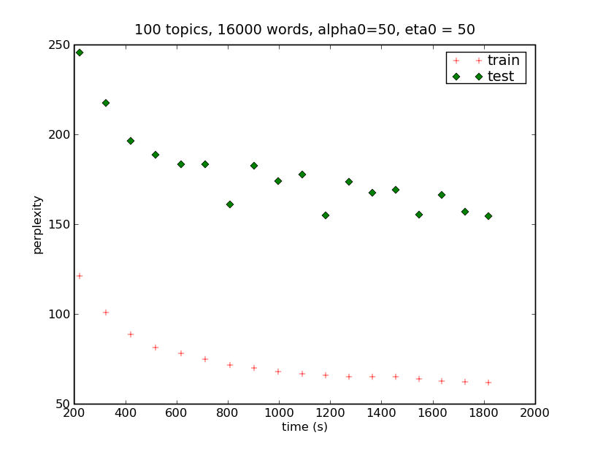
LDA Results
Memory Consumed
~ 5KB per evidence

Slide 10
Inverting Deterministic Relations and Automatic Blocking
When a random variable which is a deterministic function of other random variables is given as evidence we need to block sample its parents and we can do this automatically if the deterministic function can be inverted
For example, if Z = X + Y (string concatenation) and Z is given as evidence. We can propose (X,Y) as all partitions of Z.

Slide 11
Simplified Citation Matching
@var_dist
def numpubs(): return RoundedLogNormal(100, 1)
@var_dist
def pubcited(c): return UniformInt(0, numpubs())
@var_dist
def format(c): return Bernoulli(.5)
@var_dist
def author(p): return authdist
@var_dist
def title(p): return titledist
@var
def citetext(c):
p = pubcited(c)
if format(c) == 0:
return author(p) + title(p)
else:
return title(p) + author(p)
Automatic blocking of
pubcited(c), format(c),
author(pubcited(c)), and
title(pubcited(c)) when citetext(c)
is given as evidence
Invert the + operator

Slide 12
Conclusions
Its easy for probabilistic languages to specify a probabilistic model.
Its more interesting if efficient inference can be done without “much” user intervention
In PyBLOG, for efficient inference user has to specify only a few properties of a distribution or likelihood function.
Deterministic functions force special handling

