Slide 1
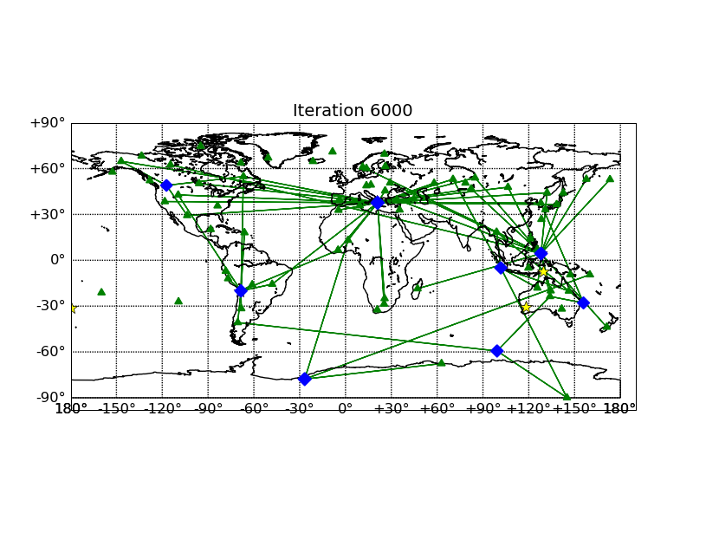
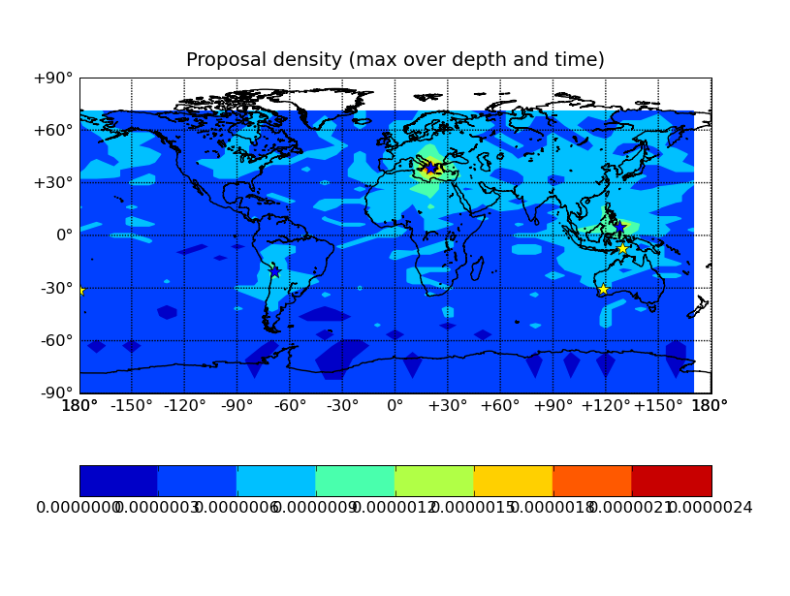
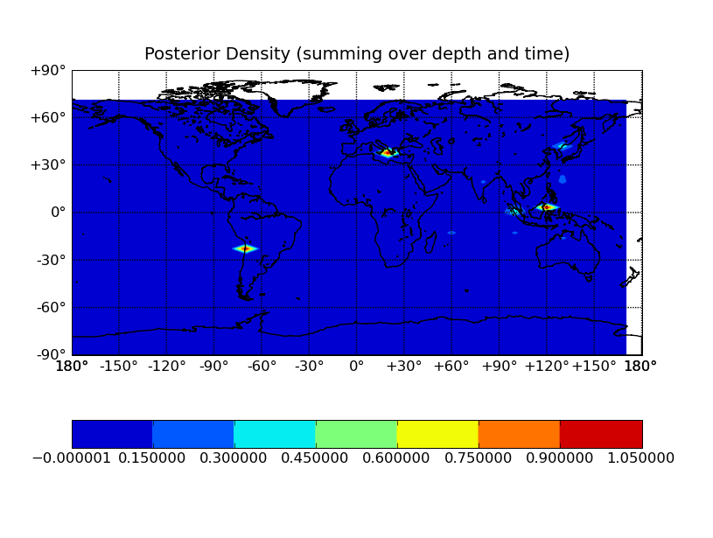
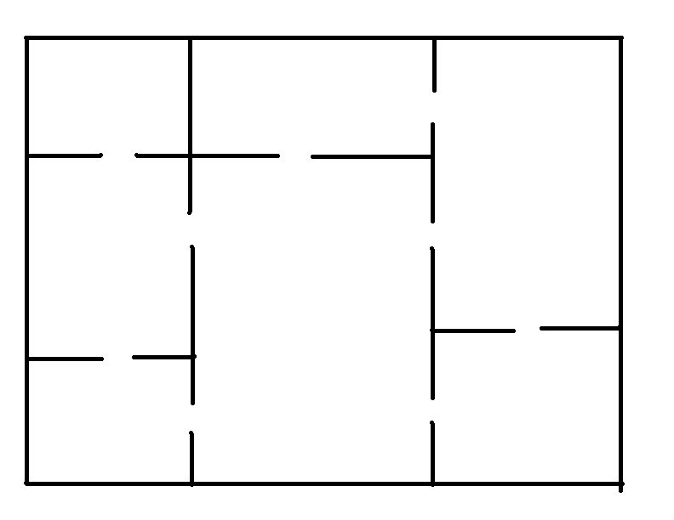
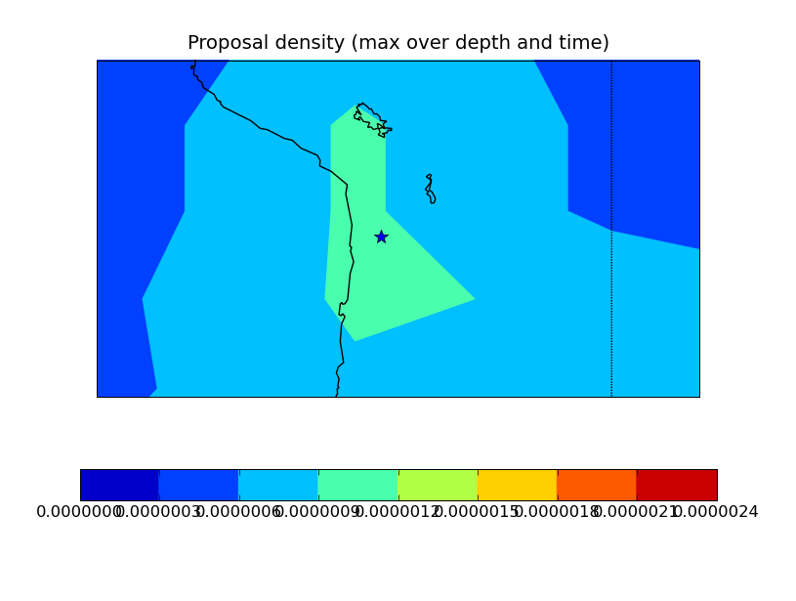
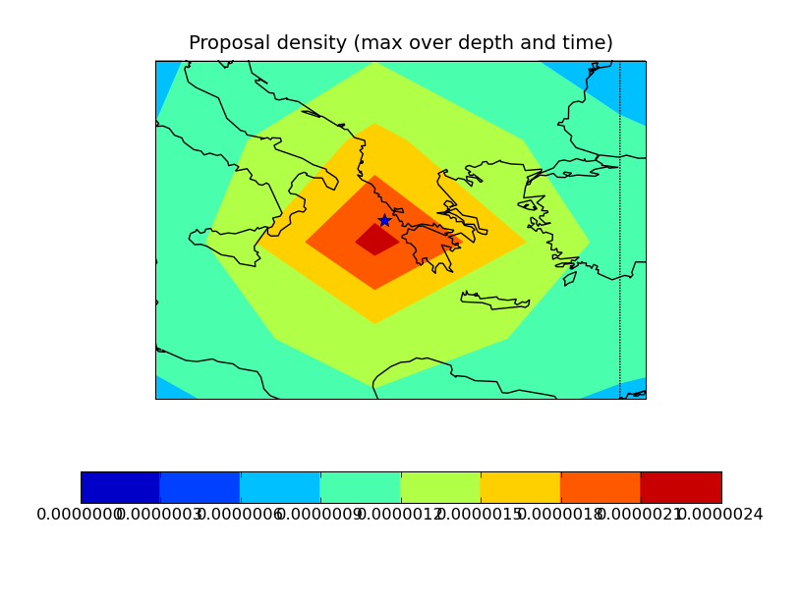
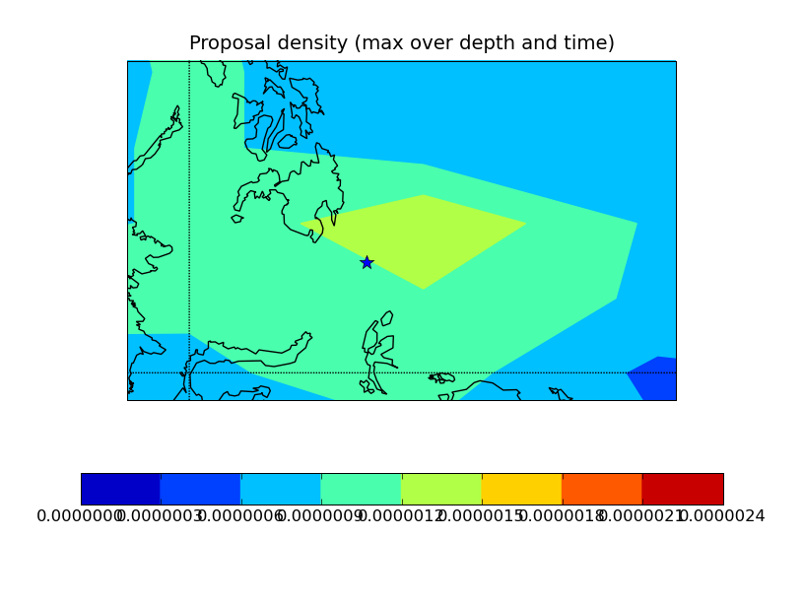
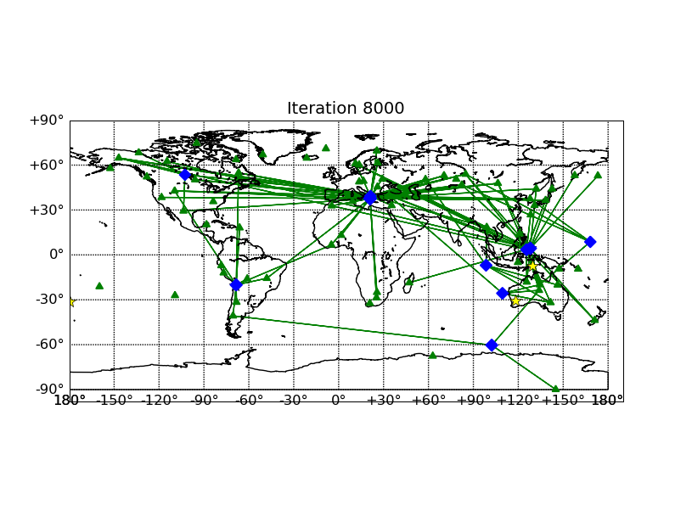
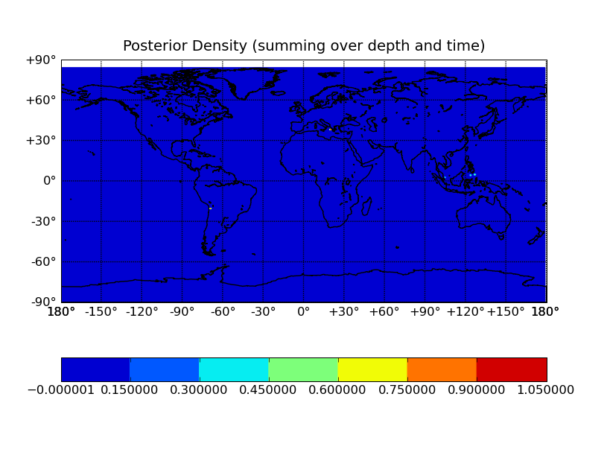
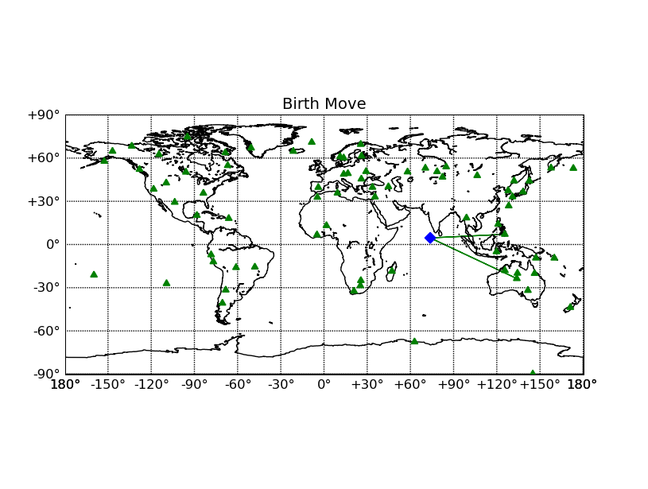
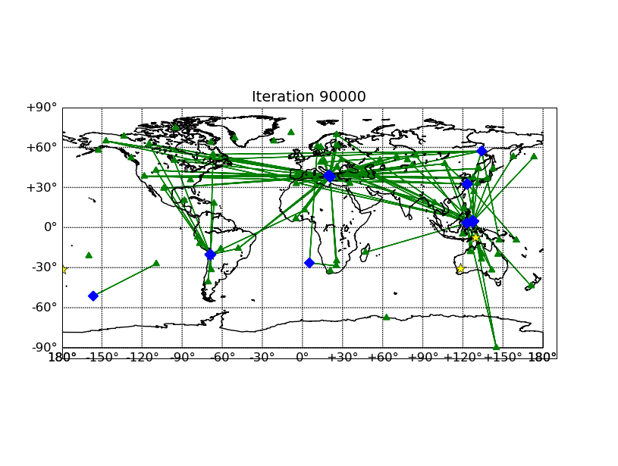
Vertically Integrated Seismological Analysis II : Inference
Nimar S. Arora, Stuart Russell, and Erik B. Sudderth
University of California, Berkeley
Approximate Inference
Inferring Seismic Event Locations
Random Walk Moves
When do we know MCMC has converged ?
Exact inference of the posterior is computationally infeasible. Instead, we use an approximation technique known as Markov Chain Monte Carlo (MCMC).
We start out with the hypothesis that all the seismometer readings are noise. Then we propose moves which tweak the hypothesis.
Random walk moves don’t change the number of events hypothesized, instead they modify the parameters of the events to allow them to better explain the seismometer readings.
We employ two different methods:
The posterior density converges.
Independent Markov Chains converge to the same posterior.
Markov Chain
Birth moves, proposals…
Inference Examples...
We propose new event locations with a probability that increases with the number of detections which could have originated in that location.
What do we do with the posterior density?
Imagine a tourist wandering in a museum. After spending some time in a room, the tourist picks one of the doors at random and steps through it. Repeating this process in the new room…
True event
locations
We can inspect the posterior density in low resolution…
Events are created, modified, and the ones which don’t explain the evidence well are deleted…
.. or high resolution, and label the peaks as the events
This is an example of a Markov Chain. If the tourist were to wander through the museum for a sufficiently long time, the fraction of the total time spent in each room would converge to a stationary distribution.
Birth move, examples…
Monitoring stations
Monte Carlo
One way to deduce the stationary distribution is to let the tourist actually wander through the museum and keep track of the time spent in each room. At the end of the day, he could compute the stationary distribution.
This is an example of a Monte Carlo method.
Although many events are hypothesized, a common theme emerges from all the hypothesis
We can also answer questions like, are those two separate events or one event with uncertain location?
Hypothesized event
Explained detections
Conclusions
Completing the analogy…
Death moves
Posterior density can be estimated by collecting samples from a Markov Chain.
The posterior can be used to answer interesting questions about the events.
A room in the museum represents a hypothesis – number, locations, times, and magnitudes of seismic events, such that they explain the observed seismometer readings.
Moving between rooms represents moves between hypothesis. The moves are chosen such that the stationary distribution of the Markov Chain is the posterior distribution over possible explanations that we wish to infer.
Death moves hypothesize one less seismic event. All events in the current hypothesis are candidates for deletion. The events which are not good explanations for the detected blips are automatically deleted.
.
Common events in most states

