Slide 1

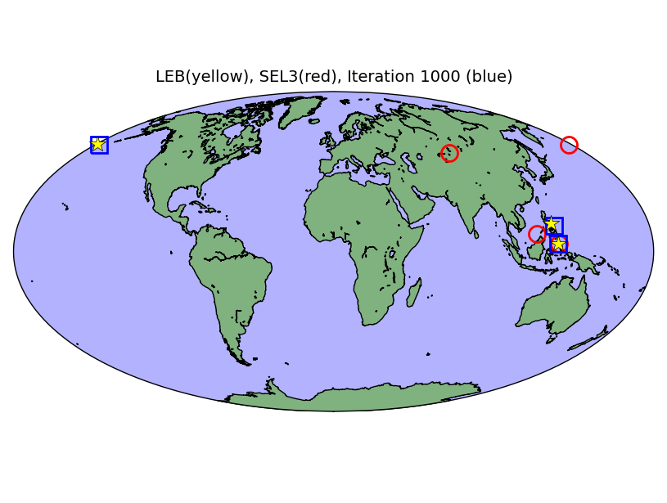
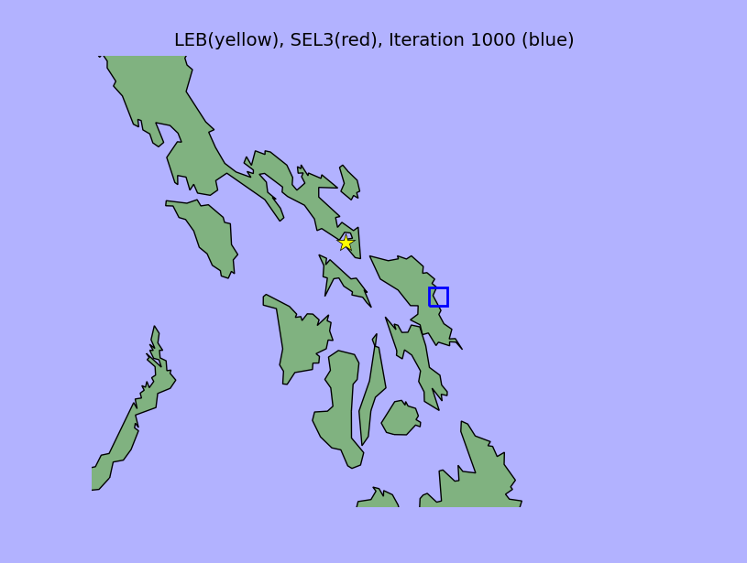
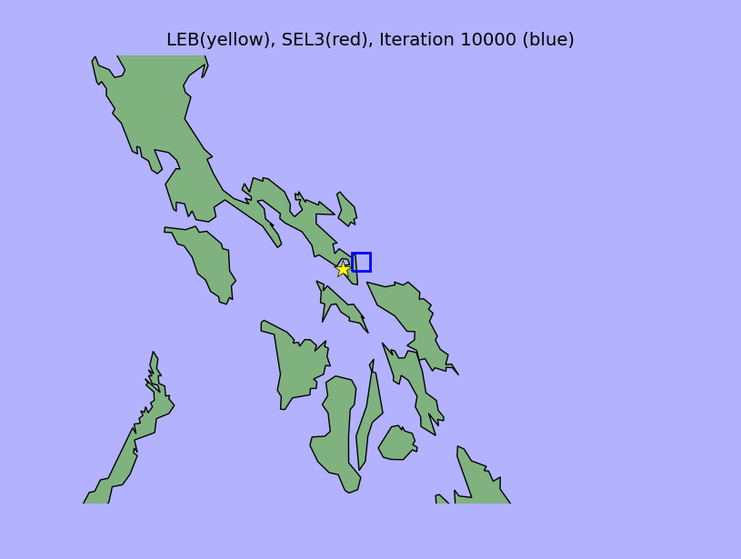

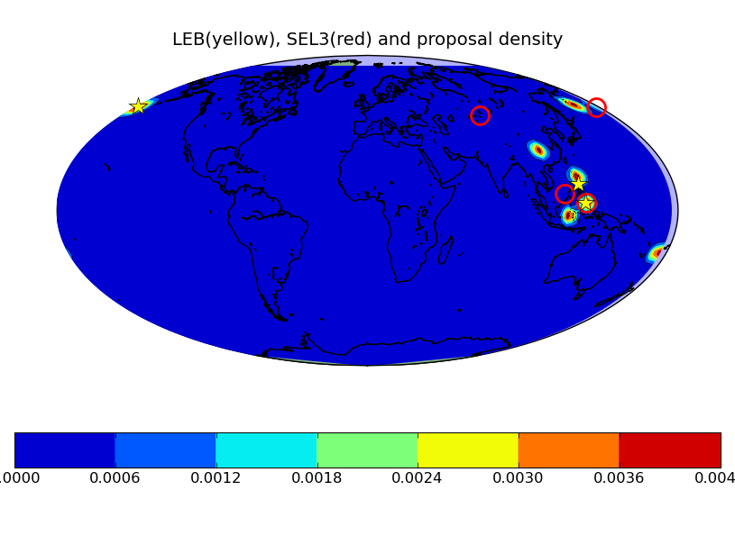
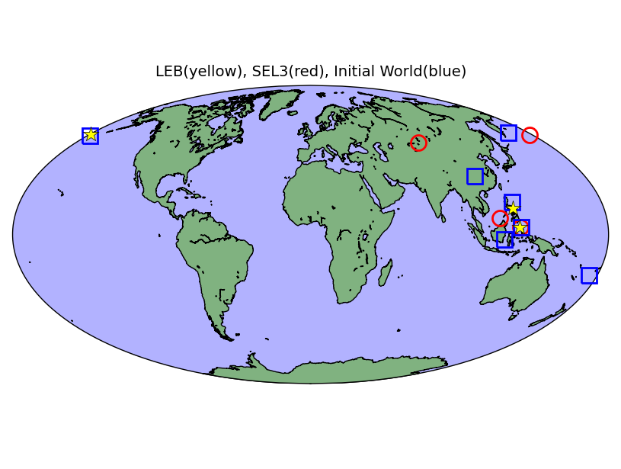
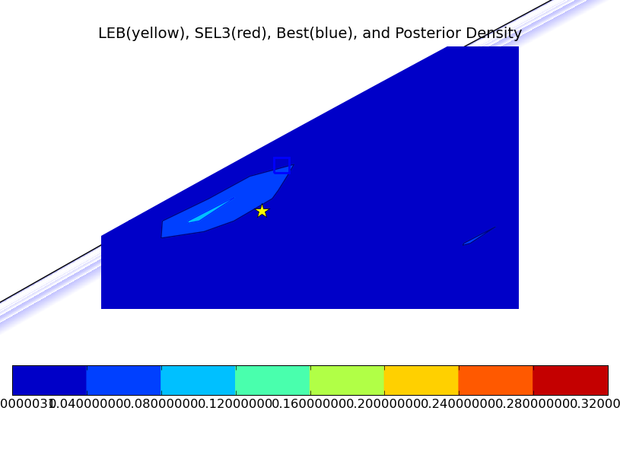
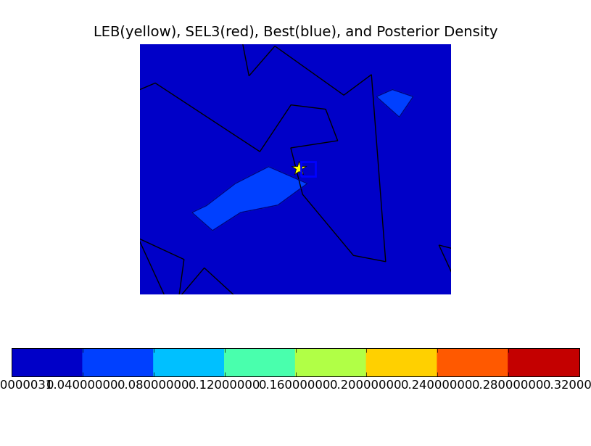

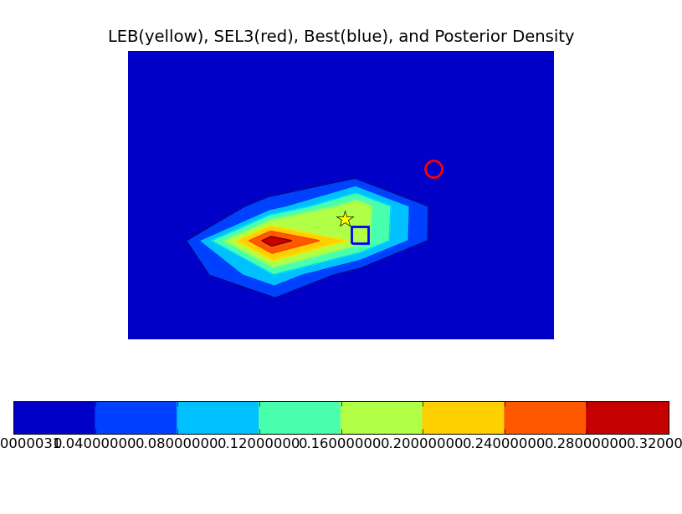
Vertically Integrated Seismological Analysis II : Inference (S31B-1713)
Nimar S. Arora, Stuart Russell, and Erik B. Sudderth
nimar@cs.berkeley.edu, russell@cs.berkeley.edu, and sudderth@cs.brown.edu
The Model
Markov Chain Monte Carlo
Example Continued…
Evaluation
# SeismicEvents
~ Poisson[TIME_DURATION*EVENT_RATE];
IsEarthQuake(e) ~ Bernoulli(.5);
EventLocation(e)
  If IsEarthQuake(e) ~ EarthQuakeDistribution()
  Else ~ UniformEarthDistribution();
Magnitude(e) ~ Exponential(log(10)) + MIN_MAG;
Distance(e,s)
  = GeographicalDistance(EventLocation(e), SiteLocation(s));
IsDetected(e,s)
  ~ Logistic[SITE_COEFFS(s)]
  (Magnitude(e), Distance(e,s),Distance(e,s)**2];
#Arrivals(site = s)
~ Poisson[TIME_DURATION*FALSE_RATE(s)];
#Arrivals(event=e, site=s)
  If IsDetected(e,s) = 1
  Else = 0;
Time(a)
  If (event(a) = null) ~ Uniform(0,TIME_DURATION)
  else = IASPEI-TIME(EventLocation(event(a)),
  SiteLocation(site(a)))
  + TimeRes(a);
TimeRes(a) ~ Laplace(TIMLOC(site(a)), TIMSCALE(site(a)));
Azimuth(a)
  If (event(a) = null) ~ Uniform(0, 360)
  else
  = AddAngle(GeographicalAzimuth(EventLocation(event(a)),
  SiteLocation(site(a)))
  + AzRes(a);
AzRes(a) ~ Laplace(0, AZSCALE(site(a)));
Slow(s)
  If (event(a) = null) ~ Uniform(0,20)
  else = IASPEI-SLOW(EventLocation(event(a)),
  SiteLocation(site(a)))
  + SlowRes(site(a));
SlowRes(a) ~ Laplace(0, SLOSCALE);
The model combined with the actual observations of the arrivals defines a posterior probability density on the number, type, and locations of the seismic events – π(x), where x is a possible world.
We use Markov Chain Monte Carlo (MCMC, Gilks et al., 1996) methods to infer π(x). In other words, we sample from a Markov Chain whose stationary distribution is π(x). To construct this Markov Chain, we design moves which transition between the hypothesis space.
The birth and death moves create new events and destroy them, respectively.
The switch arrival move changes the event associated with an arrival.
The random walk move changes the location and other parameters of an event.
We assume that LEB (human annotated bulletin) is the ground truth. We evaluate our system by comparing against the performance of SEL3 (the current automated bulletin) using the same arrivals as are available to SEL3.
The predictions are evaluated by computing a min-cost max-cardinality matching of the predicted events with the ground truth events where the cost is the distance between the predicted and the true event location. Any edge with more that 50 seconds or 5 degrees of error is not included in the matching.
We report precision (percentage of predicted events which are matched), recall (percentage of true events which are matched), F1 (harmonic mean of precision and recall), and the average cost of the matching.
Over some iterations, all the events are proposed, but the locations may not be very good.
Gradually, due to random walk and switch association moves, the locations of all the events are improved.
Dataset
76 days of parametric data (i.e. arrivals marked by
automated station processing) for training.
7 days of validation data (results below)
7 days of test data (not currently used).
MCMC example
Proposal density is constructed by inverting the arrivals.
Results
The samples collected from the Markov Chain can be used to infer the posterior density
 | F1 | Precision/ Recall | Error/S.D. (km) | Average Log-likelihood
SEL3 (IDC Automated) | 55.6 | 46.2 / 69.7 | 98 / 119 | _
VISA (Best Start) | 80.4 | 70.9 / 92.9 | 100 / 117 | -1784
VISA (SEL3 Start) | 55.2 | 44.3 / 73.4 | 104 / 124 | -1791
VISA (Back projection Start) | 50.6 | 49.1 / 52.0 | 126 / 139 | -1818
Initial world has a number of spurious events.
Limitations of the Model
Analysis of Errors
Based on arrivals identified by automated station
processing (i.e. not based on waveforms, yet!).
Relies only on the first P-arrival.
The death move quickly kills off most of the spurious events.
Markov chain is not converging fast enough. We need
better moves to avoid local minima.
Automated station processing has systematic bias in
picking arrivals late. We need to build models on waveforms
directly.

