Slide 1
Gibbs sampling in open-universe stochastic languages
Nimar S. Arora
Rodrigo de Salvo Braz
Erik Sudderth
Stuart Russell

Slide 2




Basic Task
Given observations, make inferences about underlying objects
Difficulties: many related objects, open universe
  Don’t know list of objects in advance
  Don’t know when same object observed twice
(identity uncertainty / data association / record linkage)
Slide Courtesy Brian Milch & Stuart Russell
Notes:
This talk is about one of the fundamental tasks that humans and other intelligent systems have to perform when reasoning about the world. The world is full of objects – people, cars, buildings, organizations – with various attributes and various relations among them. The way an agent gets information about these objects is through some sensory inputs. Then given these observations, the agent makes inferences about the underlying objecs.

Slide 3
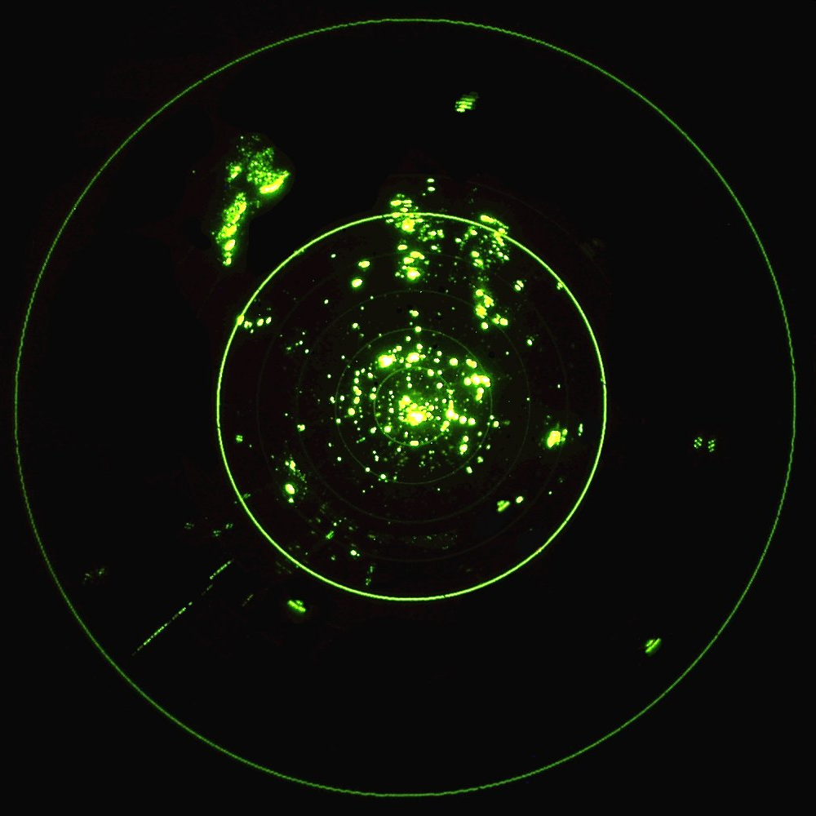
Motivating Problem: Tracking
Image Courtesy http://radartutorial.eu
Notes:
ATC radar tracking.

Slide 4
Motivating Problem: Tracking
Weather clutter
Surface clutter
Target 1
Target 2
Image Courtesy http://radartutorial.eu

Slide 5


Motivating Problem: Bibliographies
Russell, Stuart and Norvig, Peter. Articial Intelligence. Prentice-Hall, 1995.
S. Russel and P. Norvig (1995). Artificial Intelligence: A Modern Approach. Upper Saddle River, NJ: Prentice Hall.

Slide 6
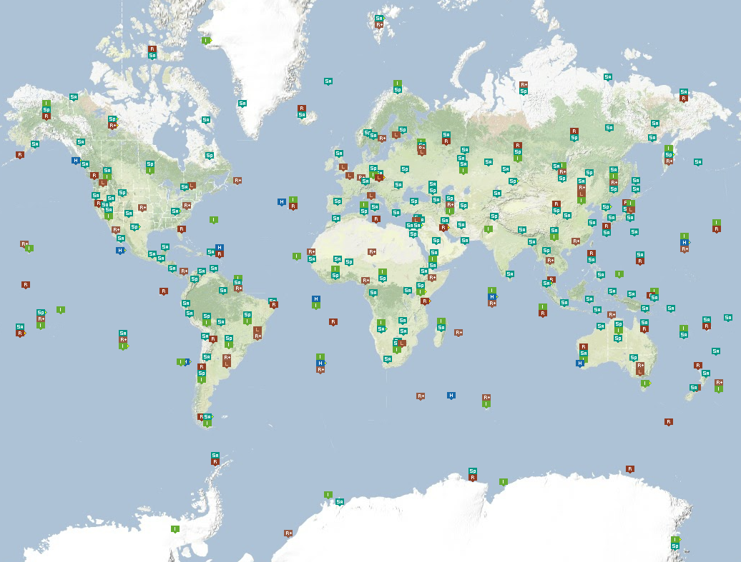
Motivating Problem: Global Seismic Monitoring

Slide 7
Motivating Problem: Global Seismic Monitoring
Notes:
Stations get 100s of false detection per true detection. Single event produces multiple detections at the same station.

Slide 8
OUPM languages (e.g., BLOG)
#Aircraft(EntryTime = t) ~ NumAircraftPrior();
Exits(a, t)
if InFlight(a, t) then ~ Bernoulli(0.1);
InFlight(a, t)
if t < EntryTime(a) then = false
elseif t = EntryTime(a) then = true
else = (InFlight(a, t-1) & !Exits(a, t-1));
State(a, t)
if t = EntryTime(a) then ~ InitState()
elseif InFlight(a, t) then
~ StateTransition(State(a, t-1));
#Blip(Source = a, Time = t)
if InFlight(a, t) then
~ NumDetectionsCPD(State(a, t));
#Blip(Time = t)
~ NumFalseAlarmsPrior();
ApparentPos(r)
if (Source(r) = null) then ~ FalseAlarmDistrib()
else ~ ObsCPD(State(Source(r), Time(r)));

Slide 9
BLOG model for citation matching
#Researcher ~ NumResearchersPrior();
Name(r) ~ NamePrior();
#Paper(FirstAuthor = r) ~
NumPapersPrior(Position(r));
Title(p) ~ TitlePrior();
PubCited(c) ~ Uniform({Paper p});
Text(c) ~ NoisyCitationGrammar
(Name(FirstAuthor(PubCited(c))),
Title(PubCited(c)));

Slide 10
BLOG model for CTBT monitoring
# SeismicEvents ~ Poisson[TIME_DURATION*EVENT_RATE];
IsEarthQuake(e) ~ Bernoulli(.999);
EventLocation(e) ~ If IsEarthQuake(e) then EarthQuakeDistribution()
  Else UniformEarthDistribution();
Magnitude(e) ~ Exponential(log(10)) + MIN_MAG;
Distance(e,s) = GeographicalDistance(EventLocation(e), SiteLocation(s));
IsDetected(e,s) ~ Logistic[SITE_COEFFS(s)](Magnitude(e), Distance(e,s);
#Arrivals(site = s) ~ Poisson[TIME_DURATION*FALSE_RATE(s)];
#Arrivals(event=e, site) = If IsDetected(e,s) then 1 else 0;
Time(a) ~ If (event(a) = null) then Uniform(0,TIME_DURATION)
  else IASPEI-TIME(EventLocation(event(a),SiteLocation(site(a)) + TimeRes(a);
TimeRes(a) ~ Laplace(TIMLOC(site(a)), TIMSCALE(site(a)));
Azimuth(a) ~ If (event(a) = null) then Uniform(0, 360)
  else GeoAzimuth(EventLocation(event(a)),SiteLocation(site(a)) + AzRes(a);
AzRes(a) ~ Laplace(0, AZSCALE(site(a)));
Slow(a) ~ If (event(a) = null) then Uniform(0,20)
  else IASPEI-SLOW(EventLocation(event(a)),SiteLocation(site(a)) + SlowRes(site(a));

Slide 11
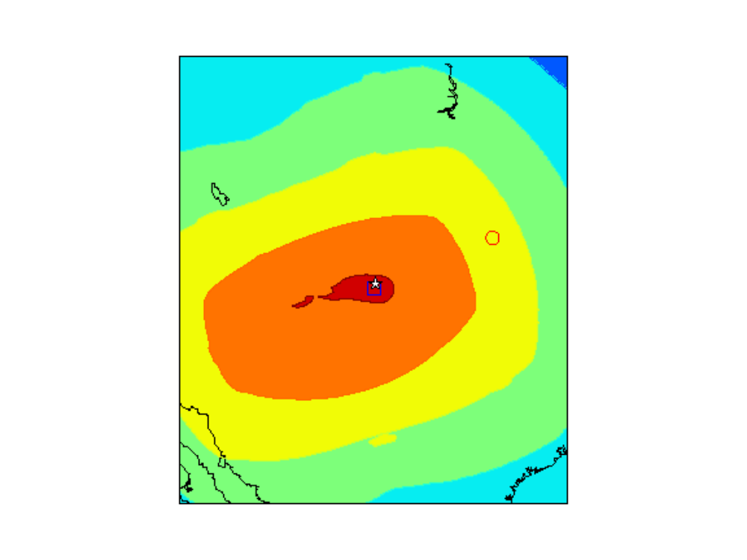
Sample posterior density for a weak seismic event
White star – USGS
ground truth
Red circle – existing
automated processing
Blue square – most probable
explanation
Notes:
An example of what we want from the inference. This slide show the posterior density of the location for a seismic event versus the true location.

Slide 12
Inference in OUPMs
Current methods:
  Convert to grounded infinite contingent Bayes net (CBN), use MCMC etc.
  Lifted inference (other work)
Current generic algorithms are very slow!
(The alternative - application-specific inference code - is hard and error prone)

Slide 13
Outline
Contingent Bayes nets (CBNs)
Simple Metropolis-Hastings (MH) for CBNs
New algorithm for general CBNs defined by OUPMs
Experimental results

Slide 14
Contingent Bayes Net (CBN)
Wing Type is one of Helicopter, FixedWing, or TiltRotor
Wing Type
Rotor Length
Blade Flash
Wing Type = Helicopter or TiltRotor
Radar signal
Blade Flash

Slide 15
CBN – some minimal instantiations
WingType
=Helicopter
Rotor Length
= Long
Blade Flash

Slide 16
CBN – some minimal instantiations
WingType
=FixedWing
Rotor Length
= Long
Blade Flash

Slide 17
CBN – some minimal instantiations
WingType
=FixedWing
Blade Flash
Notes:
Not minimal

Slide 18
CBN – some minimal instantiations
WingType
=TiltRotor
Rotor Length
= Short
Blade Flash

Slide 19
CBN – MH inference (Milch & Russell 2006)
For a randomly chosen variable
  Sample a new value conditioned on parent values
  Instantiate needed variables (to make the world self-supporting)
  Uninstantiate unneeded variables (to make the world minimal)
  Compute acceptance ratio
Notes:
The overview of the algorithm.

Slide 20
CBN – MH Example
WingType
=FixedWing
Blade Flash
Notes:
Not minimal

Slide 21
CBN – MH inference (Milch & Russell 2006)
For a randomly chosen variable
  Sample a new value conditioned on parent values
  Instantiate needed variables (to make the world self-supporting)
  Uninstantiate unneeded variables (to make the world minimal)
  Compute acceptance ratio
Notes:
The overview of the algorithm.

Slide 22
CBN – MH Example
WingType
=Helicopter
Blade Flash
Notes:
Not minimal

Slide 23
CBN – MH inference (Milch & Russell 2006)
For a randomly chosen variable
  Sample a new value conditioned on parent values
  Instantiate needed variables (to make the world self-supporting)
  Uninstantiate unneeded variables (to make the world minimal)
  Compute acceptance ratio
Notes:
The overview of the algorithm.

Slide 24
CBN – MH Example
WingType
=Helicopter
RotorLength
Blade Flash
Not supported
Notes:
Not self-supporting at this point since RotorLength is needed for BladeFlash when WingType is Helicopter.

Slide 25
CBN – MH Example
WingType
=Helicopter
RotorLength
= Long
Blade Flash
Notes:
Not minimal

Slide 26
CBN – MH inference (Milch & Russell 2006)
For a randomly chosen variable
  Sample a new value conditioned on parent values
  Instantiate needed variables (to make the world self-supporting)
  Uninstantiate unneeded variables (to make the world minimal)
  Compute acceptance ratio
Notes:
The overview of the algorithm.

Slide 27
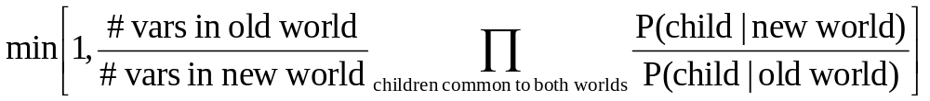
CBN – MH Acceptance Ratio

Slide 28
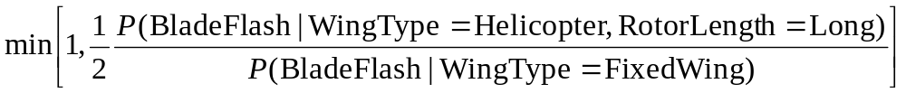
CBN – MH Acceptance Ratio Example
WingType
=FixedWing
WingType
=Helicopter
RotorLength
= Long
Blade Flash
Blade Flash

Slide 29
CBN – MH : Problem
The sampled value for the variable may have high probability given parent variables, but assign low probability to children
Our Gibbs sampling approach: sample from a weighted distribution which incorporates information from both parent and child variables

Slide 30
CBN – Gibbs
For a randomly chosen variable
  Sample multiple worlds, one for each value of variable
  Assign weight to each world
  Choose a world
Notes:
The overview of the algorithm.

Slide 31
CBN – Gibbs
For a randomly chosen variable
  Sample multiple worlds, one for each value of variable
  Assign a weight to each world
  Choose a world
Notes:
The overview of the algorithm.

Slide 32
Sampling, First Approach
Modify the variable in question
Don’t delete any variable
Make each world minimal and self-supporting

Slide 33
Sampling, First Approach
WingType
=Helicopter
WingType
=FixedWing
RotorLength
= Long
RotorLength
= Long
Blade Flash
Blade Flash
WingType
=TiltRotor
RotorLength
= Long
Blade Flash
Notes:
Not minimal

Slide 34
Sampling, First Approach
WingType
=Helicopter
WingType
=FixedWing
RotorLength
= Long
Blade Flash
Blade Flash
WingType
=TiltRotor
RotorLength
= Long
Blade Flash

Slide 35
Sampling, First Approach
Modify the variable in question
Don’t delete any variable
Make each world minimal and self-supporting
Problem:
  Children whose conditional distribution has changed may get very low probability in the new world
  Children deleted in some worlds pose book keeping issues for reverse moves

Slide 36
Sampling, First Approach
Modify the variable in question
Don’t delete any variable
Make each world minimal and self-supporting
Problem:
  Children whose conditional distribution has changed may get very low probability in the new world
  Children deleted in some worlds pose book-keeping issues for reverse moves
Notes:
This can cause the move to get rejected

Slide 37
Sampling, First Approach
WingType
=Helicopter
WingType
=FixedWing
RotorLength
= Long
Blade Flash
Blade Flash
WingType
=TiltRotor
RotorLength
= Long
Low probability
Blade Flash

Slide 38
Sampling, First Approach
Modify the variable in question
Don’t delete any variable
Make each world minimal and self-supporting
Problem:
  Children whose conditional distribution has changed may get very low probability in the new world
  Children deleted in some worlds pose book-keeping issues for reverse moves
Notes:
This can cause the move to get rejected

Slide 39
Sampling, First Approach
WingType
=Helicopter
Same sampled value
WingType
=FixedWing
RotorLength
= Long
Blade Flash
Blade Flash
WingType
=TiltRotor
RotorLength
= Long
Starting World
Blade Flash
Notes:
The move has to be reversible

Slide 40
Solution: Reduce to Core First
The core is roughly the intersection of all possible worlds that could be reached after modifying a variable and making it minimal and self-supporting

Slide 41
Example: Create Multiple Worlds
WingType
=Helicopter
WingType
=FixedWing
RotorLength
= Long
RotorLength
= Long
Blade Flash
Blade Flash
WingType
=TiltRotor
RotorLength
= Long
Blade Flash
Notes:
This is the initial step to create multiple worlds

Slide 42
Example: Reduce to core
WingType
=Helicopter
WingType
=FixedWing
RotorLength
= Long
Blade Flash
Blade Flash
WingType
=TiltRotor
Keep original
world intact
RotorLength
not in core
Blade Flash

Slide 43
Example: .. and then sample
WingType
=Helicopter
WingType
=FixedWing
RotorLength
= Long
Blade Flash
Blade Flash
WingType
=TiltRotor
RotorLength
= Short
RotorLength may
have a new value
Blade Flash

Slide 44
CBN – Gibbs
For a randomly chosen variable
  Sample multiple worlds, one for each value of variable
  Assign a weight to each world
  Choose a world
Notes:
The overview of the algorithm.

Slide 45
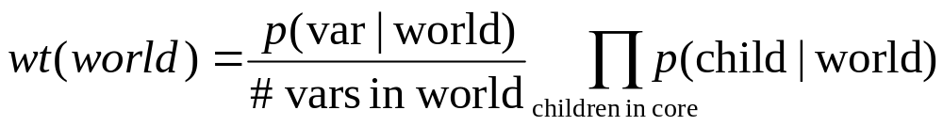
CBN – Gibbs: Weight of world

Slide 46
BLOG Implementation
Gibbs sample finite-domain variables
Birth-Death moves for number variables
MH moves for other variables (working on Gibbs!)
Model analysis to identify core for each variable (For example RotorLength is not in core of WingType)
Generate C sampling code

Slide 47
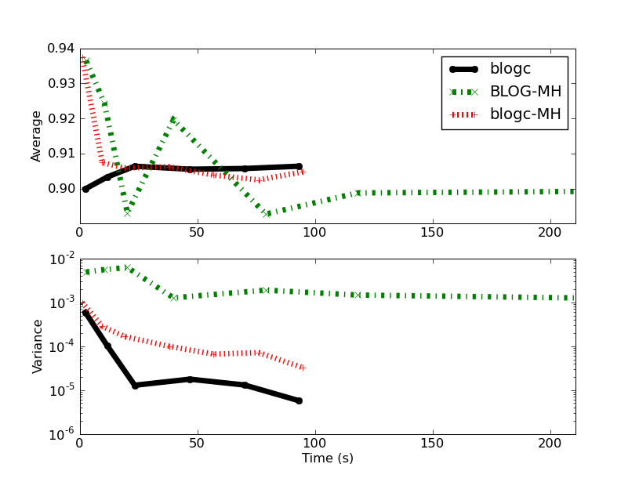
Results on a Bayes Net

Slide 48
BLOG model: Unknown number of aircrafts generating radar blips
#Aircraft(WingType = w)
if w = Helicopter
then ~ Poisson [1.0]
else ~ Poisson [4.0];
#Blip(Source = a) ~ Poisson[1.0]
#Blip ~ Poisson[2.0];
RotorLength(a)
if WingType(a) = Helicopter
then ~ TabularCPD [[0.4, 0.6]]
BladeFlash(b)
if Source(b) = null
then ~ Bernoulli [.01]
elseif WingType(Source(b)) = Helicopter
then ~ TabularCPD [[.9, .1], [.6, .4]]
(RotorLength(Source(b)))
else ~ Bernoulli [.1]

Slide 49
BLOG model: Unknown number of aircrafts generating radar blips
#Aircraft(WingType = w)
if w = Helicopter
then ~ Poisson [1.0]
else ~ Poisson [4.0];
#Blip(Source = a) ~ Poisson[1.0]
#Blip ~ Poisson[2.0];
RotorLength(a)
if WingType(a) = Helicopter
then ~ TabularCPD [[0.4, 0.6]]
BladeFlash(b)
if Source(b) = null
then ~ Bernoulli [.01]
elseif WingType(Source(b)) = Helicopter
then ~ TabularCPD [[.9, .1], [.6, .4]]
(RotorLength(Source(b)))
else ~ Bernoulli [.1]

Slide 50
BLOG model: Unknown number of aircrafts generating radar blips
#Aircraft(WingType = w)
if w = Helicopter
then ~ Poisson [1.0]
else ~ Poisson [4.0];
#Blip(Source = a) ~ Poisson[1.0]
#Blip ~ Poisson[2.0];
RotorLength(a)
if WingType(a) = Helicopter
then ~ TabularCPD [[0.4, 0.6]]
BladeFlash(b)
if Source(b) = null
then ~ Bernoulli [.01]
elseif WingType(Source(b)) = Helicopter
then ~ TabularCPD [[.9, .1], [.6, .4]]
(RotorLength(Source(b)))
else ~ Bernoulli [.1]

Slide 51
BLOG model: Unknown number of aircrafts generating radar blips
#Aircraft(WingType = w)
if w = Helicopter
then ~ Poisson [1.0]
else ~ Poisson [4.0];
#Blip(Source = a) ~ Poisson[1.0]
#Blip ~ Poisson[2.0];
RotorLength(a)
if WingType(a) = Helicopter
then ~ TabularCPD [[0.4, 0.6]]
BladeFlash(b)
if Source(b) = null
then ~ Bernoulli [.01]
elseif WingType(Source(b)) = Helicopter
then ~ TabularCPD [[.9, .1], [.6, .4]]
(RotorLength(Source(b)))
else ~ Bernoulli [.1]

Slide 52
BLOG model: Unknown number of aircrafts generating radar blips
#Aircraft(WingType = w)
if w = Helicopter
then ~ Poisson [1.0]
else ~ Poisson [4.0];
#Blip(Source = a) ~ Poisson[1.0]
#Blip ~ Poisson[2.0];
RotorLength(a)
if WingType(a) = Helicopter
then ~ TabularCPD [[0.4, 0.6]]
BladeFlash(b)
if Source(b) = null
then ~ Bernoulli [.01]
elseif WingType(Source(b)) = Helicopter
then ~ TabularCPD [[.9, .1], [.6, .4]]
(RotorLength(Source(b)))
else ~ Bernoulli [.1]

Slide 53
Evidence and Queries
obs {Blip b} = {b1, b2, b3, b4, b5, b6};
obs BladeFlash(b1) = true;
obs BladeFlash(b2) = false;
obs BladeFlash(b3) = false;
obs BladeFlash(b4) = false;
obs BladeFlash(b5) = false;
obs BladeFlash(b6) = false;
query WingType(Source(b1));
query WingType(Source(b2));
query WingType(Source(b3));
query WingType(Source(b4));
query WingType(Source(b5));
query WingType(Source(b6));
Notes:
We observe six blips one of which has a Blade Flash. We want to query the type of aircraft which produced each blip.

Slide 54
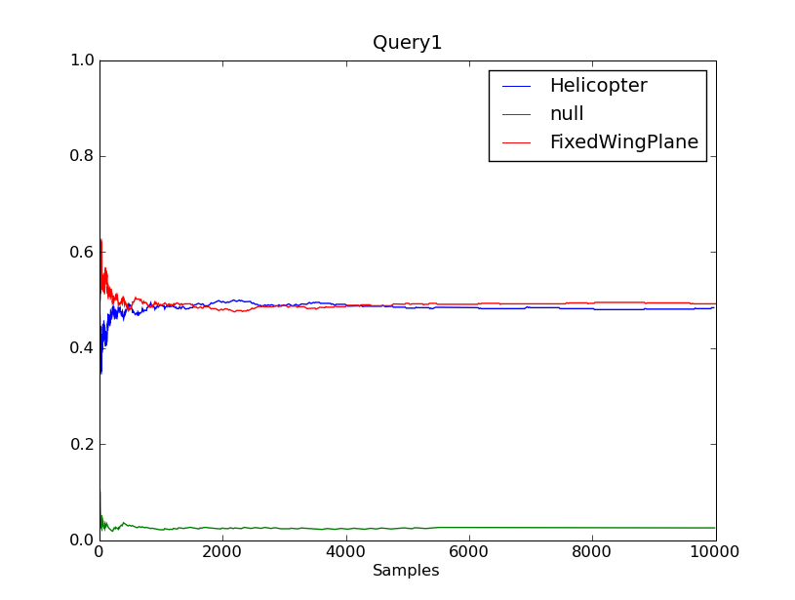
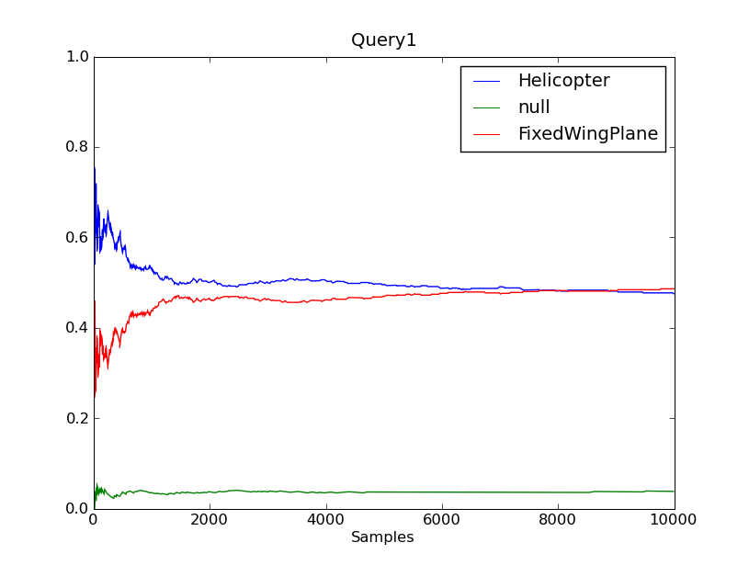
Posterior of WingType(Source(b1))
Gibbs
0.3 seconds
MH
0.2 seconds
Notes:
As seen in the plot Gibbs converges to the true posterior much faster than MH. The correct posterior for Helicopter is .48 as verified by brute force

Slide 55
BLOG model: blip location depends on aircraft location and number of blips depends on type of aircraft
#Aircraft(WingType = w)
if w = Helicopter
then ~ Poisson [1.0]
else ~ Poisson [4.0];
#Blip(Source = a)
if WingType(a) = Helicopter
then ~ Poisson[1.0]
else ~ Poisson[2.0]
#Blip ~ Poisson[2.0];
Location(a)
~ UniformReal [100.0, 1000.0];
BlipLocation(b)
if Source(b) != null
then ~ UnivarGaussian[10.0]
(Location(Source(b)))
else ~ UniformReal [50.0, 1050.0]
RotorLength(a)
if WingType(a) = Helicopter
then ~ TabularCPD [[0.4, 0.6]]
BladeFlash(b)
if Source(b) = null
then ~ Bernoulli [.01]
elseif WingType(Source(b)) = Helicopter
then ~ TabularCPD [[.9, .1], [.6, .4]]
(RotorLength(Source(b)))
else ~ Bernoulli [.1]

Slide 56
BLOG model: blip location depends on aircraft location and number of blips depends on type of aircraft
#Aircraft(WingType = w)
if w = Helicopter
then ~ Poisson [1.0]
else ~ Poisson [4.0];
#Blip(Source = a)
if WingType(a) = Helicopter
then ~ Poisson[1.0]
else ~ Poisson[2.0]
#Blip ~ Poisson[2.0];
Location(a)
~ UniformReal [100.0, 1000.0];
BlipLocation(b)
if Source(b) != null
then ~ UnivarGaussian[10.0]
(Location(Source(b)))
else ~ UniformReal [50.0, 1050.0]
RotorLength(a)
if WingType(a) = Helicopter
then ~ TabularCPD [[0.4, 0.6]]
BladeFlash(b)
if Source(b) = null
then ~ Bernoulli [.01]
elseif WingType(Source(b)) = Helicopter
then ~ TabularCPD [[.9, .1], [.6, .4]]
(RotorLength(Source(b)))
else ~ Bernoulli [.1]

Slide 57
BLOG model: blip location depends on aircraft location and number of blips depends on type of aircraft
#Aircraft(WingType = w)
if w = Helicopter
then ~ Poisson [1.0]
else ~ Poisson [4.0];
#Blip(Source = a)
if WingType(a) = Helicopter
then ~ Poisson[1.0]
else ~ Poisson[2.0]
#Blip ~ Poisson[2.0];
Location(a)
~ UniformReal [100.0, 1000.0];
BlipLocation(b)
if Source(b) != null
then ~ UnivarGaussian[10.0]
(Location(Source(b)))
else ~ UniformReal [50.0, 1050.0]
RotorLength(a)
if WingType(a) = Helicopter
then ~ TabularCPD [[0.4, 0.6]]
BladeFlash(b)
if Source(b) = null
then ~ Bernoulli [.01]
elseif WingType(Source(b)) = Helicopter
then ~ TabularCPD [[.9, .1], [.6, .4]]
(RotorLength(Source(b)))
else ~ Bernoulli [.1]

Slide 58
BLOG model: blip location depends on aircraft location and number of blips depends on type of aircraft
#Aircraft(WingType = w)
if w = Helicopter
then ~ Poisson [1.0]
else ~ Poisson [4.0];
#Blip(Source = a)
if WingType(a) = Helicopter
then ~ Poisson[1.0]
else ~ Poisson[2.0]
#Blip ~ Poisson[2.0];
Location(a)
~ UniformReal [100.0, 1000.0];
BlipLocation(b)
if Source(b) != null
then ~ UnivarGaussian[10.0]
(Location(Source(b)))
else ~ UniformReal [50.0, 1050.0]
RotorLength(a)
if WingType(a) = Helicopter
then ~ TabularCPD [[0.4, 0.6]]
BladeFlash(b)
if Source(b) = null
then ~ Bernoulli [.01]
elseif WingType(Source(b)) = Helicopter
then ~ TabularCPD [[.9, .1], [.6, .4]]
(RotorLength(Source(b)))
else ~ Bernoulli [.1]

Slide 59
Posterior WingType – Gibbs
Blip
Blip with Blade Flash
Notes:
[This slide is not meant to be very readable – I’ll mainly use it to explain the evidence for the subsequent slide]
The lone blade flash is more likely to be a helicopter while the lone blip is more likely to be noise. A blade flash with nearby blips is likely to be a fixed wing plane and so are a pair of co-located blips.

Slide 60
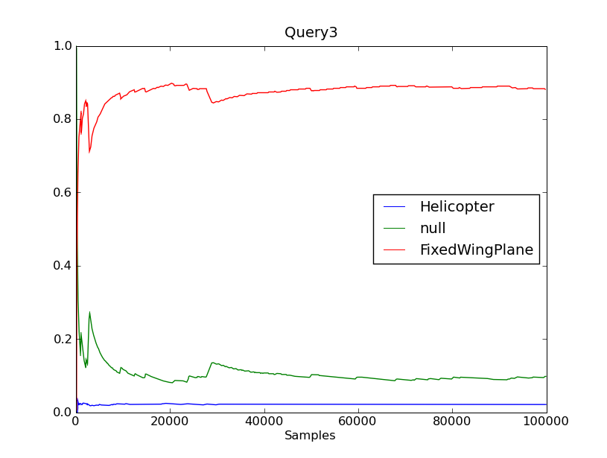
Posterior WingType – Gibbs
Blip
Blip with Blade Flash
Notes:
A pair of blips are more likely to be FixedWingPlane

Slide 61
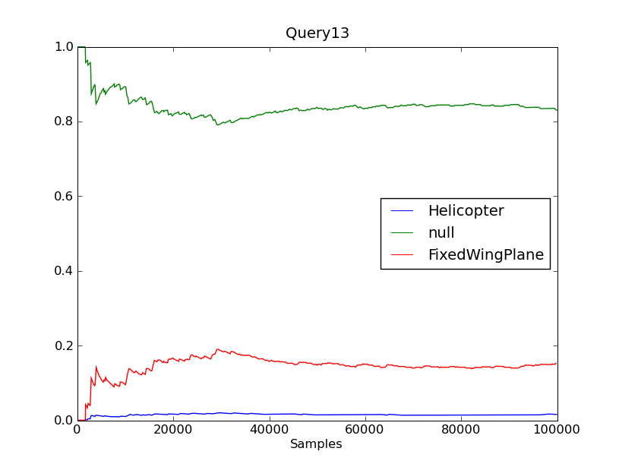
Posterior WingType – Gibbs
Blip
Blip with Blade Flash
Notes:
A lone blip by itself is more likely to be noise.

Slide 62
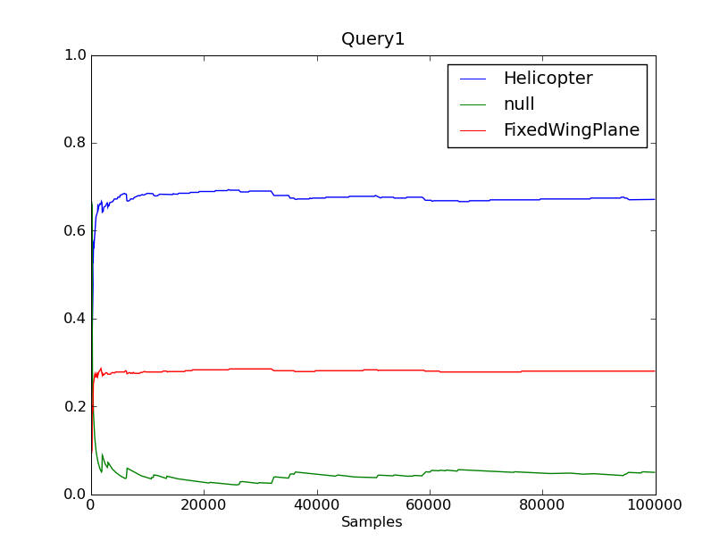
Posterior WingType – Gibbs
Blip
Blip with Blade Flash
Notes:
A lone blade flash is likely to be a helicopter

Slide 63
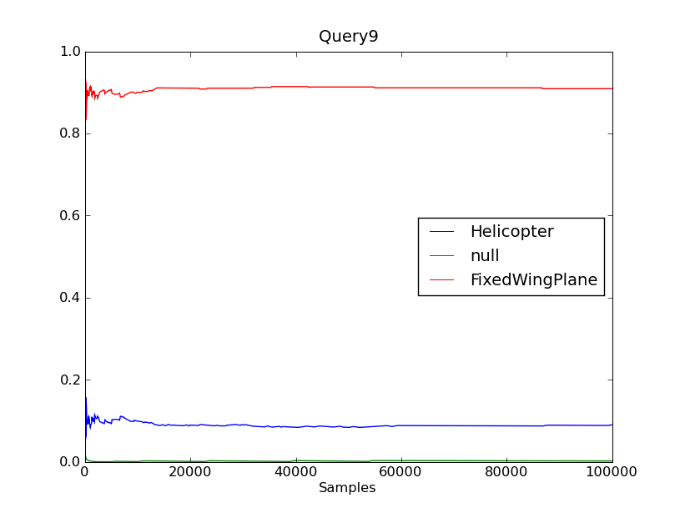
Posterior WingType – Gibbs
Blip
Blip with Blade Flash
Notes:
[This slide is not meant to be very readable – I’ll mainly use it to explain the evidence for the subsequent slide]
The lone blade flash is more likely to be a helicopter while the lone blip is more likely to be noise. A blade flash with nearby blips is likely to be a fixed wing plane and so are a pair of co-located blips.

Slide 64
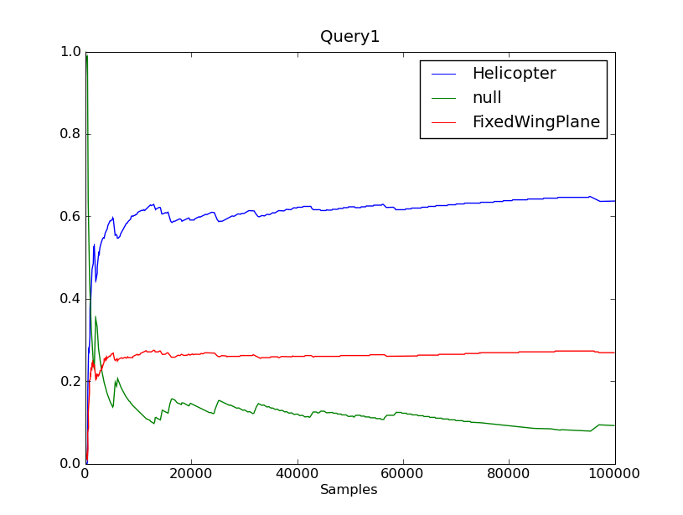
Posterior WingType for lone blade flash
Gibbs
5 seconds
MH
3 seconds
Notes:
As before Gibbs converges much faster than MH even though the Location variable is currently being MH sampled.

Slide 65
Conclusions
Open Universe Probability Models (OUPMs) capture important real world problems
Stochastic languages make it easy to express such models
Automatic inference is currently too slow
Gibbs sampling in OUPM is a substantial improvement over MH
Combined with the C implementation we can now get results very quickly on some non-trivial models.
http://code.google.com/p/blogc

