Slide 1
Automatic Inference in BLOG
Nimar S. Arora University of California, Berkeley
Stuart Russell University of California, Berkeley
Erik Sudderth Brown University

Slide 2
Open Universe Probability Models (OUPMs)
OUPMs extend Bayes Nets with first-order expressive power, effectively infinitely many variables
  Edges may be contingent on predicates over ancestor variables
OUPMs can express important real-world problems
  Seismic event localization for enforcing Comprehensive Nuclear Test Ban Treaty (CTBT)
    OUPM model using data from the International Monitoring System (IMS) with vanilla probabilistic inference was able to produce better results than specialized algorithms developed over 100 years by seismologists!
  Multi-target tracking
  Citation matching / Record linkage
OUPMs can be expressed by Contingent Bayes Nets (CBNs) or stochastic languages like BLOG

Slide 3
BLOG model for CTBT monitoring
# SeismicEvents ~ Poisson[TIME_DURATION*EVENT_RATE];
IsEarthQuake(e) ~ Bernoulli(.999);
EventLocation(e) ~ If IsEarthQuake(e) then EarthQuakeDistribution()
  Else UniformEarthDistribution();
Magnitude(e) ~ Exponential(log(10)) + MIN_MAG;
Distance(e,s) = GeographicalDistance(EventLocation(e), SiteLocation(s));
IsDetected(e,s) ~ Logistic[SITE_COEFFS(s)](Magnitude(e), Distance(e,s);
#Arrivals(site = s) ~ Poisson[TIME_DURATION*FALSE_RATE(s)];
#Arrivals(event=e, site) = If IsDetected(e,s) then 1 else 0;
Time(a) ~ If (event(a) = null) then Uniform(0,TIME_DURATION)
  else IASPEI-TIME(EventLocation(event(a),SiteLocation(site(a)) + TimeRes(a);
TimeRes(a) ~ Laplace(TIMLOC(site(a)), TIMSCALE(site(a)));
Azimuth(a) ~ If (event(a) = null) then Uniform(0, 360)
  else GeoAzimuth(EventLocation(event(a)),SiteLocation(site(a)) + AzRes(a);
AzRes(a) ~ Laplace(0, AZSCALE(site(a)));
Slow(a) ~ If (event(a) = null) then Uniform(0,20)
else IASPEI-SLOW(EventLocation(event(a)),SiteLocation(site(a)) + SlowRes(site(a));

Slide 4
Recent Improvements in automatic inference for BLOG
Gibbs sampling for all finite-domain variables including switching variables, which change the structure of the partial world
Birth–Death moves for number variables
Model analysis to pre-compute parent-child dependencies, variables which need to be instantiated/uninstantiated, etc.
C code generation
Available: http://code.google.com/p/blogc

Slide 5
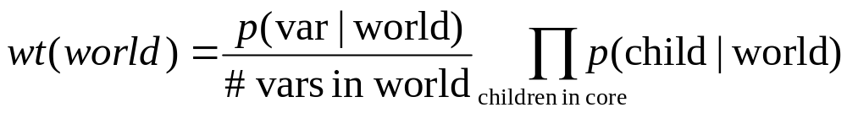
Gibbs Sampling Over Partial Worlds : Main Idea
Problem: When sampling a switching variable, different values lead to different network structures that may require additional variables to be instantiated. How to construct a valid Gibbs sampler?
Solution: Reduce the partial world to the core
  Core is roughly the intersection of all possible partial worlds reachable by modifying the switching variable
Assign the following weight to each world and pick one:

Slide 6
Contingent Bayes Net (CBN)
Wing Type is one of Helicopter, FixedWing, or TiltRotor
Wing Type
Rotor Length
Blade Flash
Wing Type = Helicopter or TiltRotor
Radar signal
Blade Flash

Slide 7
Example: Step 1, modify variable
WingType
=Helicopter
WingType
=FixedWing
RotorLength
= Long
RotorLength
= Long
Blade Flash
Blade Flash
WingType
=TiltRotor
Initial World
RotorLength
= Long
Blade Flash
Notes:
This is the initial step to create multiple worlds

Slide 8
Example: Step 2, Reduce to core
WingType
=Helicopter
WingType
=FixedWing
RotorLength
= Long
Blade Flash
Blade Flash
WingType
=TiltRotor
Keep original
world intact
RotorLength
not in core
Blade Flash

Slide 9
Example: Step 3, make worlds self-supporting. Finally, pick a world.
WingType
=Helicopter
WingType
=FixedWing
RotorLength
= Long
Blade Flash
Blade Flash
WingType
=TiltRotor
RotorLength
= Short
RotorLength may
have a new value
Blade Flash

Slide 10
BLOG model: Unknown number of aircraft generating radar blips
#Aircraft(WingType = w)
if w = Helicopter
then ~ Poisson [1.0]
else ~ Poisson [4.0];
#Blip(Source = a) ~ Poisson[1.0]
True blips
False Blips
#Blip ~ Poisson[2.0];
Aircraft can be either helicopter or fixed wing planes
Blade flash is an artifact of a rotor interacting with the radar beam
RotorLength(a)
if WingType(a) = Helicopter
then ~ TabularCPD [[0.4, 0.6]]
BladeFlash(b)
if Source(b) = null
then ~ Bernoulli [.01]
elseif WingType(Source(b)) = Helicopter
then ~ TabularCPD [[.9, .1], [.6, .4]]
(RotorLength(Source(b)))
else ~ Bernoulli [.1]
Only helicopters have a rotor length

Slide 11
Model Analysis Example
Compile-time analysis of model enables efficient graph manipulations and probability calculations
RotorLength(a) is always a child of WingType(a)
  RotorLength variables prelinked to WingType variables
Whenever Source(b)=a, BladeFlash(b) is a child of WingType(a) (and possibly of RotorLength(a), for helicopters and tilt-rotors)
  Each aircraft keeps a list of blips pointing to it via the Source variable. This simplifies bookkeeping of parent-child relationships
  The above list is updated whenever Source(b) is changed
Moves that modify WingType(a) need to uninstantiate RotorLength(a) (which is not in the core for this move)

Slide 12
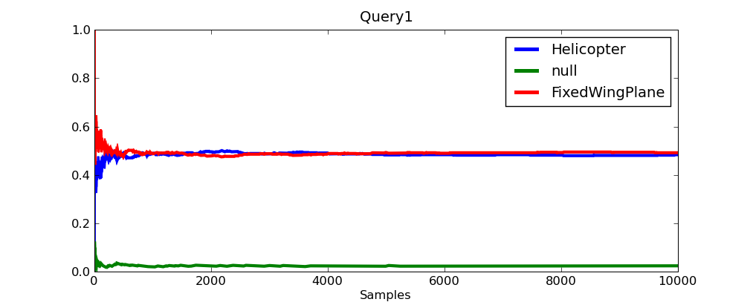
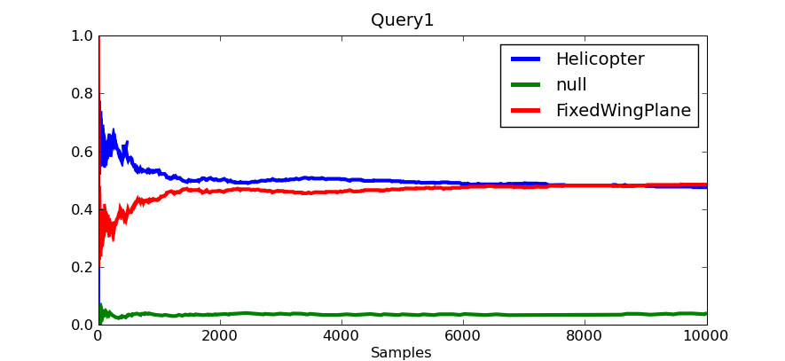
Posterior WingType of blip with blade flash given 5 other blips
Gibbs
0.3 seconds
MH
0.2 seconds
Notes:
As seen in the plot Gibbs converges to the true posterior much faster than MH. The correct posterior for Helicopter is .48 as verified by brute force

Slide 13
BLOG model: blip location depends on aircraft location, number of blips depends on aircraft type
#Aircraft(WingType = w)
if w = Helicopter
then ~ Poisson [1.0]
else ~ Poisson [4.0];
#Blip(Source = a)
if WingType(a) = Helicopter
then ~ Poisson[1.0]
else ~ Poisson[2.0]
#Blip ~ Poisson[2.0];
Location(a)
~ UniformReal [100.0, 1000.0];
BlipLocation(b)
if Source(b) != null
then ~ UnivarGaussian[10.0]
(Location(Source(b)))
else ~ UniformReal [50.0, 1050.0]
RotorLength(a)
if WingType(a) = Helicopter
then ~ TabularCPD [[0.4, 0.6]]
BladeFlash(b)
if Source(b) = null
then ~ Bernoulli [.01]
elseif WingType(Source(b)) = Helicopter
then ~ TabularCPD [[.9, .1], [.6, .4]]
(RotorLength(Source(b)))
else ~ Bernoulli [.1]

Slide 14
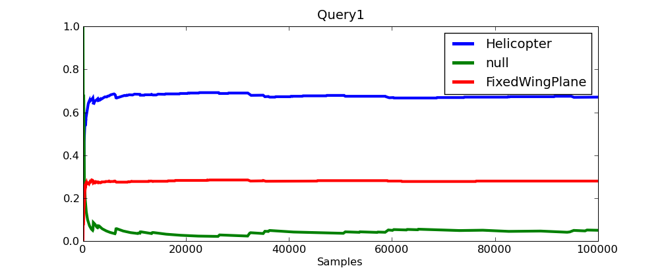
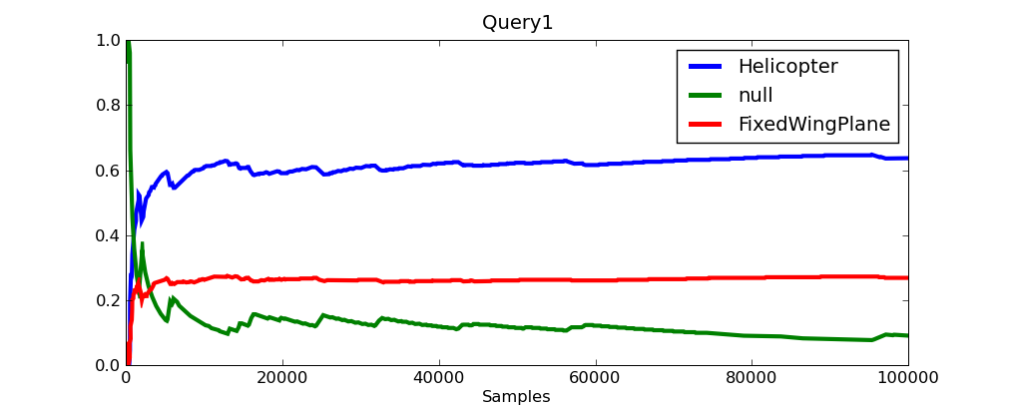
Posterior WingType
Gibbs
(5 seconds)
MH
(3 seconds)
Blip
Blip with Blade Flash
Notes:
[This slide is not meant to be very readable – I’ll mainly use it to explain the evidence for the subsequent slide]
The lone blade flash is more likely to be a helicopter while the lone blip is more likely to be noise. A blade flash with nearby blips is likely to be a fixed wing plane and so are a pair of co-located blips.

Slide 15
Comparative performance
Model (variance threshold) | BLOG-MH (java impl.) | blogc (Gibbs) | blogc-MH
Alarm Bayes Net (1e-4) | 1600 | 11 | 33
Aircraft (1e-6) | _ | 2 | 12.1
Aircraft with location (1e-4) | _ | 2.8 | 14
Time in seconds

