Slide 1
Bayesian Monitoring in VISA: Results and Plans
Nimar Arora University of California, Berkeley
Stuart Russell University of California, Berkeley
Erik Sudderth Brown University
Paul Kidwell Lawrence Livermore National Labs
Notes:
This is a progress report of our efforts to bring Bayesian modeling and inference to bear upon the task of locating seismic events.

Slide 2
Vertically Integrated Seismic Analysis (VISA)
Events
Seismic Wave Propagation
Inference
Waveforms at seismometers
Notes:
We are building a generative model of seismic events, their propagation and resultant seismic waveforms at the IMS stations. Using this model and the observed waveforms we can simultaneously infer all the unknowns in our model without requiring separate modules.

Slide 3
Network Processing (NET-VISA)
Events
Inference
Seismic Wave Propagation
Waveform Parameters
Waveforms at seismometers
Station Processing
Notes:
For the moment though we are using the output of station processing rather than the actual waveforms. This is equivalent to the network processing in SEL3. (In this talk we will restrict our attention to NET-VISA.)

Slide 4
Overview
Generative Probabilistic Model
Inference
Results
Analysis
Future plans

Slide 5
NET-VISA model: variables
Number of Events
Event
Location (longitude, latitude)
Depth
m_{b}
Time
Is Detected(event, station, phase) -> [true or false]
Number of false detections per station
Detection
Arrival Time
Arrival Azimuth
Arrival Slowness
Arrival Phase
Arrival Amplitude
Source -> [event or null]
True Phase -> [phase or null]
Notes:
Is Detected is only relevant if the station is up at the expected arrival time of the phase at the station

Slide 6
Generative Model
Event
Is Detected = True
Transmission
Detection
#stations
Detection
#phases
#stations
# false det
# events
#stations
Notes:
The double arrow to transmission represents the deterministic dependencies. These are the IASPEI model average, the distance between event to station, expected azimuth, expected slowness etc. They capture our knowledge of seismic wave propagation. (They also capture the station specific azimuth, slowness corrections).
The detection parameters have a stochastic dependency on these parameters.

Slide 7
Generative Model
Event
Is Detected = True
Transmission
Detection
#stations
Detection
#phases
#stations
# false det
# events
#stations

Slide 8
Event Prior
Event magnitude is given by a Gutenberg Richter distribution
Depth is assumed to be uniformly distributed (0 – 700 km)

Slide 9
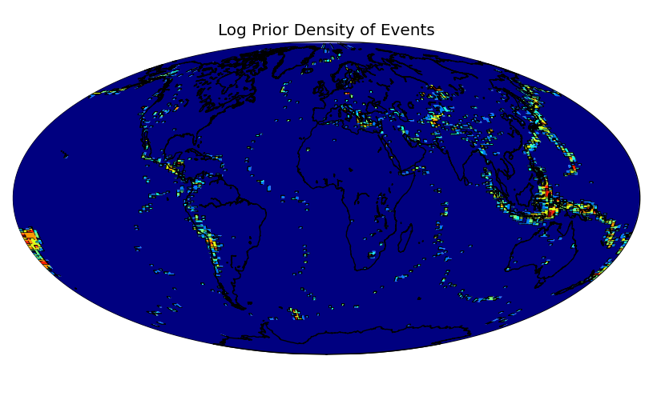
Event Location Prior 2 deg buckets
Simple histogram for 2 degree buckets over the surface of the earth. Absolute discount smoothing – similar to mixing with a uniform distribution

Slide 10
Generative Model
Event
Is Detected = True
Transmission
Detection
#stations
Detection
#phases
#stations
# false det
# events
#stations

Slide 11
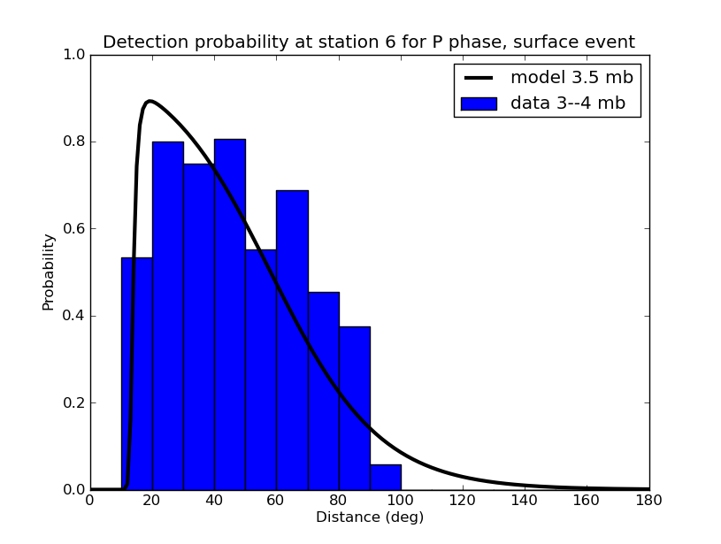
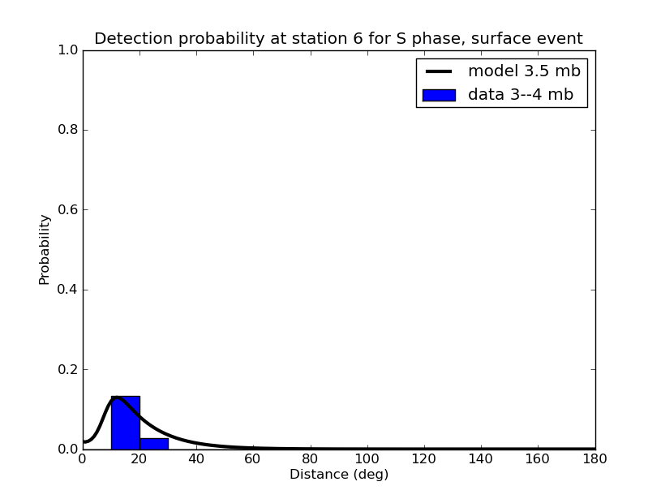
Detection Model
Logistic Regression using event magnitude, depth, and distance to station as basic features
Various combinations of the basic features

Slide 12
Generative Model
Event
Is Detected = True
Transmission
Detection
#stations
Detection
#phases
#stations
# false det
# events
#stations

Slide 13
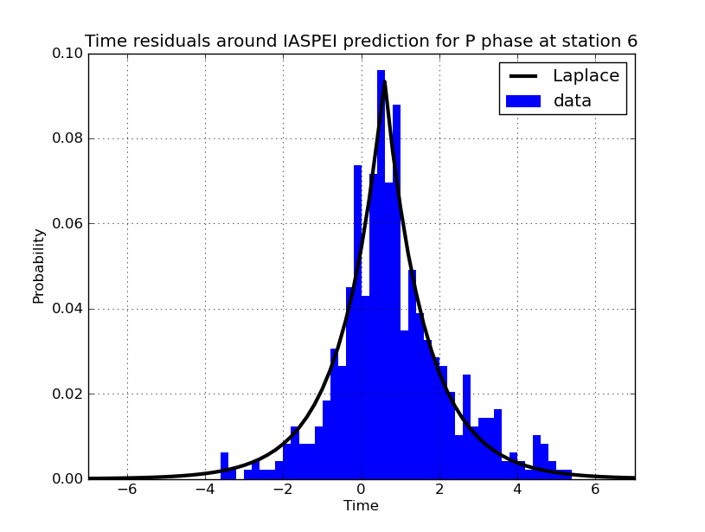
Arrival Time – Laplacian Distribution

Slide 14
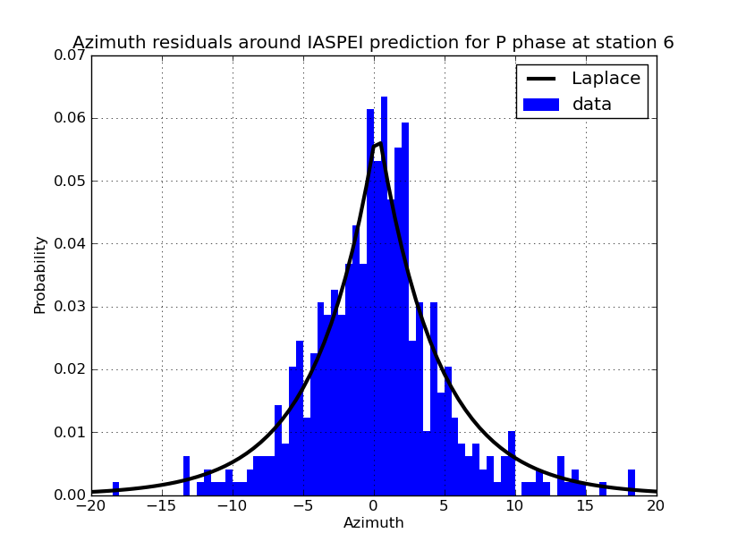
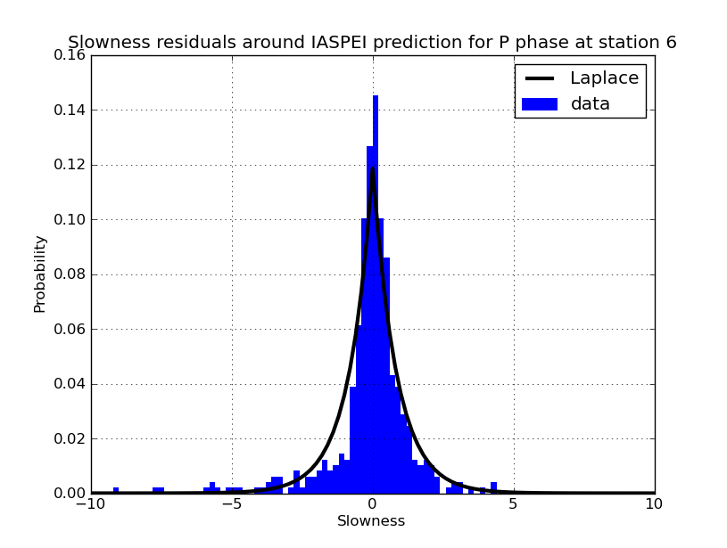
Arrival Azimuth and Slowness .. also Laplacian

Slide 15
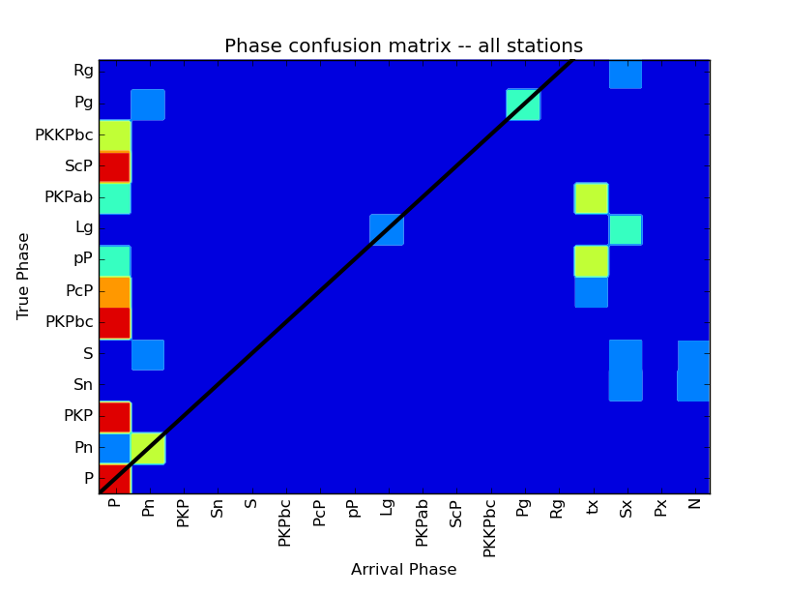
Arrival Phase
Arrival phase is a multinomial conditional on the true phase

Slide 16
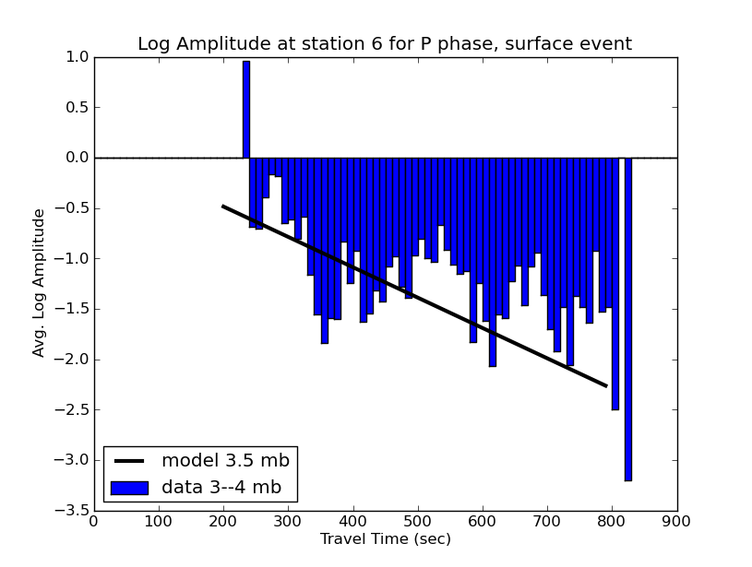
Arrival Amplitude
Log-amplitude is a linear model of event magnitude, depth, and travel time

Slide 17
Generative Model
Event
Is Detected = True
Transmission
Detection
#stations
Detection
#phases
#stations
# false det
# events
#stations

Slide 18
False Arrival Model
Time, Azimuth, and Slowness are uniformly distributed

Slide 19
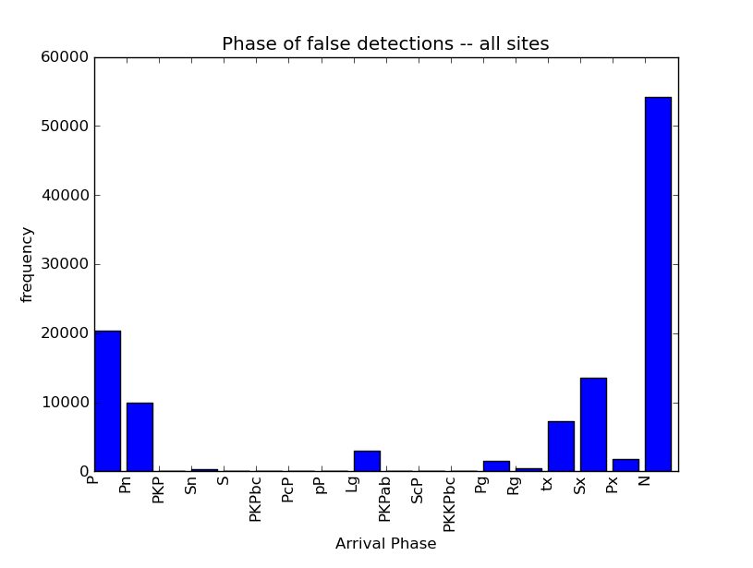
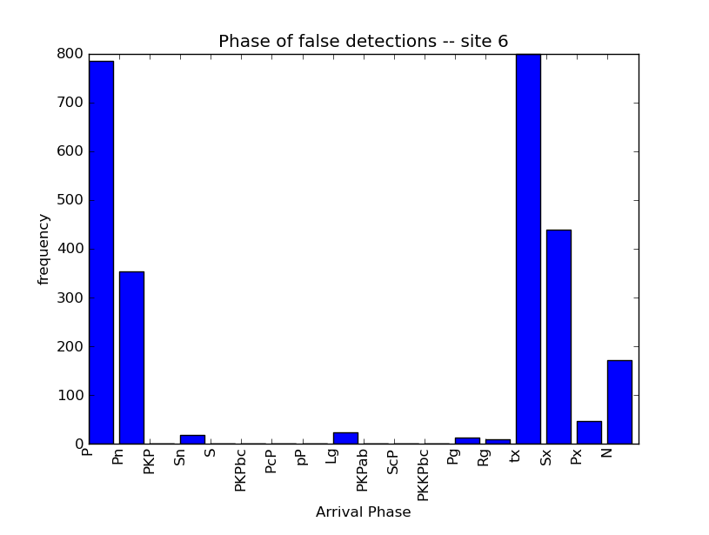
False Arrival : phase distribution
Phase has a multinomial distribution
Notes:
All parameters are learned hierarchically

Slide 20
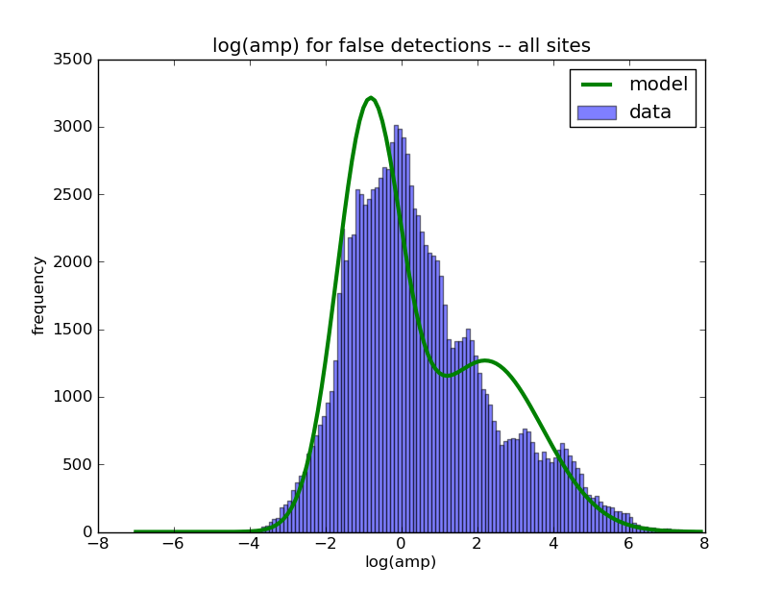
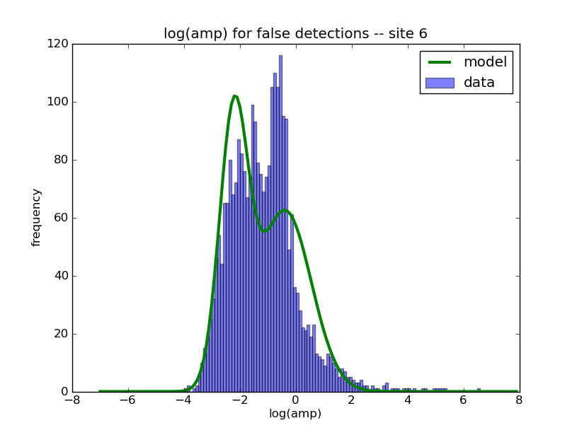
False Arrival: amplitude distribution
Log-Amplitude is a mixture of two Gaussians

Slide 21
Overview
Generative Probabilistic Model
Inference
Results
Analysis
Future plans

Slide 22
Inference
Number of Events
Event
Location (longitude, latitude)
Depth
m_{b}
Time
Is Detected(event, station, phase) -> [true or false]
Number of false detections per station
Detection
Arrival Time
Arrival Azimuth
Arrival Slowness
Arrival Phase
Arrival Amplitude
Source -> [event or null]
True Phase -> [phase or null]
Notes:
Variables in red are inferred while variables in blue are observed

Slide 23
MAP Inference
A hypothesis is a complete sequence of events and the detections associated to them
Max a-posteriori (MAP) hypothesis is the single most probable explanation as per the model
Easier to compare to SEL3
Future MCMC inference can use MAP as an initializer
Notes:
Technically, we should be integrating the probability density in a ball around the event parameters.

Slide 24
Inference Overview
Continuously extend hypothesis by incorporating new detections
Greedy moves improve the probability
Birth
Reassociate
Relocate
Death

Slide 25
Inference Example
Events
e1
e2
e3
time
d1
d2
d3
d4
d5
d5
d6
d7
d8
d9
d10
d11
d12
d13
Detections
window
Notes:
We will explain the algorithm by this example.

Slide 26
Inference : Birth Move
Events
e4
e1
e2
e3
e5
time
d1
d2
d3
d4
d5
d5
d6
d7
d8
d9
d10
d11
d12
d13
Detections
window
Notes:
The dotted lines are detections which were used during proposing the event. The birth move proposes the best possible subset of events using the detections.

Slide 27
Inference : Birth Move
Events
e4
e1
e2
e3
e5
time
d1
d2
d3
d4
d5
d5
d6
d7
d8
d9
d10
d11
d12
d13
Detections
window
Notes:
The detections used as part of the birth move are removed from the hypothesis

Slide 28
Inference : Reassociate Detections
Events
e4
e1
e2
e3
e5
time
d1
d2
d3
d4
d5
d5
d6
d7
d8
d9
d10
d11
d12
d13
Detections
window
Notes:
Detection d8 finds a better event to explain it. But d5 and d10 stick to their event

Slide 29
Inference : Reassociate Detections
Events
e4
e1
e2
e3
e5
time
d1
d2
d3
d4
d5
d5
d6
d7
d8
d9
d10
d11
d12
d13
Detections
window
Notes:
e2-d8 is deleted

Slide 30
Inference : Relocate Events
Events
e4
e1
e2
e3
e5
e5
time
d1
d2
d3
d4
d5
d5
d6
d7
d8
d9
d10
d11
d12
d13
Detections
window
Notes:
E5 finds a better location

Slide 31
Inference : Death Move
Events
e4
e1
e2
e3
e5
time
d1
d2
d3
d4
d5
d5
d6
d7
d8
d9
d10
d11
d12
d13
Detections
window
Notes:
E2, e4 have –ve score

Slide 32
Inference : Death Move
Events
e1
e3
e5
time
d1
d2
d3
d4
d5
d5
d6
d7
d8
d9
d10
d11
d12
d13
Detections
window
Notes:
E2, e4 are killed

Slide 33
Inference : Move Window Forward
Events
e1
e3
e5
time
d1
d2
d3
d4
d5
d5
d6
d7
d8
d9
d10
d11
d12
d13
d14
d15
Detections
New detections
window

Slide 34
Inference : Output stable events
Events
e1
e3
e5
time
d1
d2
d3
d4
d5
d5
d6
d7
d8
d9
d10
d11
d12
d13
d14
d15
Detections
window
Notes:
e1 can’t affect any detection in the window. The inference proceeds on with newer detections…

Slide 35
Overview
Generative Probabilistic Model
Inference
Results
Analysis
Future plans

Slide 36
Analyzing Performance
Min-cost max-cardinality matching where edges exist between prediction and ground truth events within 50 seconds and 5 degrees.
The cost of an edge is the distance between the events.
Precision – percentage of predictions that match.
Recall – percentage of ground truths that match.
Error – average distance between matching events.

Slide 37
Matching Example
e1
90
e1
50
e2
110
e2
LEB
VISA
e3
e3
10
e4
e4
e5

Slide 38
Matching Example
e1
90
e1
50
e2
110
e2
LEB
VISA
e3
e3
10
e4
e4
e5
Notes:
Note: we are deleting the minimum cost edge to LEB:e1. This is because we are finding a max-cardinality matching first and then a min-cost matching

Slide 39
Matching Example
Precision = 3/5 = 60%
e1
90
Recall = ¾ = 75%
e1
Avg. Err = 210/3 = 70km
e2
110
e2
LEB
VISA
e3
e3
10
e4
e4
e5

Slide 40
Recall & Error by m_{b}
m_{b} | #events | Recall |  | Error (km)
 |  | SEL3 |  | SEL3
 |  |  | NET-VISA |  | NET-VISA
0 – 2 | 74 | 64.9 |  | 101
 |  |  | 86.5 |  | 93
2 – 3 | 36 | 50.0 |  | 186
 |  |  | 75.0 |  | 138
3 – 4 | 558 | 66.5 |  | 104
 |  |  | 83.5 |  | 119
> 4 | 164 | 86.6 |  | 70
 |  |  | 89.6 |  | 80
all | 832 | 69.7 |  | 99
 |  |  | 84.6 |  | 109
Notes:
(Run 15 results in this and the subsequent 3 slides)

Slide 41
Recall & Error by m_{b}
m_{b} | #events | Recall |  | Error (km)
 |  | SEL3 |  | SEL3
 |  |  | NET-VISA |  | NET-VISA
0 – 2 | 74 | 64.9 |  | 101
 |  |  | 86.5 |  | 93
2 – 3 | 36 | 50.0 |  | 186
 |  |  | 75.0 |  | 138
3 – 4 | 558 | 66.5 |  | 104
 |  |  | 83.5 |  | 119
> 4 | 164 | 86.6 |  | 70
 |  |  | 89.6 |  | 80
all | 832 | 69.7 |  | 99
 |  |  | 84.6 |  | 109
Notes:
(Run 15 results in this and the subsequent 3 slides)

Slide 42
Recall & Error by m_{b}
m_{b} | #events | Recall |  | Error (km)
 |  | SEL3 |  | SEL3
 |  |  | NET-VISA |  | NET-VISA
0 – 2 | 74 | 64.9 |  | 101
 |  |  | 86.5 |  | 93
2 – 3 | 36 | 50.0 |  | 186
 |  |  | 75.0 |  | 138
3 – 4 | 558 | 66.5 |  | 104
 |  |  | 83.5 |  | 119
> 4 | 164 | 86.6 |  | 70
 |  |  | 89.6 |  | 80
all | 832 | 69.7 |  | 99
 |  |  | 84.6 |  | 109
Notes:
(Run 15 results in this and the subsequent 3 slides)

Slide 43
Recall & Error by m_{b}
m_{b} | #events | Recall |  | Error (km)
 |  | SEL3 |  | SEL3
 |  |  | NET-VISA |  | NET-VISA
0 – 2 | 74 | 64.9 |  | 101
 |  |  | 86.5 |  | 93
2 – 3 | 36 | 50.0 |  | 186
 |  |  | 75.0 |  | 138
3 – 4 | 558 | 66.5 |  | 104
 |  |  | 83.5 |  | 119
> 4 | 164 | 86.6 |  | 70
 |  |  | 89.6 |  | 80
all | 832 | 69.7 |  | 99
 |  |  | 84.6 |  | 109
Notes:
(Run 15 results in this and the subsequent 3 slides)

Slide 44
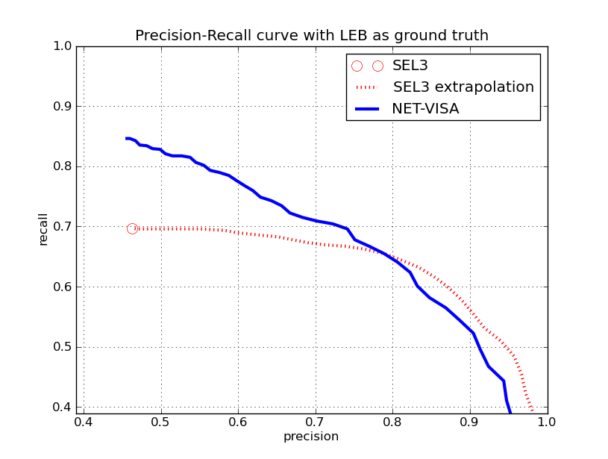
Precision & Recall
SEL3 extrapolation courtesy Mackey & Kleiner
Notes:
SEL3 extrapolation uses scores from the false event identification (FEI) task. Note: the purpose of this slide is not to compare Mackey & Kleiner’s work with ours – they are solving a different task. The purpose is to compare the performance of our algorithm with improvements that could be made to SEL3 using information already in the SEL3 bulletin.

Slide 45
Alternate Evaluation Criteria
Criteria | Precision |  | Recall |  | Error (km)
 | SEL3 |  | SEL3 |  | SEL3
 |  | NETVISA |  | NETVISA |  | NETVISA
Matching, 5 deg, 50s | 46.2 |  | 69.7 |  | 99
 |  | 45.6 |  | 84.6 |  | 109
5deg, 50s | 48.0 |  | 70.0 |  | 98
 |  | 53.4 |  | 85.2 |  | 104
250km,40s | 41.5 |  | 60.9 |  | 63
 |  | 46.2 |  | 74.9 |  | 71
Notes:
The top line is our evaluation criteria. The middle line shows that not requiring matching can give a big boost to the precision. The bottom line shows that a more stringent error ball. Irrespective of criteria, NET-VISA has a 15% higher recall than SEL3 at the same or better precision.

Slide 46
Overview
Generative Probabilistic Model
Inference
Results
Analysis
Future plans

Slide 47
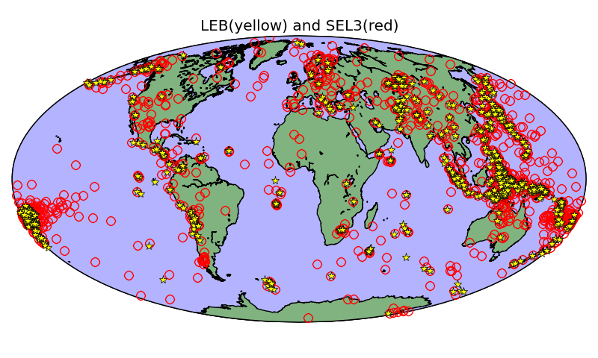
All Predicted Events (LEB & SEL3)

Slide 48
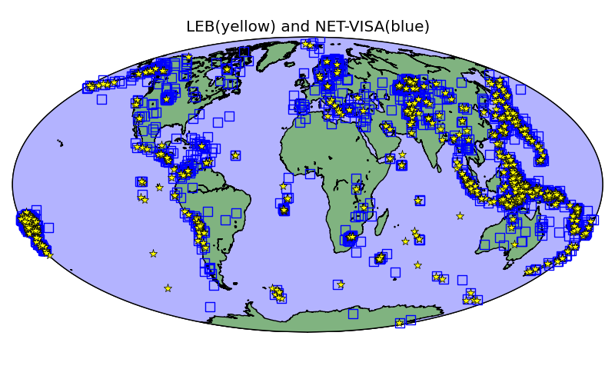
All Predicted Events (LEB & NET-VISA)

Slide 49
Error Analysis : 1
NET-VISA considers many more combinations of detections than LEB
=> Event locations tend to be different
=> New events are predicted

Slide 50
Additional Detections in NET-VISA
m_{b} | #events | #Additional detections
0 – 2 | 64 | 2
2 – 3 | 27 | 2
3 – 4 | 465 | 2
>4 | 148 | 4
All | 704 | 3

Slide 51
Example 1 :
Orid | Phase | Sta | Timeres | Azres | Slores
5295573 | P | ASAR | -1.9 | -8.5 | -0.2
5295573 | P | WRA | -0.8 | -2.2 | 0.6
5295573 | P | FITZ | 1.2 | 10.2 | -0.7
5295573 | P | CTA | 1.6 | -16 | -0.3
LEB
Runid | Orid | Phase | Sta | Timeres | Azres | Slores
8 | 11 | P | ASAR | 0.6 | -10.8 | -3
8 | 11 | P | WRA | 0.4 | -4.8 | 0.6
8 | 11 | P | FITZ | 6.8 | -47.1 | -1.3
8 | 11 | P | TXAR | 3.3 | -84.9 | 0.9
8 | 11 | P | AFI | -1.1 | 22.0 | -2.4
8 | 11 | P | RPZ | 0.6 | 24.6 | 12.8
NET-VISA
Notes:
The NET-VISA event appears to be as good or better explanation with 3 of the 4 detections used by LEB. (The CTA detection was not in IDCX_Arrival). According to our model the LEB event has the best location given just the 3 detections, but using the extra detections the NET-VISA location is better.

Slide 52
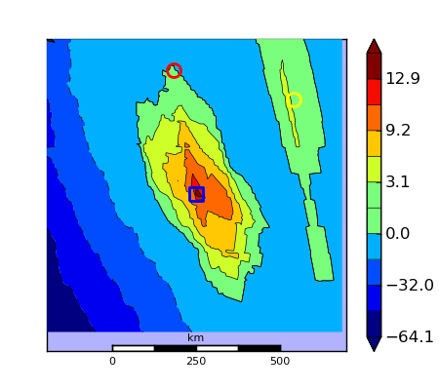
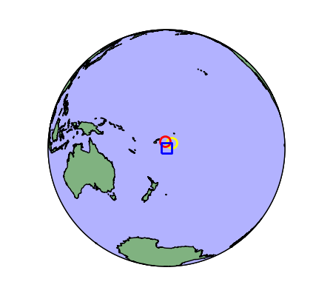
Example 1: Posterior Probability
Blue – NET-VISA, Yellow – LEB, Red – SEL3
Notes:
>python debug.py 8 visa 11 -w 4 -r .1
(NOTE: LEB/SEL3 had no hydro phases even though this event was in the ocean)

Slide 53
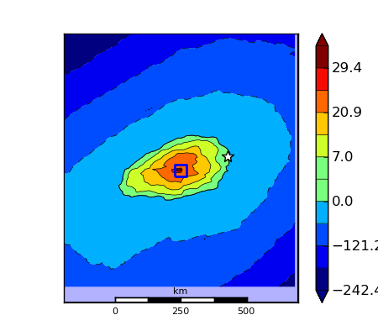
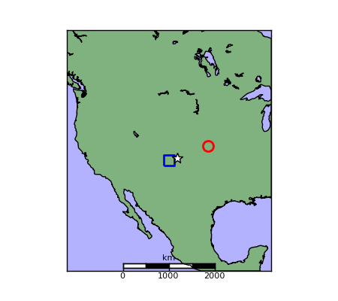
Ex 2: NEIC Event (ML 3) missed by LEB
White – NEIC, Blue – NET-VISA, Red – SEL3
Notes:
Colorado
>python debug.py 15 visa 254 -w 4 -r .1
2 PDAR and 2 TXAR detections

Slide 54
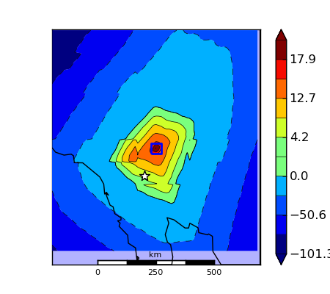
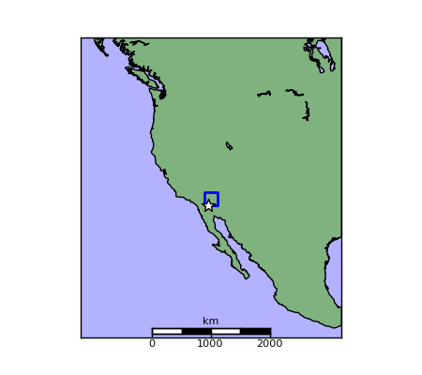
Ex 3: NEIC Event (ML 3.7) missed by LEB
White Star – NEIC : Courtesy ISC
Notes:
Southern California
>python debug.py 15 visa 2069 -w 4 -r .1

Slide 55
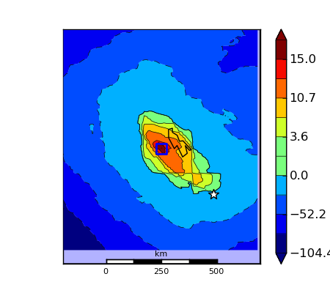
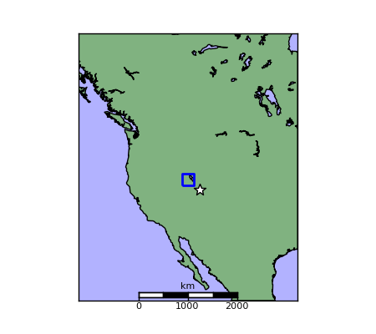
Ex 4: NEIC Event (ML 2.6) missed by LEB
White Star – NEIC : Courtesy ISC
Notes:
Utah
>python debug.py 15 visa 2338 -w 4 -r .1

Slide 56
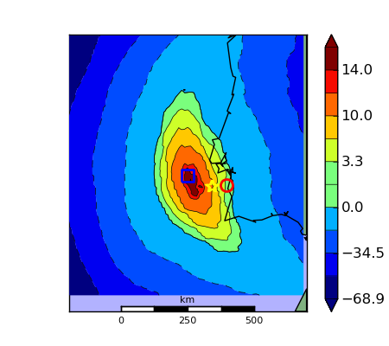
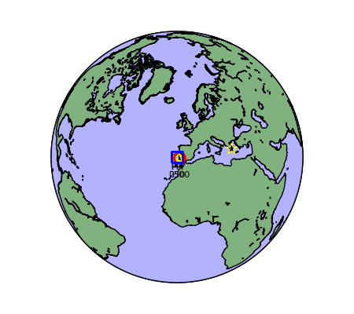
Ex 5: Portugal Event missed by LEB
Yellow star – LDG (French) network: Courtesy ISC
Notes:
Run 15 visa orid 3148
The ISC author was LDG (Laboratoire de Détection et de Géophysique)

Slide 57
Error Analysis : 2
A single phase may produce more than one detection
When this occurs consistently across multiple stations NET-VISA hypothesizes multiple events

Slide 58
Error Analysis : Pseudo Phases
Station 3
Station 2
Pn
Sn
Lg
Distance to Station
Station 1
Pseudo Phases?
time
Notes:
Run 15 events 3482, 3483, 3484

Slide 59
Error Analysis : Shadow Events
Station 3
Station 2
Pn
Sn
Lg
Distance to Station
Station 1
Shadow Events
time

Slide 60
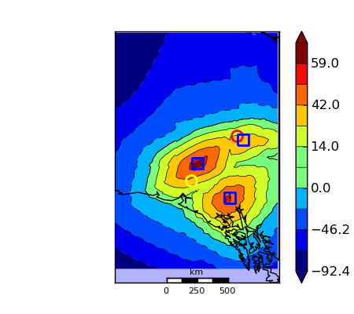
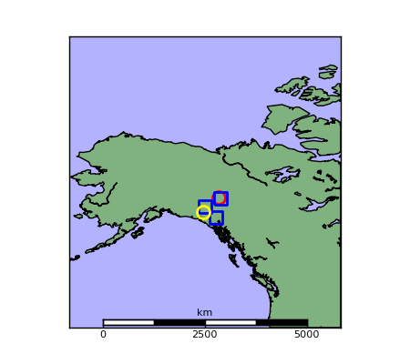
Ex 6: Shadow Events (LEB ML 2.9)
Blue – NET-VISA, Yellow – LEB, Red – SEL3
Notes:
Regional event with unknown magnitude
> python debug.py 15 visa 3482 -w 4 -r .1

Slide 61
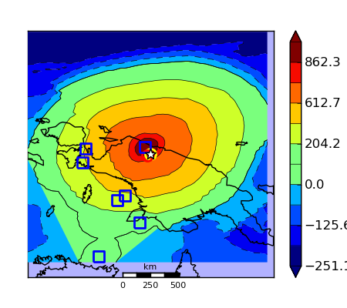
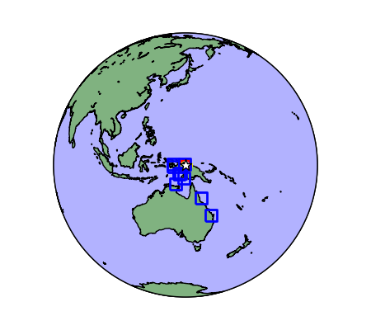
Ex 7: Shadow Events (m_{b} 5.7)
Notes:
> Leb orid 5306733

Slide 62
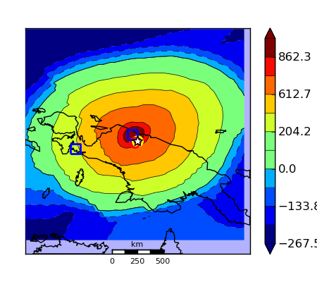
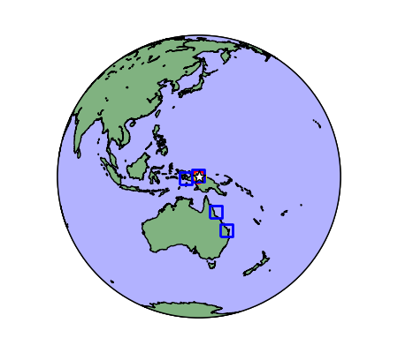
Hack … Suppress Duplicates
Notes:
Events within 5 degrees and 50 seconds of more probable event are discarded

Slide 63
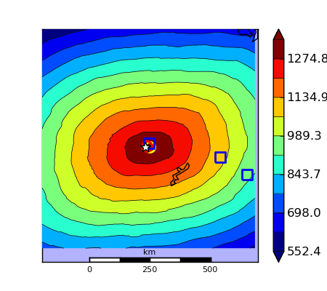
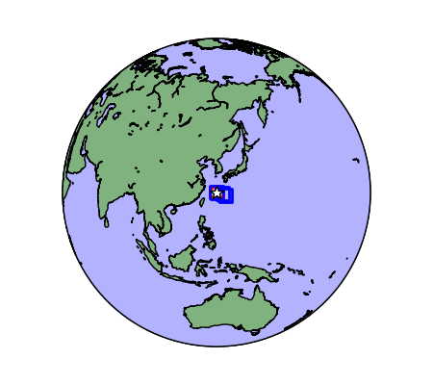
Are these duplicates?
Notes:
Northwest of Ryukyu Islands
> Run 15 Leb orid 5293631

Slide 64
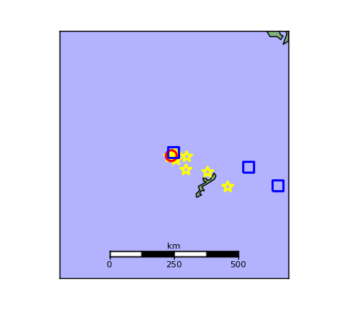
ISC event location from all sources
Yellow Stars : various sources for same event : Courtesy ISC
Notes:
Given the range of ISC locations for the event it is quite plausible that these were really multiple events

Slide 65
Overview
Generative Probabilistic Model
Inference
Results
Analysis
Future plans

Slide 66
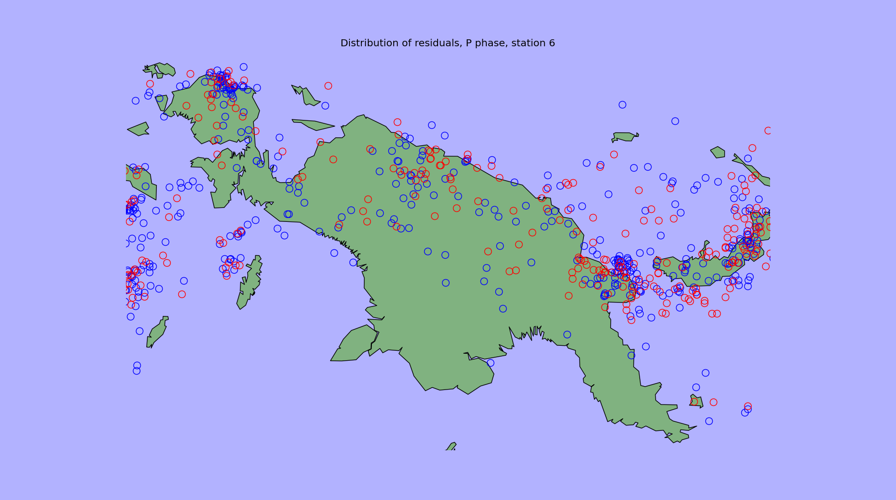
Travel Time Corrections
Blue – positive, Red – negative residual

Slide 67
Current Generative Model
Event
Is Detected = True
Transmission
Detection
#stations
Detection
#phases
#stations
# false det
# events
#stations

Slide 68
Correlated Phase Detections
Event
Transmission
Transmission
Is Detected = True
Detection
#stations
Detection
#phases
#stations
# false det
# events
#stations
Notes:
For the same event at each station we expect the P and the S phase residuals to be correlated. Similarly for the amplitudes decay

Slide 69
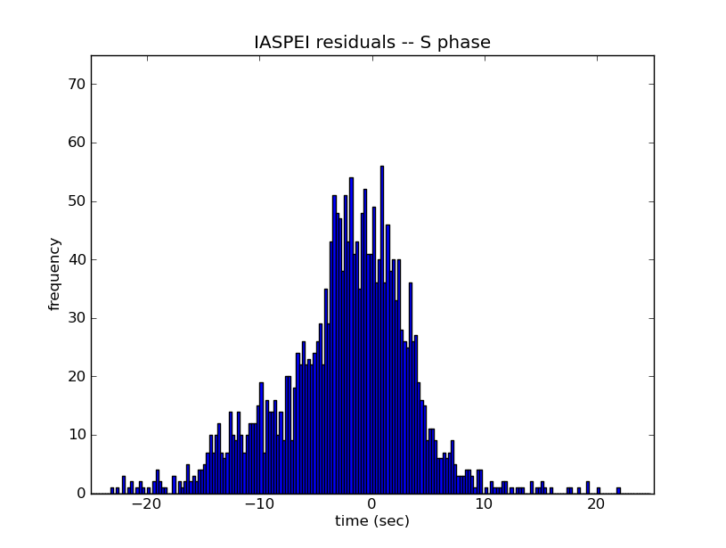
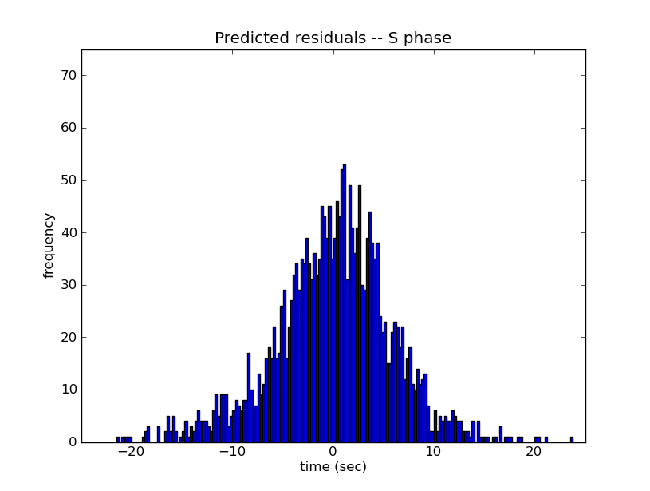
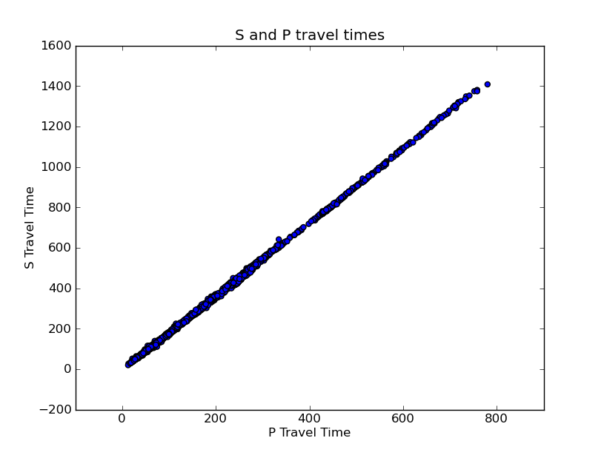
Correlation between S and P travel times

Slide 70
Time Varying Station Noise Affects Detections and False Detections
Event
Transmission
Detection
Transmission
Is Detected = True
# false det
#stations
Detection
#phases
Noise
#stations
time
# events
#stations
Notes:
The noise level and phase amplitude should dictate whether an event is detected or not. Similarly the noise level would dictate the number of false detections. The noise level can vary over time.

Slide 71
Others…
Event location prior using Fisher Binghams etc.
Model for Hydroacoustic and Infrasound detections
Multiple detections per phase (pseudo phases)
IDC Evaluation of NET-VISA
SIG-VISA

Slide 72
Conclusion
Generative Probabilistic Model of seismic events, transmission, and detection
MAP inference for direct comparison with SEL3
15% higher recall than SEL3 at the same precision
Potentially more events than LEB

