Slide 1

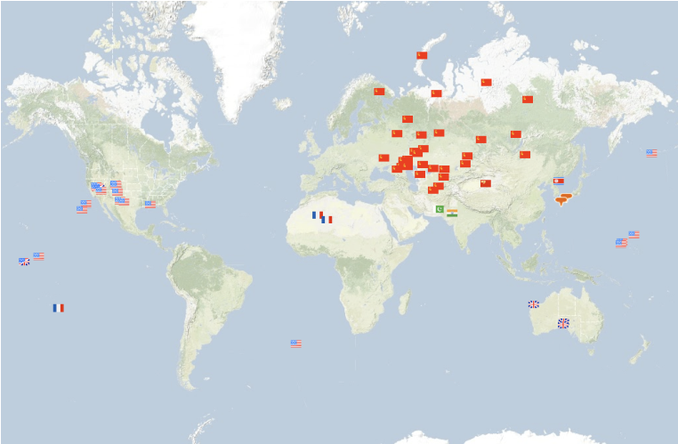
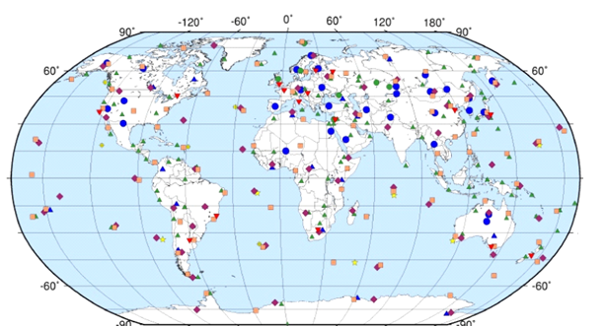
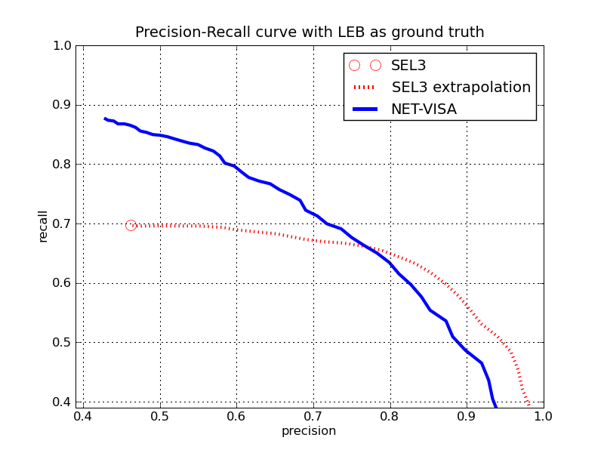
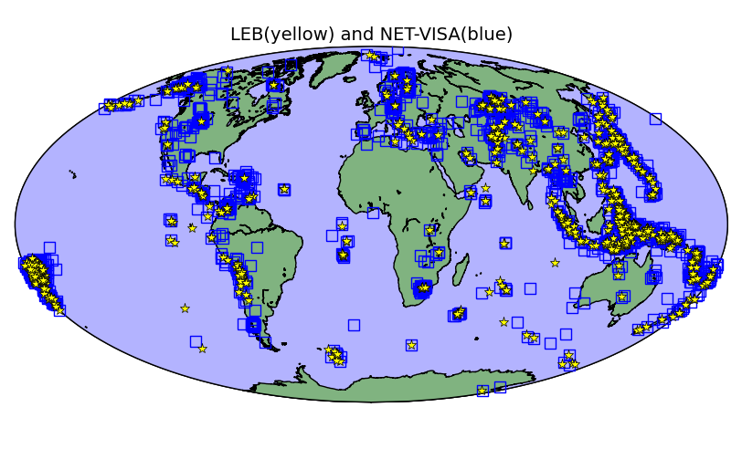
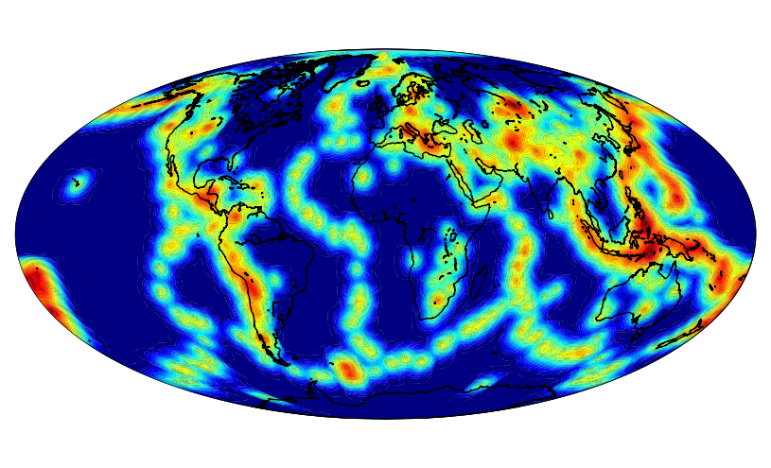
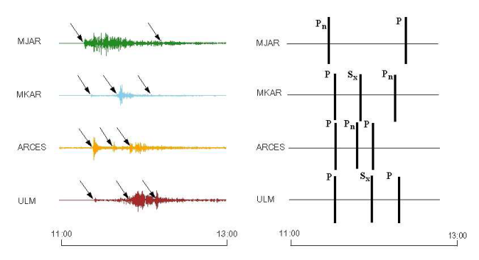
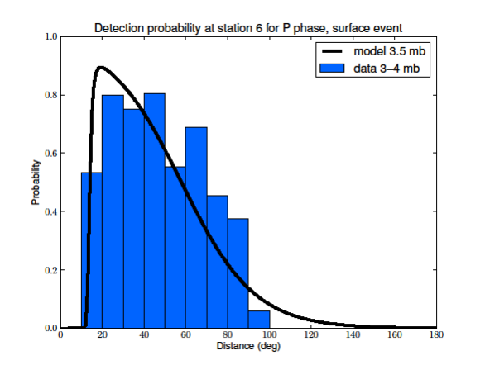
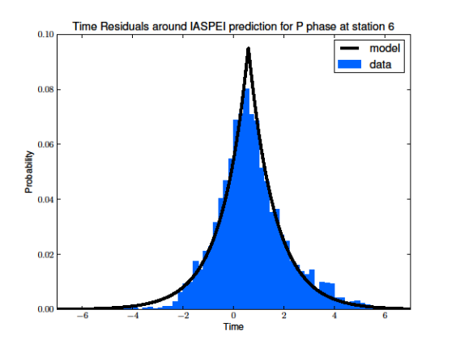
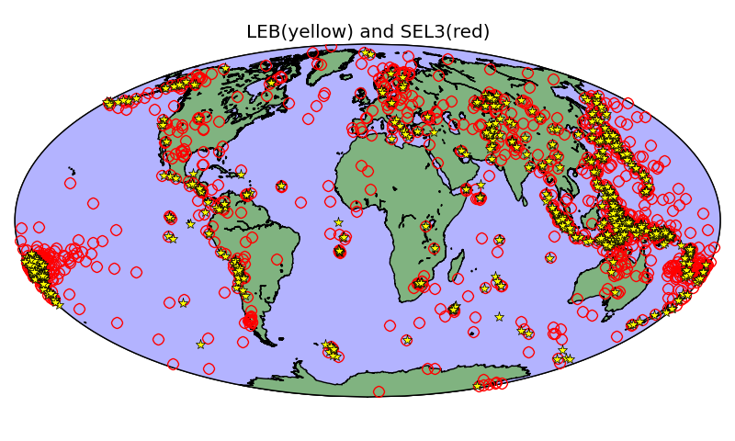
Global seismic monitoring as probabilistic inference
Nimar Arora, Stuart Russell, Paul Kidwell, Erik Sudderth
University of California Berkeley, Lawrence Livermore National Lab, Brown University.
Introduction
Our Approach
Inference
Results
The Comprehensive Nuclear-Test-Ban Treaty (CTBT) bans all nuclear explosions on Earth whether for military or for peaceful purposes.
Unlike SEL3 which processes the data in stages we propose a single vertically integrated probability model.
Our model is empirically estimated and includes seismic knowledge as prior information.
Given the set of detections at all the stations, we need to infer the most probable explanation (MPE) – a sequence of events and the association of events to detections.
Inference works by modifying the current world through a sequence of moves which mainly focus on events and detections in the current window.
SEL3: Current automated seismic bulletin.
LEB: Analyst bulletin starting from SEL3.
NET-VISA: MPE with generative model.
Generative Model of Seismic Event Generation, Transmission, and Detection
m_{b} range | SEL3 |  | NET-VISA
 | Recall | Error (km) | Recall | Error (km)
0 – 2 | 64.9 | 101 | 89.2 | 87
2 – 3 | 50.0 | 186 | 80.6 | 134
3 – 4 | 66.5 | 104 | 85.8 | 106
> 4 | 86.6 | 70 | 93.9 | 70
Locations of all known
nuclear explosions.
Seismic Event
Seismic Event
Events
E₁
E₂
E₃
D₁
D₂
D₃
D₄
D₆
time
Detections
D₅
D₇
D₈
D₉
D₁₀
D₁₁
Travel times
Travel times
window
. A sparse global network of seismic, hydroacoustic, infrasound, and radionuclide stations monitors the earth for potential violations.
We focus here on seismic events.
Detected at
Station 1?
The birth move adds new events by probabilistically “inverting” detections
Detected at
Station 2?
E₄
E₅
E₆
E₇
E₈
E₉
Precision and recall computed using max-cardinality bipartite matching with LEB (assumed to be ground truth).
Average error is the average distance between matched events.
Station 1
noise
E₁
E₂
E₃
Station 1
detections
Station 2
noise
D₁
D₂
D₃
D₄
D₆
time
Station 2
detections
D₅
D₇
D₈
D₉
D₁₀
D₁₁
Blue dots and triangles are primary seismic stations.
The re-associate move shuffles detections among the events.
Events are generated by a time-homogenous Poisson process.
Earthquakes are located according to a kernel density estimate while explosions have a uniform prior.
E₄
E₅
E₆
E₇
E₈
E₉
The Problem
E₁
E₂
E₃
Roughly 10000 detections a day of which 90% are spurious, i.e. small local events like passing trains, falling trees, etc.
Many real events (i.e. magnitude 2 or higher) are not detected at all.
Data Association Problem: What were the true events given the observed detections?
D₁
D₂
D₃
D₄
D₆
time
D₅
D₇
D₈
D₉
D₁₀
D₁₁
The relocate move changes event locations.
E₄
E₅
E₆
E₇
E₈
E₉
SEL3 extrapolation is based on scores from an SVM trained on true and false SEL3 events (Mackey, Kleiner, and Jordan . AGU 2009)
Results are based on a 3 month dataset of which 1 week was used for validation.
LEB is not perfect, the table below shows the performance of LEB and NET-VISA for prediction on the continental United States with the USGS as ground truth.
E₁
E₂
E₃
E₃
Event magnitudes are distributed as per the Guttenberg Richter distribution (exponential distribution with rate log(10)).
Event detection probabilities depend on the station, the seismic wave type (phase), event magnitude, and distance from the event to the station.
Event parameters – arrival time, azimuth, amplitude, etc. – have station-specific distributions.
time
D₁
D₂
D₃
D₄
D₅
D₆
D₇
D₈
D₉
D₁₀
D₁₁
The death move kills unlikely events.
  The current automated system (SEL3) detects 69% of real events and creates twice as many spurious (nonexistent) events.
  16 human analysts find more events, correct existing ones, throw out spurious events, generate LEB (“ground truth”)
  Unreliable below magnitude 4 (about 1 kiloton).
E₇
LEB |  | NET-VISA
Precision | Recall | Precision | Recall
4/4 | 4/33 | 9/51 | 9/33
E₁
E₃
D₁
D₂
D₃
D₄
D₆
time
D₅
D₇
D₈
D₉
D₁₀
D₁₁
Conclusions
The window moves forward, new detections are added and old events are output
NET-VISA is twice as effective as SEL3.
Under consideration for deployment by CTBTO.
Next step: SIG-VISA extends generative model down to signal level.
Yellow stars – LEB,
Red circles – SEL3.
Results for 1 week.
E₇
New detections
Noise detections are generated by a station-specific time-homogenous Poisson process.
All parameters are estimated from historical training data.
Output
E₁
E₃
D₁
D₂
D₃
D₄
D₆
time
The authors were supported by contracts from the Preparatory Commission for the CTBT and the U.S. Department of Energy.
D₅
D₇
D₈
D₉
D₁₀
D₁₁
D₁₂
D₁₃
Notes:
Introduction: We are trying to save mankind by saving the CTBT!
Prior Approach: The current approach has been to look at the predicted arrival time of seismic waves and the observed arrival time – then use least squares of the differences to find the best location. This doesn’t take mis-detections into account
Model:

