Slide 1
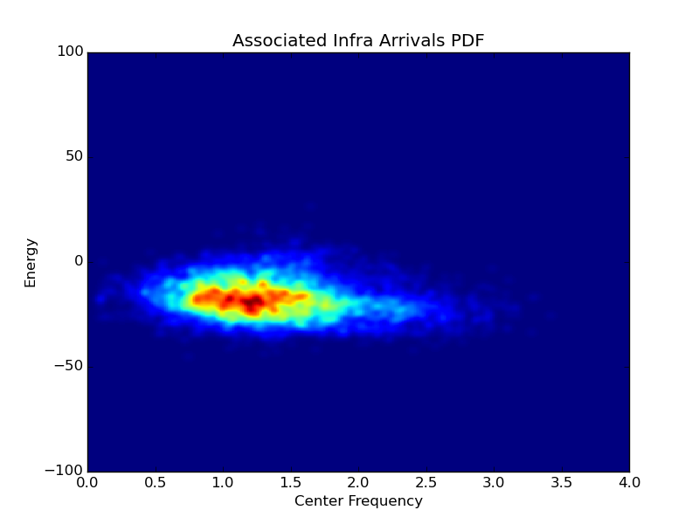
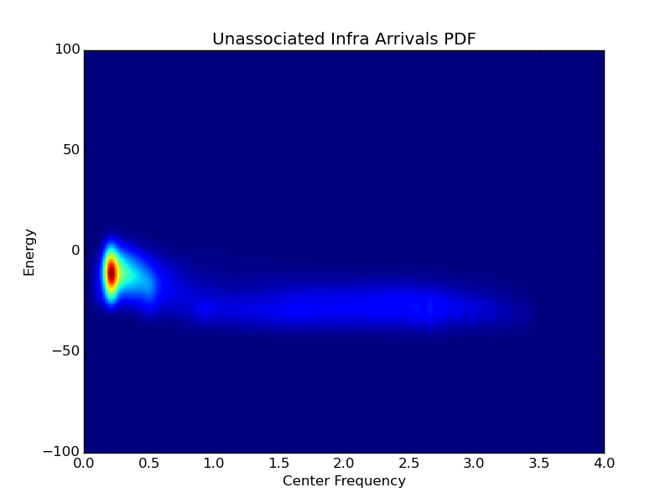
Fusion of Infrasound with Hydro-Acoustic and Seismic Data in NET-VISA (T1.1 – P9)
Probabilistic generative model of infrasound propagation added to existing seismic and hydro-acoustic model
Infrasound uses many new attributes such as
Center Frequency
Arrival Energy
Detailed probabilistic models of these attributes are created for noise as well as true arrivals. For example see pictures on right.
Infra overlap similar to GA -- 27.1% vs 25.4% for GA
However, true overlap is probably higher. Manually inspected events look better than corresponding LEB events with different arrivals.
Authors(s): Nimar S. Arora (Bayesian Logic, Inc.) and Pierrick Mialle (CTBTO)
Notes:
Probabilistic generative model of infrasound detections as well as noise. Including models of frequency and energy.
Higher overlap with the LEB than the current automated SEL3 bulletin.
Overlap may be higher because there is a lot of ambiguity for two or three station events.
Picture showing Center Frequency and Energy.
Table showing overlap of SEL3 and NET-VISA.

