Slide 1


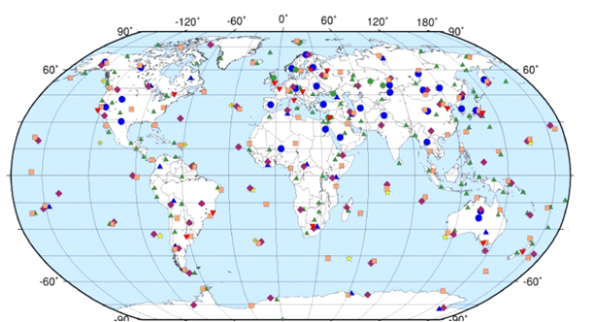
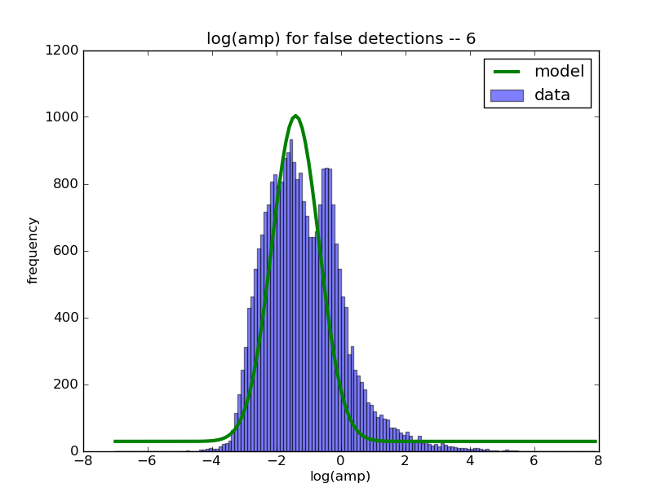
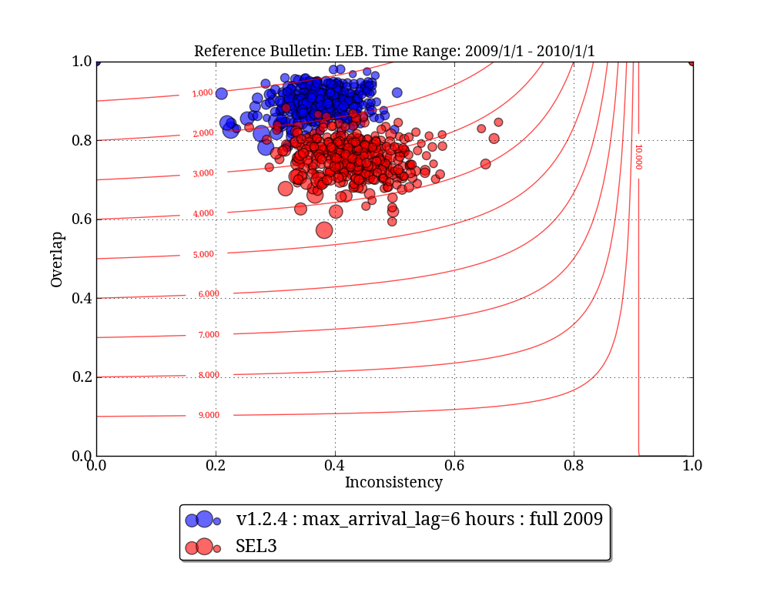
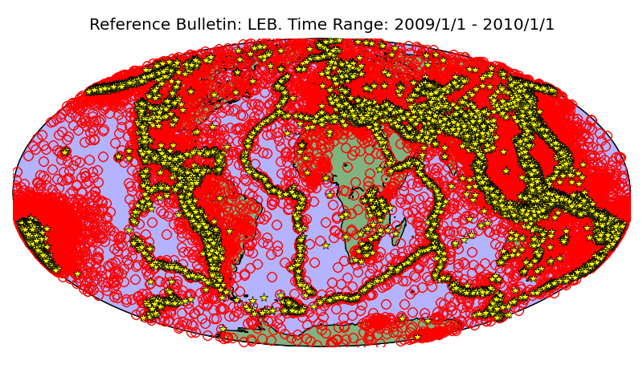
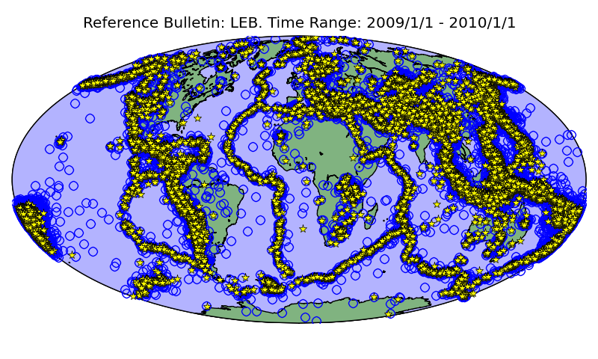
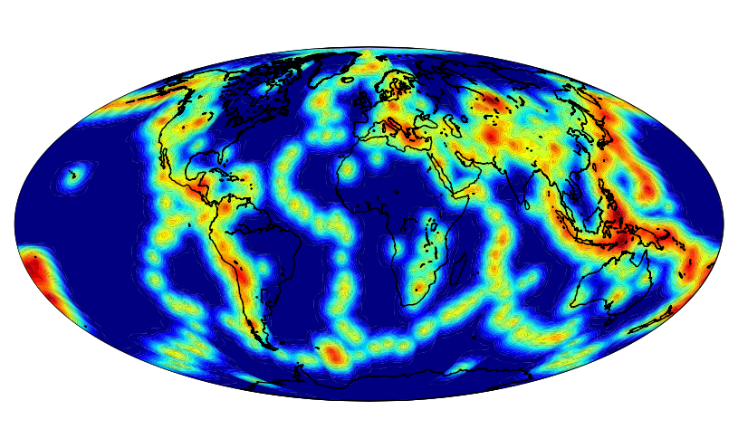
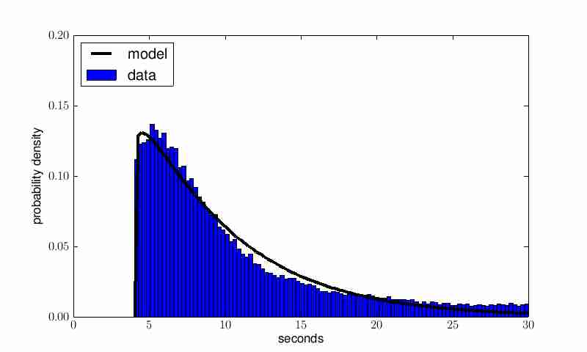
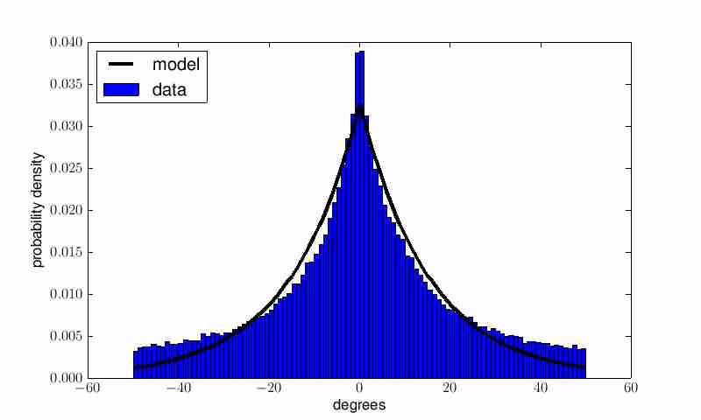
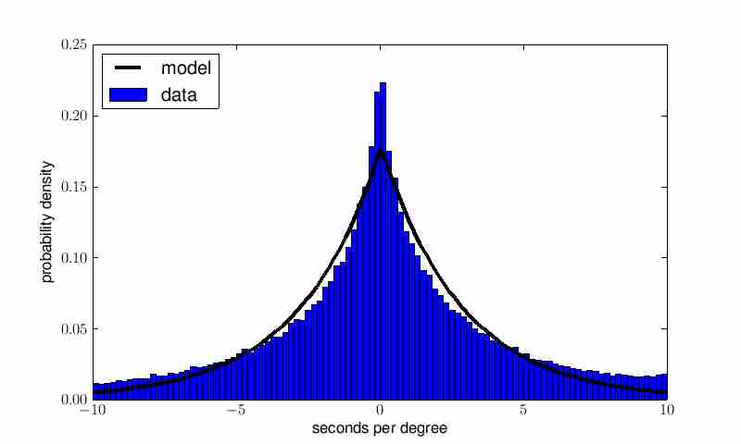
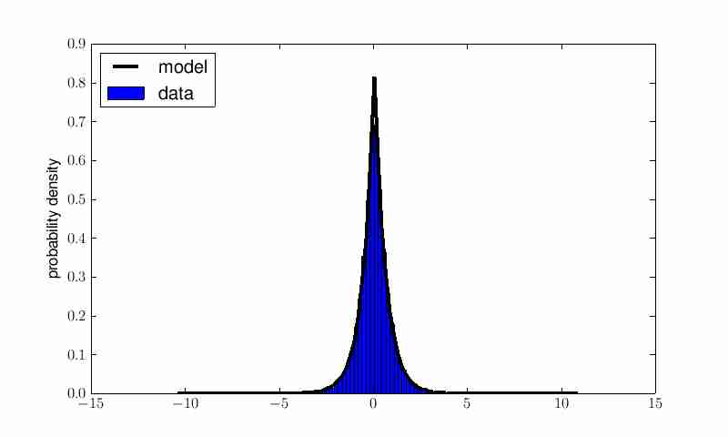
A Probabilistic Model of Global-Scale Seismology with Veith-Clawson Amplitude Corrections (S21B-2395)
Nimar S. Arora (nimar.arora@gmail.com) and Stuart Russell (russell@cs.berkeley.edu)
Introduction
The NET-VISA Model
Performing Inference
Results
The Comprehensive Nuclear-Test-Ban Treaty (CTBT) bans all nuclear explosions on Earth, regardless of purpose.
Global seismic monitoring aims to recover all seismic events in the magnitude range of interest, given a set of detections.
Data from the International Monitoring System (IMS) are processed in real time at the International Data Centre (IDC) in Vienna.
Event magnitudes are distributed as per the Guttenberg Richter distribution (exponential distribution with rate log(10)).
Event detection probabilities depend on the station, the seismic wave type (phase), event magnitude, and distance from the event to the station.
Given the set of detections at all the stations, we need to infer the most probable explanation (MPE) – a sequence of events and the association of events to detections.
Our algorithm goes through a series of moves that improve the starting (empty) solution.
All improvements are evaluated against the probabilistic model to determine whether they are accepted or rejected.
We trained the NET-VISA model using data from Sep-Dec 2008.
Evaluated on all of 2009.
When matching with LEB as the reference bulletin we look for 2 defining arrivals that match.
When matching with ISC as the reference bulletin we look for events within 5 degrees and 50 seconds.
Overlap percentage of reference events that match.
Inconsistency percentage of test events that don’t match
Event parameters – arrival time, azimuth, amplitude, etc. – have station-specific distributions.
Blue dots and triangles are primary seismic stations.
Events
E₁
E₂
E₃
D₁
D₂
D₃
D₄
D₅
D₆
D₇
D₈
D₉
D₁₀
D₁₁
time
Overlap with ISC
On Continental US
Grouped by Event ML
Detections
window
The current automated system (SEL3) detects 74% of real events and creates twice as many spurious events.
16 human analysts find more events, correct existing ones, throw out spurious events, and generate LEB (“ground truth”).
Unreliable below magnitude 4 (about 1 kiloton).
The birth move adds new events by probabilistically “inverting” detections.
Log amplitude of true detections are based on Veith-Clawson curves
E₄
E₅
E₆
E₇
E₈
E₉
E₁
E₂
E₃
time
NET-VISA
D₁
D₂
D₃
D₄
D₅
D₆
D₇
D₈
D₉
D₁₀
D₁₁
SEL3
Figure shows obviously
spurious SEL3 events
The re-associate move shuffles detections among the events.
Overlap and Inconsistency
With LEB as reference (2009)
Events are generated by a time-homogenous Poisson process.
Earthquakes are located according to a kernel density estimate, while explosions have a uniform prior.
E₄
E₅
E₆
E₇
E₈
E₉
Yellow stars – LEB,
Red circles – SEL3
Blue circles – NET-VISA.
Results for 1 year (2009).
E₁
E₂
E₃
time
D₁
D₂
D₃
D₄
D₅
D₆
D₇
D₈
D₉
D₁₀
D₁₁
Overlap with ISC
On Central Asia
Grouped by Event m_b
The relocate move changes event locations.
Many of NET-VISA’s
“spurious” events turn out
to be true when compared to ISC.
Detects 89% of LEB events.
E₄
E₅
E₆
E₇
E₈
E₉
E₁
E₂
E₃
E₃
time
D₁
D₂
D₃
D₄
D₅
D₆
D₇
D₈
D₉
D₁₀
D₁₁
The NET-VISA Model
The residual distribution for the travel time, azimuth, and slowness are mostly modeled as Laplacian distributions.
Noise detections are generated by a station-specific time-homogenous Poisson process.
All parameters are estimated from historical training data.
The death move kills unlikely events.
Conclusions and Further Work
Unlike SEL3, which processes the data in stages, we propose a single vertically integrated probability model that is empirically estimated and includes seismic knowledge as prior information.
E₃
E₇
NET-VISA reduces detection failures by a factor of 2 relative to SEL3 with LEB as reference.
Higher recall than LEB when using ISC as reference.
NET-VISA is currently being tested in the CTBTO environment for possible deployment in operations.
Extensions for Hydro-acoustic and Infrasound data are currently in development.
Please also see poster S33B-2413, Interactive Model Visualization for NET-VISA.
E₁
time
Seismic Event
Seismic Event
D₁
D₂
D₃
D₄
D₅
D₆
D₇
D₈
D₉
D₁₀
D₁₁
The window moves forward, new detections are added, and old events are output as results.
Travel times
Travel times
Coda Model
E₇
New detections
Detected at
Station 1?
Detected at
Station 2?
Time
difference
Azimuth
difference
Output
E₁
E₃
time
Station 1
noise
D₁
D₂
D₃
D₄
D₅
D₆
D₇
D₈
D₉
D₁₀
D₁₁
D₁₂
D₁₃
Station 1
Detections+coda
Station 2
noise
Slowness
difference
All the moves are implemented using threads to exploit concurrency on multi-core architectures.
The running time (on a modern laptop) is faster than real time, even for large aftershock sequences such as after the 2011 Tohoku earthquake.
Acknowledgements
Station 2
Detections+coda
Log-amplitude
difference
This project has been sponsored by the CTBTO.

