Slide 1
Summary of NET-VISA Evaluation and Testing
Details in ECS/WGB-50/PTS/14
Elena Tomuta¹, Ronan Le Bras¹, Pierrick Mialle¹, Noriyuki Kushida¹, Nimar Arora²
¹ Software Applications Section
International Data Centre
CTBTO
² Bayesian Logic, Inc.
Waveform Expert Group WGB-50
13 March 2018

Slide 2
Types of validation studies performed on NET-VISA
Evaluating the event set produced by NET-VISA:
Global set of events (Seismic+Hydro, Infrasound)
Special events sets (Geosciensce Australia bulletin, “unusual events”)
Assessing Event Quality
Event Associations (2012 Analyst Test) and Event Location
NET-VISA results assessed by IDC/MDA analysts
2012: 27 hours worth of events analyzed in parallel with the REB
2015: First tests with NET-VISA button in ARS
2018: NET-VISA button in Operations

Slide 3
Conclusions
The completeness (overlap) and false alarm rate (inconsistency) of NET-VISA results have been extensively tested against global reference datasets. NET-VISA finds more real events and roughly the same number of false alarms.
Fewer studies have looked at event quality and special event bulletins. They found that NET-VISA associates more phases from more stations and has better depth and origin time estimation, better location accuracy, comparable mislocation and poorer location coverage. Comparison with special event sets (unusual events, Geoscience Australia bulletin) has produced mixed results.
NET-VISA has the potential to reduce analyst workload. The NET-VISA button provides a practical mechanism to get analyst feedback on NET-VISA events, with virtually no increase in analyst workload.
Initial results confirm the increase in overlap shown by statistical methods.

Slide 4
Next Steps
NET-VISA development and tuning:
Focus on event quality addressing feedback from analysts and from studies performed by external experts.
What parts of the NET-VISA model can be made static, what parts should be learned.
Release and evaluation processes:
VSEL3 pipeline is an operational pipeline (segregated from the other pipeline results), releasing a new NET-VISA version goes through IDC Change Control process.
Operationalize some of the event bulletin and event quality tests performed.
Analyst tests:
Upgrade NET-VISA version (VSEL3), include auxiliary seismic, hydro and infra data.
In controlled experiments, swap VSEL3 and SEL3 results in ARS, presenting VSEL3 results first and adding SEL3 events not found by VSEL3.
Benefit: analysts review full VSEL3 without additional workload and without the danger of missing an event of interest.

Slide 5
Further information, on
testing/evaluation environments,
reference datasets,
the effect of the way NET-VISA treats auxiliary stations and noise phases,
tests to determine an optimal training regime and making elements of the model static,
references used in this presentation, etc.
can be found in:
ECS/WGB-50/PTS/14

Slide 6
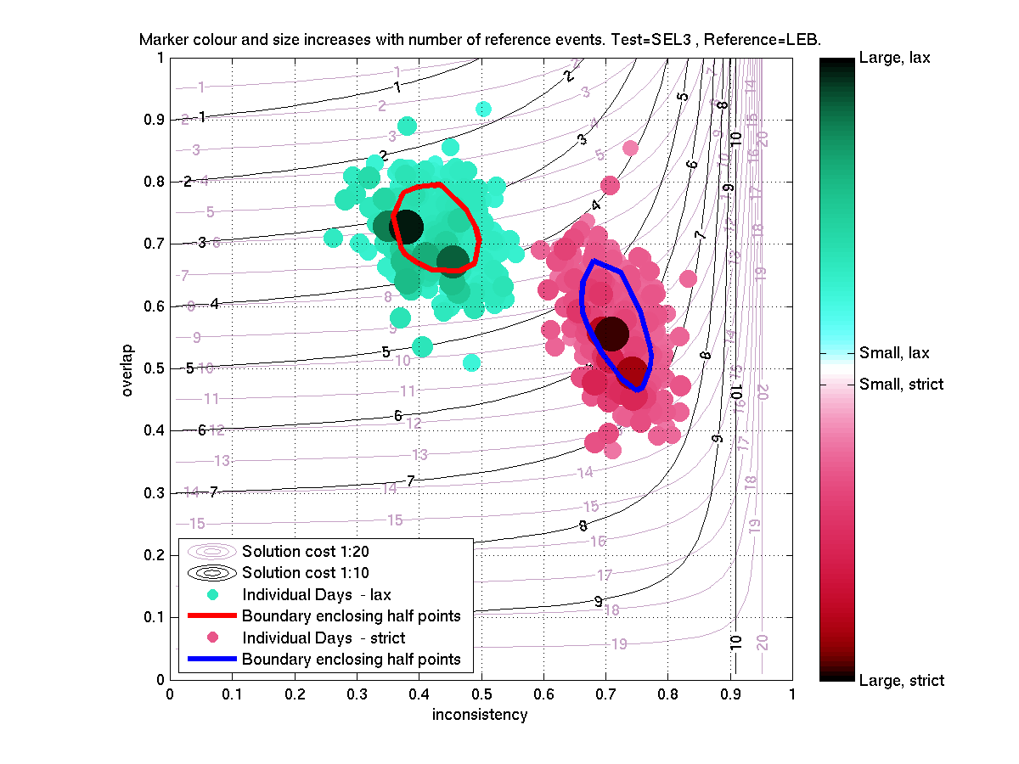
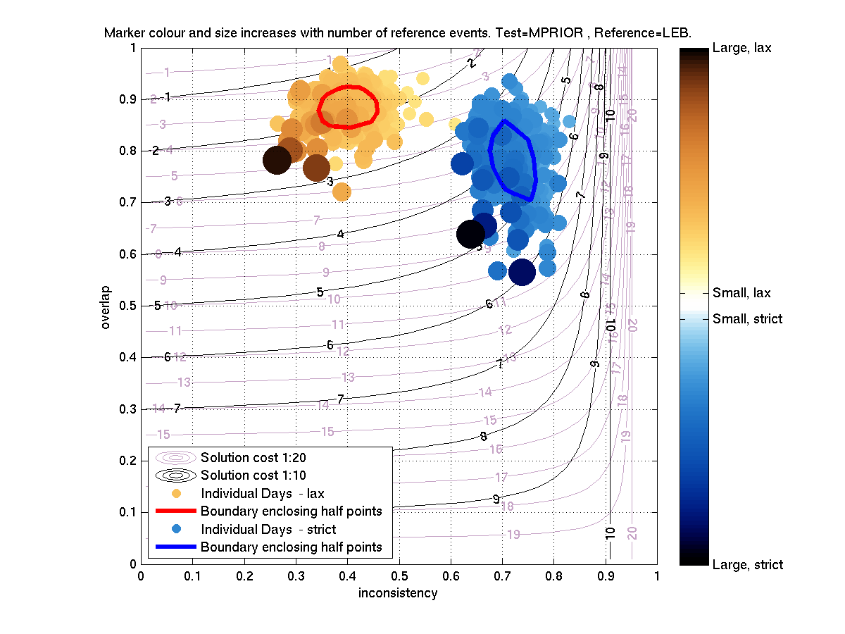
Evaluating event sets against a global reference set [Prior, 2013]
Overlap: proportion of events in the reference dataset (LEB or REB) that are present in the test dataset (NET-VISA or SEL3).
Inconsistency: proportion of events in the test dataset (NET-VISA or SEL3) that are not present in the reference dataset (false alarms).
Cost: combination of overlap and inconsistency in one metric, including the trade-off between missing a real event and proposing a false event.
Overlap for NET-VISA is about 10% better,
irrespective of matching
criterion
NET-VISA Inconsistency
is about the same as for SEL3 or slightly better.
■
Daily SEL3 bulletins (left) and NET-VISA bulletins (right) for all of 2012 shown in the overlap-inconsistency space, with LEB as a reference bulletin. Each dot represents a daily bulletin.

Slide 7
NET-VISA performance for infrasound events and associations [Mialle et. al, 2018]
Reference Dataset: LEB for 2013.
Matching criteria:
two common arrivals,
on-set times within 500 seconds of each other and
point to a back azimuth within 5 degrees of each other, for each of the common arrivals.
85.3%.
NET-VISA overlap is 42%, SEL3 overlap: 24.7% for SEL3;
The inconsistency of NET-VISA results improves very slightly.
Spurious seismic-acoustic associations: 90% lower in NET-VISA results than in SEL3;
■

Slide 8
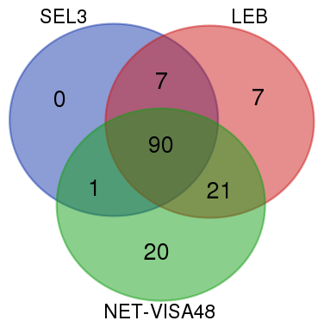
Evaluating event sets against a global set of GT events [Bondar et. al, 2017]
Reference dataset: 146 GT-5 events from the ISC reviewed bulletin for 2015, found in IDC bulletins (LEB, SEL3, NET-VISA)
Matching criteria:
onset times within 2 minutes;
Lat/lon within 5 degrees;
Manual inspection for common picks at IMS stations.
NET-VISA Overlap: 90%
SEL3 Overlap: 67%
LEB Overlap: 86%
■

Slide 9
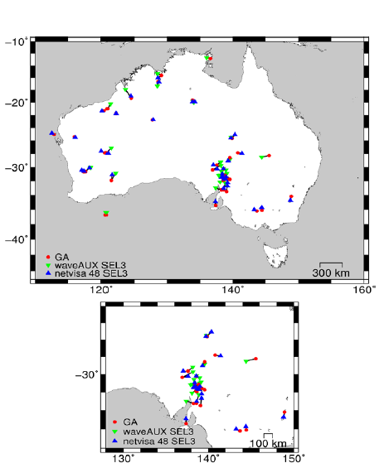
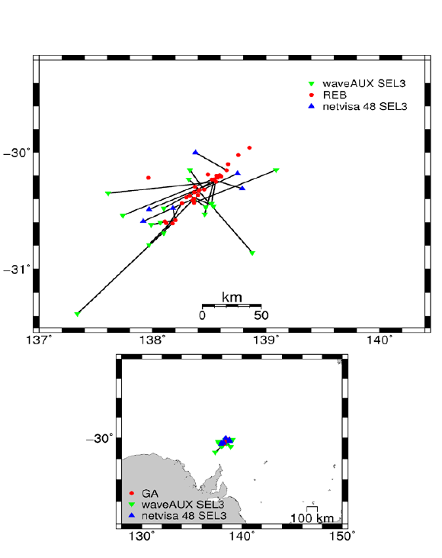
Comparing against regional bulletins: Geoscience Australia [Nippress et. al, 2018]
Reference dataset: Geoscience Australia event bulletin for 2013
Matching criteria:
epicentres are within 200km distance
onset time difference is within 10 seconds.
For seismic events in the dataset:
NET-VISA finds 36 events
SEL3 contains 30
Common to SEL3 and NET-VISA 16
SEL3 only: 14
Netvisa only: 20
For 31 Leigh Creek mine explosions:
SEL3 contains 17 explosions
NET-VISA finds 6
5 events present in both bulletins.
Locations and mislocations of seismic events (left) and Leigh Creek explosions (right) in GA (Geoscience Australia), SEL3 and NET-VISA bulletins.
■

Slide 10
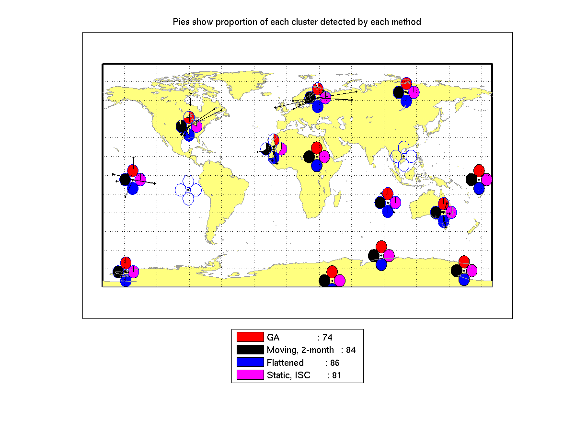
Comparing against a global set of “unusual events” [Prior, 2013b]
Question: Does NET-VISA only detect events in seismically active regions?
Reference dataset: 100 “most unusual events” selected from 2012 LEB: events for which NET-VISA location prior provides the least supporting evidence.
Clusters of “unusual” events, with pie charts representing the proportion of events built by each algorithm (red – GA, black, blue and magenta NET-VISA with various training regimes)
For most clusters, NET-VISA and SEL3 performance is similar.
In a few cases (West Africa, North America, Northern Europe) NET-VISA finds more “unusual events”.
■
■

Slide 11
Assessing event quality – [Bondar et al., 2017], Analyst Test 2012
Questions: How do NET-VISA associations compare to SEL3 ones for matching events?
How does the location of NET-VISA events compare to the SEL3 location for matching events?
NET-VISA depth and origin time estimations are superior to SEL3. SEL3 tends to make shallow events deeper in more instances than NET-VISA.
NET-VISA location accuracy matches or surpasses SEL3, mislocation is comparable to SEL3 and location coverage is poorer than for SEL3. → configuration problem corrected in subsequent version.
Analyst Test 2012: NET-VISA associated on average 2.2 more time-defining phases with events that were part of the LEB than GA, and it associated phases at 1.8 more stations with events in the LEB.
■

Slide 12
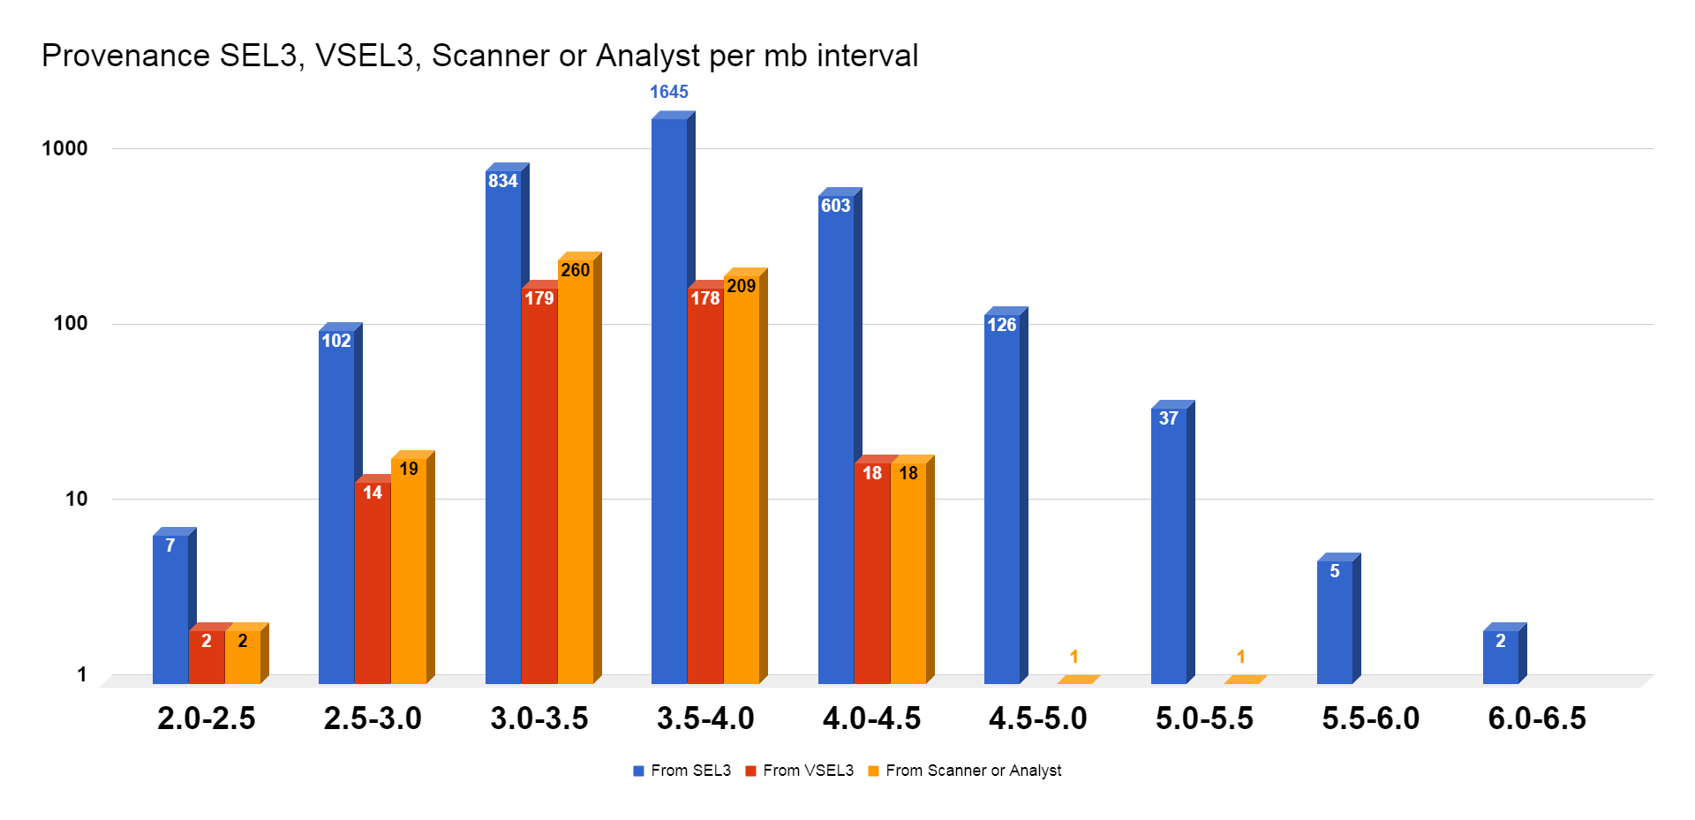
Analyst Tests (2012, 2015, 2018)
2012: Analysis of 27 hours worth of NET-VISA events (seismic only), in a test environment, comparison with the LEB for the same period.
2015: First test of NET-VISA button, bringing in additional SH events produced by NET-VISA after analyzing SEL3. 3 data days were analyzed.
2018: Use of the NET-VISA button in Operations, primary stations only. (presented by R. Le Bras at WEG-50 2018).
2012, 2015: NET-VISA has the potential to reduce analyst workload by presenting analysts with a more complete bulletin.
2015: NET-VISA adds a few events per day to the LEB.
2018: About 10% of the REB events for the data days 1 January 2018 – 15 February 2018 originate from the parallel NET-VISA.
2018 analyst test: provenance of REB events per mb bin. Logarithmic scale.
■

