Slide 1
Evaluation of NET-VISA association and location performance using Ground Truth events and RSTT model based SSSCs
EGU2018-13432
István Bondár¹, Ronan Le Bras², Nimar Arora³, Noriyuki Kushida²
and Elena Tomuta²
¹Research Centre for Astronomy and Earth Sciences, Budapest, Hungary
² Comprehensive Nuclear-Test-Ban Treaty Organization, Vienna, Austria
³ Bayesian Logic, Berkeley, CA, USA
11 April 2018, Vienna

Slide 2
Introduction
NET-VISA (Arora et al., 2013) is a next generation association and location algorithm in the final phase of implementation in the CTBTO IDC software
NET-VISA applies a Bayesian approach with a forward physical model using probabilistic representations of propagation, station capabilities, background seismicity and noise statistics to obtain the maximum probability a posteriori solution to the highly nonlinear problems of phase association and event location.

Slide 3
Objectives
Evaluate the performance of NET-VISA and demonstrate improvements in the resulting event bulletin
Test the NET-VISA association process with and without model based Source Station Specific Corrections (SSSC) calculated from the global 3D upper mantle velocity model Regional Seismic Travel Times (RSTT, Myers et al., 2010) using the ISC bulletin as a baseline
Test the NET-VISA locations with and without SSSCs using Ground Truth (GT) events

Slide 4
Data
3-months (January-March 2013) NET-VISA run
with iasp91 travel-time predictions
with RSTT SSSCs
Compared to ISC bulletin (all REB events are in the ISC bulletin, but there not necessarily exists an ISC solution for them)
1-hour NET-VISA runs around the 2013 GT events
with iasp91
with RSTT SSSCs
Relocation of 2013 GT events using iLoc (Bondár and Storchak, 2011) with and without RSTT to get an insight how a full set of RSTT SSSCs may improve locations

Slide 5
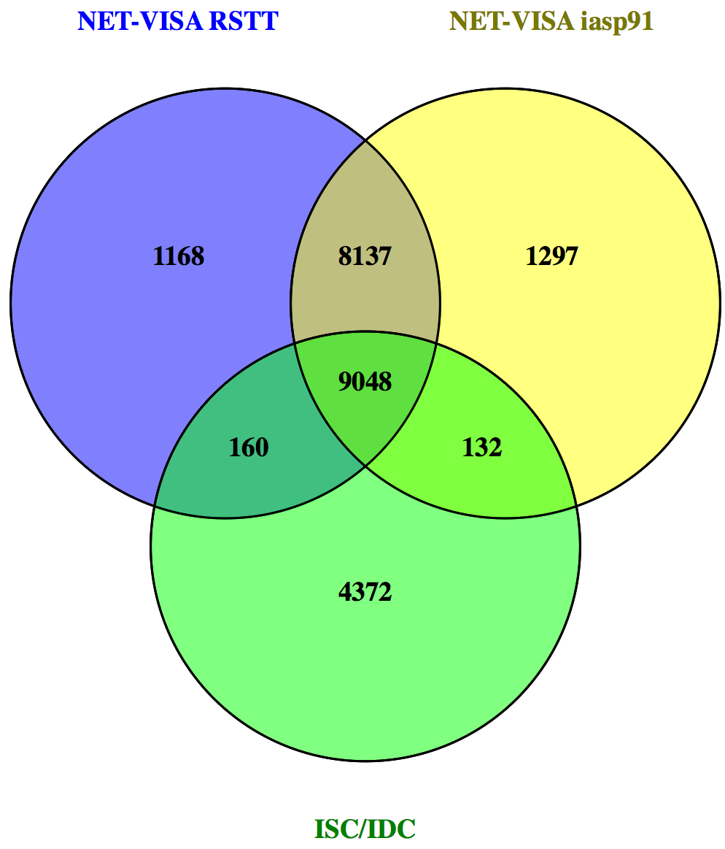
Statistics on the 3-month run
 |  | NET-VISA iasp91
 |  | true | false
ISC/IDC | true | 9180 | 4532 | 13712
 | false | 9434
 |  | 18614
 |  | NET-VISA RSTT
 |  | true | false
ISC/IDC | true | 9208 | 4504 | 13712
 | false | 9305
 |  | 18513

Slide 6
Statistics on the 3-month run
IDC/ISC: 13712 events
NET-VISA iasp91: 18614 events
66.9% valid events (of ISC/IDC)
33.1% missed events (of ISC/IDC)
50.7% false alarms (of iasp91)
NET-VISA RSTT SSSC: 18513 events
67.2% valid events (of ISC/IDC)
32.8% missed events (of ISC/IDC)
50.3% false alarms (of RSTT)
Better stats with NET-VISA RSST SSSCs

Slide 7
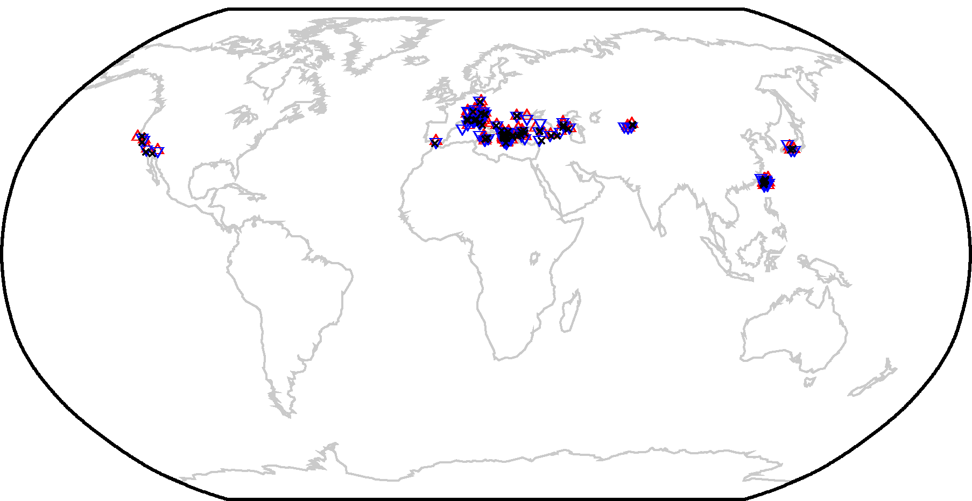
Ground truth events
292 GT5 events in the ISC GT selection from 2013
136 GT events in overall are found in the NET-VISA runs (133 in each run)
146 GT events in overall are found in the SEL3, LEB and NET-VISA bulletins
Missed GT events are mostly local/regional events below the IDC magnitude threshold

Slide 8
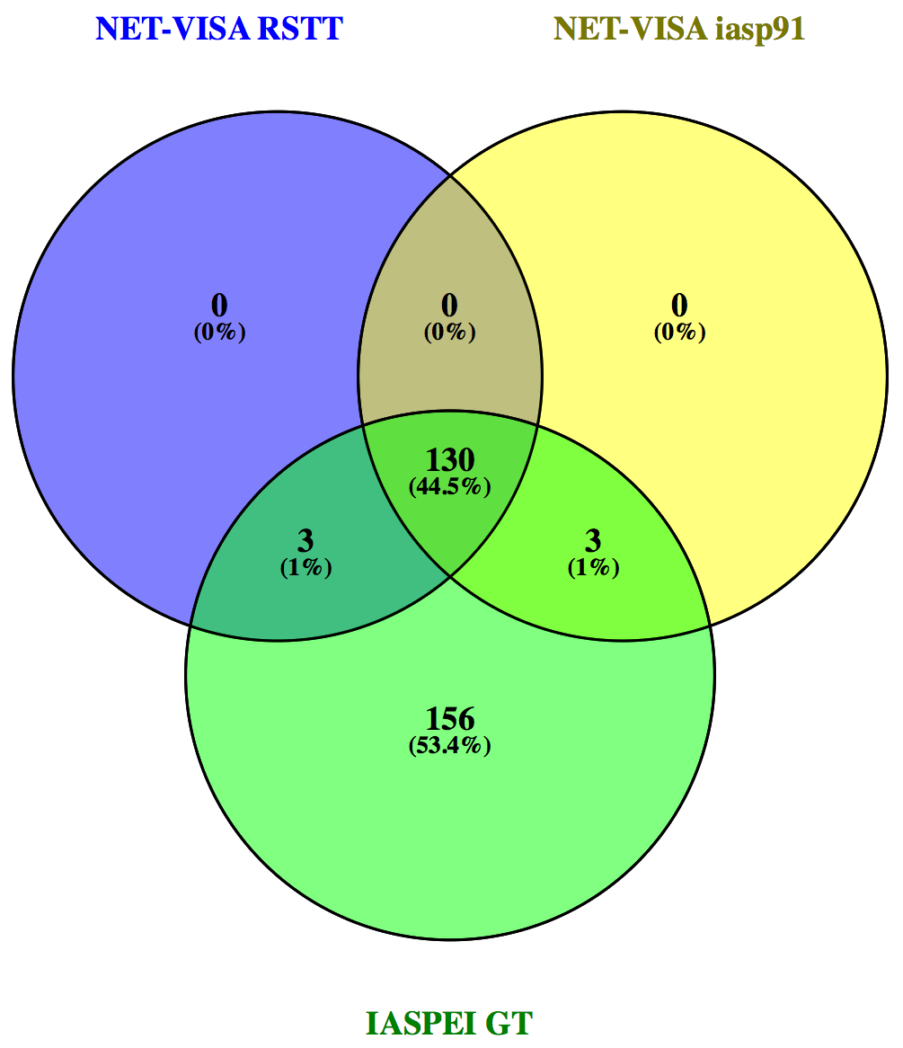
Matching GT events NET-VISA with and without RSTT
Matching criteria
OT: ±2 min; Lat, lon: ±5 degrees
Manual inspection for common picks at IMS stations
NET-VISA iasp91: 133 events
NET-VISA RSTT SSSC: 133 events
In this case no false alarm rate can be estimated as we only check for matching GT events

Slide 9
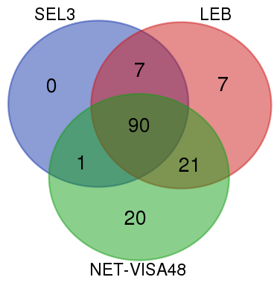
Matching GT events: SEL3, LEB and NET-VISA
146 GT5 events were matched by SEL3, LEB and NET-VISA
SEL3: 98 events (67%)
LEB: 125 events (86%)
NET-VISA 133 events (90%)
1 event was missed by LEB
20 events were built by NET-VISA only
NET-VISA reduces the number of manually added LEB events by half
NET-VISA builds significantly more GT events than SEL3

Slide 10
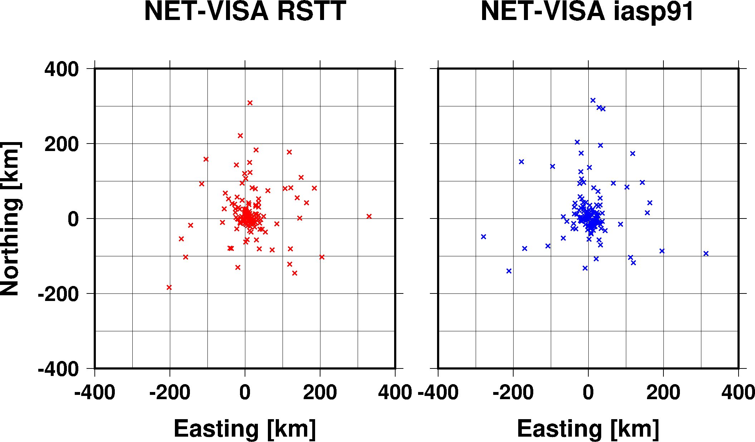
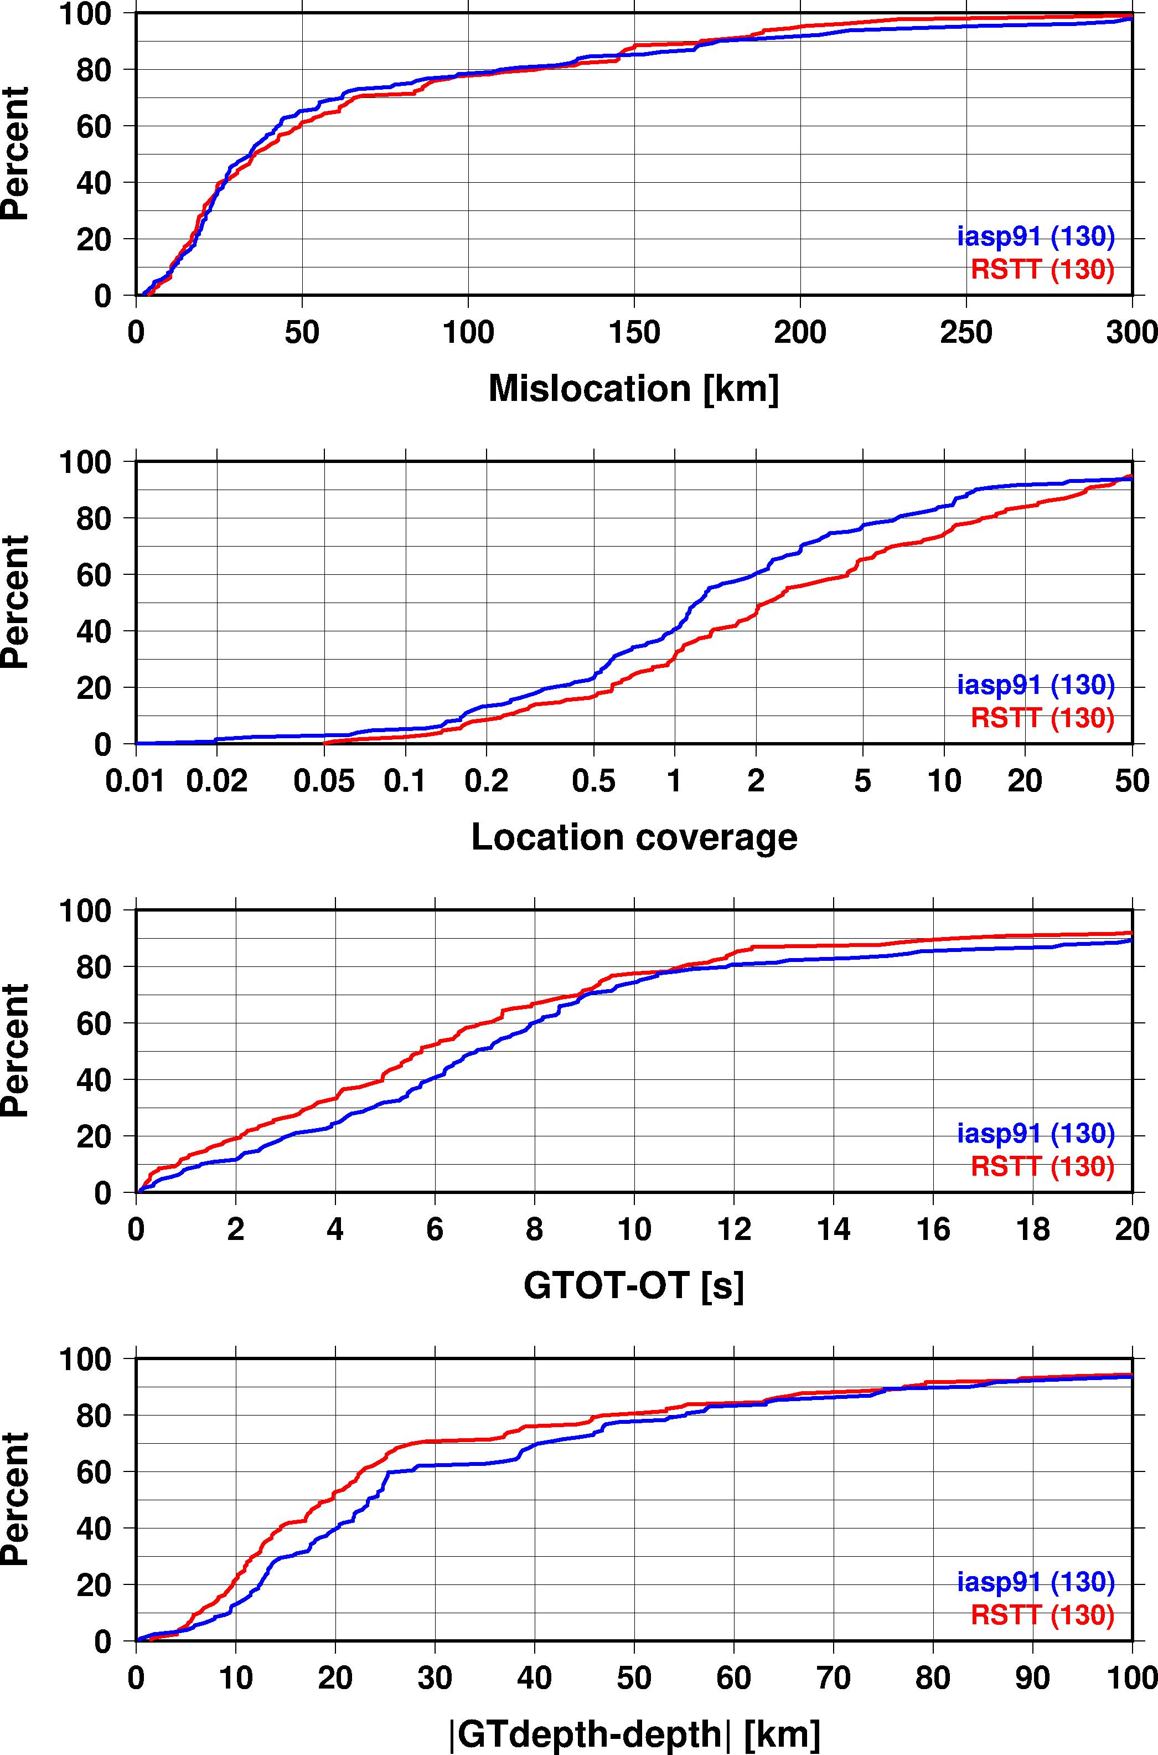
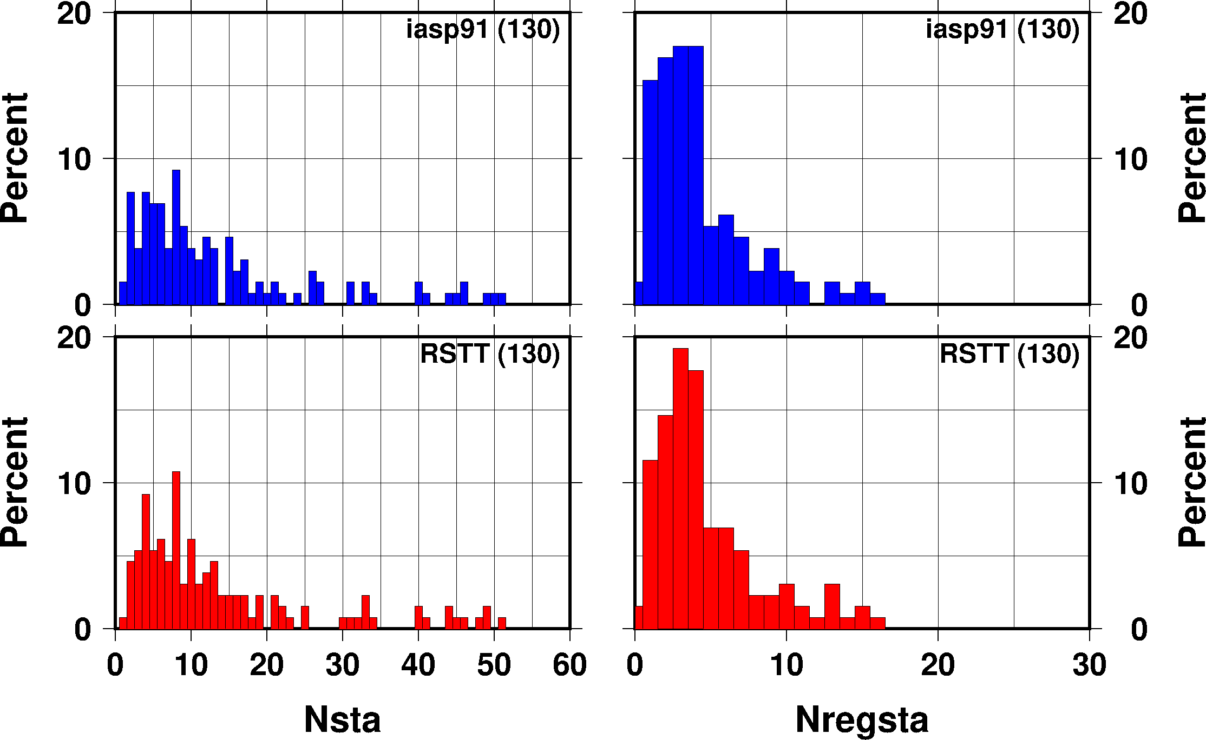
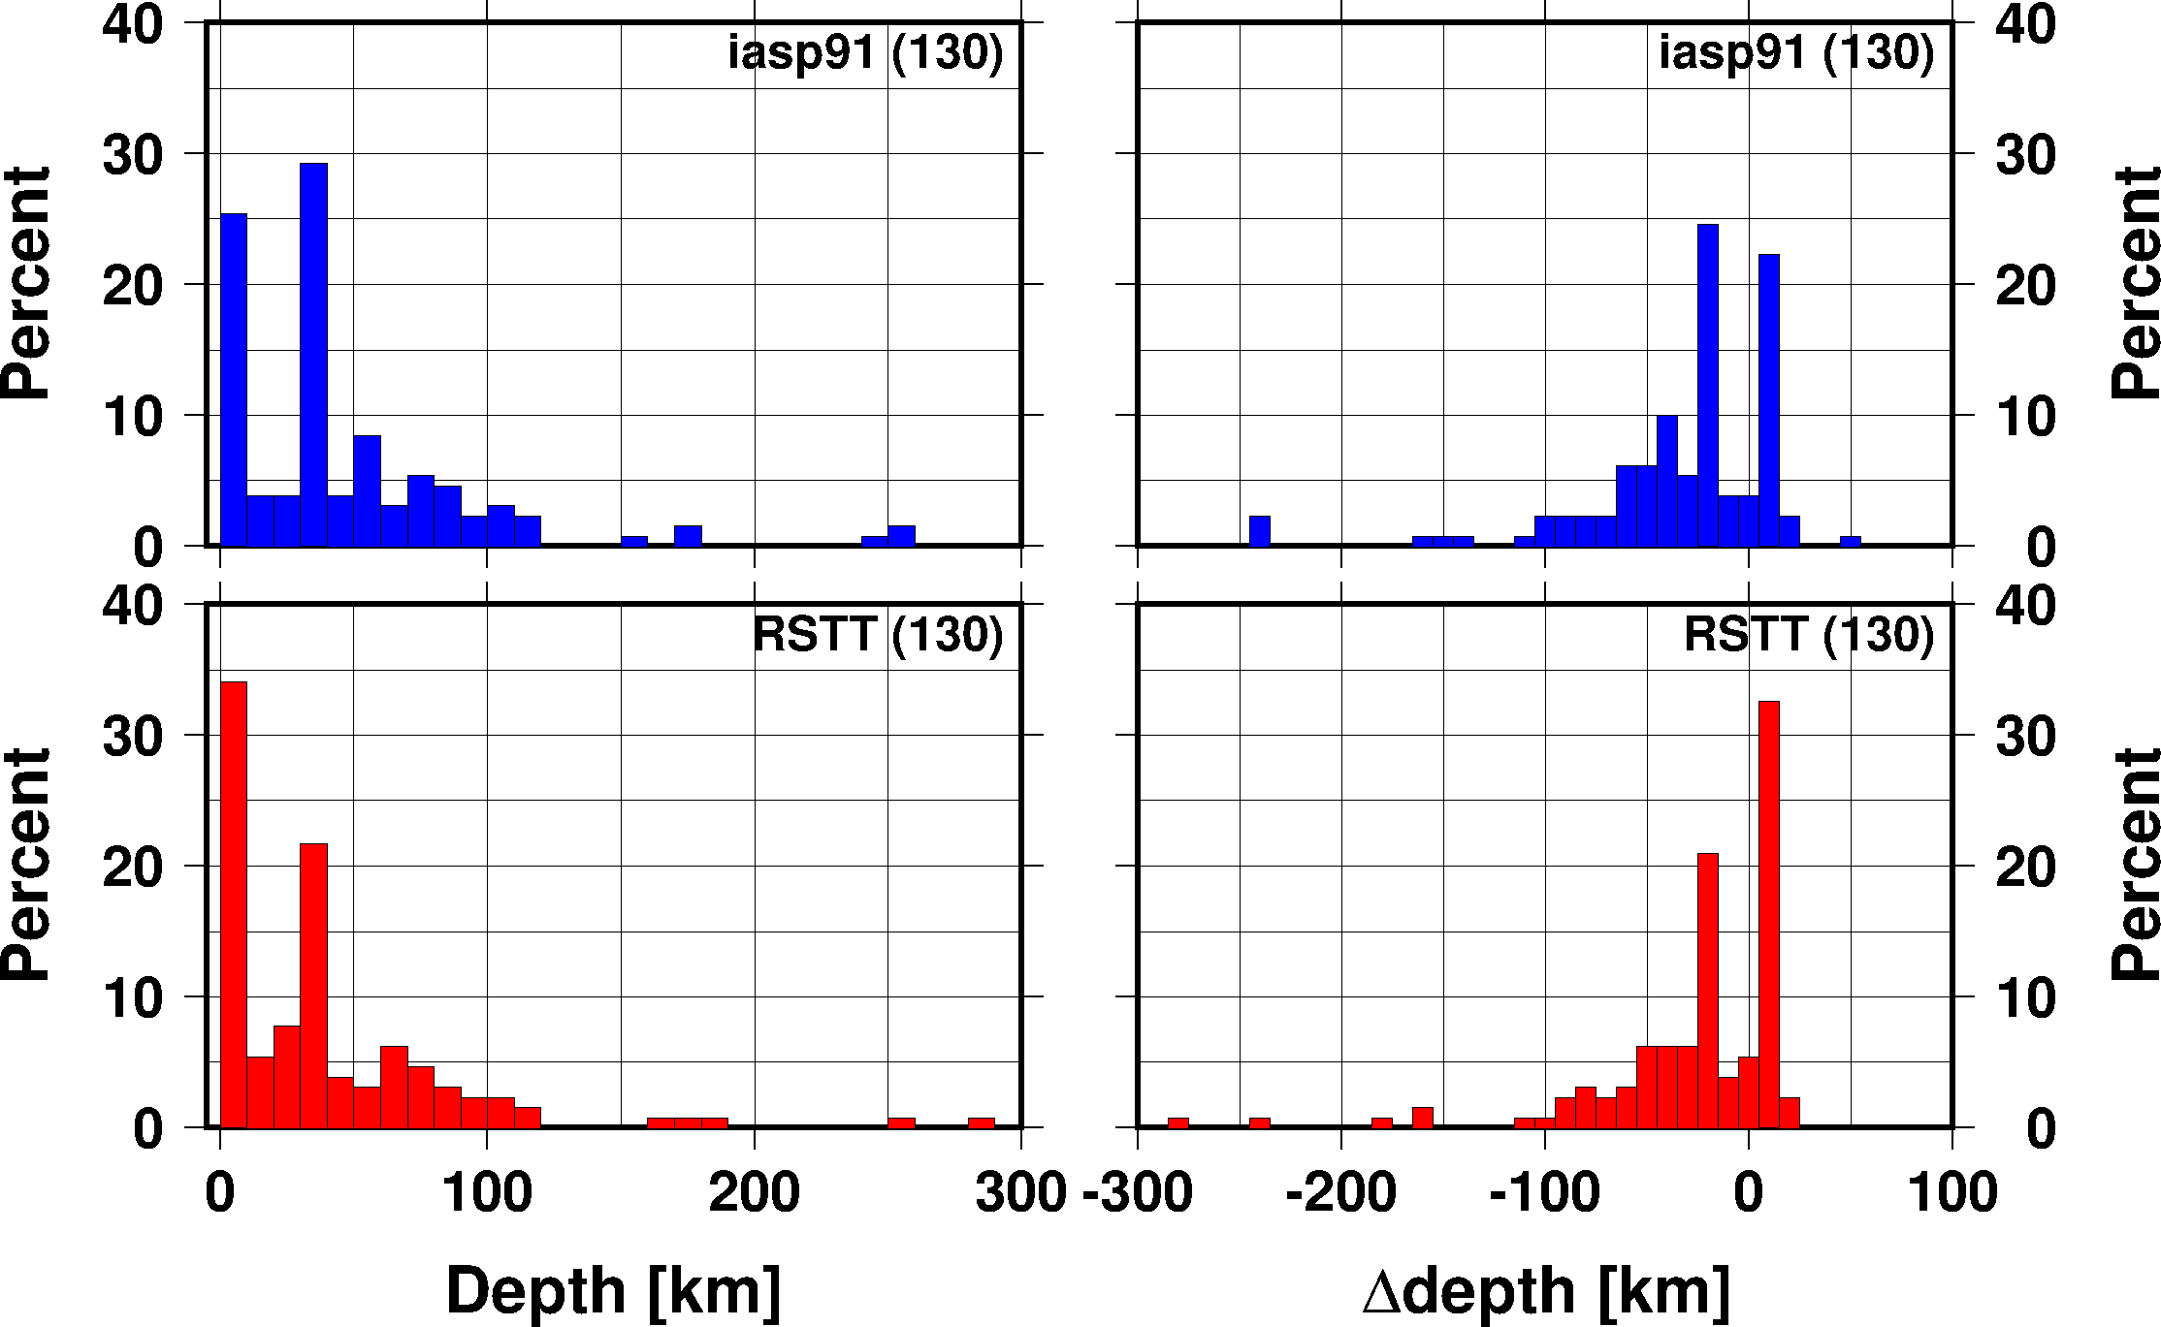
Location comparisons to GT
NET-VISA with RSTT SSSCs
Median mislocation is about 25 km with NET-VISA, no significant difference between iasp91 and RSTT
Better depth and origin time estimates with RSTT SSSCs
Larger number of regional stations and phases
Fewer outliers, somewhat reduced scatter

Slide 11
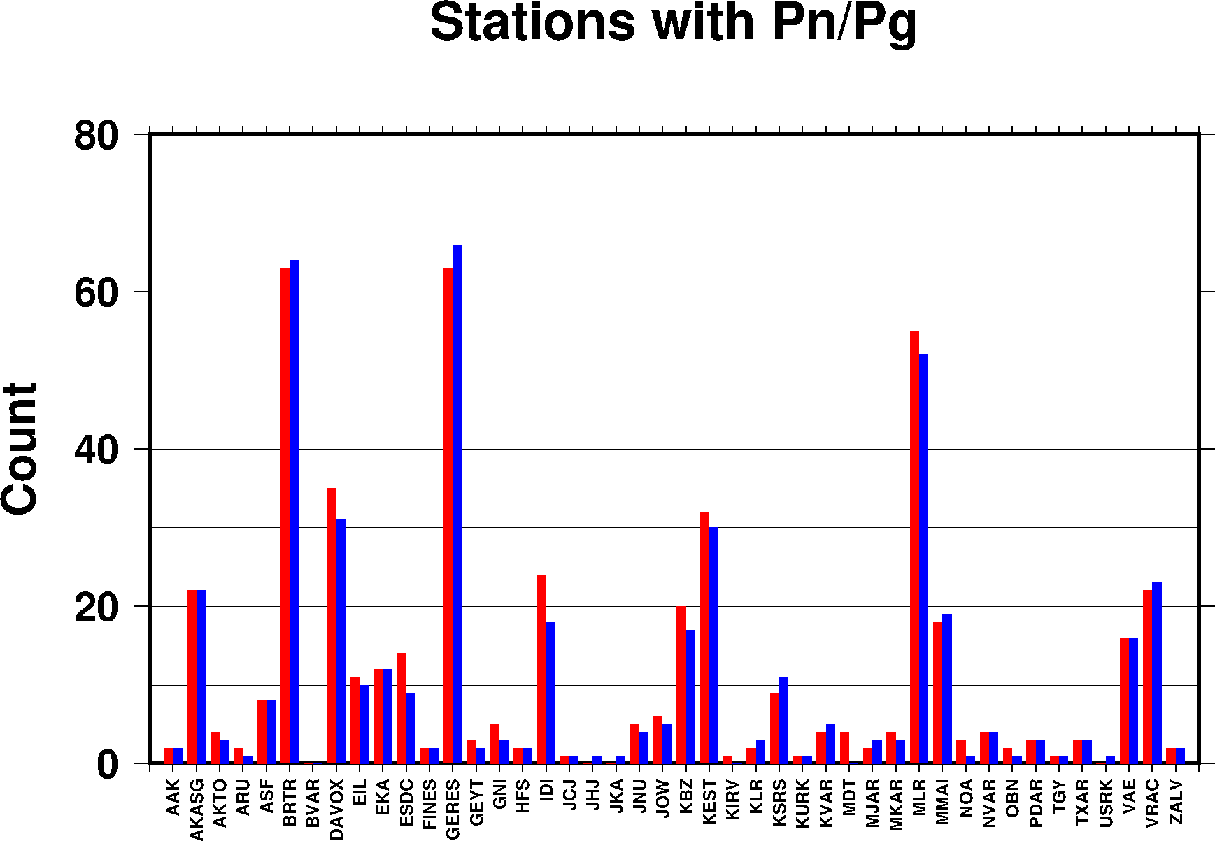
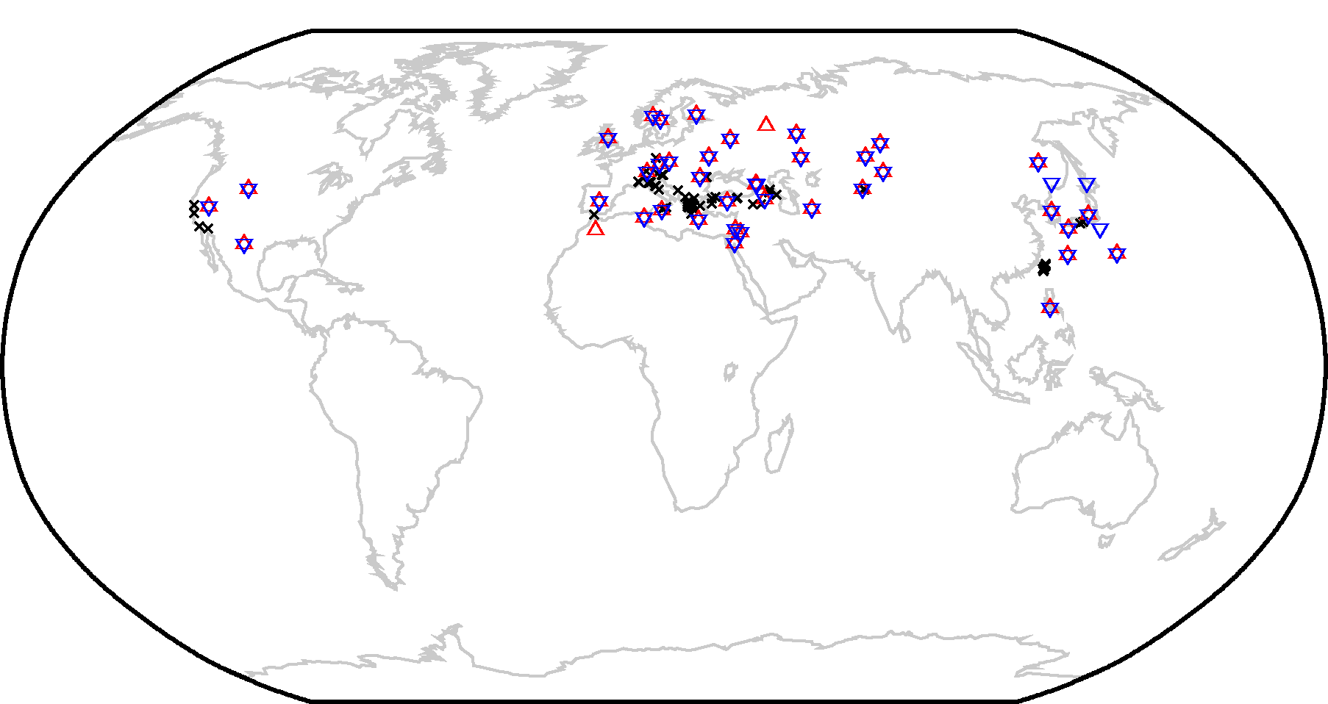
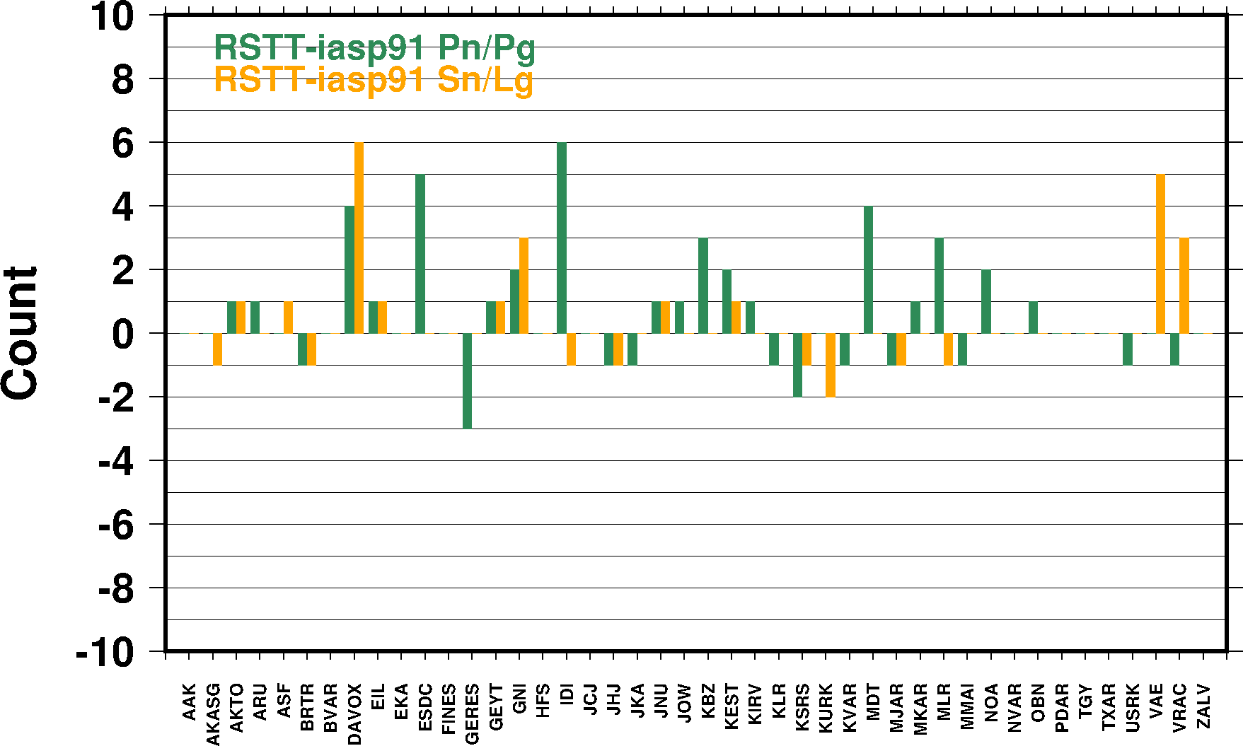
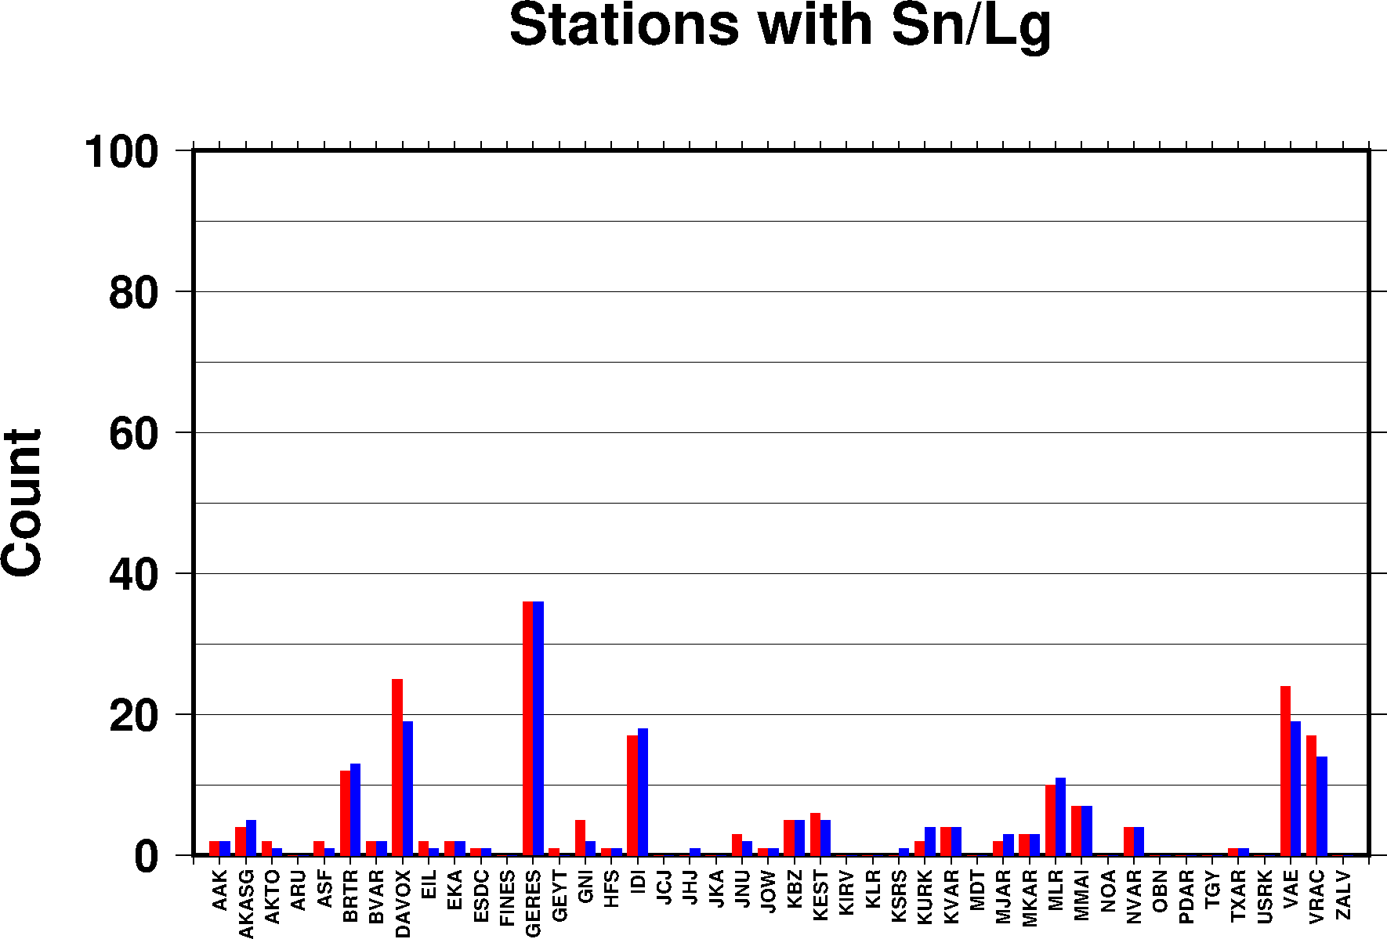
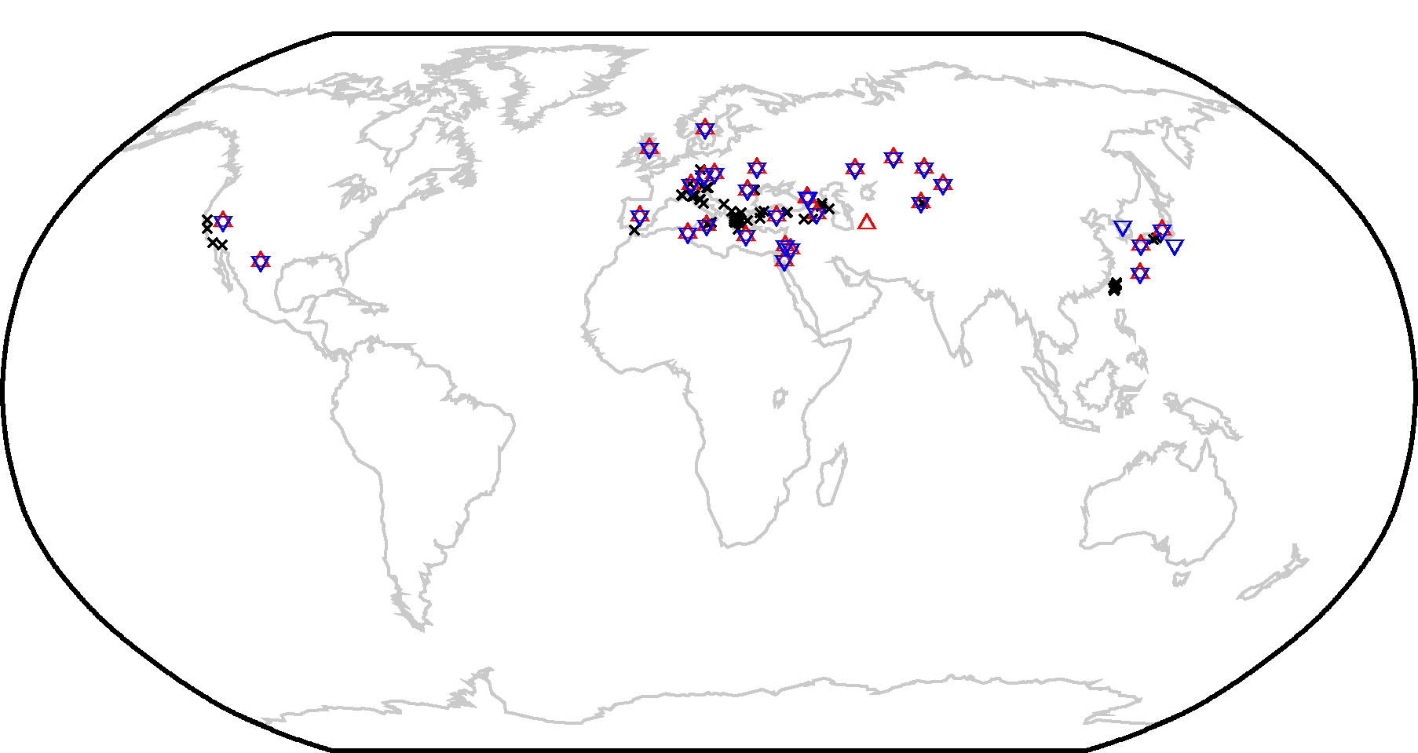
Regional stations
More regional phases with RSTT SSSCs

Slide 12
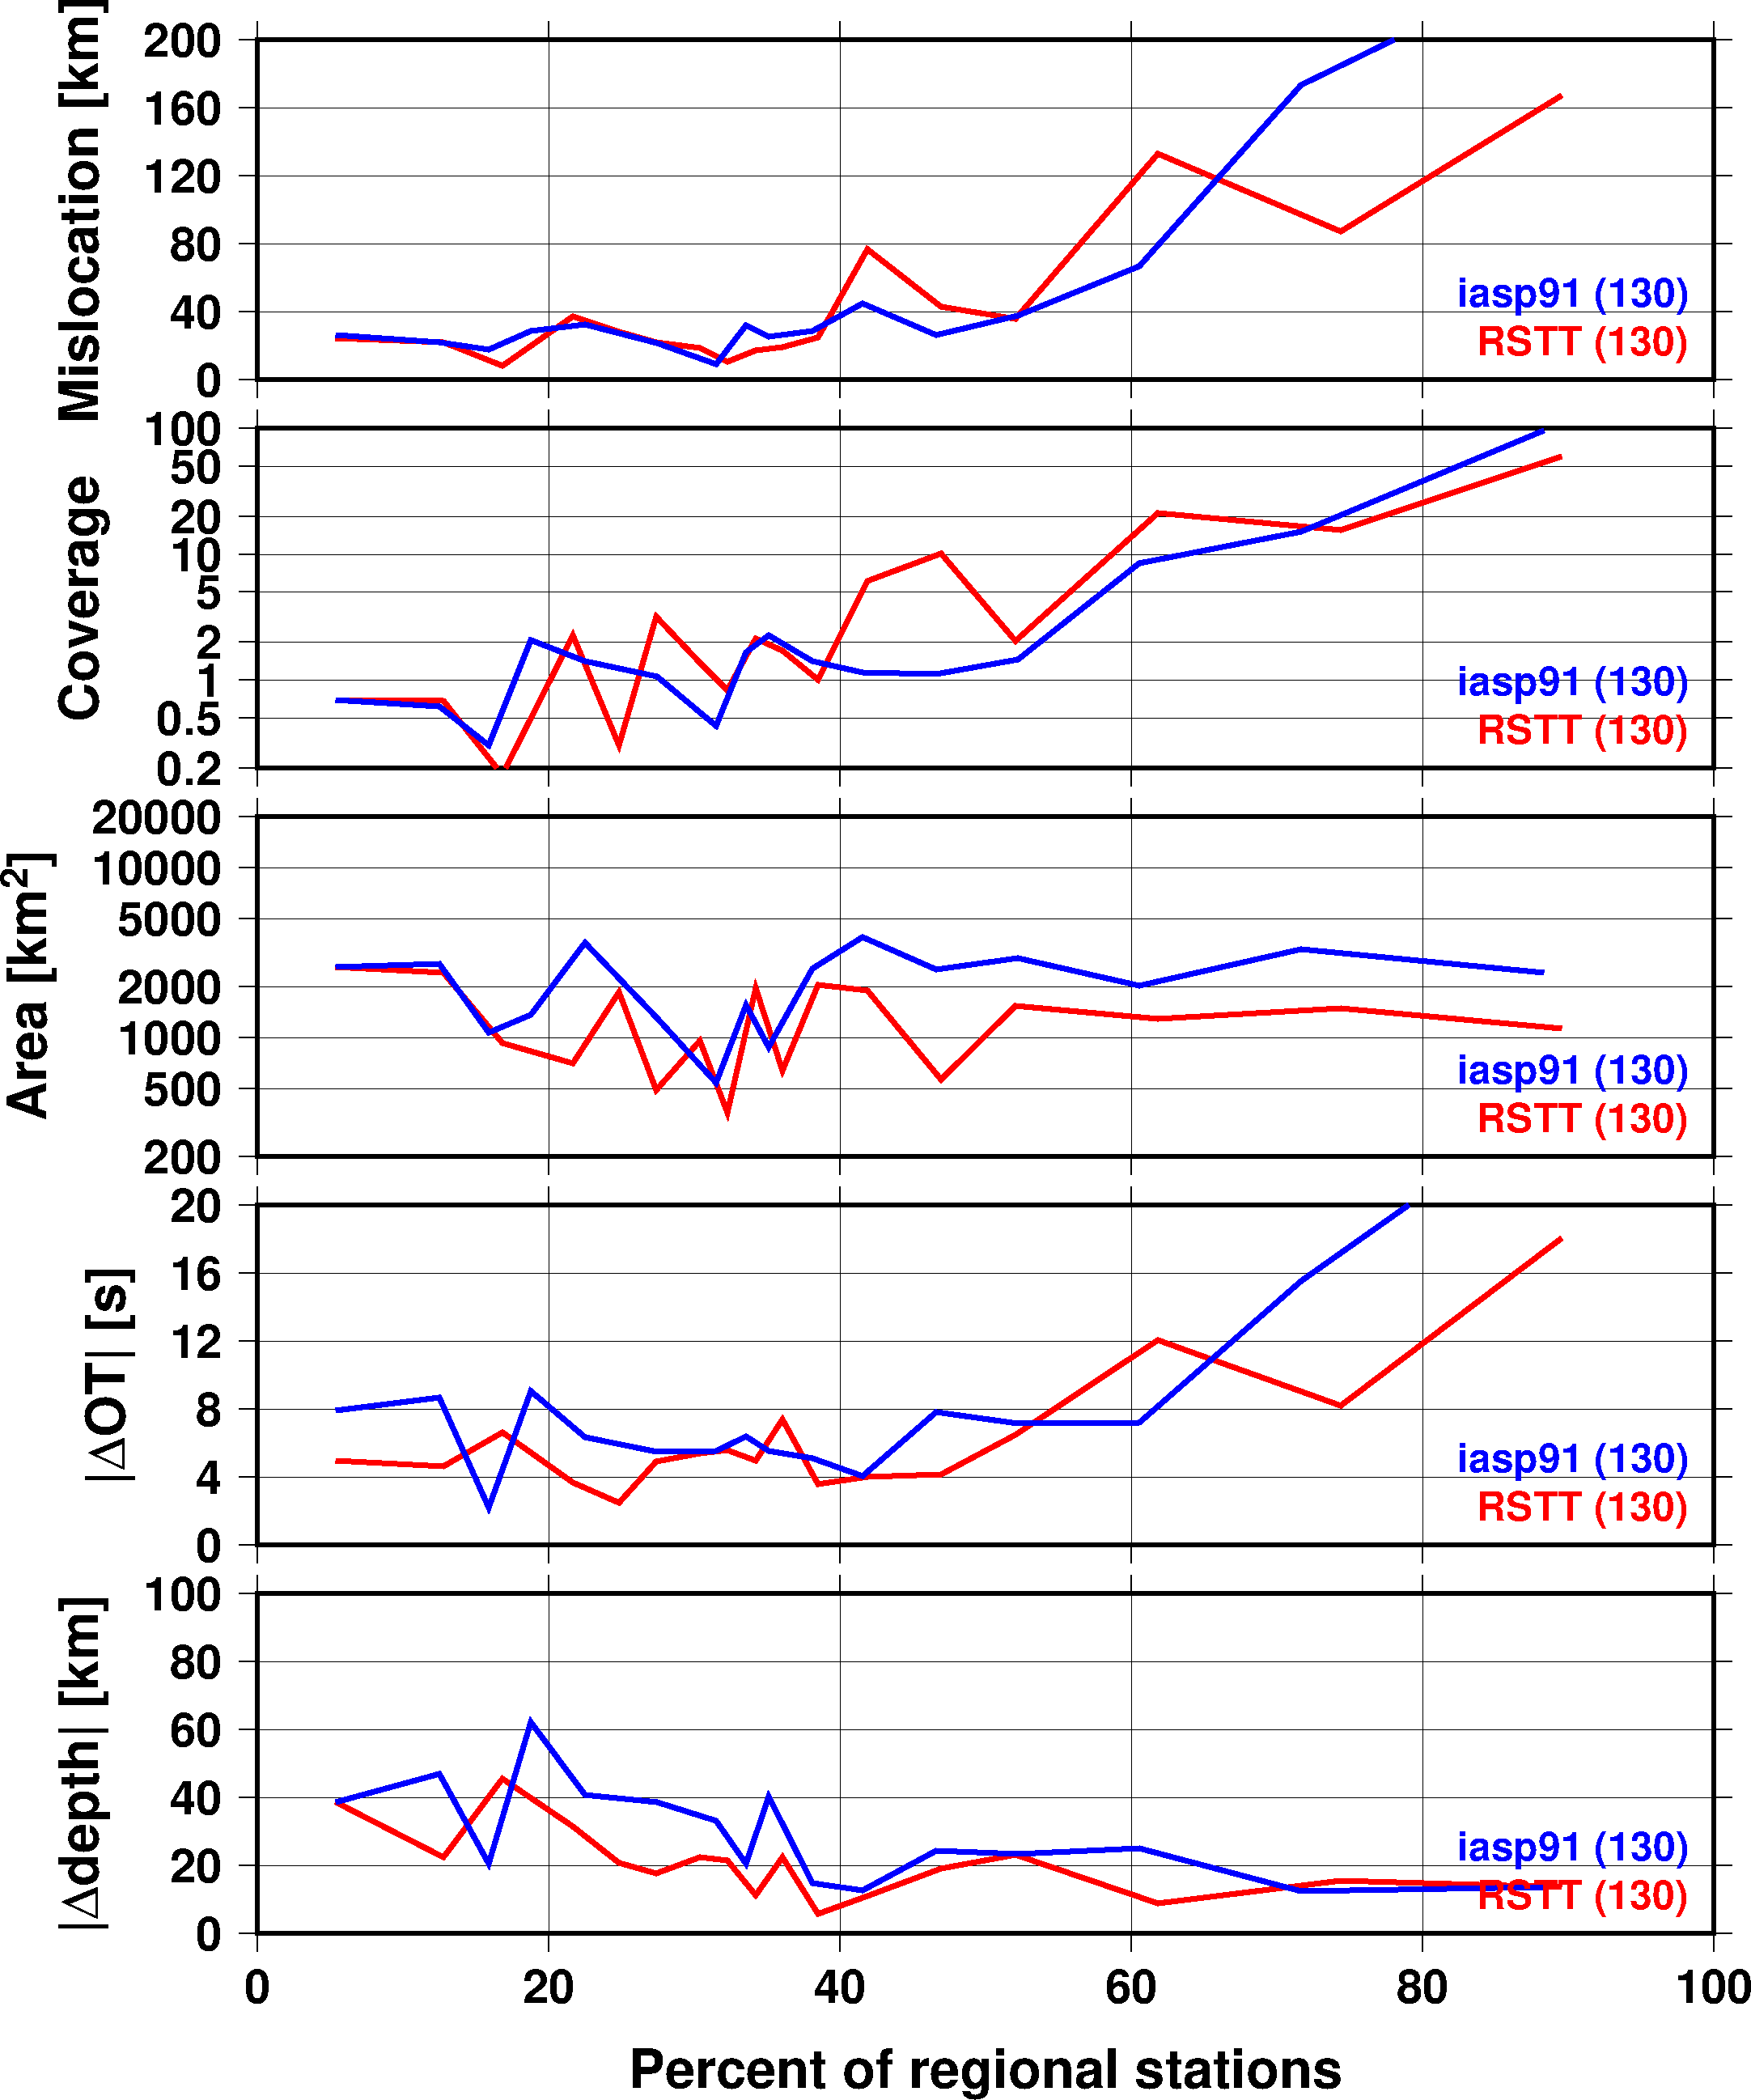
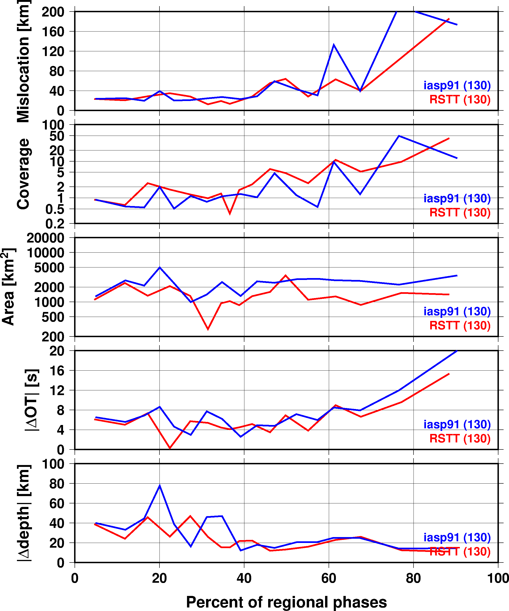
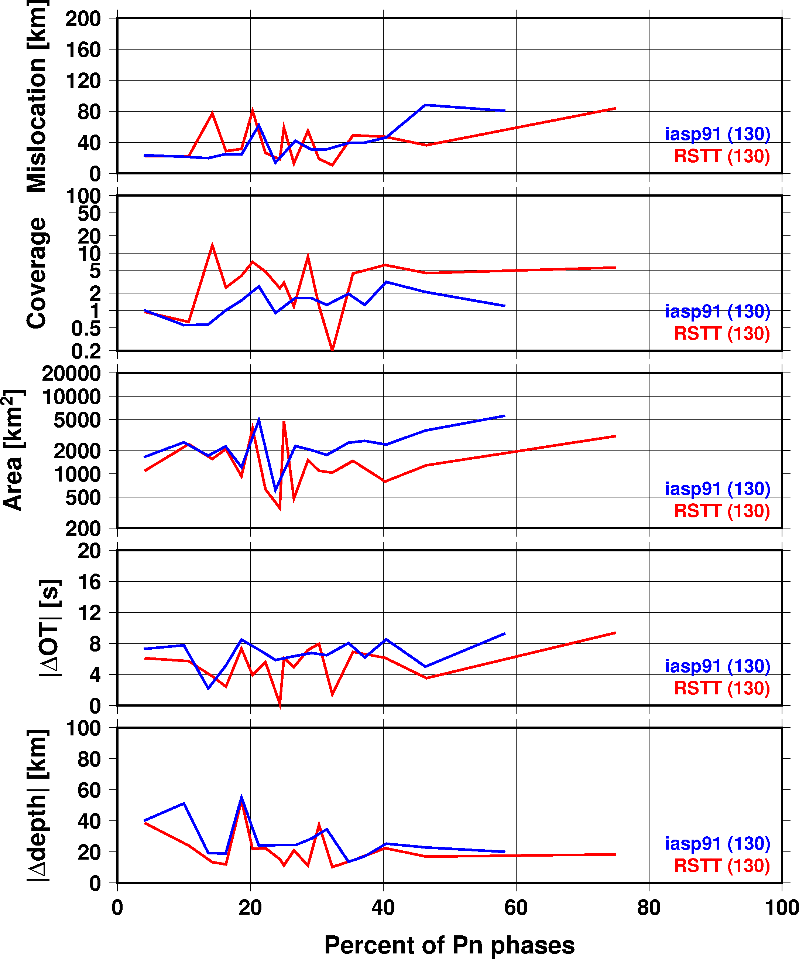
Median deviation from GT
Median values in every 5 percentile bins of data as a function of percentage of regional stations, phases and Pn
RSTT provides improvements in both location and origin time

Slide 13
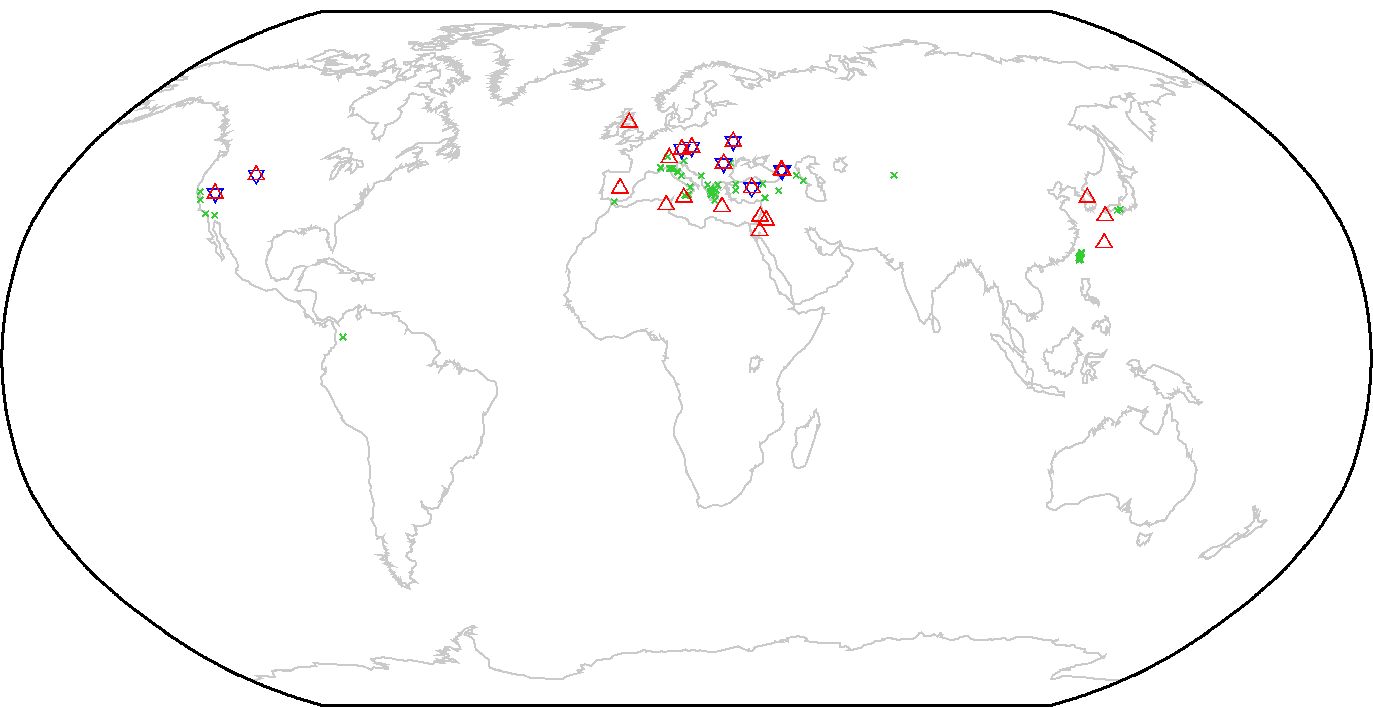
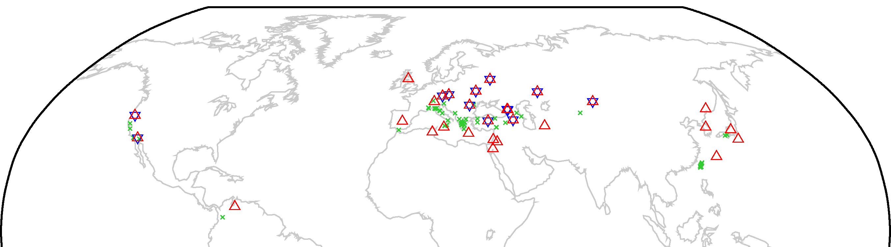
GT relocations with iLoc
Only GT events with regional phase are considered
118 LEB events with regional phases (green crosses)
LEB locations include current SSSCs
Some stations have SSSCs (hexagons), some don’t (red triangles)
Pn stations
Sn stations

Slide 14
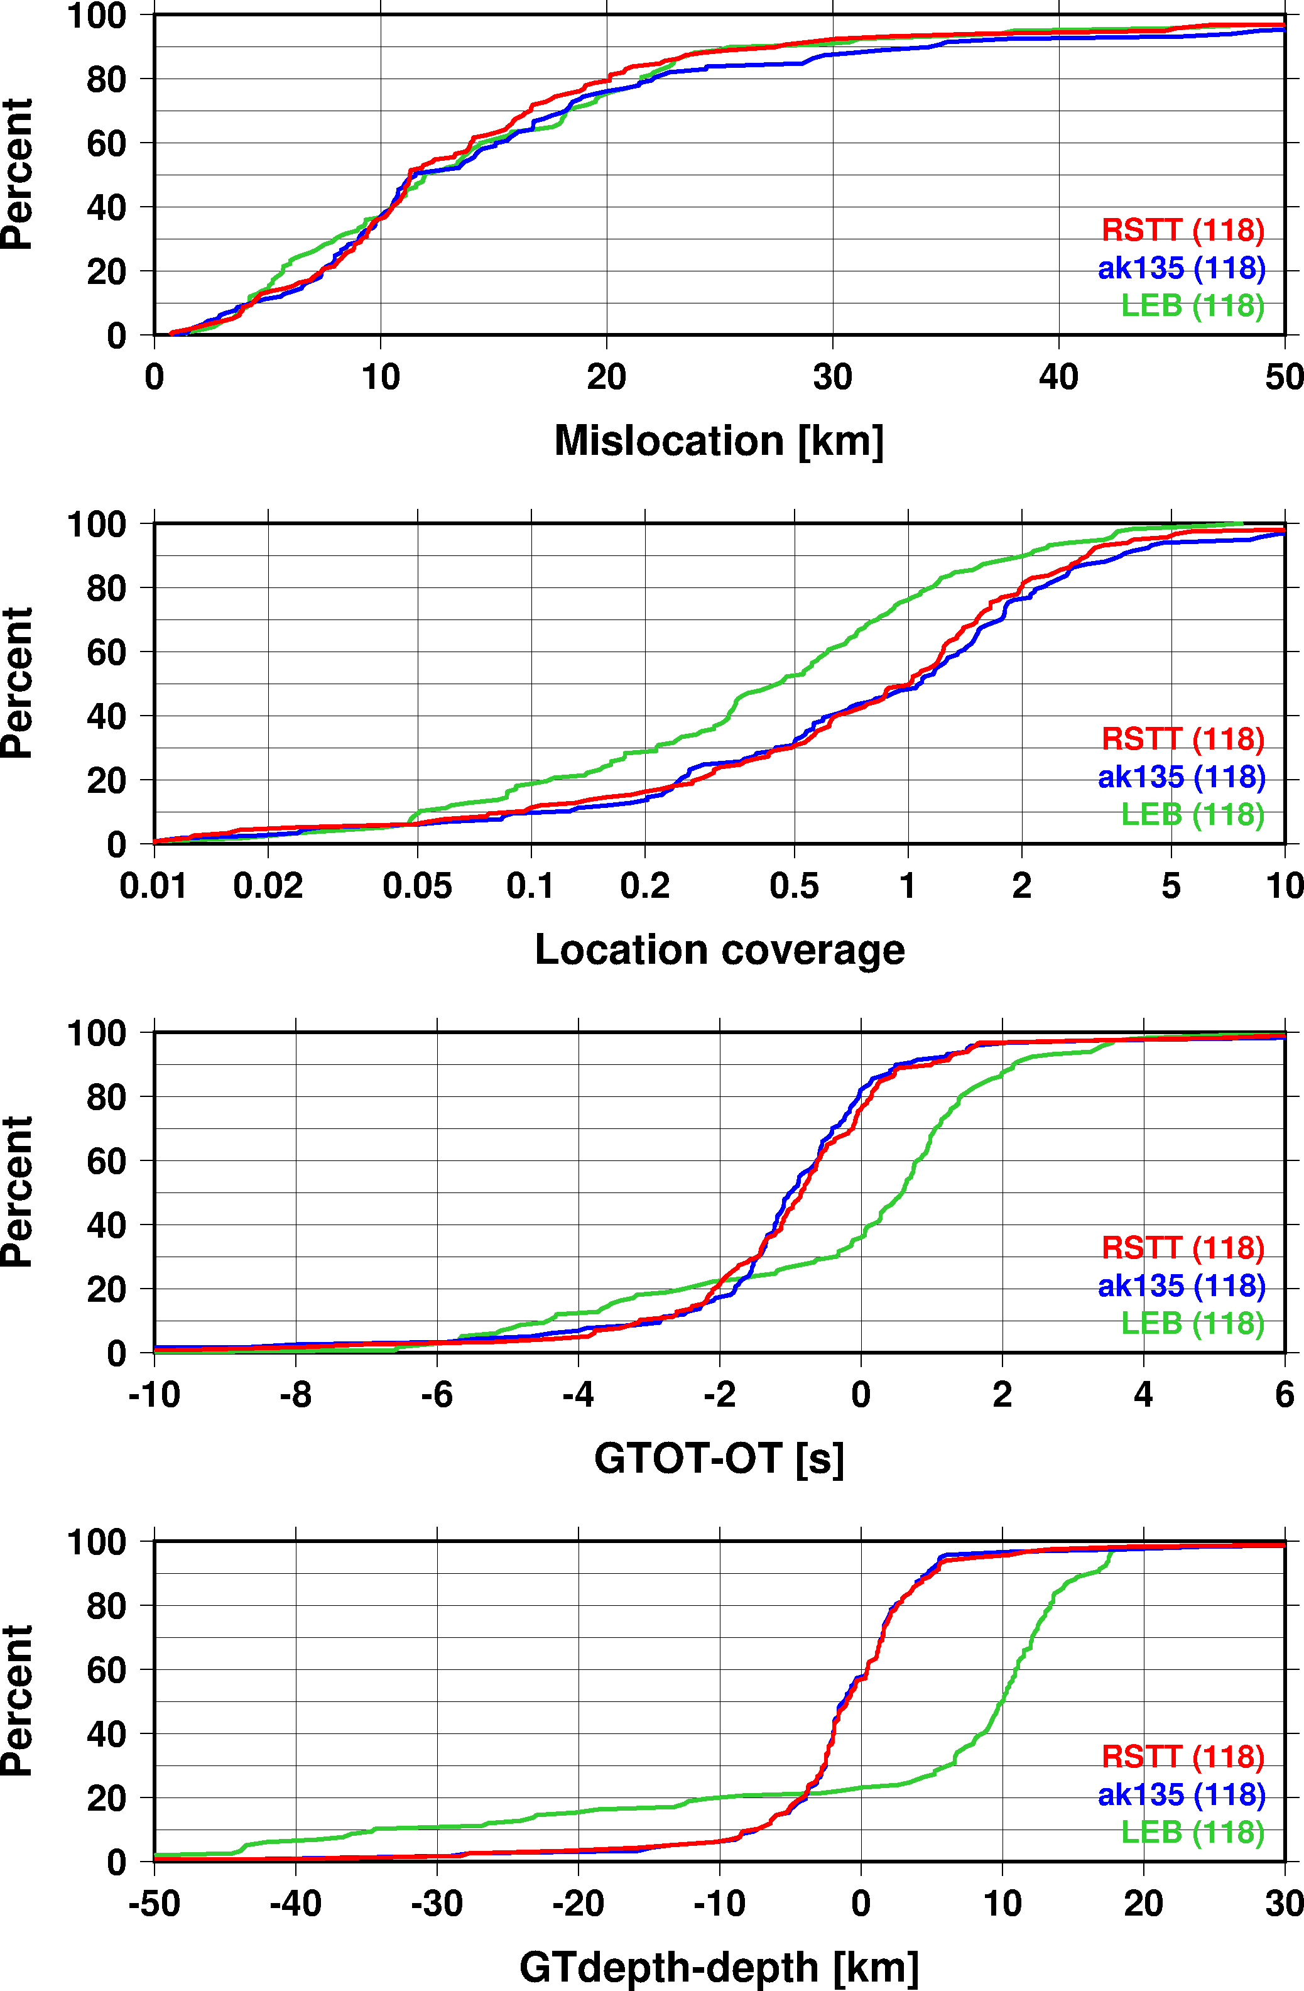
GT relocations with iLoc
Mislocation
Both LEB and RSTT outperform iasp91
Location coverage
80% coverage in LEB
LEB error ellipses are larger
Origin time and depth
iLoc provides better depth and origin time estimates
LEB puts some shallow events deep
deeper

Slide 15
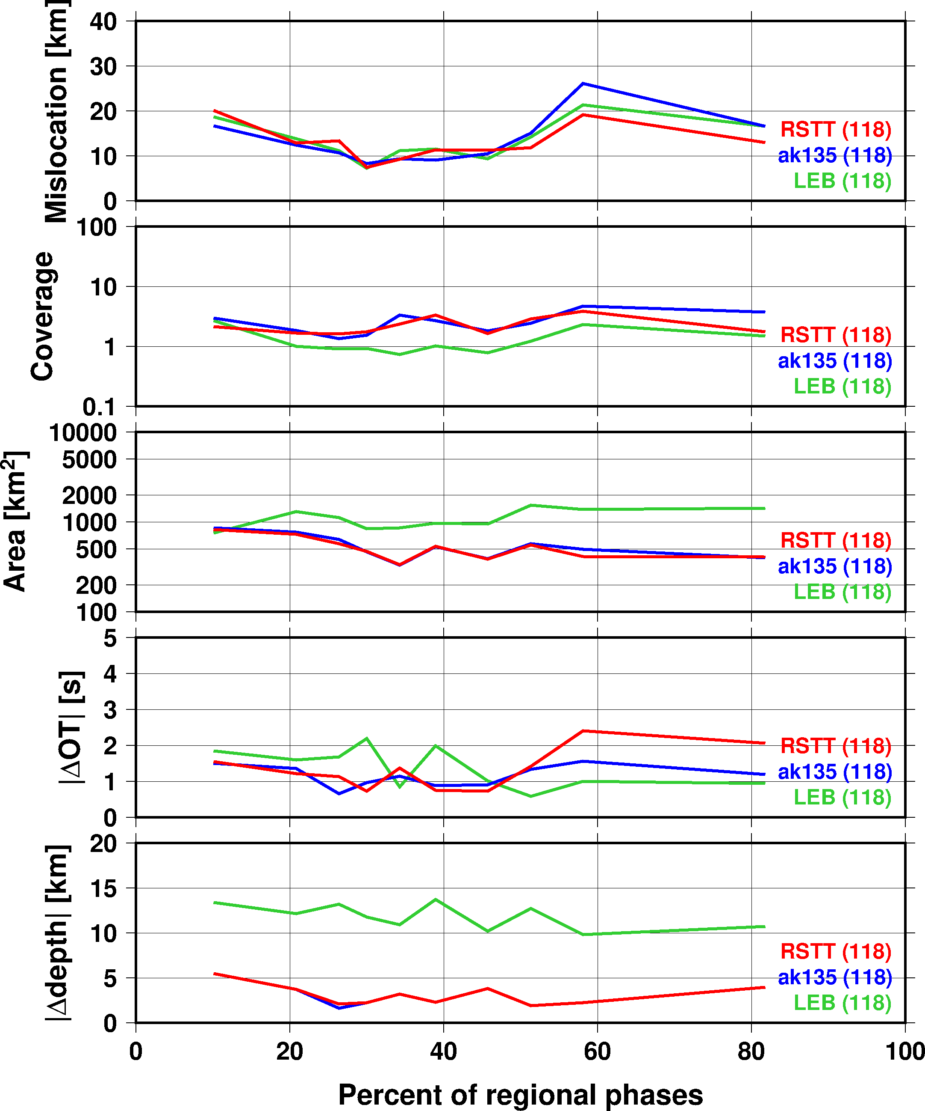
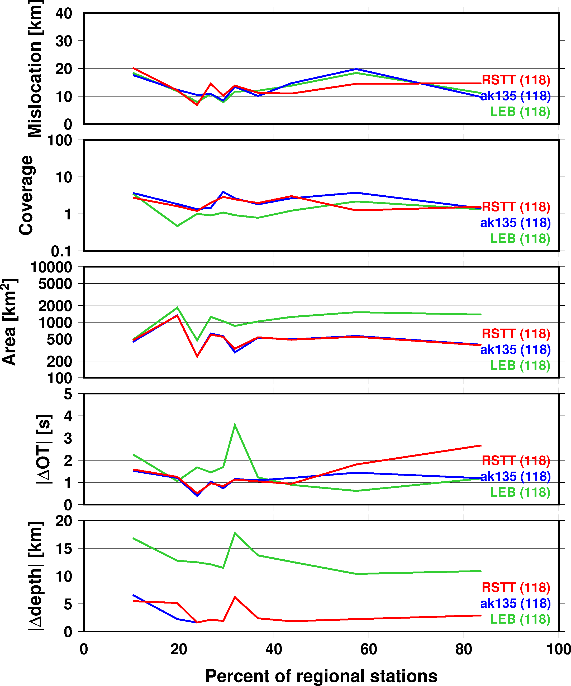
Median deviation from GT
Median values in every 5 percentile bins of data as a function of percentage of regional phases and regional stations
RSTT provides improvements in both location and origin time

Slide 16
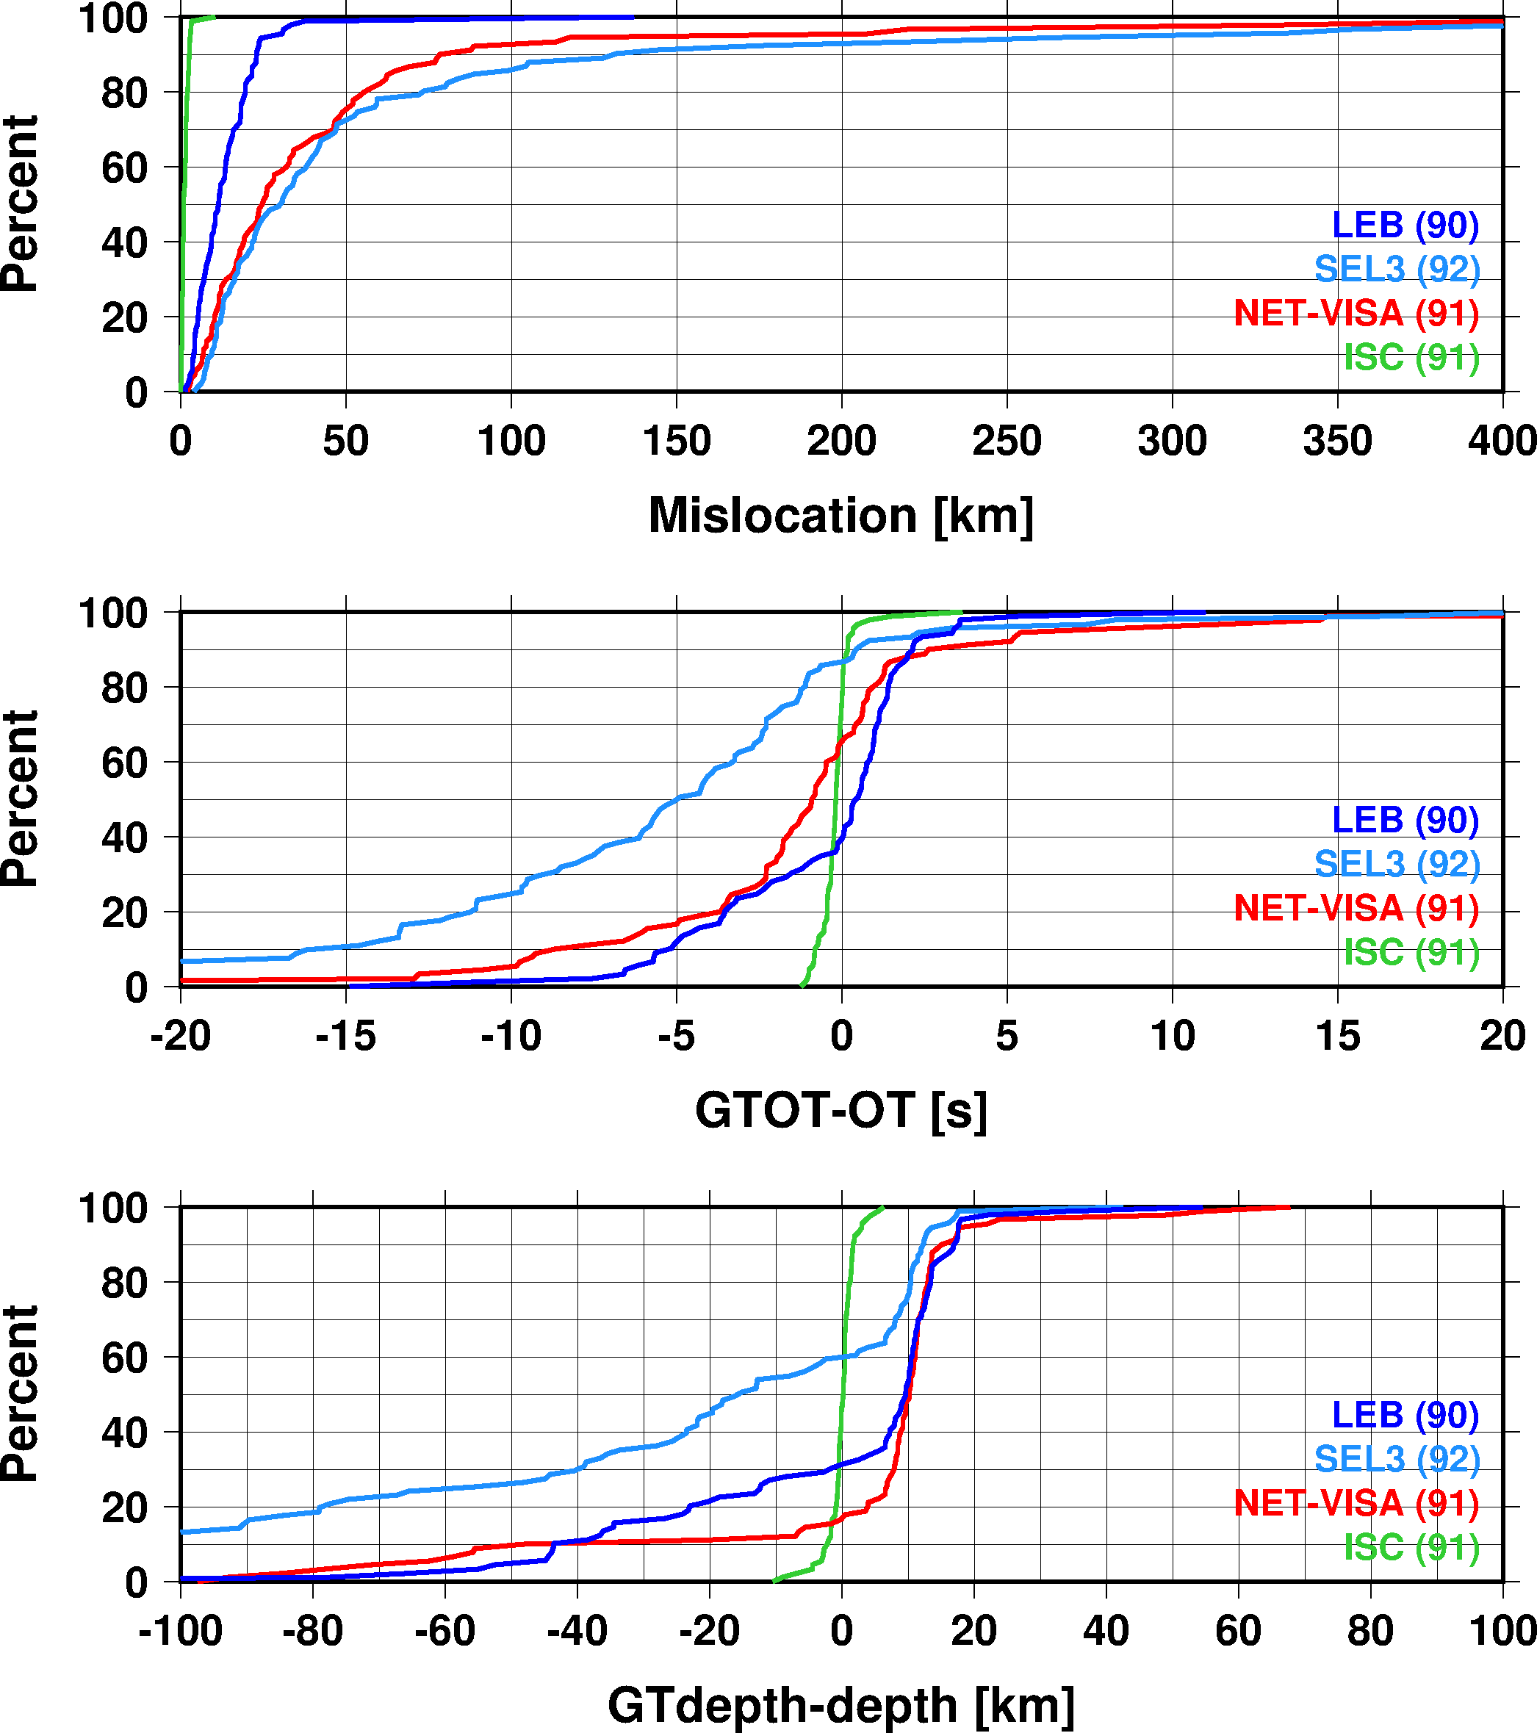
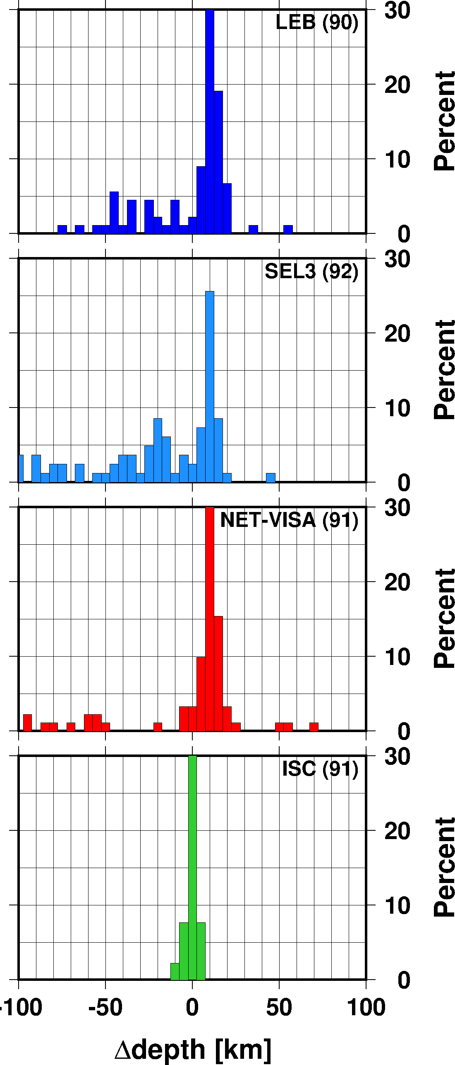
Location comparisons: GT, SEL3, LEB, NET-VISA
Much better depth and origin time with NET-VISA
SEL3 is prone to put shallow events deep
Some of these may survive the analyst review
Problem for event screening
Median mislocation 25 km with NET-VISA
NET-VISA now surpasses SEL3 location accuracy
later
earlier
deeper
shallower

Slide 17
Conclusions: NET-VISA associations
NET-VISA with RSTT SSSCs (3-month run)
Builds fewer events
Increases the number of valid events from 66.9% to 67.1%
Reduces the number of missed events from 33.1% to 32.8%
Reduces the number of false alarms from 50.7% to 50.3%
Provides better depth and origin time estimates
Improvements due to RSTT SSSCs are marginal but they are consistently better than using iasp91

Slide 18
Conclusions: RSTT location performance
iLoc relocations to test the location performance of RSTT
RSTT performs consistently better than iasp91 and not worse than current SSSCs
Model-based RSTT can provide SSSCs anywhere in the globe
NET-VISA with RSTT SSSCs (GT comparison)
Uses more regional phases in building GT events
Better depth and origin time estimates
Median mislocation is 25 km with both RSTT SSSCs and iasp91
Location improvements for events with high percentage of regional phases

Slide 19
Conclusions: NET-VISA
NET-VISA does a significantly better job at building GT events than SEL3
NET-VISA built 90% of the GT events compared to 86% of LEB and 67% of SEL3
NET-VISA produces fewer false alarms
NET-VISA reduces the number of missed events by 50%
NET-VISA location accuracy matches or surpasses SEL3
NET-VISA depth estimations are superior to SEL3
NET-VISA does not make shallow events deeper
NET-VISA with RSTT will reduce analyst workload

