Slide 1


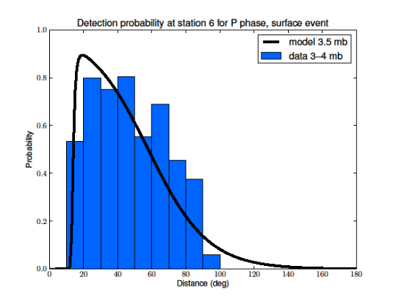
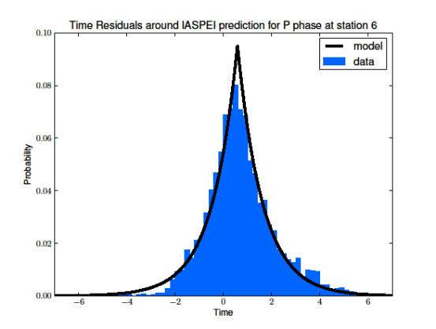
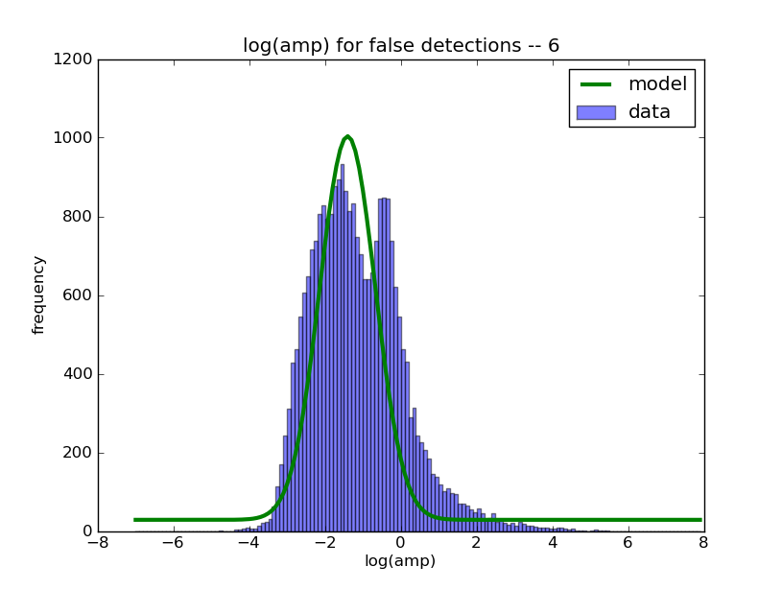
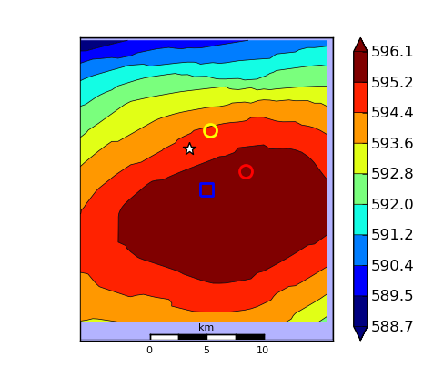
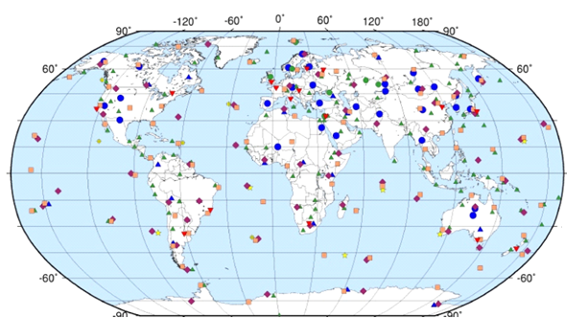
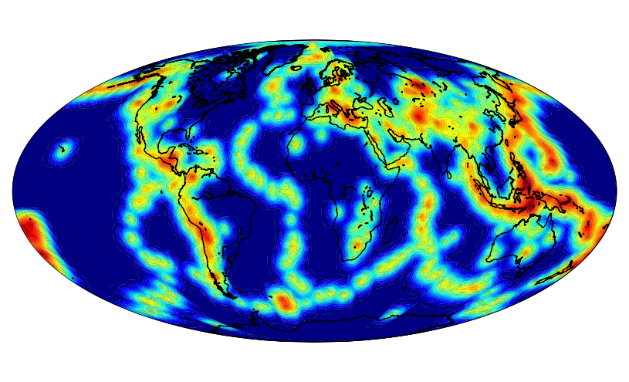
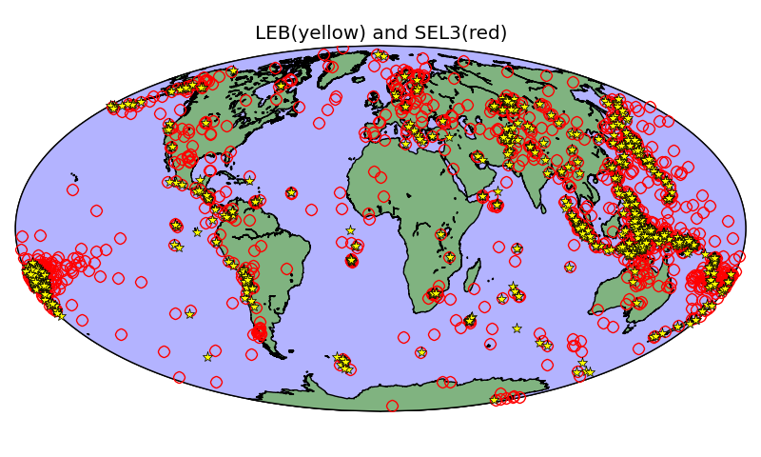
Scalable Probabilistic Inference for Global Seismic Monitoring (S43B-2238)
Nimar S. Arora, Tony Dear, and Stuart Russell
nimar@cs.berkeley.edu, tonydear@berkeley.edu, and russell@cs.berkeley.edu
Introduction
The NET-VISA Model (Continued)
Performing Inference (Continued)
Results (Continued)
The Comprehensive Nuclear-Test-Ban Treaty (CTBT) bans all nuclear explosions on Earth, regardless of purpose.
Global seismic monitoring aims to recover all seismic events in the magnitude range of interest, given a set of detections.
Data from the International Monitoring System (IMS) are processed in real time at the International Data Centre (IDC) in Vienna.
Event parameters – arrival time, azimuth, amplitude, etc. – have station-specific distributions.
E₄
E₅
E₆
E₇
E₈
E₉
Evaluation on DPRK Nuclear Explosion (25 May 2009)
NET-VISA also has no difficulty locating nuclear events.
Our prediction agrees well with NEIC and LEB (roughly 5 km).
NET-VISA associated the event with detections from 53 stations, versus 39 stations by SEL3.
E₁
E₂
E₃
E₃
time
D₁
D₂
D₃
D₄
D₅
D₆
D₇
D₈
D₉
D₁₀
D₁₁
The death move kills unlikely events.
E₁
E₃
E₇
Events are generated by a time-homogenous Poisson process.
Earthquakes are located according to a kernel density estimate, while explosions have a uniform prior.
time
LEB
Blue dots and triangles are primary seismic stations.
D₁
D₂
D₃
D₄
D₅
D₆
D₇
D₈
D₉
D₁₀
D₁₁
NEIC
The window moves forward, new detections are added, and old events are output as results.
E₁
E₃
E₇
New detections
SEL3
  The current automated system (SEL3) detects 69% of real events and creates twice as many spurious events.
  16 human analysts find more events, correct existing ones, throw out spurious events, and generate LEB (“ground truth”).
  Unreliable below magnitude 4 (about 1 kiloton).
Output
time
NET-VISA
D₁
D₂
D₃
D₄
D₅
D₆
D₇
D₈
D₉
D₁₀
D₁₁
D₁₂
D₁₃
Parallel and Distributed Computing
Dealing with Large Aftershock Sequences
Large events, such as the Dec. 2004 Sumatra earthquake and the March 2011 Tohoku earthquake, can overwhelm processors.
IDC bulletins are often delayed by weeks or months.
We take full advantage of parallel processing for speedup.
Results are shown for experiments on 72 hours of data from the Sumatra event and 48 hours from the Tohoku event.
The residual distribution for the travel time, azimuth, and slowness are mostly modeled as Laplacian distributions.
Noise detections are generated by a station-specific time-homogenous Poisson process.
All parameters are estimated from historical training data.
In actual implementation of the algorithm, we massively split up the computation using both multiple cores and multiple machines.
We first split all detections among multiple threads and propose events independently of each other.
During event relocation, each thread randomly perturbs an event independently of each other, each for a fraction of the original number of iterations. At the end, we simply keep the best one.
We further parallelize the proposal phase by splitting detections among multiple machines in a computer cluster on Amazon’s EC2.
  We use MIT’s StarCluster software to manage such networks.
Yellow stars – LEB,
Red circles – SEL3.
Results for 1 week.
Performing Inference
Event | Cores | CPU-hours | Elapsed (hrs) | SEL3 |  | NET-VISA
 |  |  |  | Recall (%) | Error (km) | Recall (%) | Error (km)
Sumatra | 1 | 645 | 645 | 70.8 | 124 | 81.9 | 119
 | 8 | 686 | 85.7 |  |  | 81.9 | 113
 | 192 | 859 | 23.4 |  |  | 81.3 | 114
Tohoku | 8 | 2010 | 251 | 71.7 | 119 | 78.9 | 108
 | 192 | 2470 | 38 |  |  | 78.4 | 101
The NET-VISA Model
Given the set of detections at all the stations, we need to infer the most probable explanation (MPE) – a sequence of events and the association of events to detections.
Our algorithm goes through a sequence of moves which mainly focus on events and detections in the current window.
Unlike SEL3, which processes the data in stages, we propose a single vertically integrated probability model that is empirically estimated and includes seismic knowledge as prior information.
Results
Seismic Event
Seismic Event
Events
We train on 2.5 months of data and evaluate on one week.
The predicted events are matched to a ground truth event from the LEB within 5 degrees and 50 seconds.
Recall: % of ground truth events that matched a predicted event.
Error: Average distance between predicted matched events.
E₁
E₂
E₃
time
As with the validation results, using multiple cores has resulted in much more reasonable computation time.
D₁
D₂
D₃
D₄
D₅
D₆
D₇
D₈
D₉
D₁₀
D₁₁
Travel times
Travel times
Detections
window
Detected at
Station 1?
Detected at
Station 2?
The birth move adds new events by probabilistically “inverting” detections.
m_{b} range | # of Events | SEL3 |  | NET-VISA
 |  | Rec (%) | Err (km) | 8 cores CPU-hours: 180 hrs Elapsed: 22.5 hrs |  | 192 cores CPU-hours: 214 hrs Elapsed: 3.65 hrs
 |  |  |  | Rec (%) | Err (km) | Rec (%) | Err (km)
0-2 | 74 | 64.9 | 101 | 86.5 | 79 | 86.5 | 90
2-3 | 36 | 50.0 | 186 | 80.6 | 153 | 83.3 | 155
3-4 | 558 | 66.5 | 104 | 87.1 | 120 | 86.7 | 118
>4 | 164 | 86.6 | 70 | 92.7 | 74 | 92.7 | 69
Avg | 832 | 69.7 | 99 | 88.0 | 108 | 87.7 | 107
Conclusions and Further Work
E₄
E₅
E₆
E₇
E₈
E₉
NET-VISA reduces detection failures by more than a factor of 2 relative to SEL3.
NET-VISA is currently being tested in the CTBTO environment for possible deployment in operations.
We are now developing the SIG-VISA prototype with an extension of the generative model down to the waveform level, including the step of signal detection in the model.
Station 1
noise
E₁
E₂
E₃
time
Station 1
detections
Station 2
detections
Station 2
noise
D₁
D₂
D₃
D₄
D₅
D₆
D₇
D₈
D₉
D₁₀
D₁₁
The re-associate move shuffles detections among the events.
Event magnitudes are distributed as per the Guttenberg Richter distribution (exponential distribution with rate log(10)).
Event detection probabilities depend on the station, the seismic wave type (phase), event magnitude, and distance from the event to the station.
E₄
E₅
E₆
E₇
E₈
E₉
E₁
E₂
E₃
time
NET-VISA significantly outperforms SEL3, reducing missed events from 30.3% down to about 12%.
Parallel computing leads to speedup with no loss of performance.
D₁
D₂
D₃
D₄
D₅
D₆
D₇
D₈
D₉
D₁₀
D₁₁
Acknowledgements
The relocate move changes event locations.
This project has been funded by CTBTO and Amazon EC2.

