Slide 1


A model of seismic coda arrivals to suppress spurious events.
Nimar Arora
Stuart Russell
UC, Berkeley
EGU – 2012-6763
SM3.1-AS4.20
April 24, 2011
Acknowledgements: Heidi Anderson Kuzma, Tony Dear

Slide 2
NET-VISA
NETwork Processing – Vertically Integrated Seismic Analysis
NET-VISA automatically analyzes arrivals from the International Monitoring System (IMS) of the Comprehensive Test Ban Treaty Organization (CTBTO)
It is designed to identify and locate seismic events using the time, magnitude, azimuth and slowness of pre-computed arrivals
NET-VISA operates by probabilistic inference, applied to a decomposable physics-based model in which empirical uncertainty is made explicit
P(Events | Arrivals) α P(Arrivals | Events) *P(Events)
Bulletin
Model
Prior
Notes:
Model = propagation + detection

Slide 3
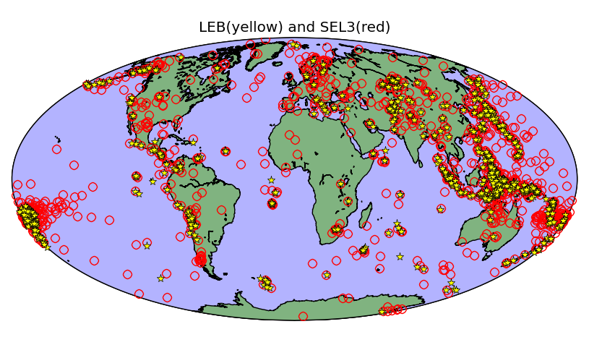
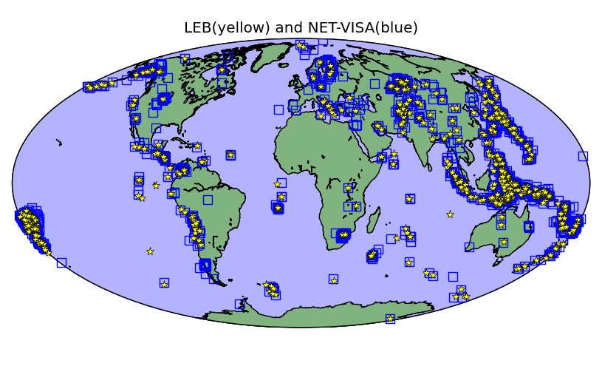
Outline
Background: NET-VISA baseline
Coda arrivals
Problem
Refined model
Results

Slide 4
NET-VISA model components
Events
Seismic Wave Propagation
NET-VISA
Inference
Detected?
Station Noise
Arrivals
Physics
Waveforms at seismometers
Inference
Station Processing

Slide 5
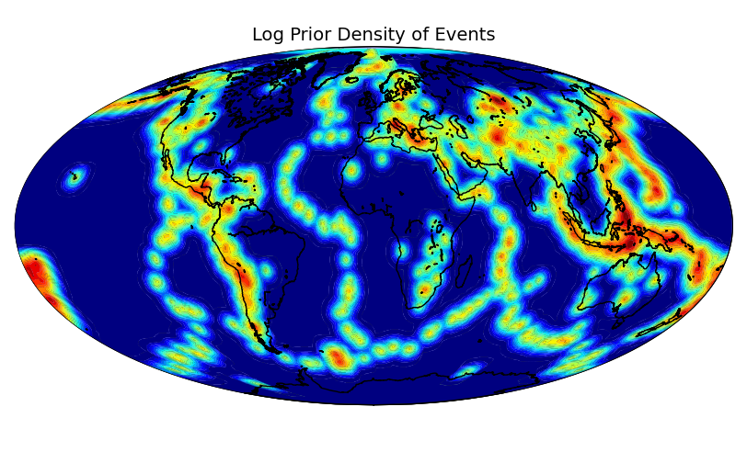
Generative Model – Event Location
Notes:
Learned with historical data and mixed with a uniform distribution to allow for explosions.

Slide 6
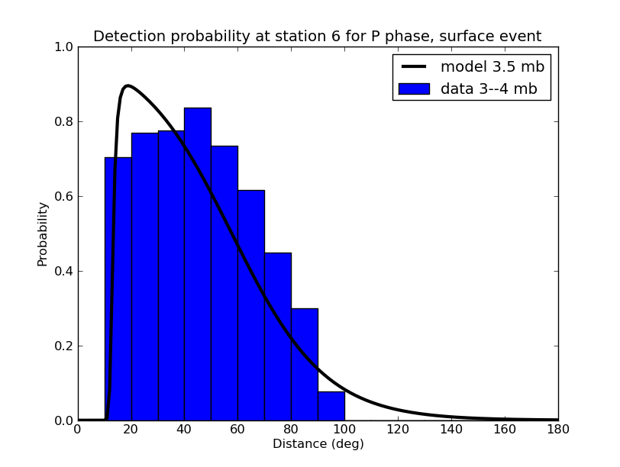
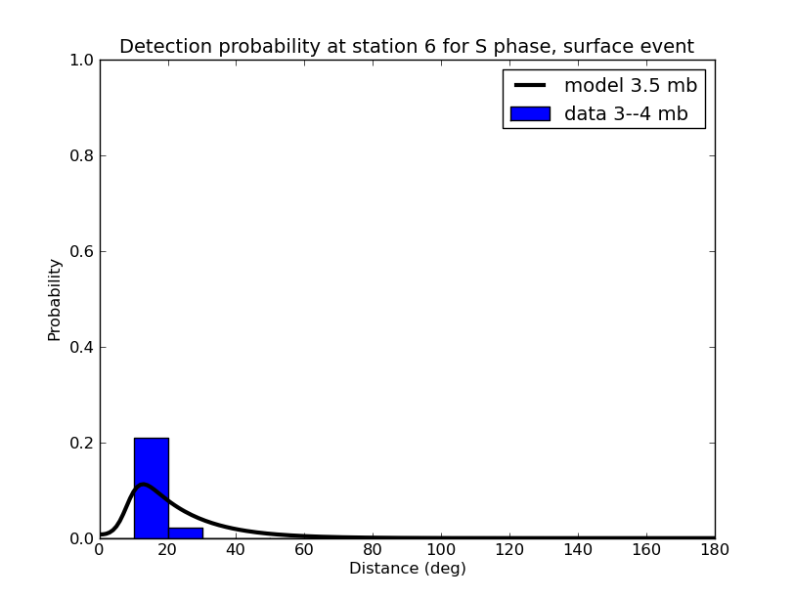
Generative Model – Detection Probability
P(Detected) = Logistic(f(distance,magnitude,depth))
P phase, station 6
S phase, station 6
Notes:
The detection probability depends on the distance and magnitude (also depth, not shown for simpicity).
In contrast, seismologists build a detection model based on histograms of detections at every point on the earth – clear tendency to overfit where there is no prior history!

Slide 7
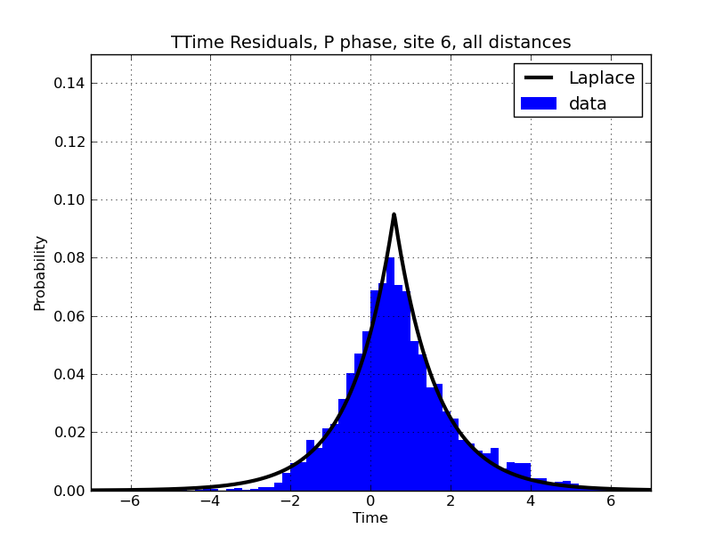
Generative Model – Arrival Time
Arrival time = Event time + IASPEI + corrections + Laplacian residual
Notes:
This is a for-example.

Slide 8
Inference Overview
Max a-posteriori (MAP) seismic event bulletin
Probability-driven search over association/phase-label/location/depth/time/magnitude
Easily parallelizable – runs in real time on Tohoku and Sumatra
Notes:
We are trying to find the MAP bulletin, because this is what seismologists expect to see.
The basic approach is a heuristic search which moves forward in time.

Slide 9
Outline
Background: NET-VISA baseline
Coda arrivals
Problem
Refined model
Results

Slide 10
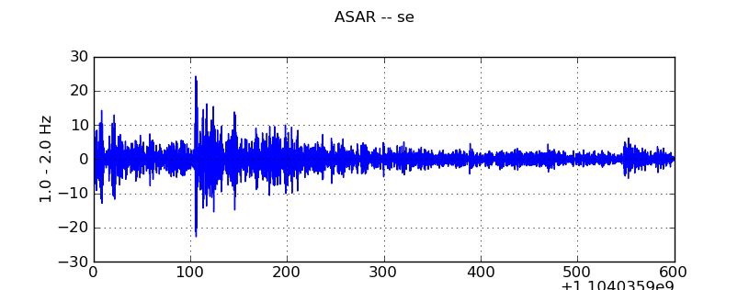
Coda arrivals
Coda Arrivals
Direct Arrivals
Notes:
But the picture is not very rosy!

Slide 11
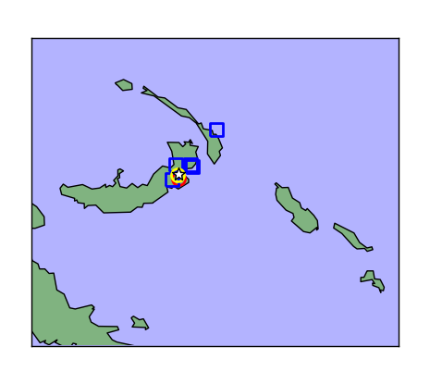
NET-VISA finds shadow events from the coda arrivals.
1 real event,
4 shadow events
Notes:
Windows: python debug.py 490 visa 1997
5297214

Slide 12
A coda model was introduced to NET-VISA
Events
Seismic Wave Propagation
Detected?
Station Noise
Arrivals
Coda Model
Waveforms at seismometers

Slide 13
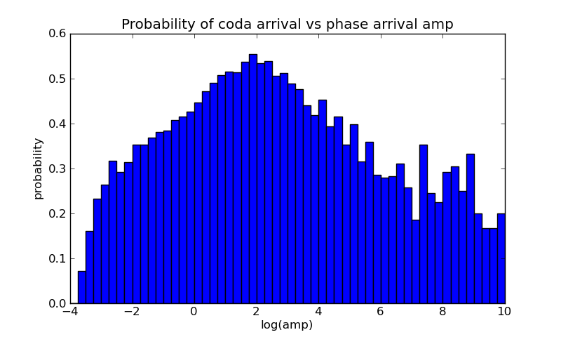
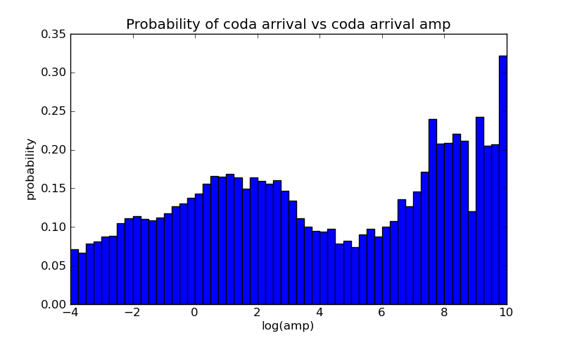
Coda Model I: Probability of coda arrivals depends on prior arrival’s amplitude
Detector finds arrivals based on ratio of Short Term Average Energy to Long Term Average Energy (STA/LTA)
Coda occurs after direct arrival
After coda arrival
Sweet Spot
Probability
Sweet Spot
Log(amp)
Log(amp)
Many codas for large events

Slide 14
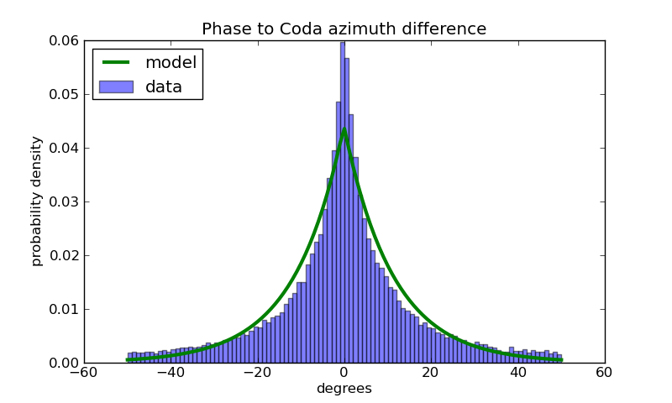
Coda Model II: Can recognize a coda arrival because its attributes are highly correlated with direct arrival’s attributes
Coda arrival azimuth relative to direct arrival’s azimuth

Slide 15
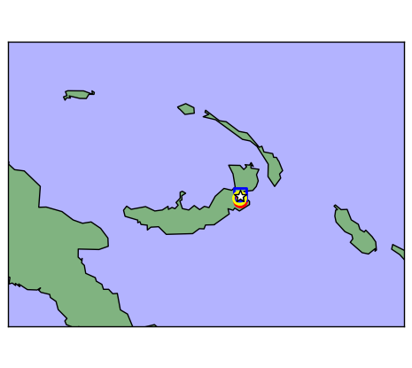
Example of results with coda added to the model
Before: NET-VISA produced 5 events.
After: Only one event is produced from same sequence of arrivals.
NET-VISA events
LEB event
Notes:
Python debug.py 492 leb 5297214

Slide 16
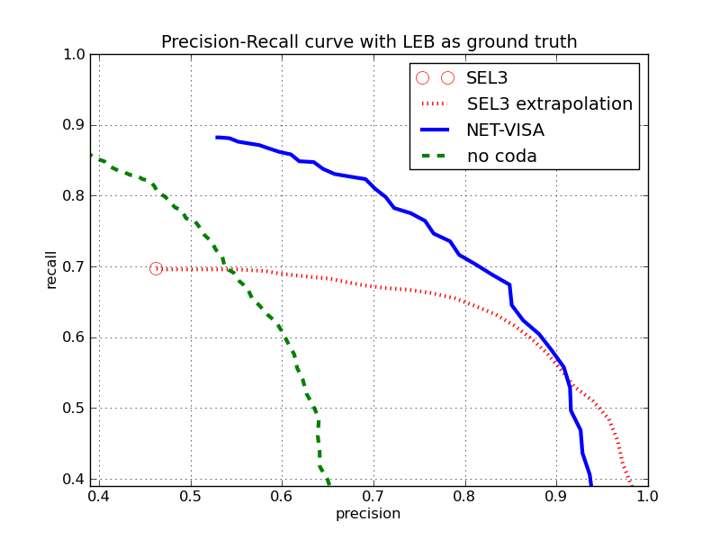
NET-VISA performance before and after coda model
After
SEL3
Before
Threshold for declaring an event has been found
% of true events that were found
% of events that were found that were true.
Coda model significantly reduces the number of false events produced by NET-VISA while continuing to find 90% of true events. Both implementations outperform SEL3.

Slide 17
Percentage of Missed Events by Event Magnitude
Percentage Missed
Body-wave magnitude
SEL3 misses 30% of LEB events. NET-VISA with coda model misses 12% overall and 5x improvement in detection of small events (that took place close enough to network stations to be detected).
Notes:
(Revision 212)

Slide 18
Recall on Continental US
Local Magnitude
LEB is missing more than 90% events in the continental USA listed in NEIC (IRIS). NET-VISA finds half of them.

Slide 19
Conclusions
Adding coda model to NET-VISA significantly improves performance.
Factor of 3 improvement over SEL3
Order of magnitude lower detection threshold vs. LEB
No need to prune spurious events

