Slide 1


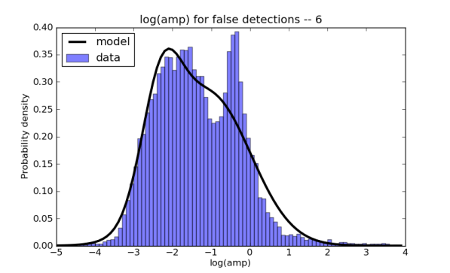
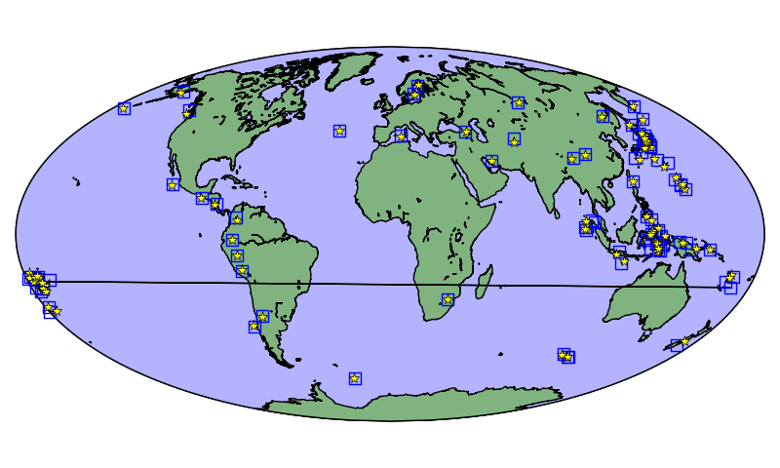
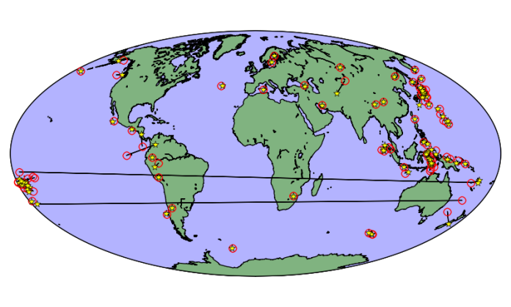
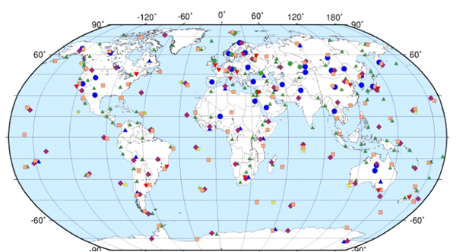
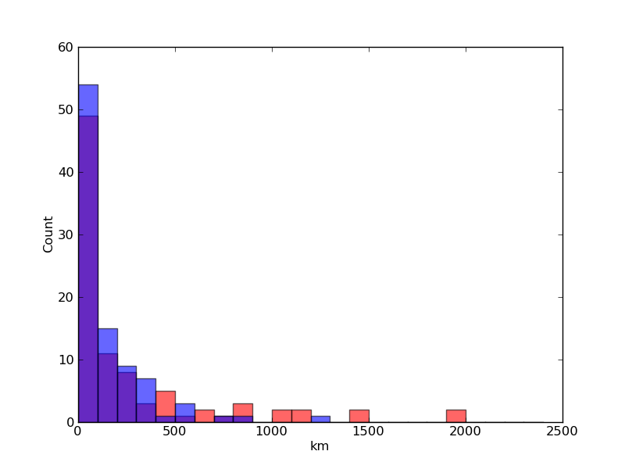
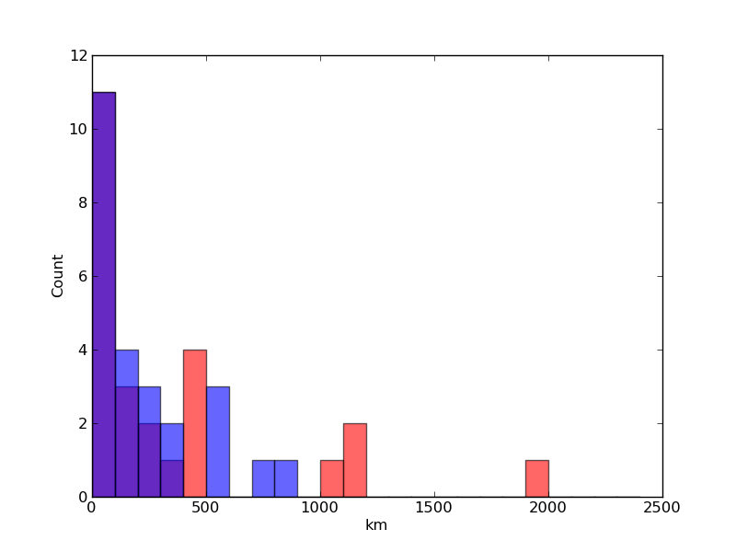
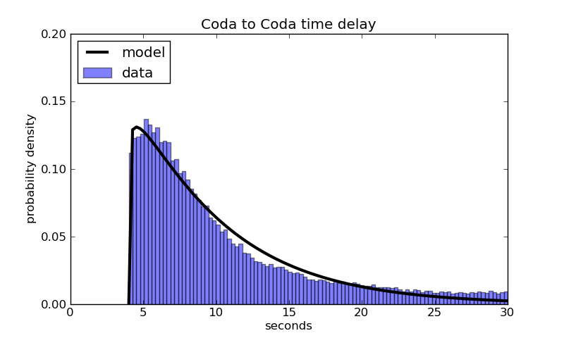
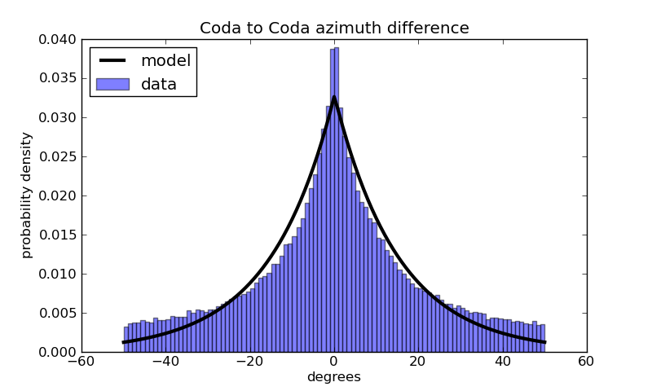
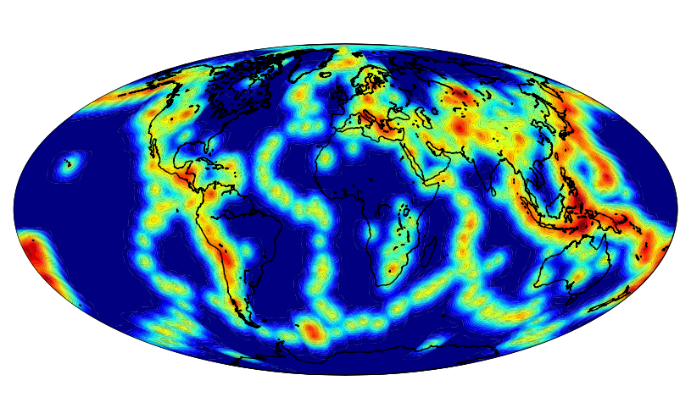
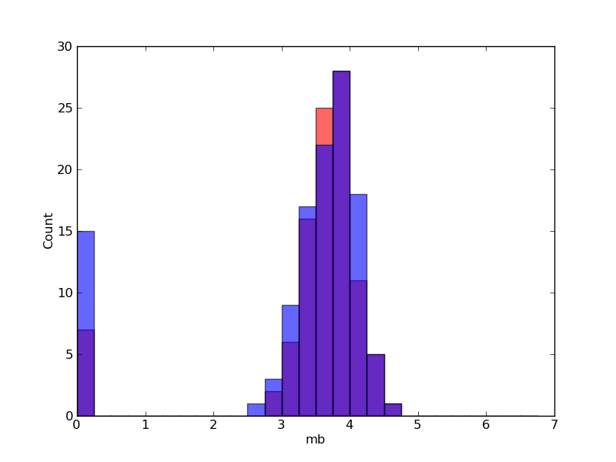
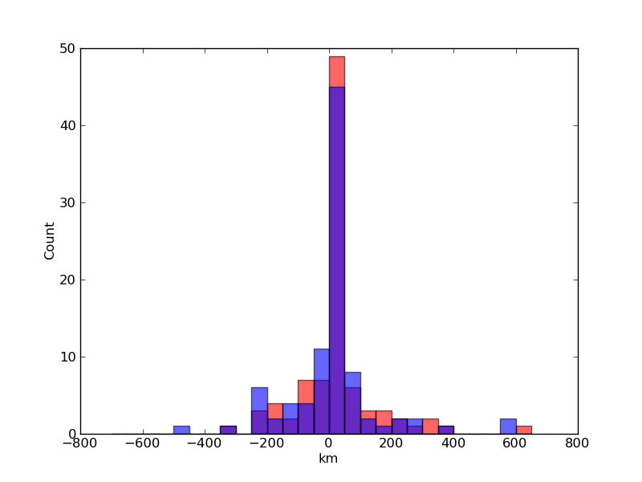
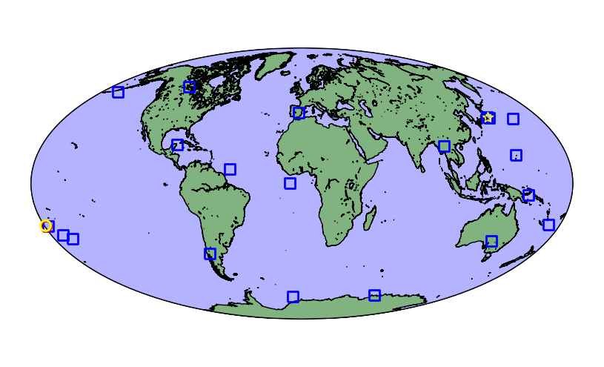
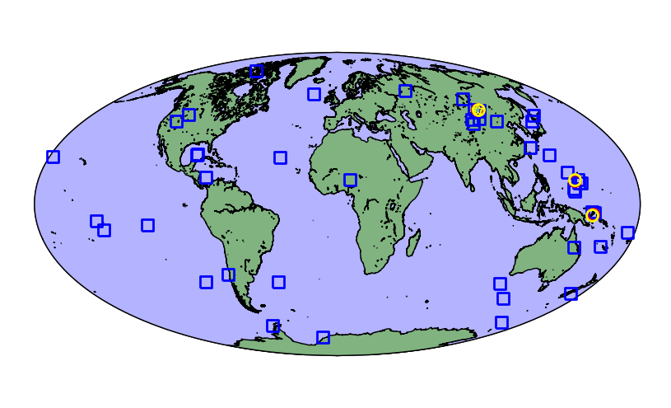
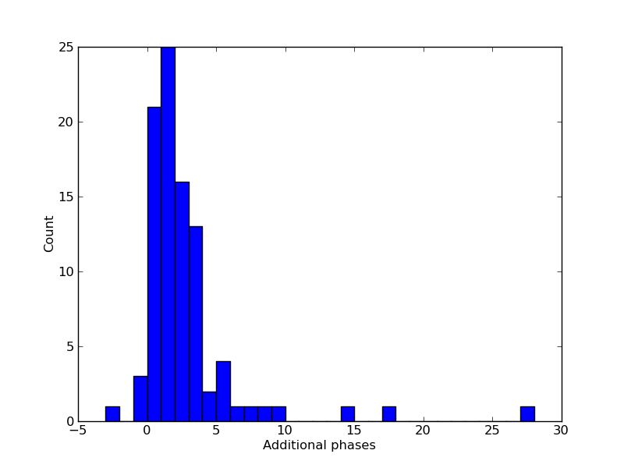
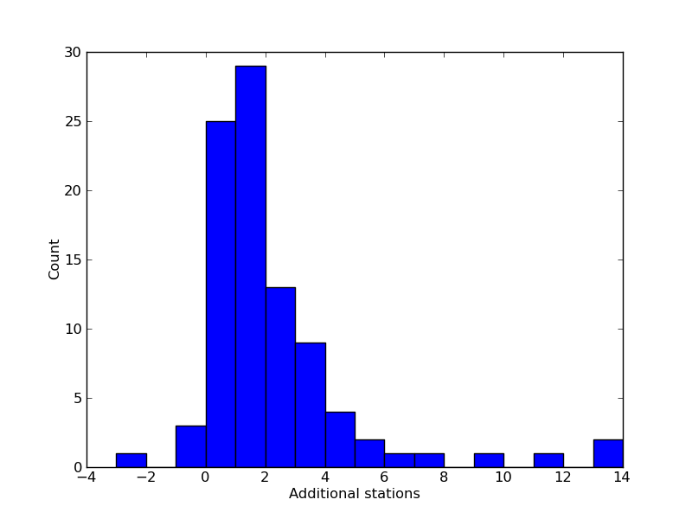
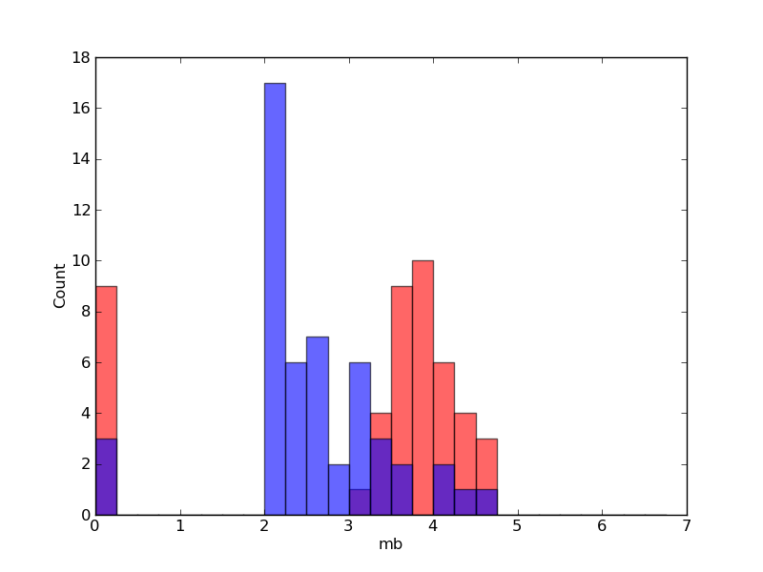
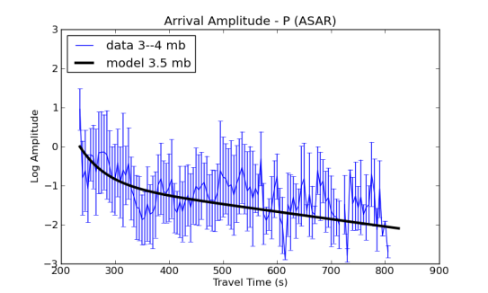
ANALYST EVALUATION OF MODEL-BASED BAYESIAN SEISMIC MONITORING AT THE CTBTO
Bayesian
Logic, Inc.
Nimar S. Arora¹, Jeffrey Given², Elena Tomuta², Stuart J. Russell^{1,3}, and Spiro Spiliopoulos²
Bayesian Logic, Inc.¹, Comprehensive Nuclear-Test-Ban Treaty Organization², and University of California, Berkeley³
NET-VISA
Generative Model (continued)
Analyst Evaluation
Analyst Evaluation (continued)
CONCLUSIONS
NET-VISA (NETwork processing Vertically Integrated Seismic Analysis) is a generative probabilistic model of global-scale seismology and an inference algorithm that deduces the seismic bulletin with the highest posterior probability given all the seismic detections (aka arrivals or triggers) and misdetections observed by a network of stations.
P_{λ}(false arrivals)
New NET-VISA bulletin called VISA
Side by side analyst review of SEL3 (GA) and VISA (NET-VISA)
Reviewed SEL3 bulletin + Scanner is LEB
Reviewed VISA bulletin is LEB_VISA
Restrict comparison to LEB events from SEL3 and not Scanner
27 hours of LEB_VISA bulletin between June 11 and June 25
Location Errors
Objective
50% fewer missed events compared to GA
Detected small (real) events not in LEB
2 Additional stations associated per event.
More accurate event locations.
Much smaller magnitude for false events, more obvious
False arrival
amplitude
Blue dots and triangles are primary seismic stations.
Overall Event Distributions
False amplitude as a mixture of Gaussians
Uniform in time, slowness, and azimuth
Subjective Feedback
LEB_VISA
LEB(SEL3)
LEB_VISA minus LEB(SEL3)
LEB(Scanner)
SEL3
Depth phases should be associated only if multiple depth phases are associated
Expect to see correlation in slowness values of P and S phases at the same station for the same event
Event definition criteria didn’t match analyst expectation
Overall Impression : NET-VISA = GA + SCANNER
P_{γ}(coda | true, false arrivals)
VISA
Generative Model
A world (or hypothesis) is a complete sequence of seismic events, associated true arrivals, false arrivals and coda arrivals.
P(world) = P_{θ}(events) P_{Φ}(true | events) P_{λ}(false) P_{γ}(coda | true, false)
Coda
time
delay
Coda
azimuth
difference
27
92
9
2
25
9
REFERENCES
P_{θ}(events)
Coda time delay as a Gamma distribution
Azimuth, Slowness, and Amplitude differences as Laplacians
Arora, N. S., S. Russell (2012). A model of seismic coda arrivals to suppress spurious events, European Geophysical Union (EGU2012-6763).
Arora, N. S. (2012). Model-Based Bayesian Seismic Monitoring. University of California, Berkeley. Technical Report No. UCB/EECS-2012-125.
Le Bras, R., H. Swanger, T. Sereno, G. Beall, and R. Jenkins (1994a). Global association. Technical Report ADA304805, Science Applications International Corp, San Diego, CA.
Le Bras, R., H. Swanger, T. Sereno, G. Beall, R. Jenkins, and W. Nagy (1994b). Global association: Design document and user's manual. Technical Report SAIC-94/1142, Science Applications International Corp, San Diego, CA.
Le Bras, R., S. Russell, N. Arora, and V. Miljanovic. Machine Learning at the CTBTO (2011). Testing and Evaluation of the False Events Identification (FEI) and Vertically Integrated Seismic Association (VISA) Projects, in Proceedings of the 2011 Monitoring Research Review: Ground-Based Nuclear Explosion Monitoring Technologies, LA-UR-11-04823, Vol 1, pp. 313–321.
Number of events in the reviewed NET-VISA and GA
bulletins
Additional events found by NET-VISA vs additional events added by Scanner
Overall location errors
for common events:
VISA : 152 km
SEL3: 297 km
Overall location errors with identical number of time-defining stations
VISA : 226 km
SEL3 : 360 km
Event location
density.
Heuristic Inference
Start with a world with no events and all arrivals are noise or coda
Series of moves change the world to improve its probability
Location prior
Gutenberg Richter magnitude prior
Uniform in depth, and time
Birth move
Inverts detections to get seed locations.
Associates seed locations to detections to identify the best set of locations.
Distribution of event magnitudes
Depth errors for common errors
VISA : 84 km
SEL3 : 70 km
P_{Φ}(true arrivals| events)
JMA event
Additional Associations
Detection probability
vs distance.
Arrival time vs IASPEI.
LEB event
False Events
ACKNOWLEDGEMENTS
Detection probability using Logistic model
IASPEI + Laplace model for travel time
SASC + Laplace model for azimuth and slowness
Amplitude as a linear regression with Gaussian noise
Example inverting detections of weak events
Example inverting detections of strong events
We are thankful to Dr. Lassina Zerbo, IDC Director, for his continued support of the development of the NET-VISA software. The research in this paper could not have been possible without the diligence of the various lead analysts – Tajan, Ali Kasmi, Ezekiel Jonathan, Jane Gore, Marcela Villarroel and Kirill Sitnikov – who produced the LEB_VISA bulletin and provided detailed feedback.
Improve Arrivals Move
Associate each arrival with the best event-phase
Improve Event Move
Find the best location for an event given the currently associated detections
Death Move
Kill unsupported events.
VISA false events have much lower magnitudes
Log amplitude vs distance
Additional Phases
Average: 2.2
Additional Stations
Average : 1.8
DISCLAIMER
For common events in VISA and SEL3
The views expressed in this paper are those of the authors and do not necessarily reflect the views of the CTBTO Preparatory Commission.

