Slide 1


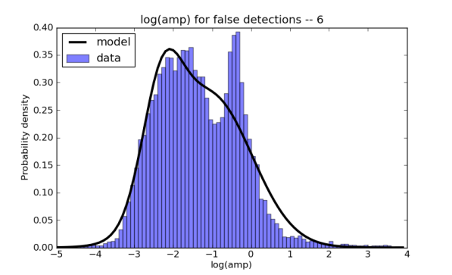
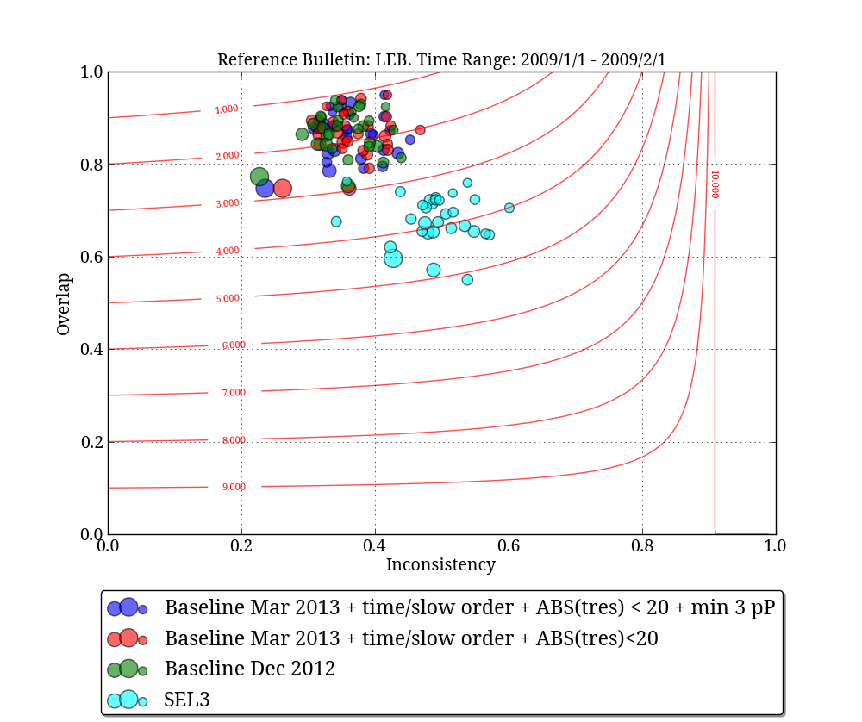
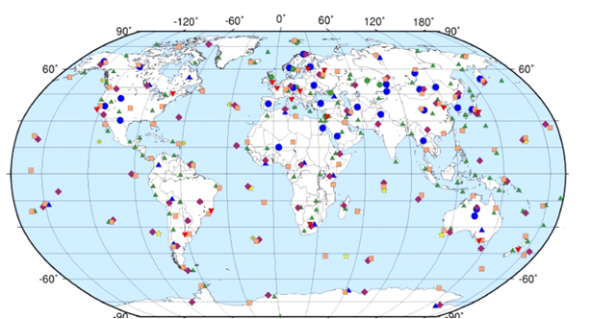
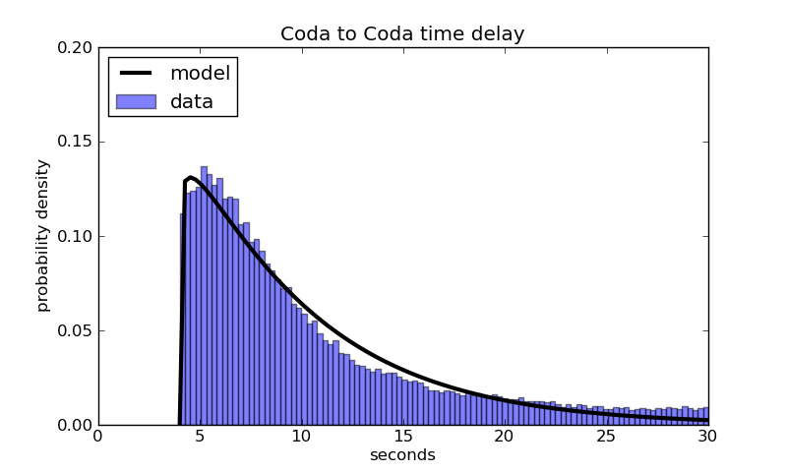
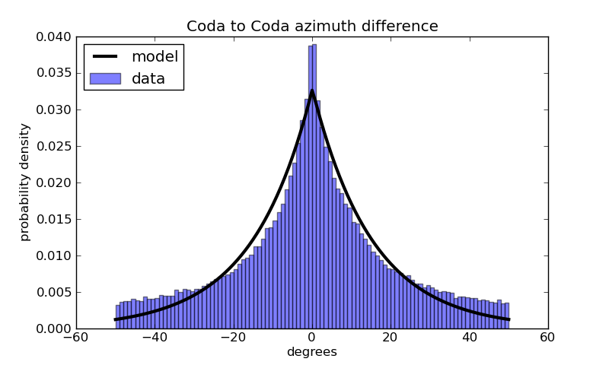
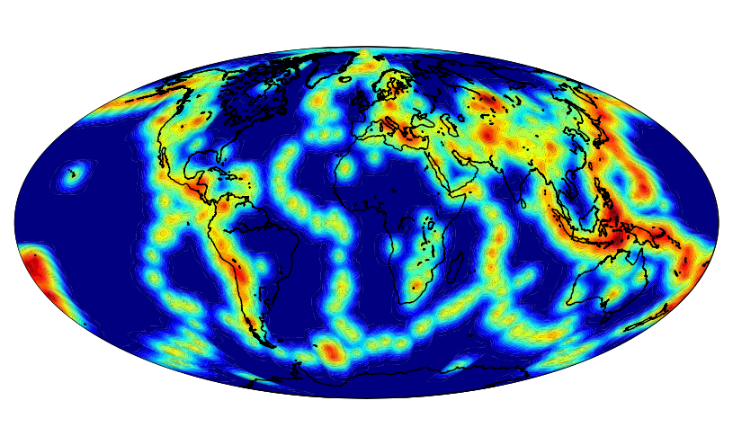
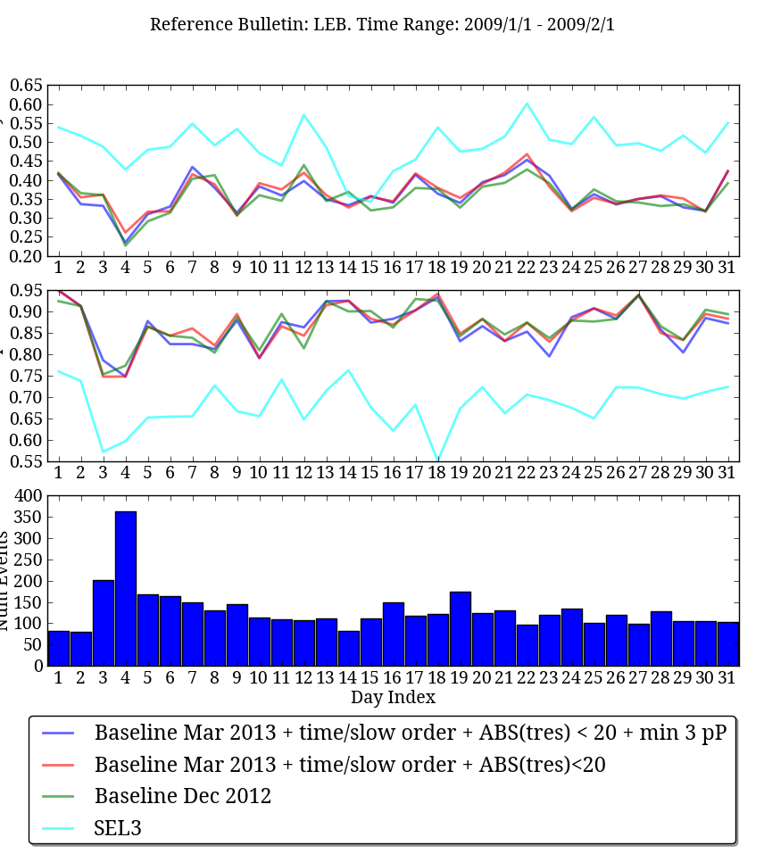
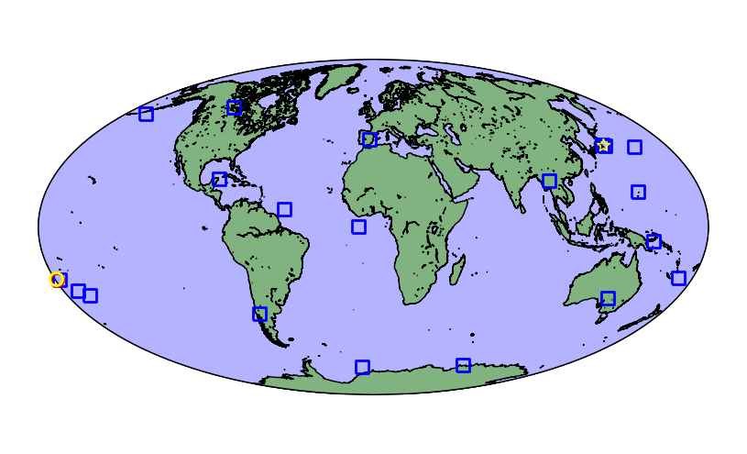
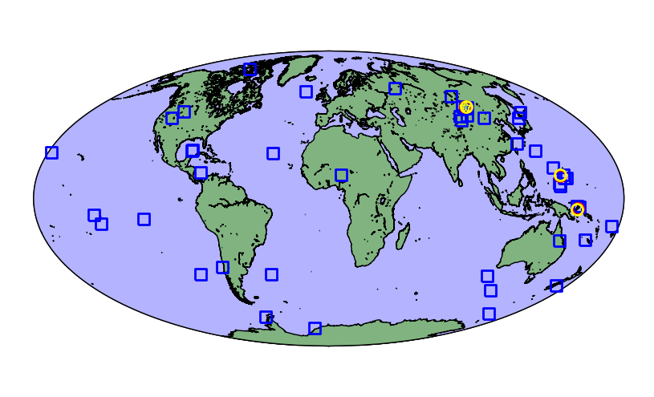


Incorporating seismic phase correlations into a probabilistic model of global-scale seismology
Nimar S. Arora
Bayesian Logic, Inc.
NET-VISA
Generative Model (continued)
Problem – Lack of Phase Correlations
Results
NET-VISA (NETwork processing Vertically Integrated Seismic Analysis) is a generative probabilistic model of global-scale seismology and an inference algorithm that deduces the seismic bulletin with the highest posterior probability given all the seismic detections (aka arrivals or triggers) and misdetections observed by a network of stations.
P_{λ}(false arrivals)
Existing model assumed that all phases are generated independently.
This can lead to anomalous phase orders, for example an S phase before a P phase. Although this is quite rare, about 1 such occurrence in 30 days of data.
Also, an event could generate a P phase with a higher slowness than an S phase at the same station.
Some of the arrival time residuals could be quite high.
Often pP phases are freely associated whereas analysts prefer to be more conservative with such phases.
The following phase association rules have been added to the model to address the above shortcomings.
The following rules are not used during the birth move.
False arrival
amplitude
Blue dots and triangles are primary seismic stations.
False amplitude as a mixture of Gaussians
Uniform in time, slowness, and azimuth
P_{γ}(coda | true, false arrivals)
Generative Model
Phase Rules
A world (or hypothesis) is a complete sequence of seismic events, associated true arrivals, false arrivals and coda arrivals.
P(world) = P_{θ}(events) P_{Φ}(true | events) P_{λ}(false) P_{γ}(coda | true, false)
If phase X has an IASPEI time before phase Y then the measured arrival time of phase X should be before phase Y.
If phase X has an IASPEI slowness less than that of phase Y then the measured slowness value of phase X should be less than that of phase Y.
The absolute time residual for any phase should not exceed 20 seconds.
Only associate pP phases if at least 3 such phases are associated to an event.
References
P_{θ}(events)
Coda time delay
Coda azimuth difference
Coda time delay as a Gamma distribution
Azimuth, Slowness, and Amplitude differences as Laplacians
Performance Evaluation
Event location
density.
Heuristic Inference
Start with a world with no events and all arrivals are noise or coda
Series of moves change the world to improve its probability
Match events in a reference bulletin and the test bulletin which have two arrivals in common. We require that the arrivals be associated using a similar phase label for both events.
Measure the overlap – the fraction of reference events that are matched.
Measure the inconsistency – the fraction of the test events that are not matched.
Compute the cost of the solution as a weighted average of the overlap and inconsistency normalized by the number of reference events. We assign a weight of 10 to the overlap and 1 to the inconsistency since it takes a lot more work by the analysts to add an event than to discard a false event.
Cost =
Birth move
Inverts detections to get seed locations.
Associates seed locations to detections to identify the best set of locations.
Location prior
Gutenberg Richter magnitude prior
Uniform in depth, and time
JMA event
P_{Φ}(true arrivals| events)
LEB event
Acknowledgements
Example inverting detections of weak events
Example inverting detections of strong events
The work done in this project was funded by the CTBTO. We are grateful to Dmitry Bobrov for suggesting the matching criteria for events and to Mark Prior for devising the formula for measuring the bulletin cost.
Improve Arrivals Move
Associate each arrival with the best event-phase
Improve Event Move
Find the best location for an event given the currently associated detections
Death Move
Kill unsupported events.
Detection probability vs distance.
Arrival time vs IASPEI.
Disclaimer
Detection probability using Logistic model
IASPEI + Laplace model for travel time
SASC + Laplace model for azimuth and slowness
Amplitude as a linear regression with Gaussian noise
The views expressed in this paper are those of the authors and do not necessarily reflect the views of the CTBTO Preparatory Commission.

