Slide 1
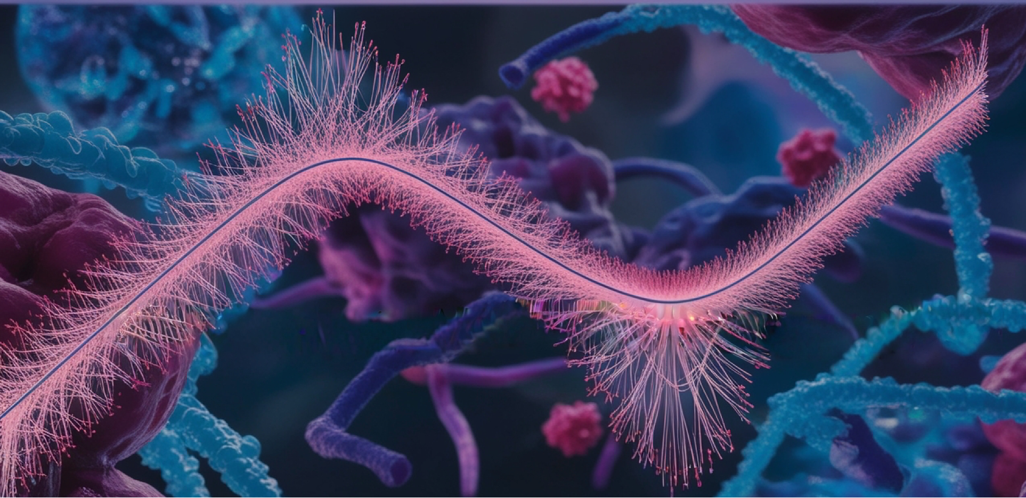
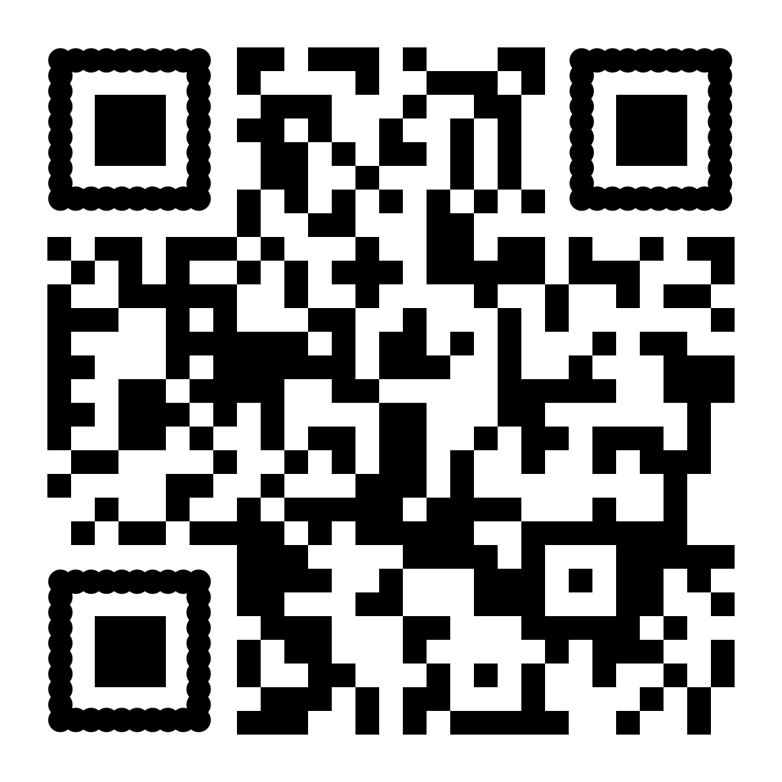


Course
Introduction to Biostatistics and Machine Learning
April 07th – 11th
BMC, Uppsala
National course for PhD students, researchers and other employees in need of biostatistical and machine learning skills. Probability theory. Hypothesis testing. Linear regression methods. GLM. Model evaluation. Clustering. Dimension reduction. Random Forest.
Apply by March 14th
Read more:
https://nbisweden.github.io/ML4Life/
or https://training.scilifelab.se/events

Slide 2
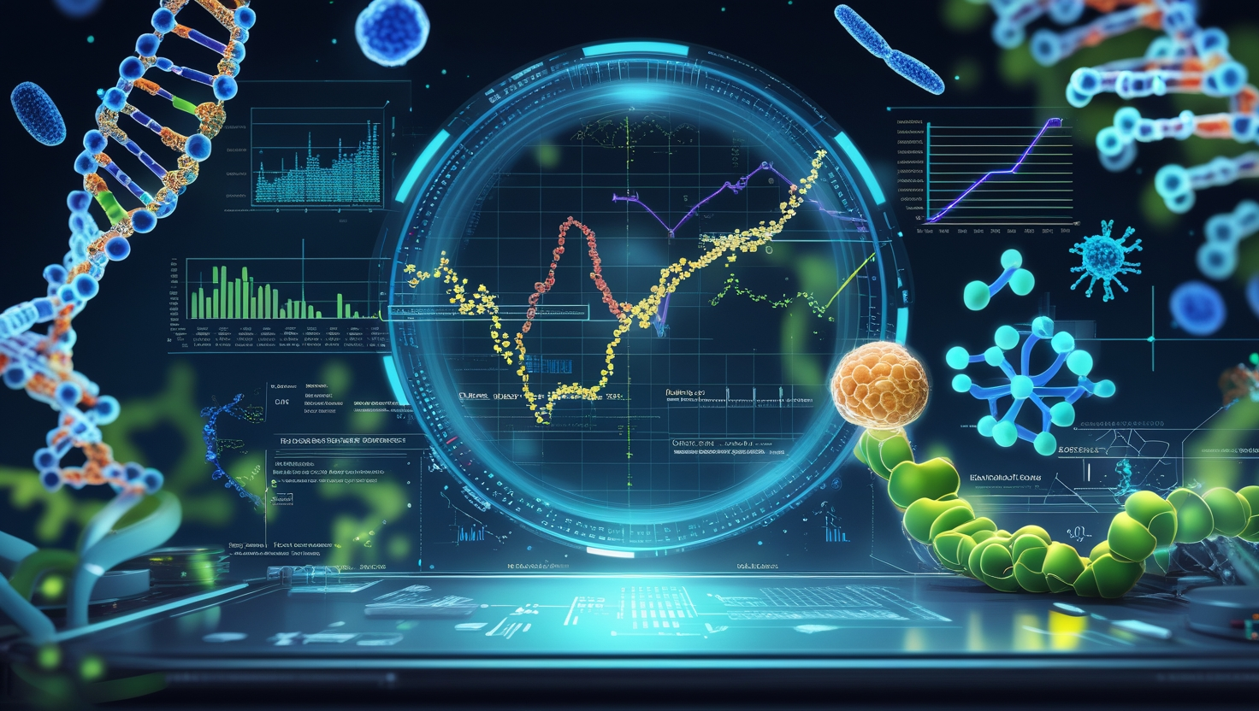
Course
Machine Learning in Life Sciences
June 09th – 13th
BMC, Uppsala
National course for PhD students and researchers who want to improve their ability to analyze data. Expand your data skills with dimensionality reduction methods beyond PCA, mixed-effect models, survival, PLS for single and multi-omics data sets and neural networks.
Apply by May 2nd
Read more:
https://nbisweden.github.io/ML4Life/
or https://training.scilifelab.se/events

