Slide 1
Using Deep Learning techniques to augment Side Channel Analysis
By Nimar Blume
Chair of Security in Information Technology

Slide 2
Contents
Deep Learning is overtaking!
AES basics – what are we attacking?
Side Channel Analysis
Template Attacks (Profiling)
Deep Learning overview
Multi layer perceptron
Convolution Neural Networks
Integrating DL & SCA
Effectiveness of DL techniques in SCA

Slide 3
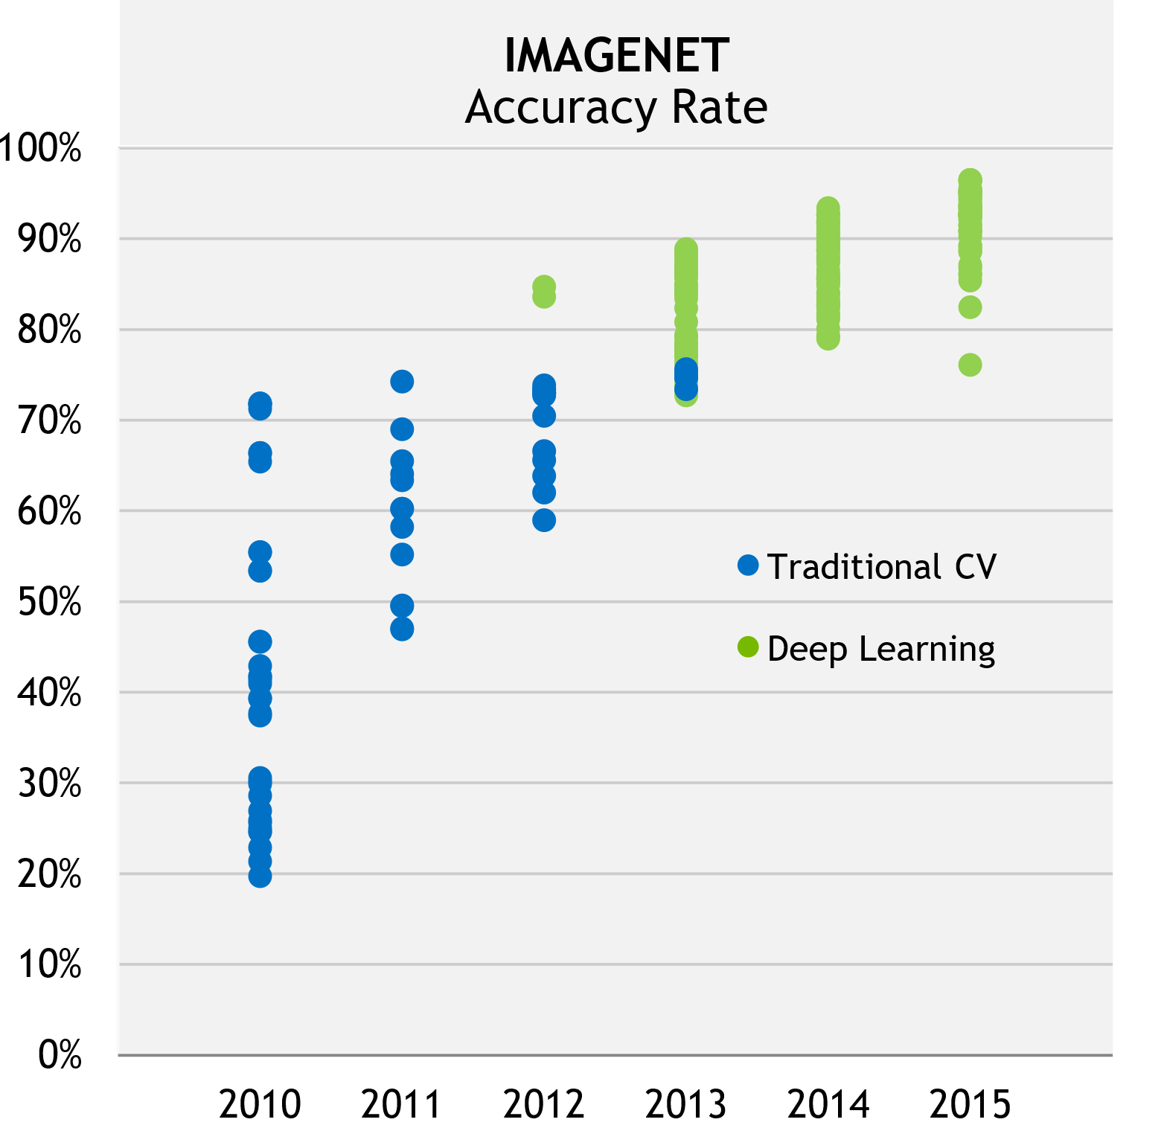
Deep Learning is overtaking
GPUs enable fast training
CNN: first application: number recognition
CNN outperforms doctors: skin cancer detection
Feb 2017
1998
Efficient GPU
Implementation
2011
Source: J. Bernauer, NVIDIA, 2016
Notes:
Overtaking traditional methonds (SVM, RF) -> SVM classifier like MLP
Overtaking humans (skin cancer detection) -> Image recog -> Mainly CNNs (130k imgs, 760classes -> 171imgs/class)

Slide 4
Deep Learning is overtaking
Can the success be replicated
in other fields?
CNN: first application: number recognition
CNN outperforms doctors: skin cancer detection
Feb 2017
1998
Efficient GPU
Implementation
2011
Source: J. Bernauer, NVIDIA, 2016
Notes:
Overtaking traditional methonds (SVM, RF) -> SVM classifier like MLP
Overtaking humans (skin cancer detection) -> Image recog -> Mainly CNNs (130k imgs, 760classes -> 171imgs/class)

Slide 5
AES / Cryptography basics
Plain Text
AddRoundKey
1. SubBytes
2. ShiftRows
3. MixColumns
4. AddRoundKey
SubBytes
ShiftRows
AddRoundKey
Ciphertext
Attack 1st round S-box
9. Rounds
Notes:
AES Sbox -> Attack >fist< or last
Possibility to recover key by getting one round key
Attacking the same device

Slide 6
Side Channel Analysis (SCA) – why is it so effective
Notes:
Basic principle of SCA
Explain DPA as example

Slide 7
Template Attack (Profiling)
Requires 2 identical devices
Profile on 1st device
Attack on 2nd device
Many traces needed for profiling
Not many traces needed for attack
Attack based on Gaussian assumption
Notes:
Explain basic principles of profiling attacks / template attacks

Slide 8
Deep Learning: an overview
Machine Learning | Deep Learning
Manual feature extraction | NN extracts features
Now: backpropagation possible on large NNs
Many types, each has own strengths
Recurrent NN
Convolutional NN
Multi Layer Perceptron
Auto Encoder
Notes:
Many different techniques, each has own strengths
Revived through more computational power -> Backpropagation algo now possible on large DNNs

Slide 9
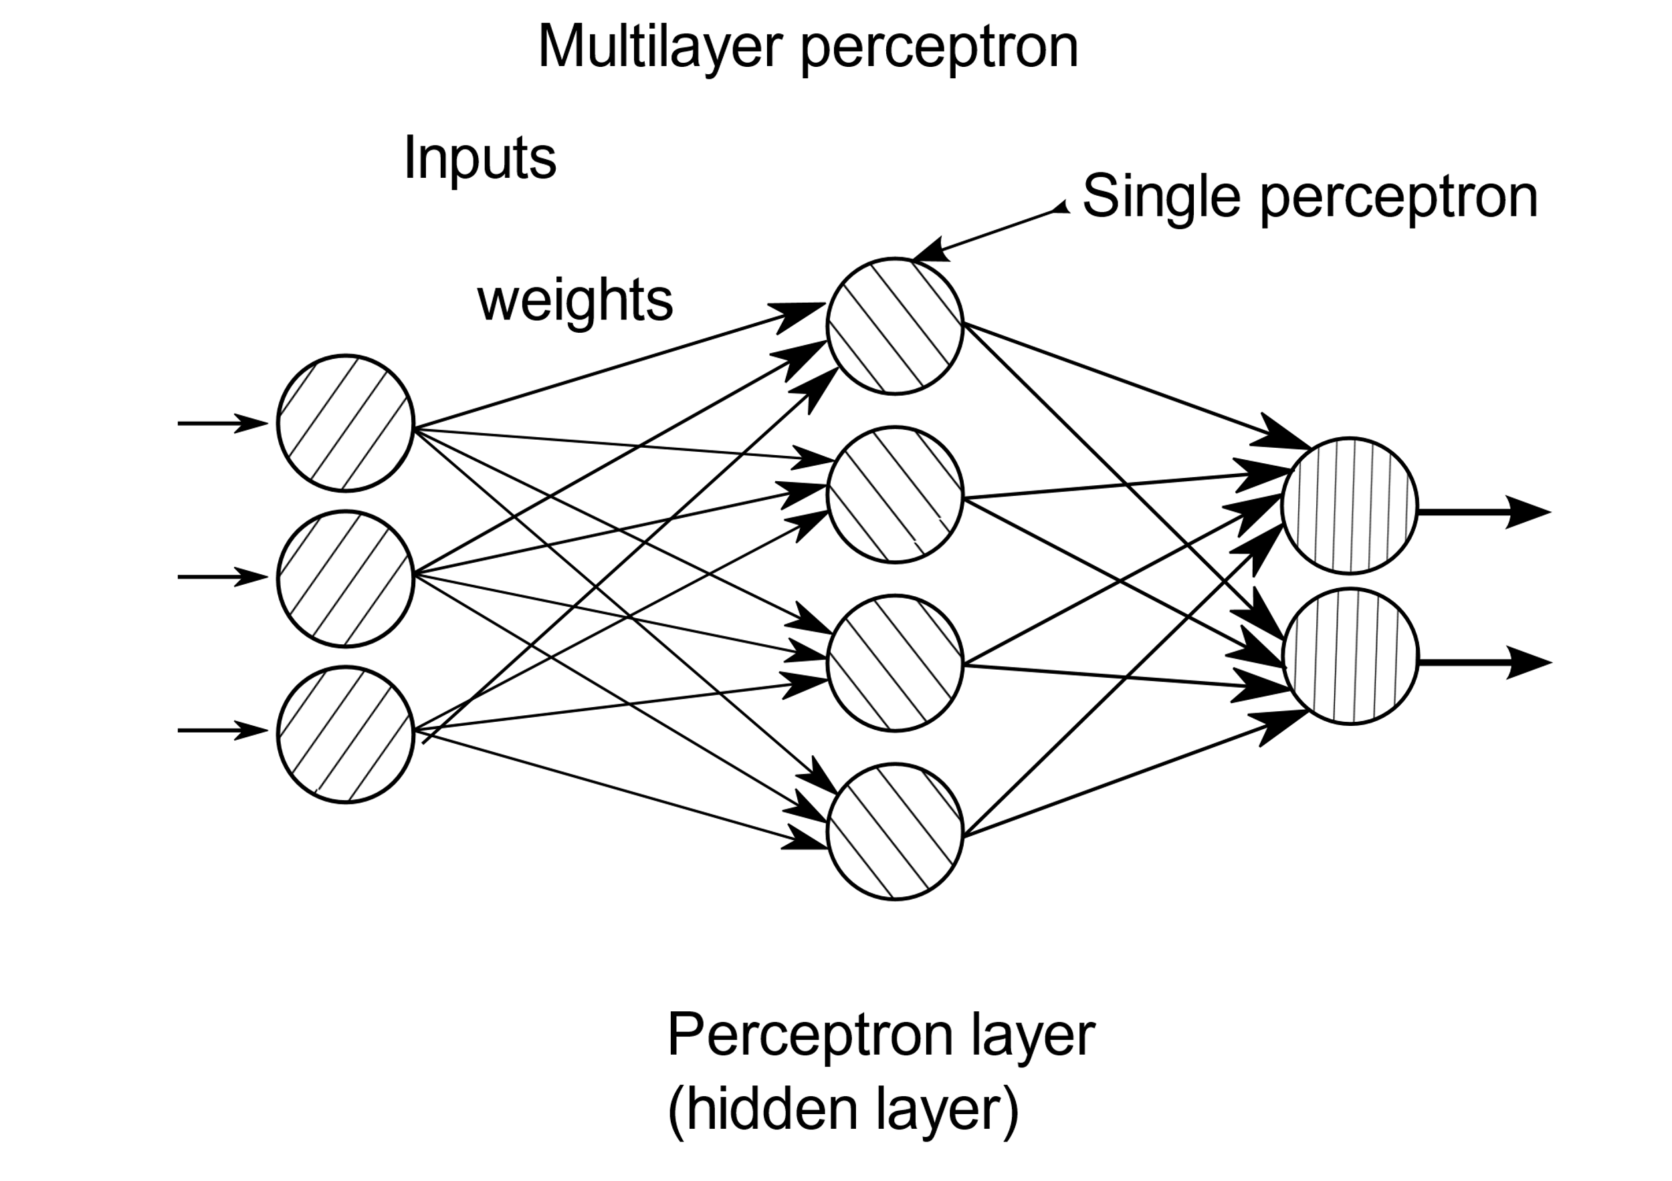
Multi Layer Perceptron (MLP)
Notes:
Made out of neutrons
Also fully connected layer
Mixes everything

Slide 10
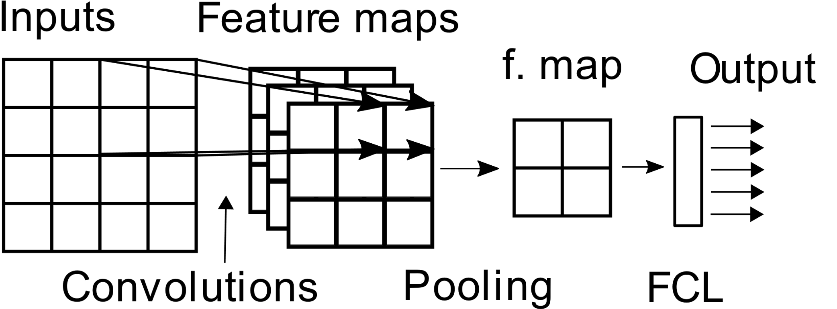
Convolutional Neural Networks
Notes:
Used mainly in image recognition -> Why? -> Feature extractor works like image kernel “Convolutions”
Convolutions -> Feature maps -> “Feature extraction”
FCL -> Classifier -> similar to SVM

Slide 11
Integrating Deep Learning techniques into SCA
Labelled data set → supervised learning!
Profile with NN instead of Gaussian assumption
Training | Attack
1k traces per key value | 20k traces with fixed key
Notes:
Basically template attack but instead of Gaussian assumption profile with a NN

Slide 12
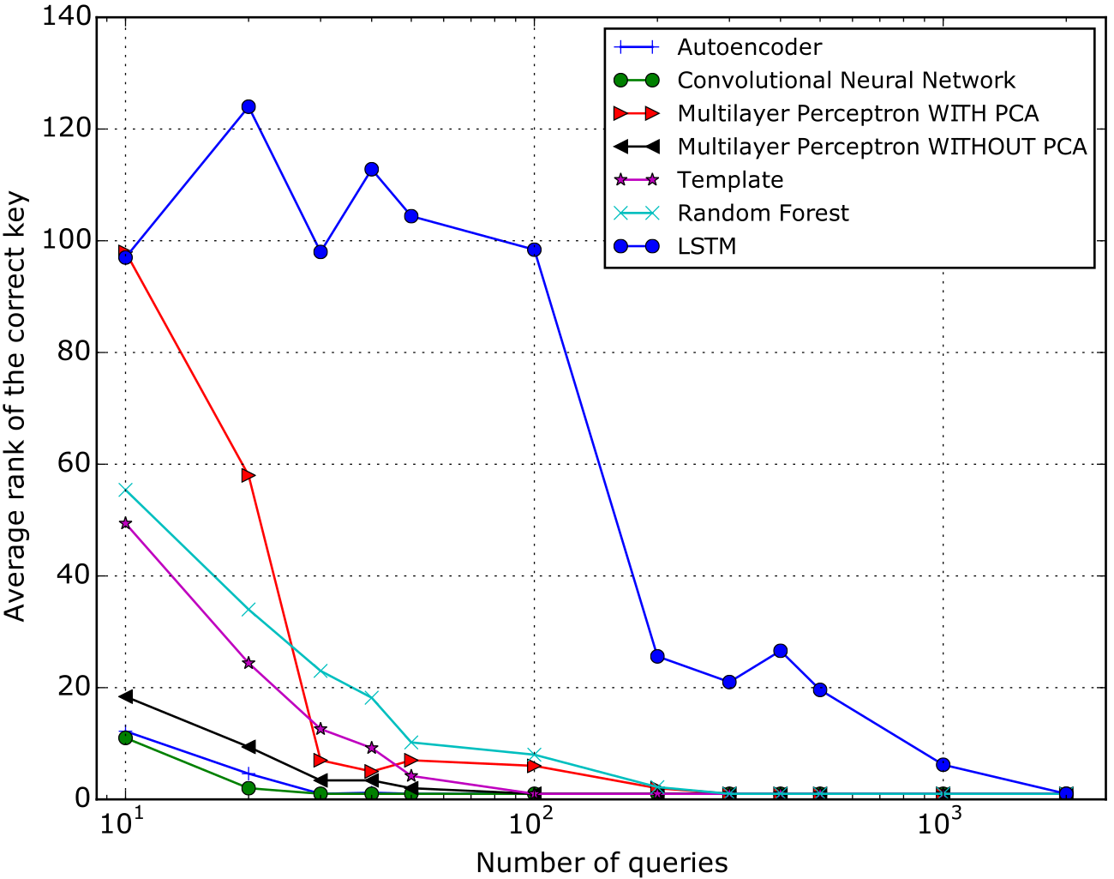
Results

Slide 13
Thank you for listening!
Do you have any questions?

Slide 14
Sources

Slide 15
Sources
Sources used throughout this presentation

