Slide 1
Using Deep Learning techniques to augment Side Channel Analysis
By Nimar Blume
Chair of Security in Information Technology

Slide 2
Agenda
Deep Learning is overtaking!
AES basics – what are we attacking?
Side Channel Analysis
Template Attacks (Profiling)
Deep Learning overview
Multi layer perceptron
Convolution Neural Networks
Integrating DL & SCA
Results

Slide 3
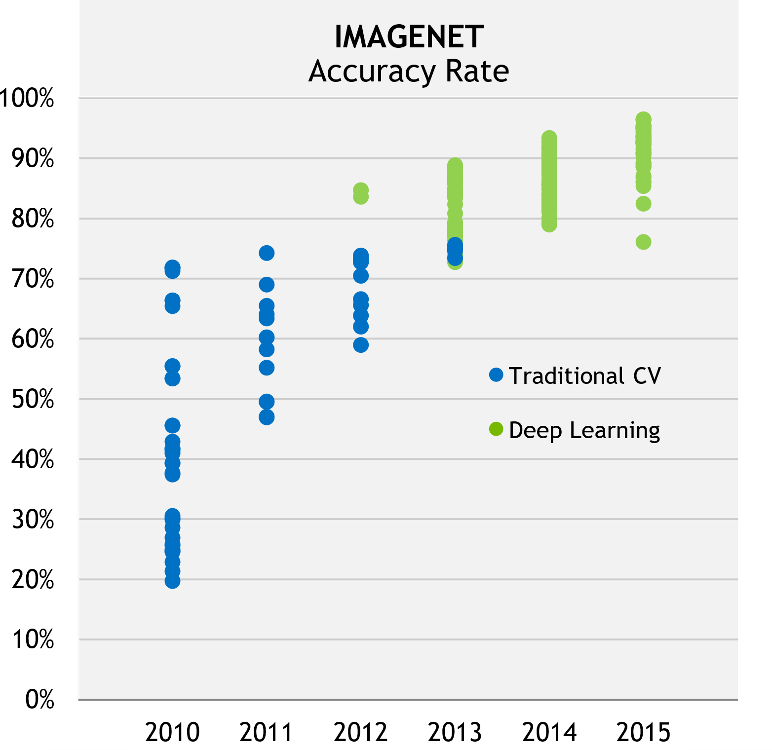
Deep Learning is overtaking
GPUs enable fast training
CNN: first application: number recognition
CNN outperforms doctors: skin cancer detection
Feb 2017
1998
Efficient GPU
Implementation
2011
Source: J. Bernauer, NVIDIA, 2016
Notes:
Overtaking traditional methods (SVM, RF) -> SVM classifier like MLP
Overtaking humans (skin cancer detection) -> Image recog -> Mainly CNNs (130k imgs, 760classes -> 171imgs/class)

Slide 4
Deep Learning is overtaking
Can the success be replicated
in other fields?
CNN: first application: number recognition
CNN outperforms doctors: skin cancer detection
Feb 2017
1998
Efficient GPU
Implementation
2011
Source: J. Bernauer, NVIDIA, 2016
Notes:
Overtaking traditional methods (SVM, RF) -> SVM classifier like MLP
Overtaking humans (skin cancer detection) -> Image recog -> Mainly CNNs (130k imgs, 760classes -> 171imgs/class)

Slide 5

AES / Cryptography basics
Plain Text
AddRoundKey
1. SubBytes
2. ShiftRows
3. MixColumns
4. AddRoundKey
SubBytes
ShiftRows
AddRoundKey
Ciphertext
Attack 1st round S-box
$$Z=SBox(X⊕k)$$
9. Rounds
x: intermediate value (PT)
k: key
Z: sensitive value
Notes:
AES Sbox -> Attack >fist< or last → why??
Possibility to recover key by getting one round key
Attacking the same device

Slide 6
Side Channel Analysis (SCA)
Attack implementation instead of algorithm
Power consumption, Execution time, …
Defences make SCA harder but not impossible
Notes:
Basic principle of SCA
Explain DPA as example

Slide 7
Template Attack (Profiling)
Requires 2 identical devices
Profile on 1st device
Attack on 2nd device
Based on Gaussian assumption
Many traces needed for profiling
Few traces needed for attack
Notes:
Explain basic principles of profiling attacks / template attacks

Slide 8
Deep Learning: an overview
Machine Learning | Deep Learning
Manual feature extraction | NN extracts features
Many types, each has own strengths
Multi Layer Perceptron
Convolutional NN
Recurrent NN
Stacked Auto Encoder
Notes:
Now: backpropagation possible on large NNs
Many different techniques, each has own strengths
Revived through more computational power -> Backpropagation algo now possible on large DNNs

Slide 9
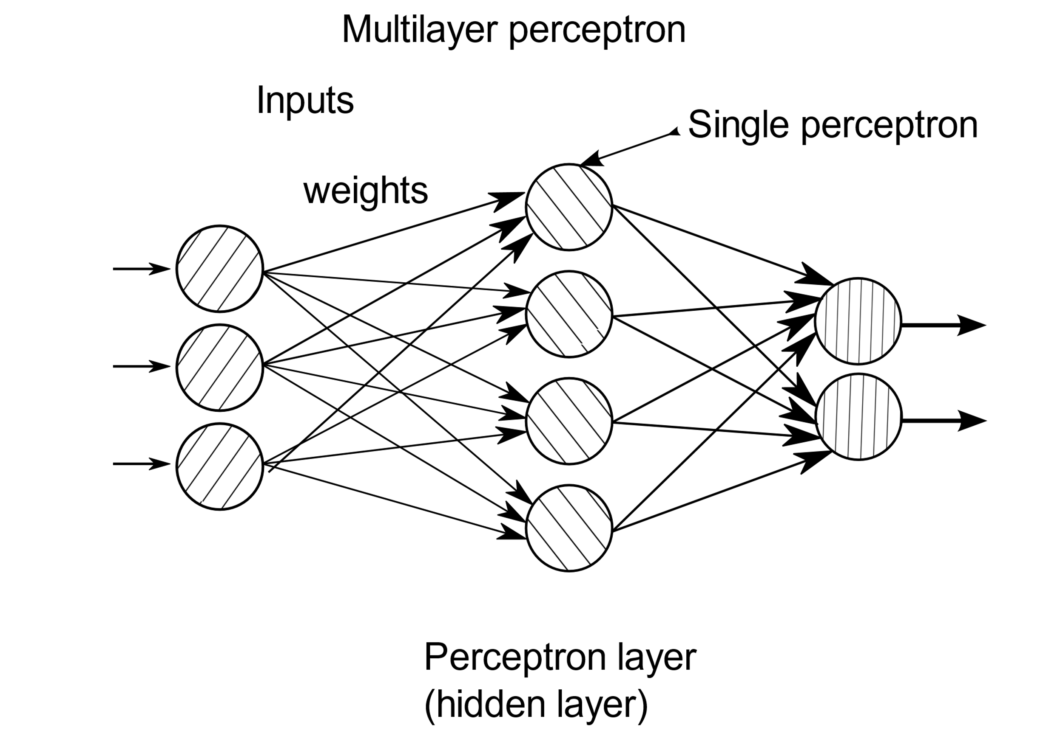





Multi Layer Perceptron (MLP)
$$x_{1}$$
$$x_{2}$$
$$x_{3}$$
$$f\left(\sum_{i=1}^{n}{w_{i}x_{i}}\right)$$
$$e\left(n\right)=d\left(n\right)−y(n)$$
Notes:
Made out of neutrons
Also fully connected layer
Mixes everything
If made for byte classification -> 256 outputs

Slide 10
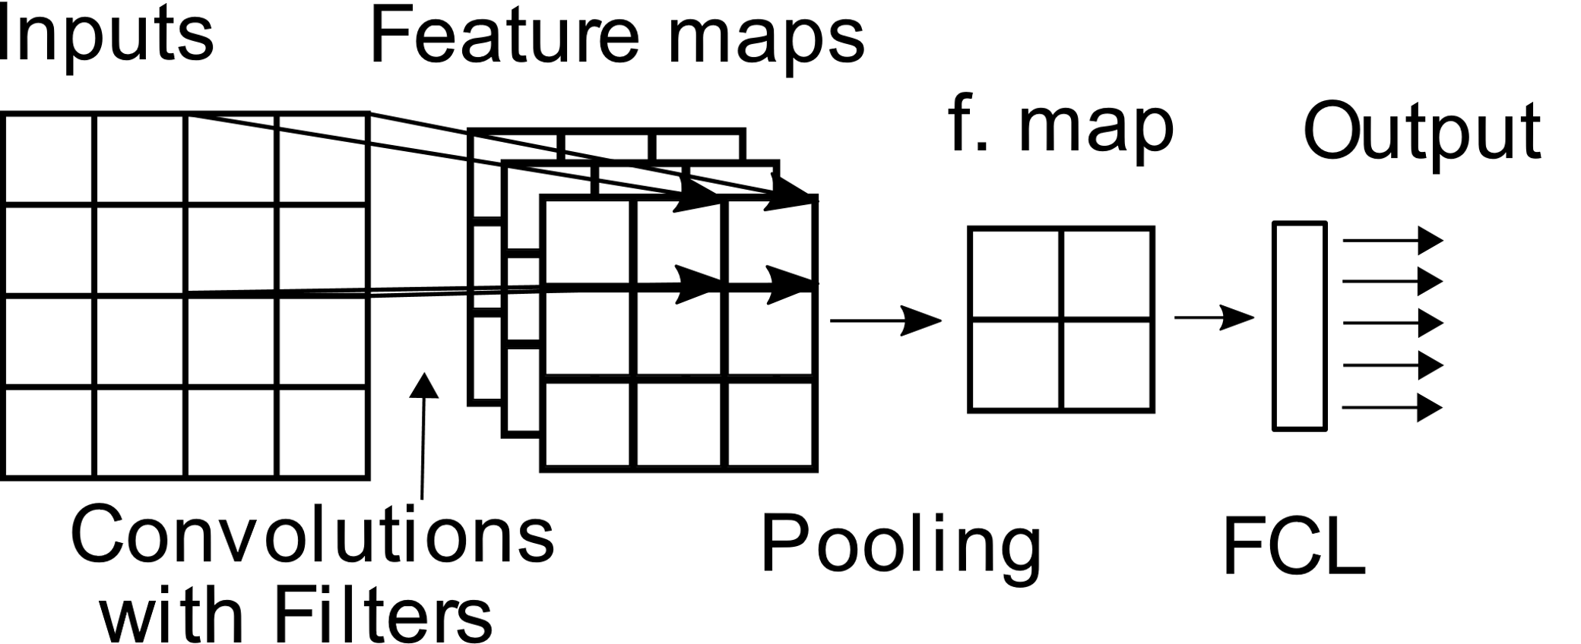
Convolutional Neural Networks
Notes:
Used mainly in image recognition -> Why? -> Feature extractor works like image kernel “Convolutions”
Convolutions -> Feature maps -> “Feature extraction”
FCL -> Classifier -> similar to SVM

Slide 11
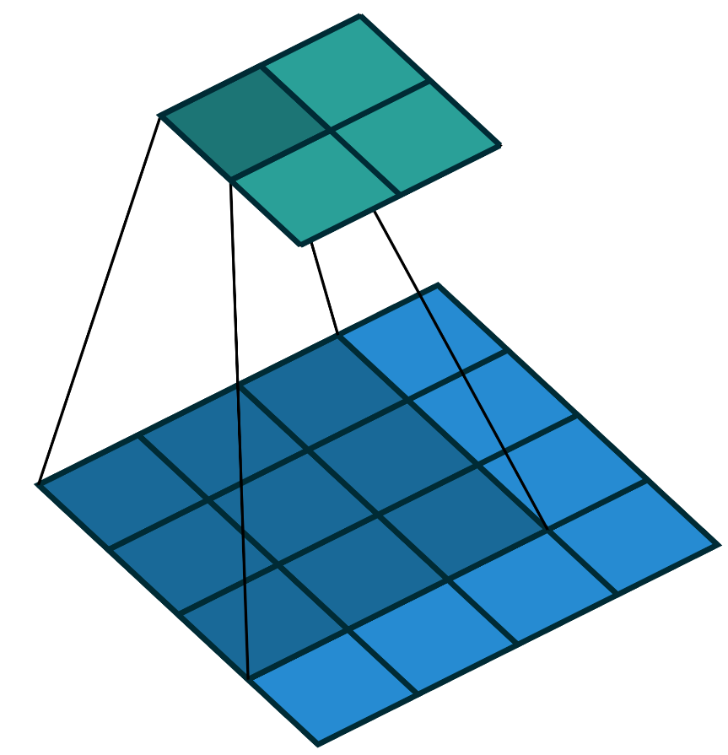
Convolutional Neural Networks - Convolutions
Feature map
3x3 Filter
1
Input
0
0
1
1
1
0
0
1
Source: vdumoulin, https://github.com/vdumoulin/conv_arithmetic/blob/master/gif/no_padding_no_strides.gif
Notes:
Feature extractor works like image kernel “Convolutions”
Filter contains the weights “feature extractor”
Convolutions -> Feature maps -> “Feature extraction”
FCL -> Classifier -> similar to SVM

Slide 12
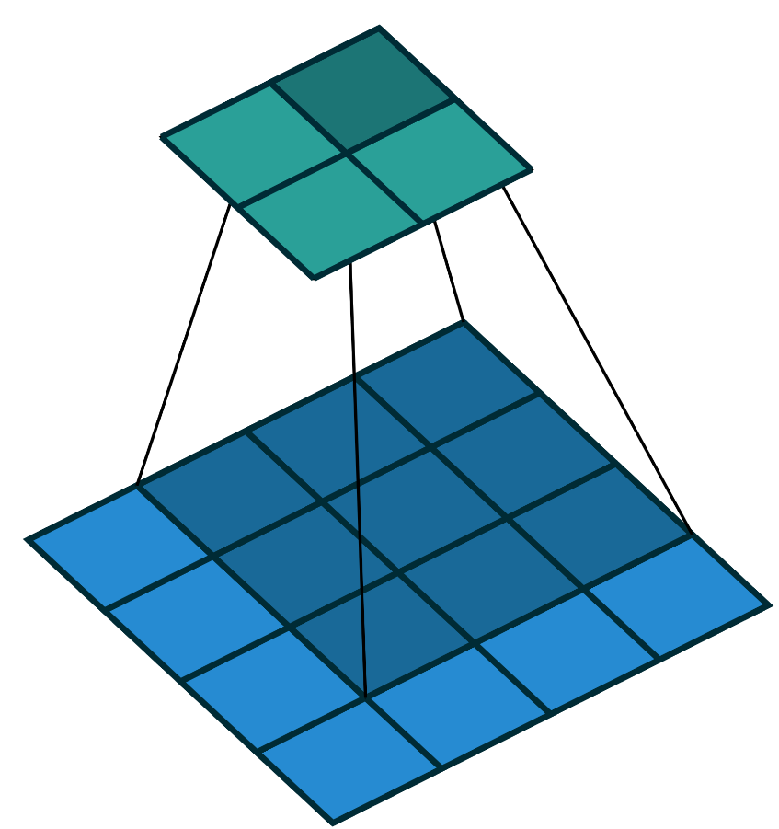
Convolutional Neural Networks - Convolutions
Feature map
3x3 Filter
1
0
0
Input
1
1
1
0
0
1
Source: vdumoulin, https://github.com/vdumoulin/conv_arithmetic/blob/master/gif/no_padding_no_strides.gif
Notes:
Feature extractor works like image kernel “Convolutions”
Filter contains the weights “feature extractor”
Convolutions -> Feature maps -> “Feature extraction”
FCL -> Classifier -> similar to SVM

Slide 13
Convolutional Neural Networks
Notes:
Used mainly in image recognition -> Why? -> Feature extractor works like image kernel “Convolutions”
Convolutions -> Feature maps -> “Feature extraction”
FCL -> Classifier -> similar to SVM

Slide 14
Deep Learning: an overview
Machine Learning | Deep Learning
Manual feature extraction | NN extracts features
Many types, each has own strengths
Multi Layer Perceptron
Convolutional NN
Recurrent NN
Stacked Auto Encoder
Notes:
Now: backpropagation possible on large NNs
Many different techniques, each has own strengths
Revived through more computational power -> Backpropagation algo now possible on large DNNs

Slide 15
Integrating Deep Learning techniques into SCA
Training phase
1k traces per sensitive value
Correct key value
NN
Weights / Filters
Attack phase
Weights / Filters
20k traces with fixed key
NN
Ranked possible key bits
Attack each key byte → 256 ranked output values
Notes:
Labelled data set → supervised learning
1k traces per sensitive value
Input each trace individually, as Matrix for CNN, 3253 inputs for MLP, others

Slide 16
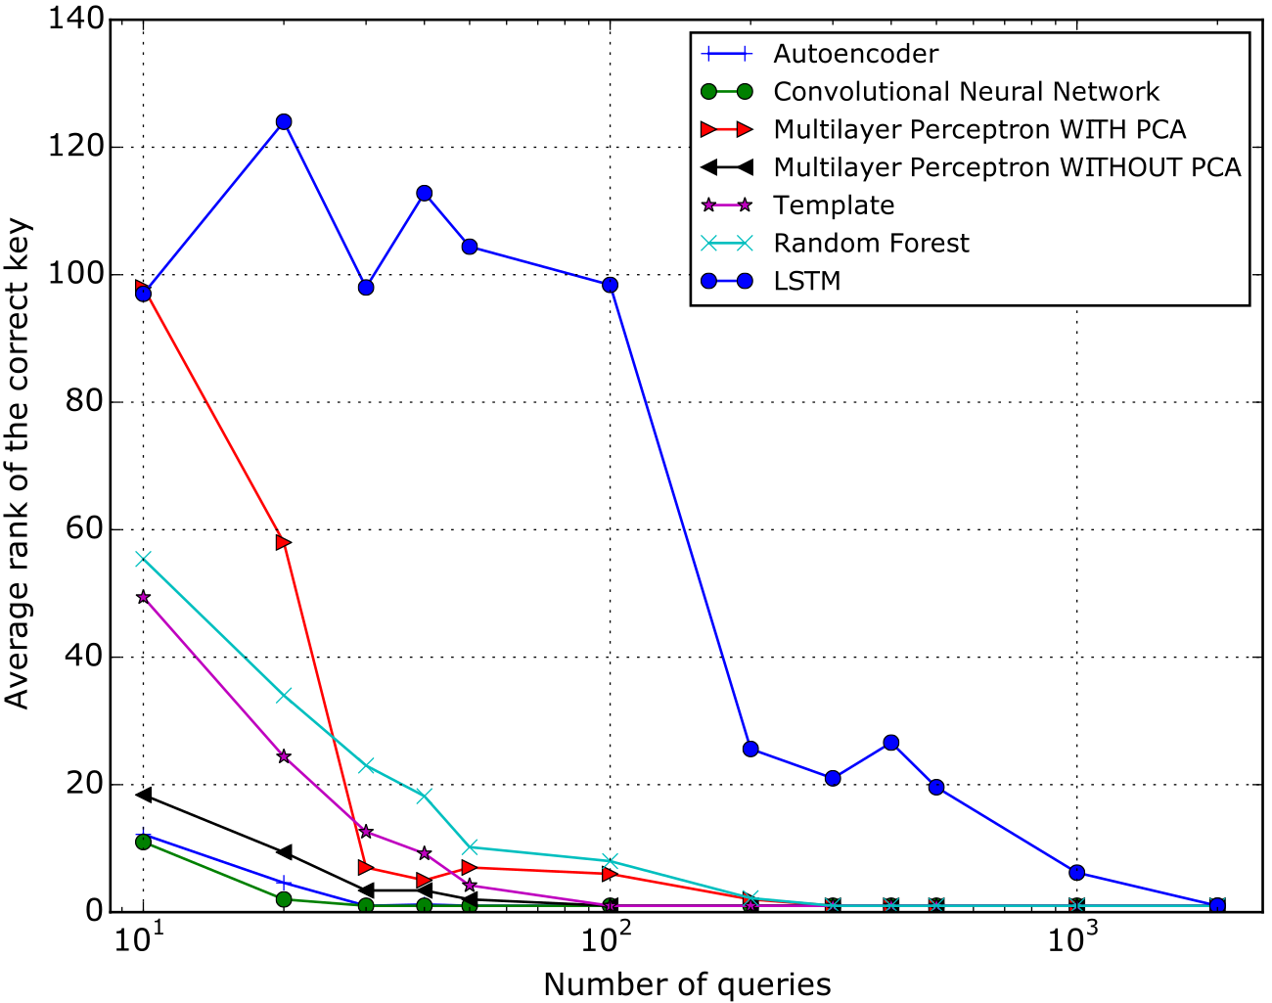
Results
Source: Breaking Cryptographic Implementations Using
Deep Learning Techniques, H. Maghrebi, T. Portigliatti, E. Prouﬀ
Notes:
CNN best performance, slightly better than AE
CNN requires less than half of the traces needed for key recovery compared to TA
Manual feature extraction using PCA not advantageous
LSTM not that good as there is no further relationship between bits far apart, time independence

Slide 17
Thank you for listening!
Do you have any questions?

Slide 18
Integrating Deep Learning techniques into SCA
Labelled data set → supervised learning!
Build profile with NN
Attack each key byte → 256 ranked output values
 | Training | Attack
Input | 1k traces per key value | 20k traces with fixed key Weights / Feature maps
Output | Weights / Feature maps | Ranked key bits
Notes:
Basically template attack but instead of Gaussian assumption profile with a NN

Slide 19
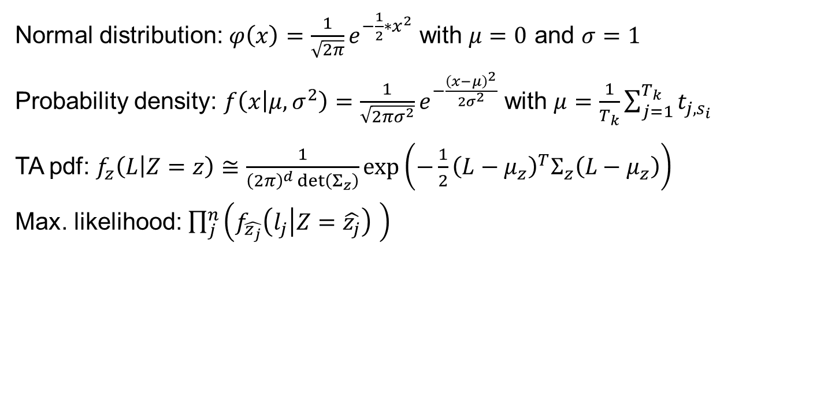
Template Attack
Normal distribution: $φ\left(x\right)=\frac{1}{\sqrt{2π}}e^{−\frac{1}{2}∗x^{2}}$ with $μ=0$ and $σ=1$
Probability density: $f\left(x | μ,σ^{2}\right)=\frac{1}{\sqrt{2πσ^{2}}}e^{−\frac{{\left(x−μ\right)}^{2}}{2σ^{2}}}$ with $μ=\frac{1}{T_{k}}\sum_{j=1}^{T_{k}}{t_{j,s_{i}}}$
TA pdf: $f_{z}\left(L | Z=z\right)≅\frac{1}{{\left(2π\right)}^{d}\det\left(Σ_{z}\right)}\exp\left(−\frac{1}{2}{\left(L−μ_{z}\right)}^{T}Σ_{z}\left(L−μ_{z}\right)\right)$
Max. likelihood: $\prod_{j}^{n}{\left(f_{\hat{z_{j}}}\left(l_{j} | Z=\hat{z_{j}}\right) \right)}$
Notes:
Mu:=mean
Sigma:=standartabweichung
Z:=sensitive value
L:=trace
Sigma:=covariance matrix
Mu_z:=mean(Sigma)

