Slide 1
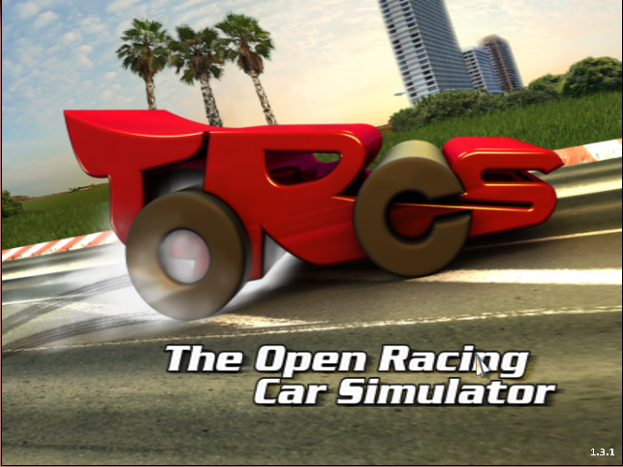
Project Plan
Learning to drive based on multiple sensor cues in The Open Racing Car Simulator (TORCS)
Nimar Blume
Tim Bicker
2nd November 2017

Slide 2
Project Goal
Develop an AI that is able to drive the car autonomously based on screen input and an artificial range sensor.

Slide 3
What input does TORCS provide?
pixel data
range sensor (with and without noise)
lateral displacement of street center
rotation angle between car and street center

Slide 4
Model Design - Goal
rot. angle
lateral displ.
TORCS
pixel input
SNN
DNN
range finder
driving commands
DNN: Deep Neural Network
SNN: Spiking Neural Network

Slide 5
Model Design / Training
Two Supervised Learning Problems
rot. angle
lateral displ.
TORCS - Picture Data
pixel input
DNN
rot. angle
lateral displ.
TORCS - Driver Data
SNN
range finder
driving commands
DNN: Deep Neural Network
SNN: Spiking Neural Network

Slide 6
Time Schedule
Overall: 30/10/17 - 28/1/18
Coding: 30/10/17 - 22/12/17
Write Report: 8/1/18 - 28/1/18
Coding:
Develop & train DNN: 4 weeks 30/10/17 - 30/11/17
Create Model pipeline, develop & test SNN with ground truth data: 4 weeks 30/10/17 - 30/11/17
Implement DNN in the Model: 3 weeks 1/12/17 - 22/12/17

Slide 7
Any Questions?

