Slide 1
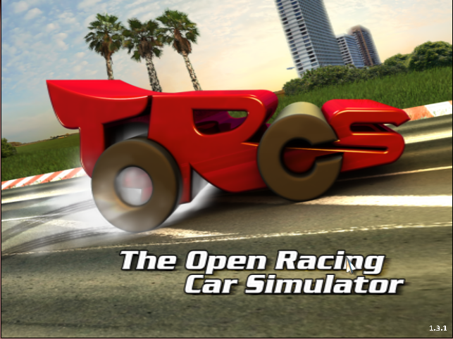
Learning to drive based on multiple sensor cues in The Open Racing Car Simulator (TORCS)
Project Progress Presentation
Nimar Blume, Tim Bicker
Technische Universität München
27.11.2017

Slide 2
Presentation Structure
Overview
CNN
Controller
Timetable

Slide 3
Overview
rot. angle
lateral displ.
TORCS
pixel input
SNN
DNN
range finder
driving commands
DNN: Deep Neural Network
SNN: Spiking Neural Network

Slide 4
Controller
The nengo controller is built with the following modules:
  Steering
  Accelerating / breaking
  Gear changing
  Clutching
We aim to use supervised learning for the following modules:
  Steering
  Accelerating / breaking
The other ensemble connections are handcrafted.

Slide 5
Supervised Learning - Steering
Input Signals:
  Speed
  Lateral displacement
  Rotation angle
  Range sensor (19 dimensions)
Output Signals:
  Steering angle

Slide 6
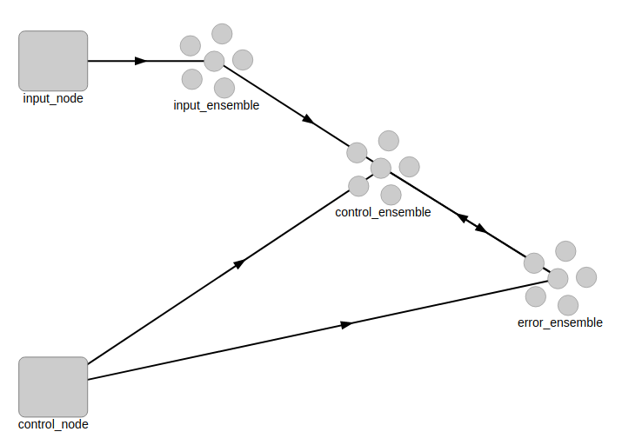
Supervised Learning – Steering
- offline online learning

Slide 7
Controller
- learning alternatives
Nengo deep learning library
Train connection function with tensorflow / keras
Hard code connection function

Slide 8
Timetable
We are a bit behind on our original planing
Now:
  Write report draft 1/12/17 – 14/12/17
  Write final report 15/12/17 - 11/1/18
Until report draft:
  Finish training the CNN
  Experience on training the SNN
Final report:
  Connect CNN and Controller
  Discuss the supervised learning results for the SNN

Slide 9
Questions
Do we have to generalize?
  How do we have to generalize?

Slide 10
This is a caption for long content
– This is a subcaption

Slide 11
Slide for short content
Event Based Vision
Self-Organizing Maps, Learning
Associative Memories
Sparse Coding
Rank Order Coding
Stereoscopic Vision
Deep Networks

Slide 12
Intermediate Slide
recap stuff
have a break

Slide 13
Final Slide

