Slide 1
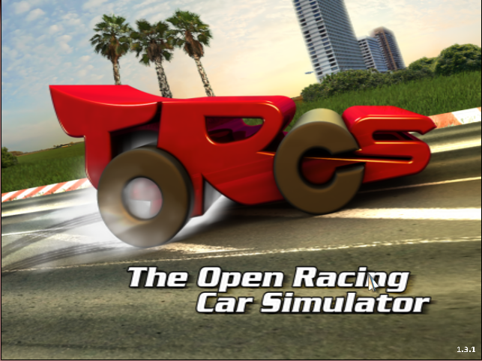
Learning to drive based on multiple sensor cues in The Open Racing Car Simulator (TORCS)
Project Progress Presentation
Nimar Blume, Tim Bicker
Technische Universität München
30.11.2017

Slide 2
Presentation Structure
Overview
CNN
Controller
Timetable

Slide 3
Overview
rot. angle
lateral displ.
TORCS
pixel input
SNN
DNN
range finder
driving commands
DNN: Deep Neural Network
SNN: Spiking Neural Network

Slide 4
Controller
The nengo controller is built with the following modules:
  Steering
  Accelerating / breaking
  Gear changing
  Clutching
We aim to use supervised learning for the following modules:
  Steering
  Accelerating / breaking
The other ensemble connections are handcrafted.

Slide 5
Supervised Learning - Steering
Input Signals:
  Speed
  Lateral displacement
  Rotation angle
  Range sensor (19 dimensions)
Output Signals:
  Steering angle

Slide 6
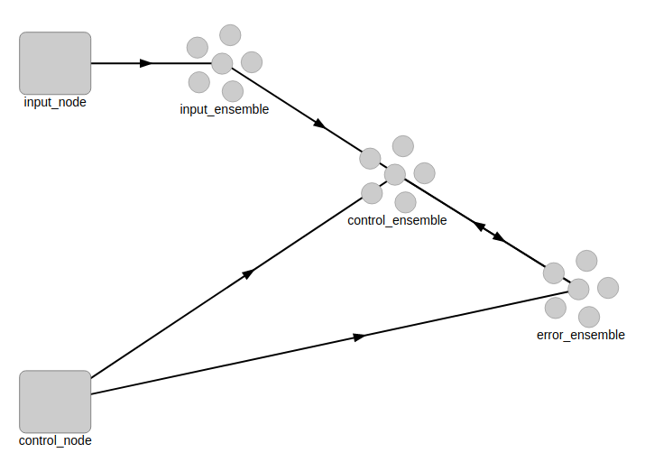
Supervised Learning – Steering
- offline online learning

Slide 7
Controller
- learning alternatives
Nengo deep learning library
Train connection function with tensorflow / keras
Hard code connection function

Slide 8
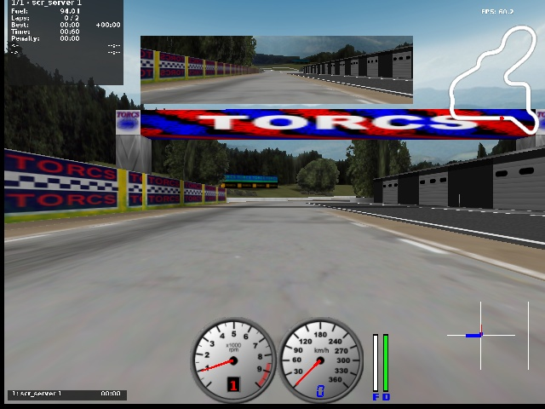
Deep Neural Network
- learning sensor data from images
Angle
Distance

Slide 9
Deep Neural Network
- training the network
One training track
4930 samples
150 training epochs
Input image scales: 0.125, 0.25, 0.5

Slide 10
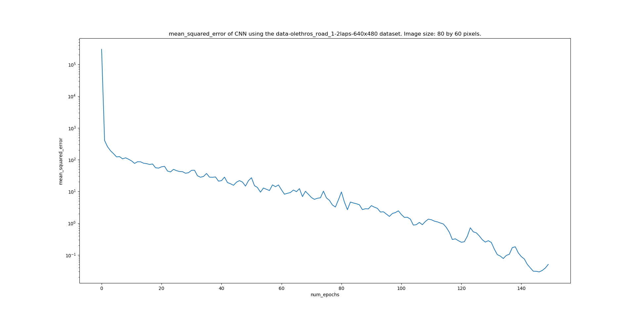
Deep Neural Network
Img → Conv2D → Conv2D → FCL → FCL → values
- Generate own training data
- Generate more training data
-

Slide 11
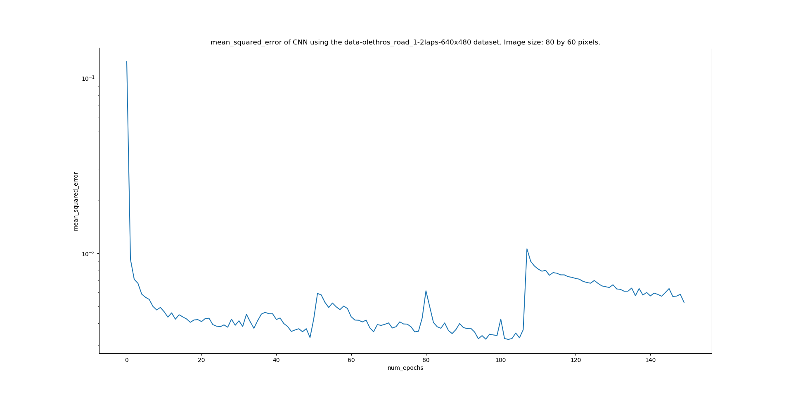
Deep Neural Network
„AlexNet“: Img →
Conv2D → Conv2D → Conv2D → Conv2D → Conv2D → FCL → FCL → FCL
→ values

Slide 12
Deep Neural Network
- possible improvments
- Generate own training data
- Generate more training data
- Try different network architectures
- difficult to evaluate without testing

Slide 13
Timetable
We are a bit behind on our original planing
Now:
  Write report draft 7/12/17 – 14/12/17
  Write final report 15/12/17 - 11/1/18
Until report draft:
  Finish training the CNN
  Experience on training the SNN
Final report:
  Connect CNN and Controller
  Discuss the supervised learning results for the SNN

Slide 14
Questions
Does our car need to be able to drive on tracks we didn‘t train on?
  „generalised model“

Slide 15
Thank you for listening!

Slide 16
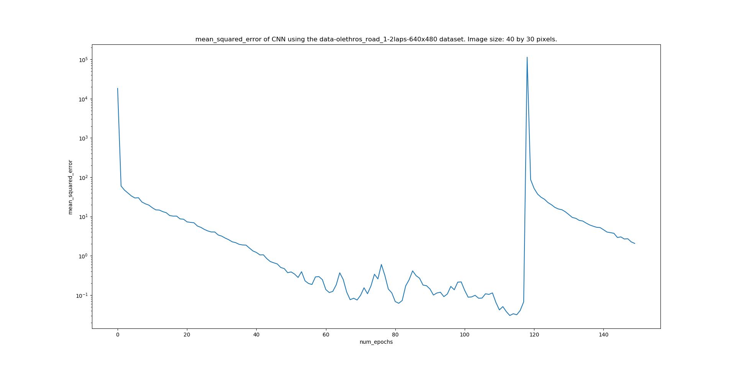
Deep Neural Network
Img → Conv2D → Conv2D → FCL → FCL → values

Slide 17
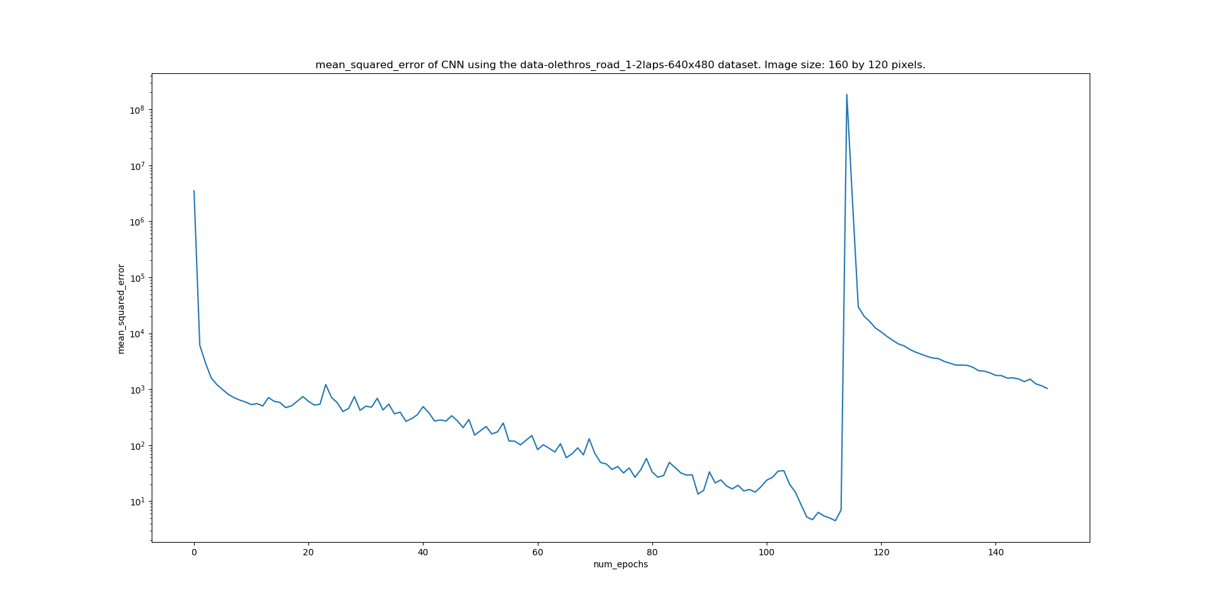
Deep Neural Network
Img → Conv2D → Conv2D → FCL → FCL → values

