Slide 1
TURNING CUSTOMERS
INTO SUBSCRIBERS
Tien Tzuo

Slide 2
WE NOW LIVE IN A
SUBSCRIPTION ECONOMY
dshiftha ppens

Slide 3

CTS
A SHIFT FROM PRO
TO RELATIONSHIPS
P oducts
P odu ct + be vices
Custo me Ce nt ic
7000
R elatio nshiD Cent ic
1990s

Slide 4

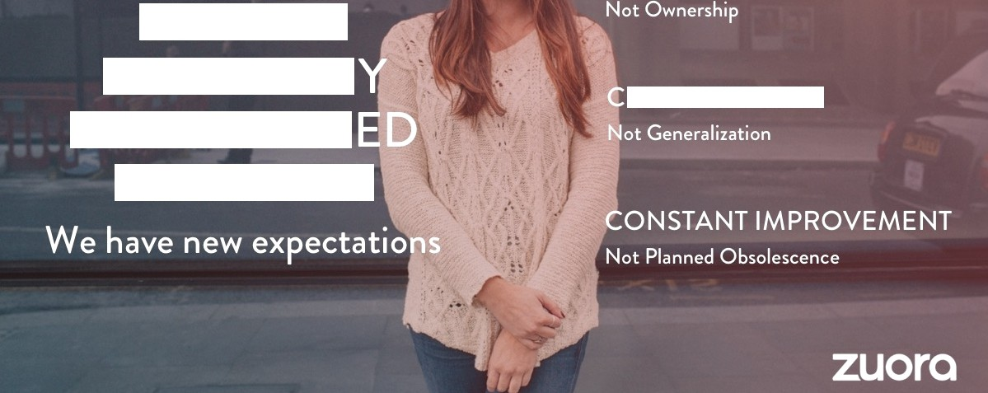
PEOPLE BU
THE WAY
U TOM ZAT ON
HAS CHANG
FOR GOOD

Slide 5

A GLOBAL
80 o 420B
O
OŁ Deo Dle in France are
OÊ German companies
^8! ⁰8 ^^8^{S}C^t tt^{O}8^
moving away from traditiona I ownership
Have dealt witH I be issue
of subscription
in the U S in 20 5; up
from $21S B in 20 0 0.
con su mptio n models
business models.

Slide 6


EVERY INDUSTRY SHIFTING
Leaders are creating new experiences through a new kind of business model

Slide 7




PAN HAVE
TH EST COM
NVE TE
EMS LVES AWAY
FROM PRODUCTS

Slide 8
FORTUNE 500 COMPANIES
HAVE DISAPPEARED
Ave age
i fe expectancy 15 years

Slide 9


Slide 10
GENERAL ELECTRIC
From light bulbs to digital services
"The dfgltoÍ company. /Îì 0 t s Olso On İndus t rİOl comeOne’

Slide 11
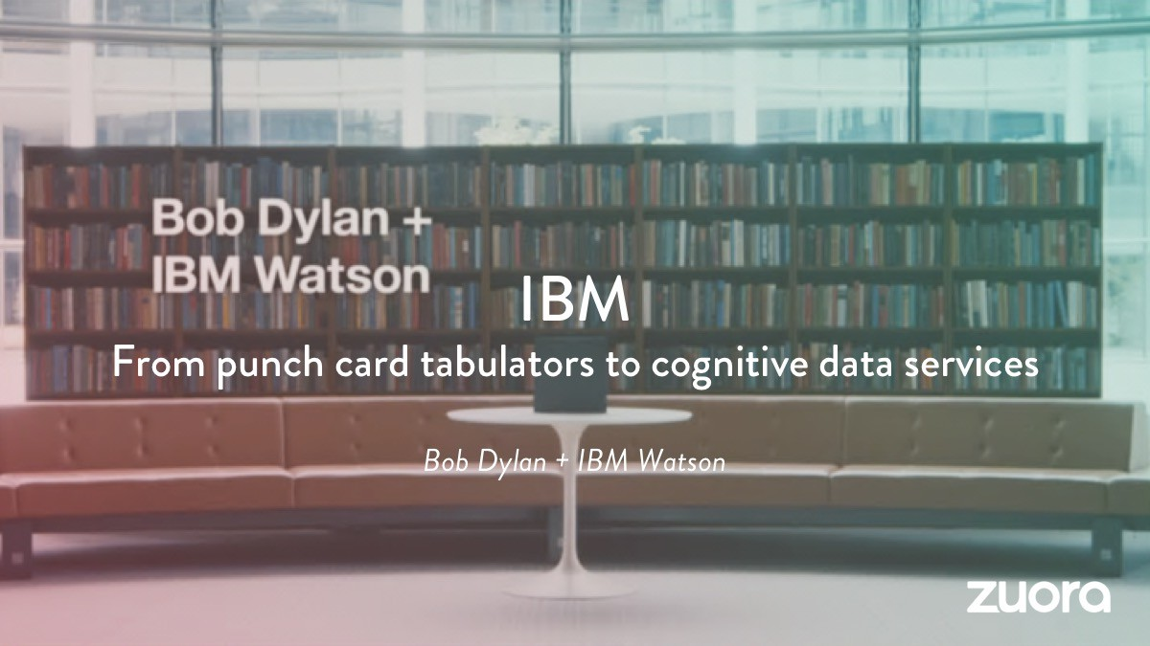

Slide 12
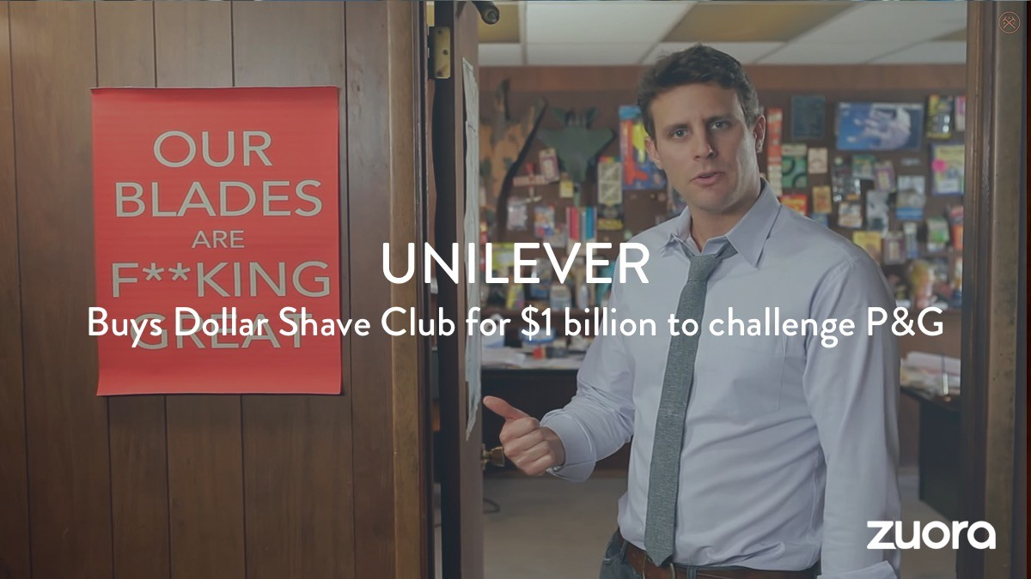

Slide 13


Slide 14
The new disruptors

Slide 15










TH COMMO
R

Slide 16



















THEY
BS
Ongo\ ng
M ernor abİe
On- demand
Ful fillmen t
R aI- tim

Slide 17








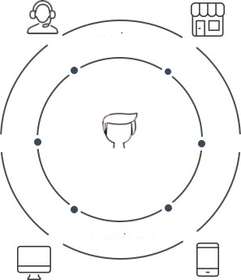












IT'S
EW WAY
THI I
product
service
VS.
channels
subscriber
experience
customer
channels

Slide 18
Unit Sales
Value pricing
Branding
Selling products
Unit margins H it products
Experience
Solving needs
Customer lifetime value Deep relationships

Slide 19
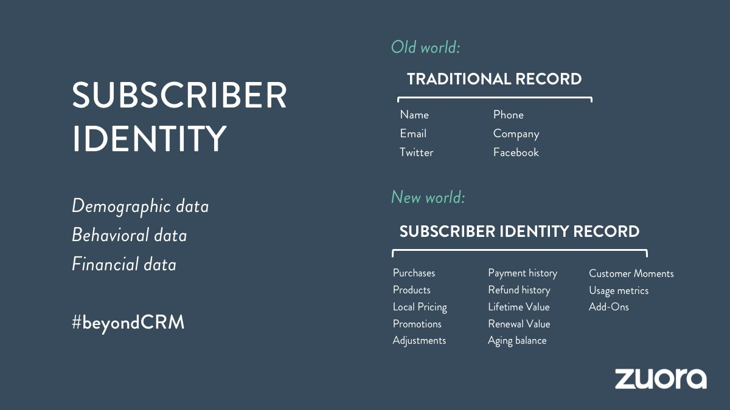

Slide 20
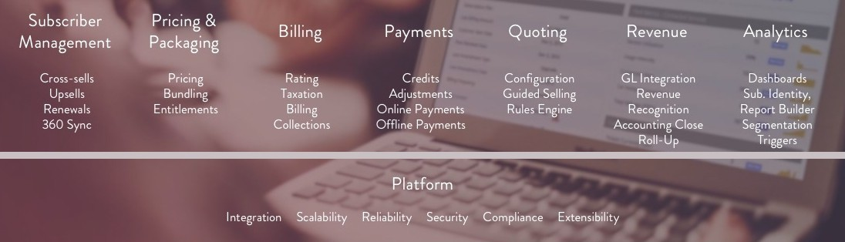
THAT S WHY WE BUILT ZUORA

Slide 21
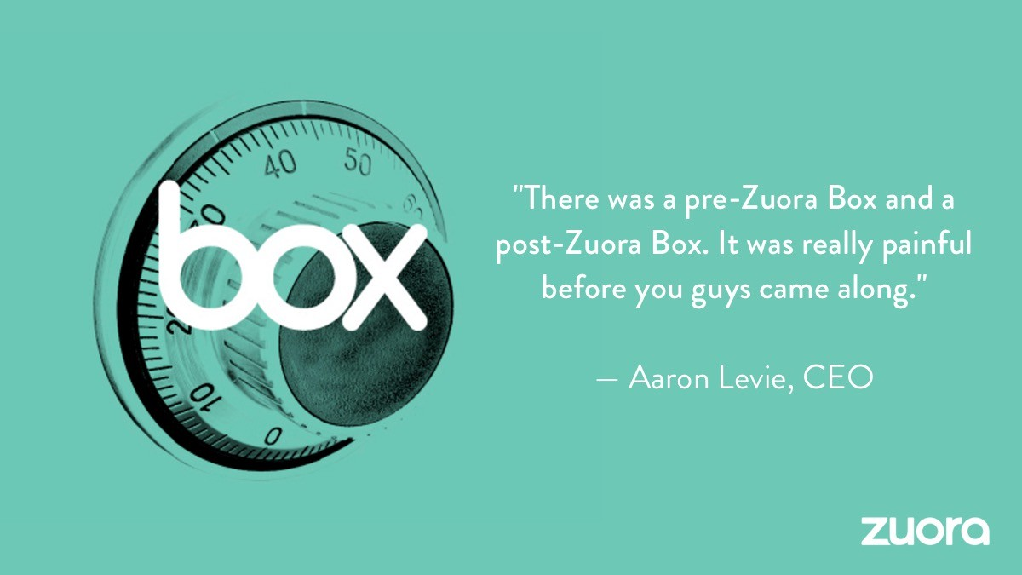

Slide 22


Slide 23


Slide 24

THE END

